Slide 1
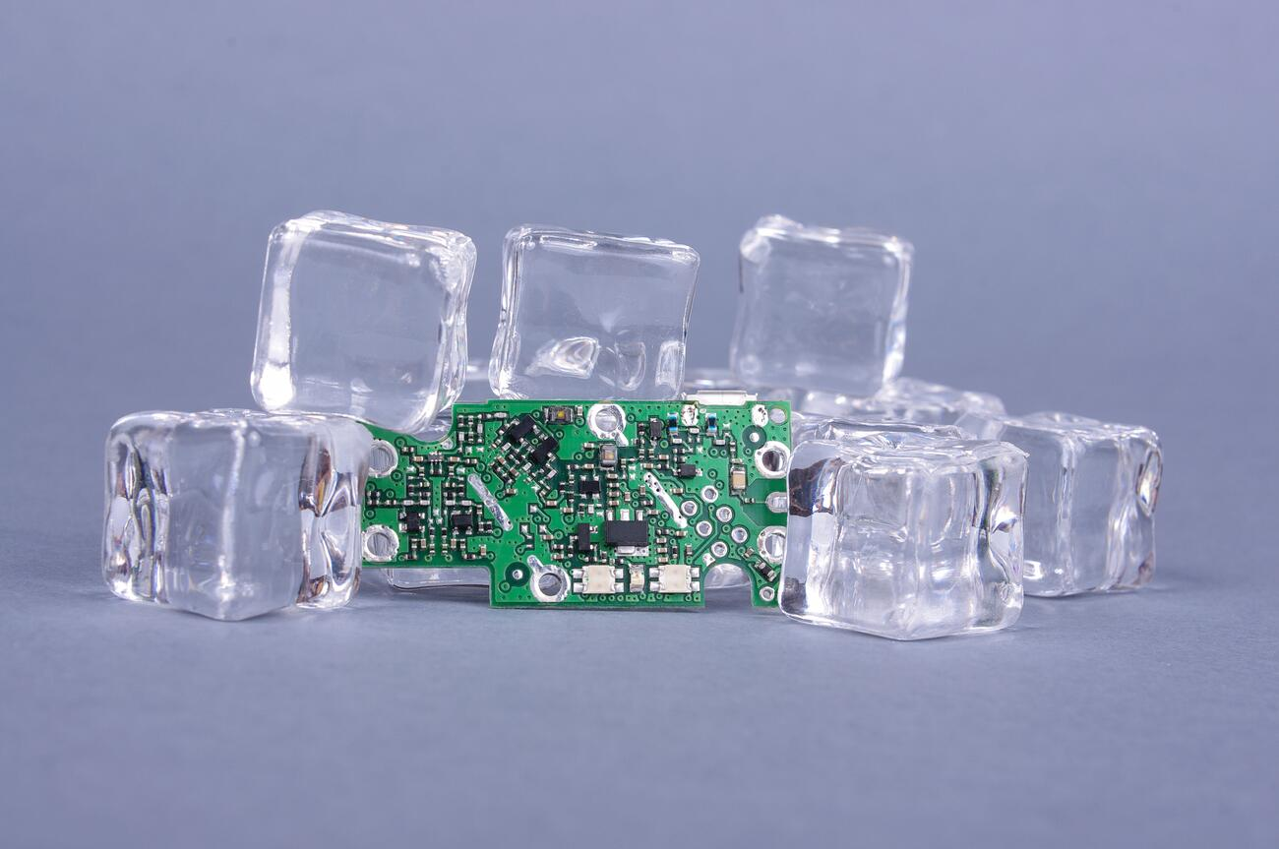



Thermal Management in Electronics Packaging
P M V Subbarao
Professor
Mechanical Engineering Department
Infusion of Precision in Temperature Aware Design for Thermal Management….

Slide 2

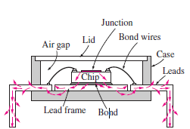
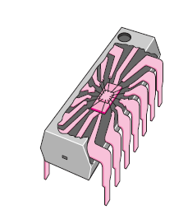
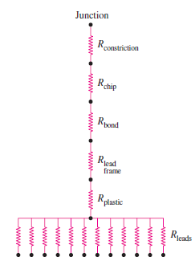

Design Level Thermal Management of DIP Electronic Processor
Is this description complete?
If not complete, is it comprehensive?
Total Thermal Resistance of an electronic chip:
$R_{total}=R_{constriction}$+ $R_{chip}$+ $R_{bond}$+ $R_{lead−frame}+R_{plastic}+R_{leads}$

Slide 3
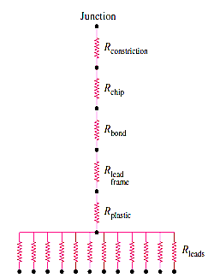
Design Level Thermal Management of DIP Electronic Processor
Total Thermal Resistance of an electronic chip:
$R_{total}=R_{constriction}$+ $R_{chip}$+ $R_{bond}$+ $R_{lead−frame}+R_{plastic}+R_{leads}$

Slide 4
Heat Conduction from Sites of Heat Generation to Chip
The heat conduction analysis of an electronic device starts with the circuitry or junction of a chip.
Junction is the site of Heat Generation.
The heat generated at the junction spreads throughout the chip and is conducted across the thickness of the chip.
The spread of heat from the junction to the body of the chip is three-dimensional in nature.
This can be approximated as one-dimensional by adding a Constriction Thermal Resistance to the thermal resistance network.
http://160592857366.free.fr/joe/ebooks/Mechanical%20Engineering%20Books%20Collection/HEAT%20TRANSFER/handbook%20of%20HeatTransfer.pdf
Chapter 3

Slide 5
Constriction & Spreading Resistance
Constriction and spreading resistances exist whenever heat flows from one region to another of different cross-sectional area.
The term constriction is used describe the situation where heat flows into a narrower region.
The term spreading is used to describe the case where heat flows out of a narrow region into a larger cross-sectional area.
Phenomenologically the constriction resistance and spreading resistance are different.
However, quantitative analysis of thermal rectification due to the direction of heat flow, the constriction and spreading resistances are assumed to be identical in magnitude.

Slide 6
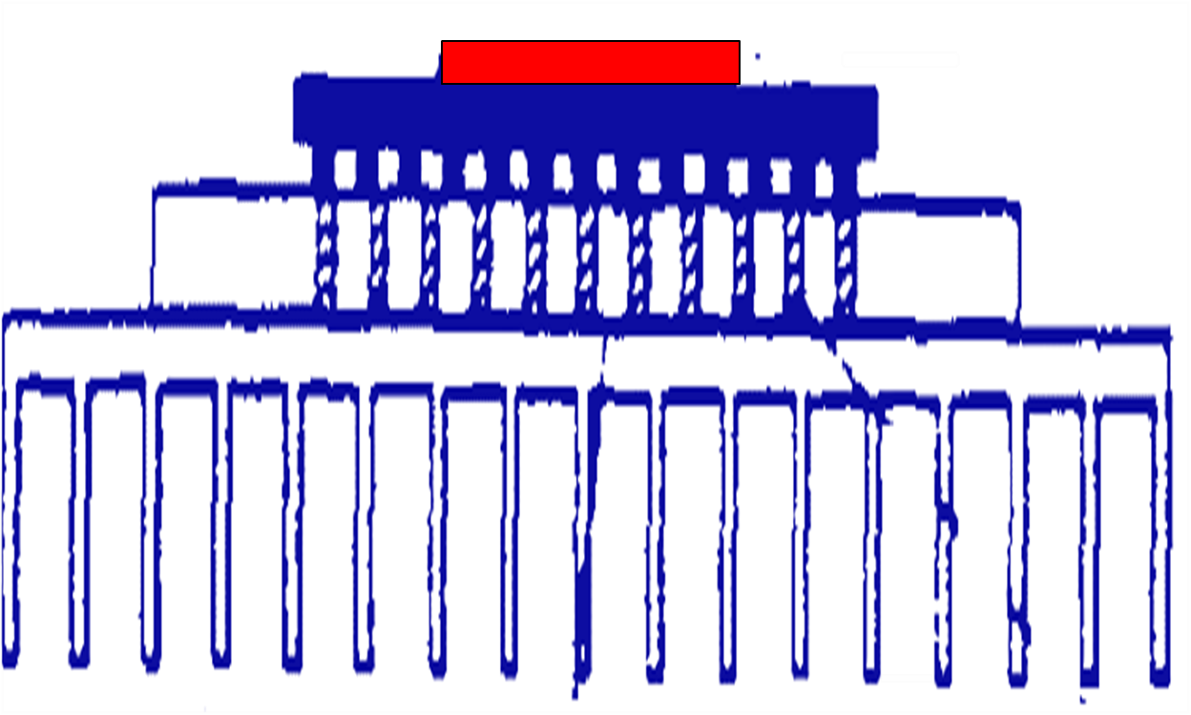
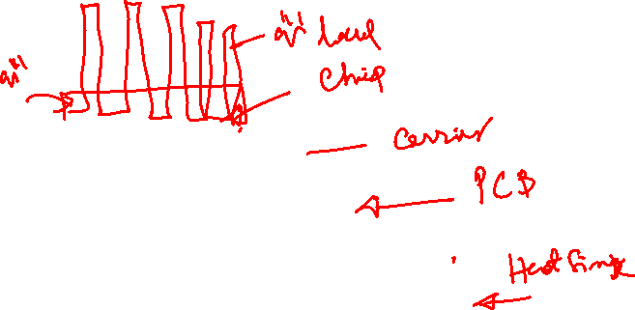
Constriction & Spreading Resistances in Electronics Packaging
Consider a case of chip package on PCB & Heat Sink:

Slide 7
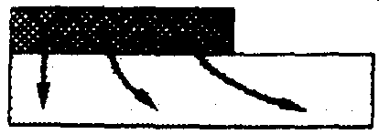
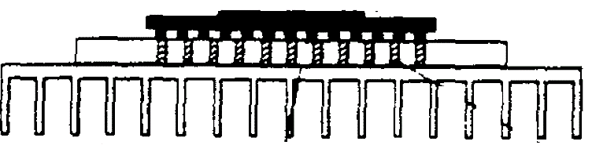
Constriction & Spreading Resistances in Electronics Packaging
Consider a chip package on PCB:
Chip to Substrate Spread

Slide 8
Constriction & Spreading Resistances in Electronics Packaging
Consider a chip package on PCB:
Chip to Substrate Spread
Constriction & Spread across Solder Balls

Slide 9
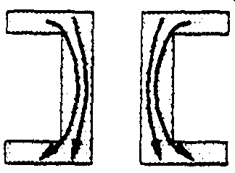
Constriction & Spreading Resistances in Electronics Packaging
Consider a chip package on PCB:
Chip to Substrate Spread
Constriction & Spread across Solder Balls
Constriction & Spread Through Thermal Vias

Slide 10
Constriction & Spreading Resistances in Electronics Packaging
Consider a chip package on PCB:
Chip to Substrate Spread
Constriction & Spread across Solder Balls
Constriction & Spread Through Thermal Vias
PCB to Heat Sink

Slide 11
In many instances,
the constriction and spreading resistances may become greater than one-dimensional material resist antes in a system and represent an essential part of the total thermal resistance in predicting the overall thermal performance of the device.
Many studies have been carried out to determine the constriction/spreading resistances since 1960.!!!

Slide 12
Theory of Constriction Resistance
Models for Steady-state and Transient constriction (spreading) resistances
for a range of geometries
for isothermal and iso-flux boundary conditions are essential for chip level thermal management.
Analytical solutions will help in obtaining simple models for constriction resistance.
Elastoconstriction resistance and gap and joint resistances for line and point contacts are also equally important.

Slide 13
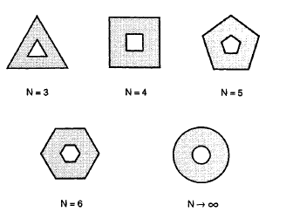
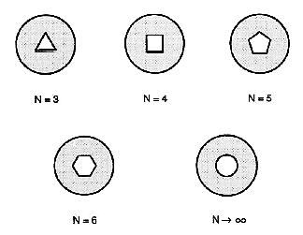
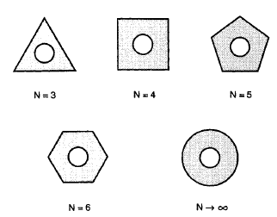
Geometrical Models for Generalized Constriction Resistance
Dissimilar Constrictions
Similar Constrictions

Slide 14
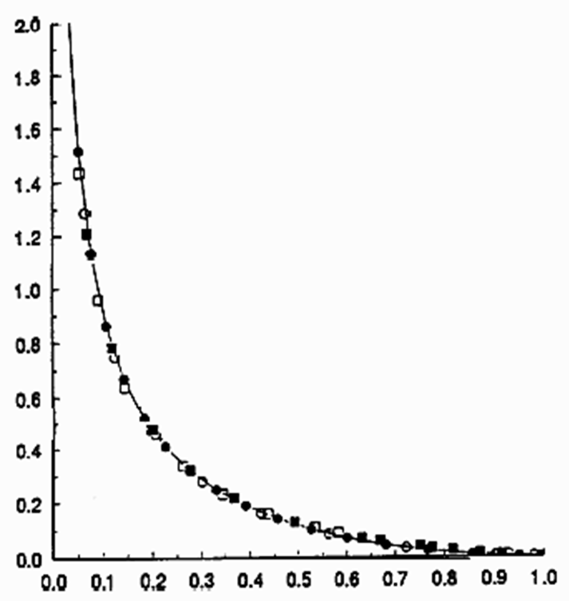
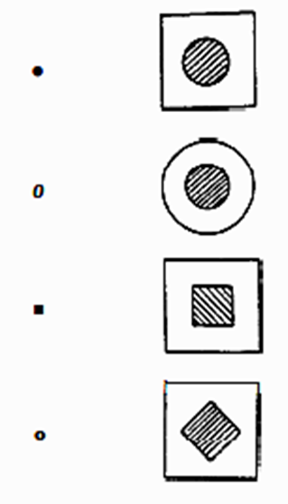

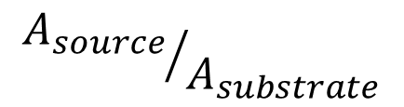
Generalized Models for Constriction Resistance
$$R_{th−c−dimensionless}$$
$${A_{source}}/{A_{substrate}}$$

