Slide 1
Modelling of Constriction Resistance in Chip Packaging
P M V Subbarao
Professor
Mechanical Engineering Department
Quantification of Hurdles for Heat Transcer in a Chip Package….

Slide 2
Estimation of Constriction (Spreading) Thermal Resistance
Spreading (constriction) resistance depends on several factors such as
(1) geometry (2) domain, (3) boundary condition and (4) time (steady-state, transient).
The analytical solutions are expressed in the form of infinite series.
Integrals can be computed quickly and accurately by means of computer algebra systems.

Slide 3
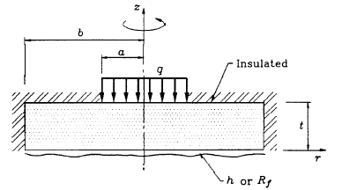
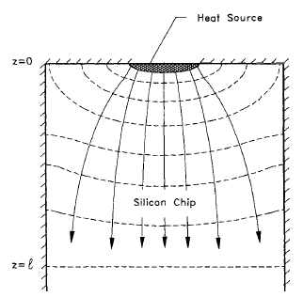
Role of Domain on Constriction Resistance Model

Slide 4
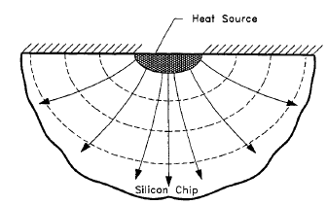
Definitions of Spreading Resistance M. M. Yovanovich , University of Waterloo
Half-Space Spreading Resistance:
Applicable for electronic packages whose dimensions
are two or more orders of magnitude larger than the largest dimension of the source area.
The spreading resistance is defined as the difference between the heat source temperature$\left(T_{junction}\right)$ and the heat sink temperature $\left(T_{sink}\right)$divided by the total heat generate rate from all the junctions in a chip.

Slide 5
Definitions of Spreading Resistance M. M. Yovanovich , University of Waterloo
Half-Space Spreading Resistance:
Uniform Heat generation in a chip or function block:
The junction temperature may be based on the area-average source temperature or the centroid temperature, which is the maximum temperature or close to it.
Non-uniform Heat generation in a chip or function block:
The area average temperature is used in the definition.
$$∴R_{constriction−HS}=\frac{T_{junction}−T_{heat sink}}{q^{′′}}$$

Slide 6
Definitions of Spreading Resistance M. M. Yovanovich , University of Waterloo
Flux Tube or Channel Spreading Resistance:
Applicable for electronic packages such as a finite or an infinitely long flux tube or flux channel.
The combined resistance due to one-dimensional conduction resistance and other resistances.
The definition proposed by Mikic and Rohsenow can be used to define the spreading resistance.
It is as follows:
$$R_{constriction−HS}=\frac{{\overline{T}}_{chip/FB}−{\overline{T}}_{conctact Plane}}{\frac{1}{A_{chip}}\iint{q^{′′}dA}}$$

Slide 7
Steady conduction in a 2D Domain
$$\frac{∂^{2}T}{∂x^{2}}+\frac{∂^{2}T}{∂y^{2}}=0$$
Write the solution as a product of a function of x and a function of y:
H
$$T\left(x,y\right)=X\left(x\right)×Y\left(y\right)$$
Substitute this relation into the governing relation given by
y
$$Y\frac{∂^{2}X}{∂x^{2}}+X\frac{∂^{2}Y}{∂y^{2}}=0$$
0
W
x
$$Y\frac{∂^{2}X}{∂x^{2}}=−X\frac{∂^{2}Y}{∂y^{2}}=λ^{2}$$

Slide 8
Parallel Processing of Conduction Equation
$$Y\frac{∂^{2}X}{∂x^{2}}=−X\frac{∂^{2}Y}{∂y^{2}}=λ^{2}$$
H
Parallelization of Multidimensional PDE:
$$\frac{∂^{2}X}{∂x^{2}}+λ^{2}X=0 \& \frac{∂^{2}Y}{∂y^{2}}−λ^{2}Y=0$$
y
The form of solution of above depends on the sign and value of $λ^{2}$.
0
W
x
The only way that the correct form can be found is by an application of the boundary conditions.
Three possibilities may be be considered:$λ^{2}<0;λ^{2}=0 \& λ^{2}=0$

Slide 9
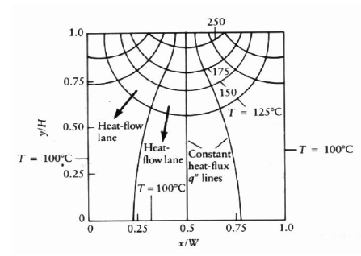
Parallel Processing of Conduction Equation
$$\frac{∂^{2}T}{∂x^{2}}+\frac{∂^{2}T}{∂y^{2}}=0$$
The solution of above PDE for $λ^{2}=0$.
$$T\left(x,y\right)=\left\{C_{1}+C_{2}x\right\}×\left\{C_{1}+C_{2}y\right\}$$
The solution of above PDE for $λ^{2}<0$.
$$T\left(x,y\right)=\left(C_{1}e^{−kx}+C_{2}e^{kx}\right)\left(C_{3}\cos{(}ky)+C_{4}\sin{(}ky)\right)$$
The solution of above PDE for $λ^{2}>0$.
$$T\left(x,y\right)=\left(C_{1}\cos{(}kx)+C_{2}\sin{(}kx)\right)\left(C_{3}e^{−ky}+C_{4}e^{ky}\right)$$

Slide 11
Thermal Resistance R_{th}

Slide 15
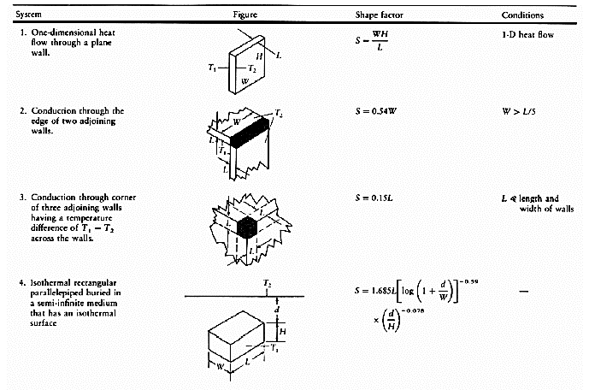
Shape Factor for Standard shapes

Slide 16
Role of Domain on Constriction Resistance Model
Spreading in a half-space
Spreading in a Flux Tube

Slide 17
Spreading Resistance.
The dimensionless spreading resistance is generally defined as R*_{th-c}= kℒRs
where k is the thermal conductivity of the region.
ℒ is some length scale related to the contact area.
For Singly connected contact areas, ℒ = $\sqrt{A}$, where A is the active area of the heat source.

Slide 18
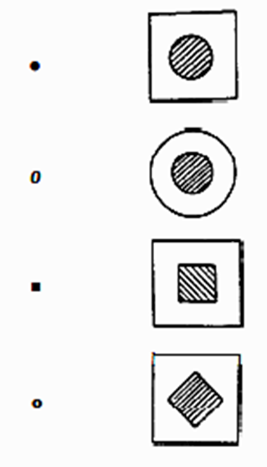
Generalized Models for Dimensionless Constriction Resistance
$$R_{th−c−dimensionless}=k\sqrt{A_{substrate}}R_{th−c}$$
$${A_{source}}/{A_{substrate}}$$

