Slide 1



Recent Chip Packaging Methods
P M V Subbarao
Professor
Mechanical Engineering Department
Geometrical Innovations in Thermal Management of A Chip….

Slide 2

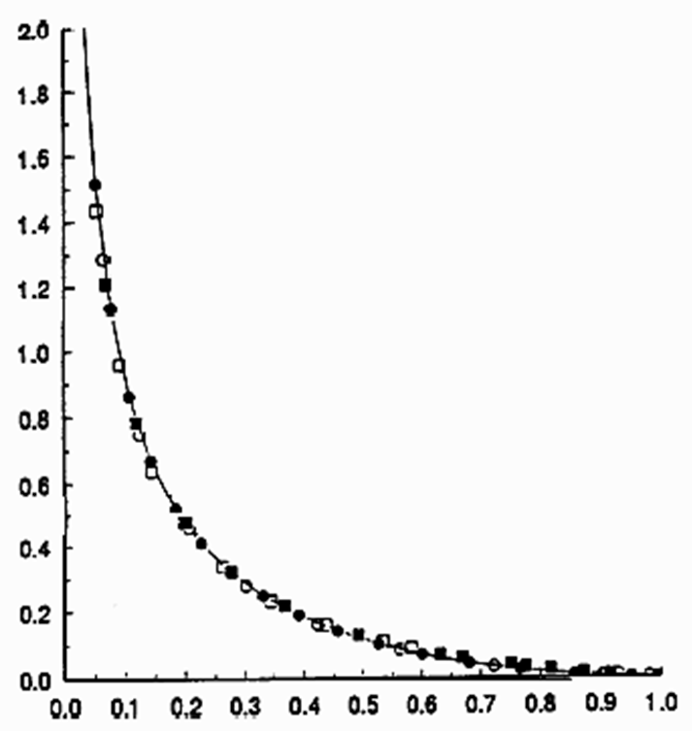
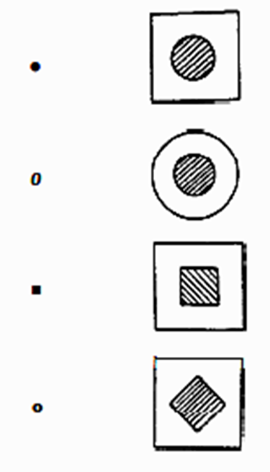

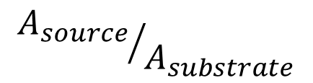
Generalized Models for Dimensionless Constriction Resistance
$$R_{th−c−dimensionless}=k\sqrt{A}R_{th−c}$$
$${A_{source}}/{A_{substrate}}$$

Slide 3
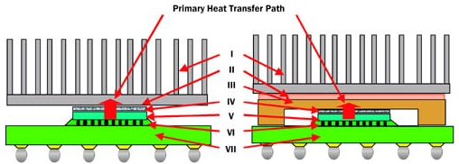
Chip is An Assembly of Layers

Slide 4
Popular Chip Packages
First two decades of 21st century:
Chip ball grid arrays (BGAs) (1990–2005)
3D stacked modules (2005–2015)
Multi-chip embedded PCBs (2010–2020)

Slide 5
Chip ball grid arrays (BGAs) (1990–2005)
Various types of BGA-like packages have been proposed as follows:
High performance (HP),
Extra performance (XP),
Plastic (P),
Multi-chip (MC), and others.
These BGA’s were often soldered to moderately complex flexible printed circuit boards (FPCBs) using surface mount technology (SMT) assembly.
Around 2005, BGA format was found to be incapable of supporting the rapidly increasing VLSI.

Slide 6
Three-dimensional (3D) packages (2005–2015)
Three-dimensional (3D) packages were found to be suitable for increased level of VLSI.
Internal stacking modules (ISM) are the package stacked and molded within the base package.
They often have been used for smart mobile phone chip sets.
For several applications during 2005 - 2015, package-on-package (PoP) is a popular 3D package.
The connections between different dies go through the substrate, the parasitic load for these connections was found to be high.
An appreciable amount of power was consumed and dissipated due to these connections.

Slide 7
Embedded die packaging (2015 – 2020)
Embedded die packaging was the innovation in 2015.
This helped in further miniaturization and increased functionality of most electronic systems.
Specially the systems with signal frequencies in the order of several GHz and more demanded shorter and impedance-matched interconnections.
Achieved using the Embedding Technology:
Chip-on-flex organic substrates with high density build-up-layers and microvias on both sides with surface mount passive components and active chips were embedded as a single package.

Slide 8
Packaging (2020+)
The technologies keep the miniaturization trend and advance from a 2D to a 3D system-in-package technology.
d and advance from a 2D to a 3D system-in-package technology.
The miniaturization of modern Ultra LSI circuits leads to an increase in the power dissipation density, which causes their increased heating.
The heat drain from electron device active areas is the main factor limiting the device functionality and reliability.
The packages are the key elements determining the effectivity of heat dissipation in electronic components and systems.
Therefore, the analysis of

Slide 9
Tools for Efficient Thermal Management
Heat Sinks, Heat Spreaders, Heat Risers & Heavy Metal Backplates
Thermal Vias (PTH used to leverage thermal conductivity of copper)
Thermal Coins (Inserts of metal conductors in PCB cut-outs under active components to improve heat transfer)
Thermal Interface Materials, Thermally Conductive Adhesives, Gap Fillers, Grease, etc.
Thermally Conductive Printed Circuit Board Materials

Slide 10
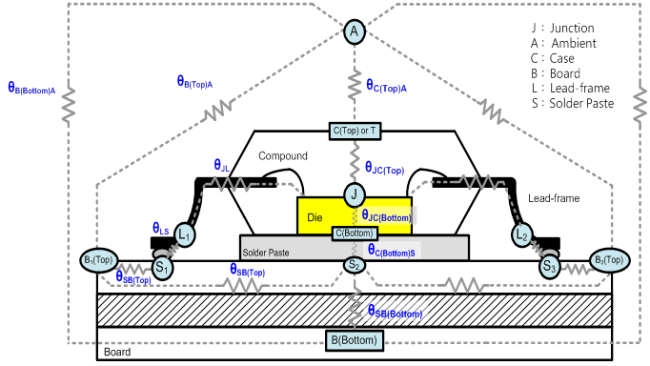
Total Thermal Resistance of A Package

Slide 11
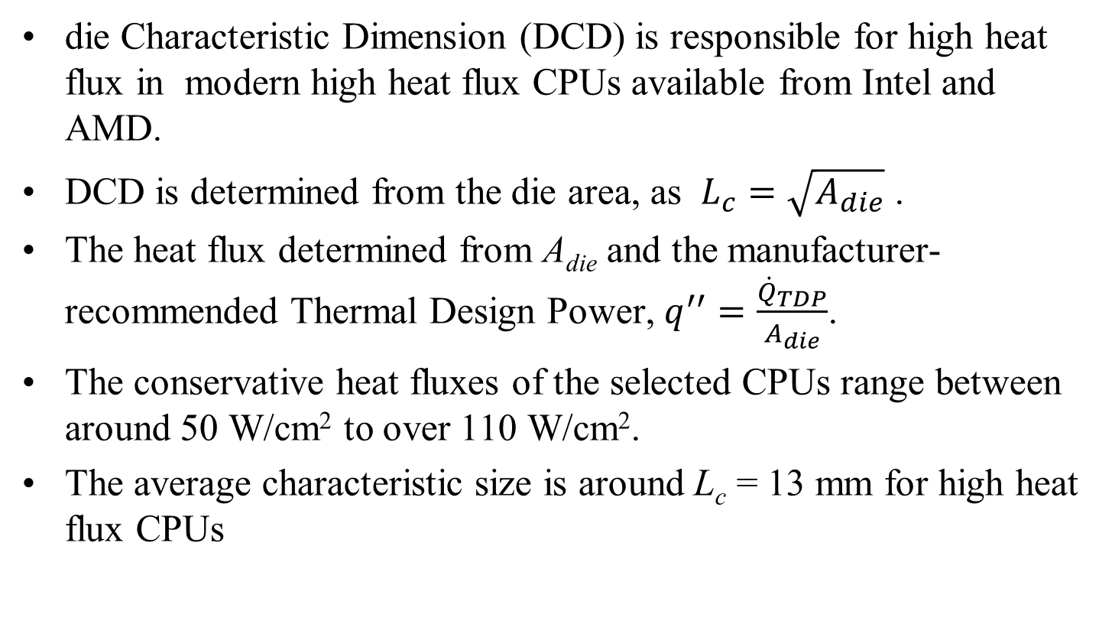
Heat Spreaders in Modern CPU Packages
die Characteristic Dimension (DCD) is responsible for high heat flux in modern high heat flux CPUs available from Intel and AMD.
DCD is determined from the die area, as $L_{c}=\sqrt{A_{die}}$ .
The heat flux determined from A_{die} and the manufacturer-recommended Thermal Design Power, $q^{′′}=\frac{{\dot{Q}}_{TDP}}{A_{die}}$.
The conservative heat fluxes of the selected CPUs range between around 50 W/cm² to over 110 W/cm².
The average characteristic size is around L_{c} = 13 mm for high heat flux CPUs

Slide 12

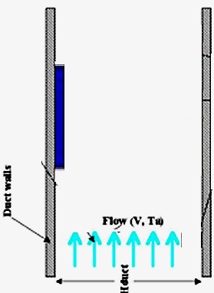
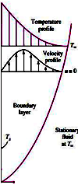
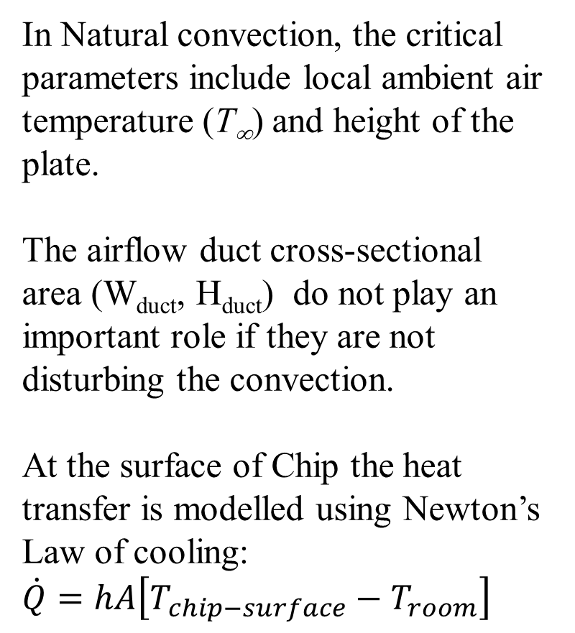
Temperature of A Hot Chip: Natural Convection
In Natural convection, the critical parameters include local ambient air temperature (T∞) and height of the plate.
The airflow duct cross-sectional area (W_{duct}, H_{duct}) do not play an important role if they are not disturbing the convection.
At the surface of Chip the heat transfer is modelled using Newton’s Law of cooling:
$\dot{Q}=hA\left[T_{chip−surface}−T_{room}\right]$

Slide 13
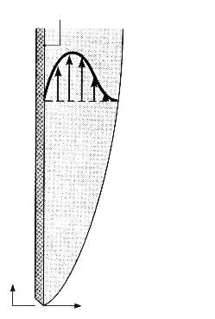
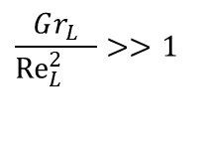
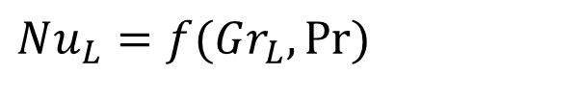


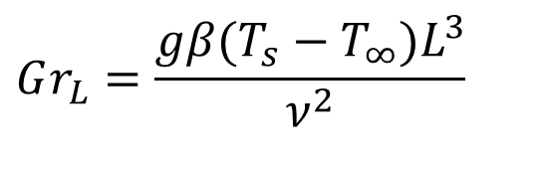

Laminar Free Convection on Vertical Surface
As y → ∞ : u = 0, T = T∞
As y → 0 : u = 0, T = T_{s}
With little or no external driving flow, Re ≅ 0 and forced convection effects can be safely neglects
$$T_{s}>T_{∞}$$
u(x,y)
$$T_{s}$$
$$T_{∞}$$
g
$$\frac{Gr_{L}}{{Re}_{L}^{2}{}}>>1$$
x
y
$$Nu_{L}=f(Gr_{L},\operatorname{Pr}{)}$$
u
v
$$Gr_{L}=\frac{gβ(T_{s}−T_{∞})L^{3}}{ν^{2}}$$

Slide 14
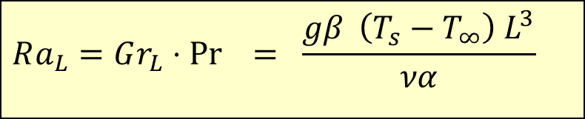

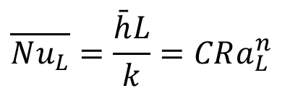
Empirical Correlations Natrual Convection
Typical correlations for heat transfer coefficient developed from experimental data are expressed as:
$$\overline{Nu_{L}}=\frac{\bar{h}L}{k}=CRa_{L}^{n}$$
$$Ra_{L}=Gr_{L}⋅\operatorname{Pr}{ } = \frac{gβ \left(T_{s}−T_{∞}\right) L^{3}}{να}$$
$$\left\{\begin{aligned}&n=1/4 \\ &n=1/3\end{aligned}\right.$$
For Turbulent
For Laminar

Slide 15
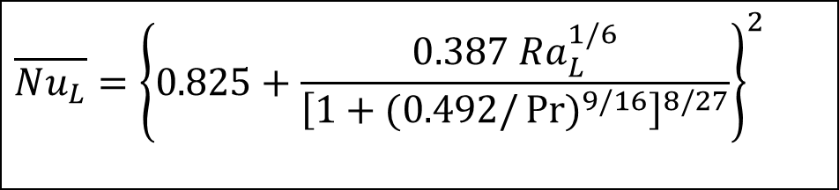
Empirical Correlations Natrual Convection
Alternative applicable to entire Rayleigh number range (for constant Ts)
$$\overline{Nu_{L}}={\left\{0.825+\frac{0.387 Ra_{L}^{1/6}}{{\left[1+(0.492/\operatorname{Pr}{)^{9/16}}\right]}^{8/27}}\right\}}^{2}$$

Slide 16
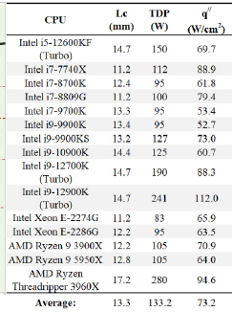
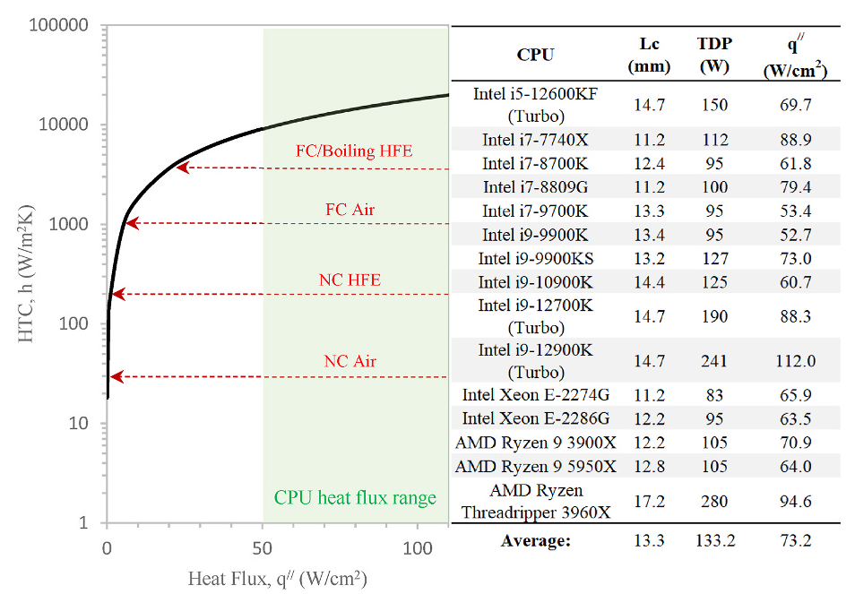
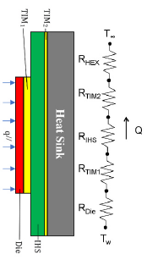
Need for A Heat Spreader
H Required for a source-to-sink temperature difference of ΔTj-c = Tj-Tc = 55 K must be maintained

Slide 17
Temperature of Hot Chip: Forced Convection
In forced convection, the critical parameters include local upstream air temperature (T_{a}) and velocity (V)
The airflow duct cross-sectional area (W_{duct}, H_{duct}) play an important role in plate heat transfer.

Slide 18
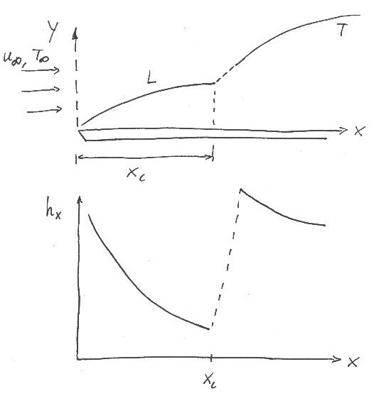

Flat Plate Boundary Layer Trasition
Important point:
  Typically a turbulent boundary layer is preceded by a laminar boundary layer first upstream
  ∴ need to consider case with mixed boundary layer conditions!
$${\bar{h}}_{x}=\frac{1}{L}\left[\int_{0}^{xc}{h_{lam}dx }+\int_{xc}^{L}{h_{turb}dx }\right]$$

Slide 19
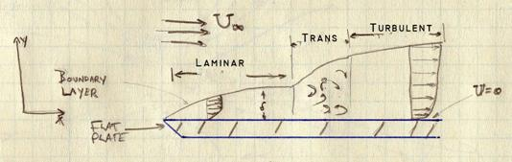
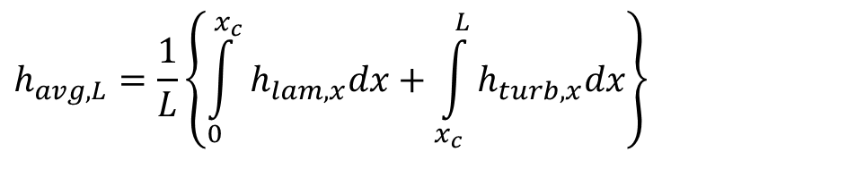
Leading
Edge
X_{c}
Trailing
Edge
L
$$h_{avg,L}=\frac{1}{L}\left\{\int_{0}^{x_{c}}{h_{lam,x}dx}+\int_{x_{c}}^{L}{h_{turb,x}dx}\right\}$$

Slide 20
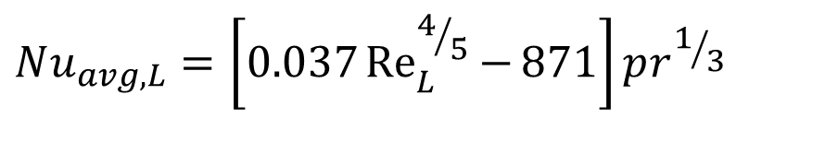
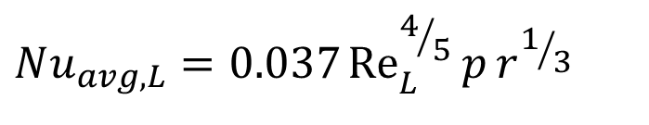
For a smooth flat plate: Re_{xc} = 5 X 10⁵
$$Nu_{avg,L}=\left[0.037{Re}_{L}^{4/5}{−}871\right]pr^{1/3}$$
For very large flat plates: L >> X_{c}, in general for Re_{L} > 10⁸
$$Nu_{avg,L}=0.037{Re}_{L}^{4/5}{p}r^{1/3}$$

Slide 21
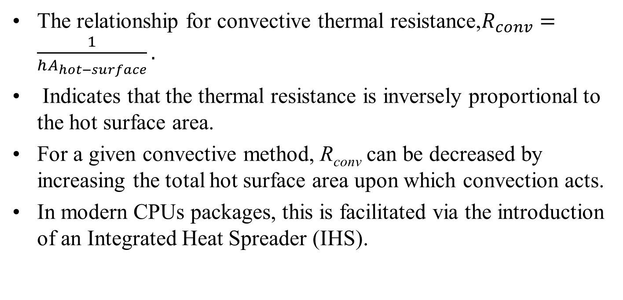
Control of Convection Resistance
The relationship for convective thermal resistance,$R_{conv}=\frac{1}{hA_{hot−surface}}.$
Indicates that the thermal resistance is inversely proportional to the hot surface area.
For a given convective method, R_{conv} can be decreased by increasing the total hot surface area upon which convection acts.
In modern CPUs packages, this is facilitated via the introduction of an Integrated Heat Spreader (IHS).

Slide 22
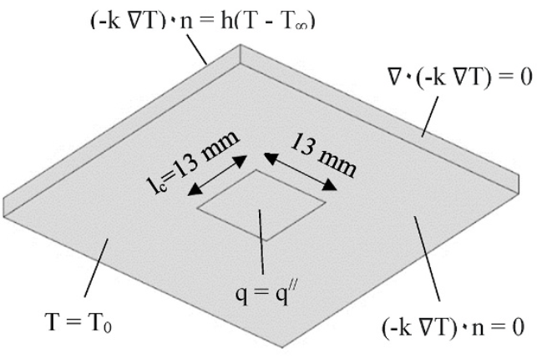
Integrated Heat Spreader
An IHS functions by adding additional surface area between the heat source and the heat sink, allowing the heat to spread laterally.

Slide 23
Integrated Heat Spreader
For an insufficient convective heat transfer coefficient, h, there can be enough surface area, A_{IHS}, to allow the target thermal resistance to be achieved.
Practically, however, implementing an IHS requires the stack package.

Slide 24
Integrated Heat Spreader
HIS involves the penalties of adding further resistances to the thermal network, namely the Thermal Interface Materials (TIMs) and the IHS itself.
The balance, when adding these elements to improve the heat transfer, should always be to ensure that the net resistance is lower than if direct cooling occurred on the bare die.
The inclusion of an IHS can be of further benefit as it acts as a protective barrier between the die and the coolant.
IHS allows the use of high-performance coolants, i.e. liquids like water, and high-performance thermal hardware, such as microchannels and microjet coldplates.

Slide 25
Integrated Heat Spreader
HIS involves the penalties of adding further resistances to the thermal network, namely the Thermal Interface Materials (TIMs) and the IHS itself.
The balance, when adding these elements to improve the heat transfer, should always be to ensure that the net resistance is lower than if direct cooling occurred on the bare die.
The inclusion of an IHS can be of further benefit as it acts as a protective barrier between the die and the coolant.
IHS allows the use of high-performance coolants, i.e. liquids like water, and high-performance thermal hardware, such as microchannels and microjet coldplates.

Slide 26
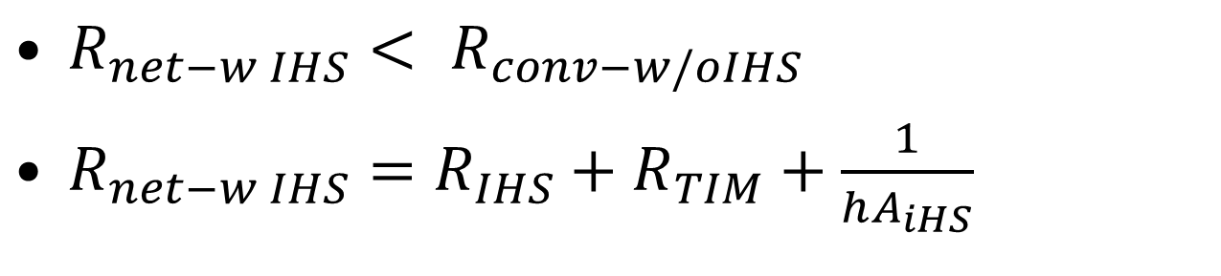
Design Constraints for IHS
${R_{net−w IHS}< R}_{conv−w/oIHS}$
$R_{net−w IHS}=R_{IHS}+R_{TIM}+\frac{1}{hA_{iHS}}$

