Slide 1
Chip Packaging & Tools for Design Level Thermal Management-2
P M V Subbarao
Professor
Mechanical Engineering Department
More Hardware for less Thermal Resistance!?!?

Slide 2
Tools for Efficient Thermal Management
Heat Sinks, Heat Spreaders, Heat Risers & Heavy Metal Backplates
Thermal Vias (PTH used to leverage thermal conductivity of copper)
Thermal Coins (Inserts of metal conductors in PCB cut-outs under active components to improve heat transfer)
Thermal Interface Materials, Thermally Conductive Adhesives, Gap Fillers, Grease, etc.
Thermally Conductive Printed Circuit Board Materials

Slide 3
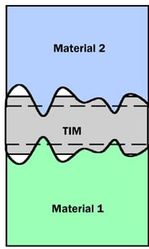
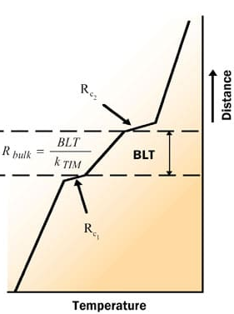
Desired Characteristics of a TIM
$$R_{TIM}=\frac{BLT}{k_{TIM}}+R_{c1}++R_{c2}$$
BLT is the bond-line thickness of the TIM
https://www.electronics-cooling.com/2004/02/thermal-interface-materials-a-brief-review-of-design-characteristics-and-materials/

Slide 4
Desired Characteristics of a TIM
$$R_{TIM}=\frac{BLT}{k_{TIM}}+R_{c1}++R_{c2}$$
R_{c1} and R_{c2} are the contact resistances of the TIM with the two adjoining surfaces.
R_{TIM}, R_{c1}, and R_{c2} are area-normalized thermal resistances (k-m²/W).
One of the goals of thermal design is to reduce R_{TIM}.
To be accomplished by reducing the BLT,
increasing the thermal conductivity and
reducing the contact resistances R_{c1} and R_{c2}.

Slide 5
Bond-Line Thickness (BLT)
BLT reduction is often another parallel goal of thermal design.
BLT is a function of various parameters such as application pressure (i.e., pressure applied in bringing the two contact surfaces together) and particle volume fraction.
Correlation for BLT:
$BLT=1.31×{10}^{−4}\frac{τ_{yield}}{p}$
where τ_{yield} is the yield stress of the TIM and
p is the applied pressure.
BLT in meters.

Slide 6
Chip to Chip on Board
Chip on board (COB) packages are a type of electronic packaging technology.
COB involves mounting a semiconductor chip directly onto a printed circuit board (PCB) or substrate.
COB packaging is a popular way to integrate the chip and the substrate into a single unit.

Slide 7
Making of Chip on Board Package
Steps involved in making a COB package:
Prepare the substrate by cleaning it and applying a thin layer of conductive material, such as copper, to the surface.
The semiconductor chip is then placed onto the substrate and aligned with the conductive traces on the substrate.
The chip is then bonded to the substrate using a conductive adhesive, such a silver die attach epoxy, silicone or acrylate.
The bond wires are then attached to the chip and the substrate using a wire bonding process.

Slide 8
Printed Circuit Boards
A printed circuit board (PCB) is a properly wired plane board made of polymers and glass–epoxy materials on which various electronic components are mounted to perform a certain task.
A typical electronic system involves several PCBs.
The device-to-board edge thermal resistance of a PCB is usually high (about 20 to 60°C/W).
This is due to low thermal conductivity of the board material.
A thin layer of copper cladding on one side of the board can decrease the device-to-board edge thermal resistance in the plane of the board and enhance heat transfer in that direction drastically.
During thermal design of a PCB, it is important to pay particular attention to the components that are not tolerant of high temperatures

Slide 9
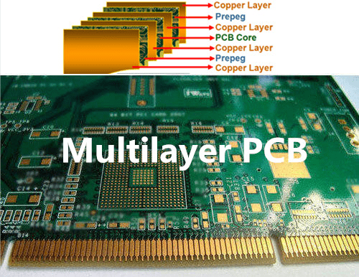
Types of Printed Circuit Boards
Printed circuit boards come in three types:
Single-sided, Double-sided, and Multilayer boards.
Each type will have strengths and weaknesses.
Multilayer PCBs contain several layers of circuitry and are suitable for high-density devices.
They are equivalent to several PCBs sandwiched together.

Slide 10
Materials for Printed Circuit Boards
Materials used in the fabrication of PCB:
Effective electrical insulators to prevent electrical breakdown.
Heat conductors to conduct away the heat generated.
High material strength to withstand forces and to maintain dimensional stability;
Thermal expansion coefficients that closely match that of copper.
Resistance to moisture absorption.
Stability in properties at temperature levels encountered in electronic applications;
Ready availability and manufacturability.
Low cost.
Glass–epoxy laminates made of an epoxy or polymide matrix reinforced by several layers of woven glass cloth.

Slide 11
Conduction Heat Transfer for Printed Circuit Boards
$$ρC_{}\frac{∂T}{∂t}=∇.\left\{\vec{\vec{k}}.∇T\right\}+g(r,t)$$
$$ρC_{}\frac{∂T}{∂t}=k_{lateral}\left\{\frac{∂^{2}T}{∂x^{2}}+\frac{∂^{2}T}{∂z^{2}}\right\}+k_{perpendicular}\frac{∂^{2}T}{∂y^{2}}$$

Slide 12
Thermal Conductivity of A PCB
Effective PCB Thermal Conductivity
Lateral Conductivity
Perpendicular Conductivity

Slide 13
EFFECTIVE THERMAL CONDUCTIVITY OF A PCB
Lateral Conductivity
w
L
A_{EG}
ΔT
A_{Cu}
Multiple layers in Parallel :
$\frac{1}{R_{PCB−lateral}}=\sum_{1}^{n}{\frac{1}{R_{EG,i}}}+\sum_{1}^{m}{\frac{1}{R_{Cu,i}}}$
$R_{EG,i}=\frac{t_{i}}{kA_{EG,i}}$
$R_{Cu,i}=\frac{t_{i}}{kA_{Cu,i}}$
$R_{PCB−lateral}=\frac{t_{PCB}}{k_{eff}A_{PCB}}$

Slide 14
True Areas of Layers in A PCB
$$A_{cu,i}=\sum_{1}^{n}{∆A{\left\{1−\frac{\%cutout}{100}\right\}}_{j}=β_{Cu,i}A_{PCB}}$$
$$A_{EG,i}=\sum_{1}^{n}{∆A{\left\{1−\frac{\%cutout}{100}\right\}}_{j}=β_{EG,i}A_{PCB}}$$

Slide 15
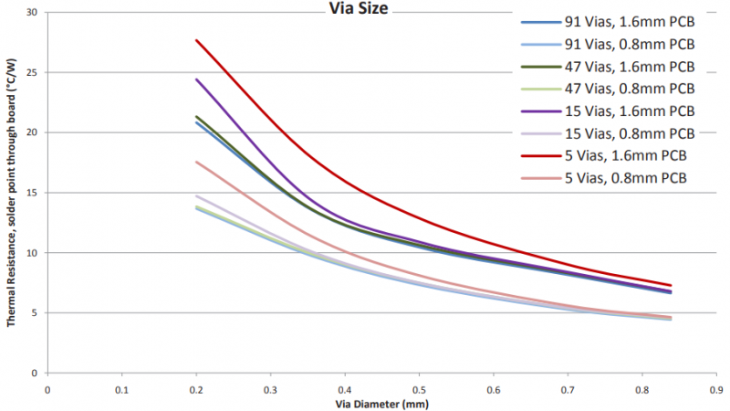
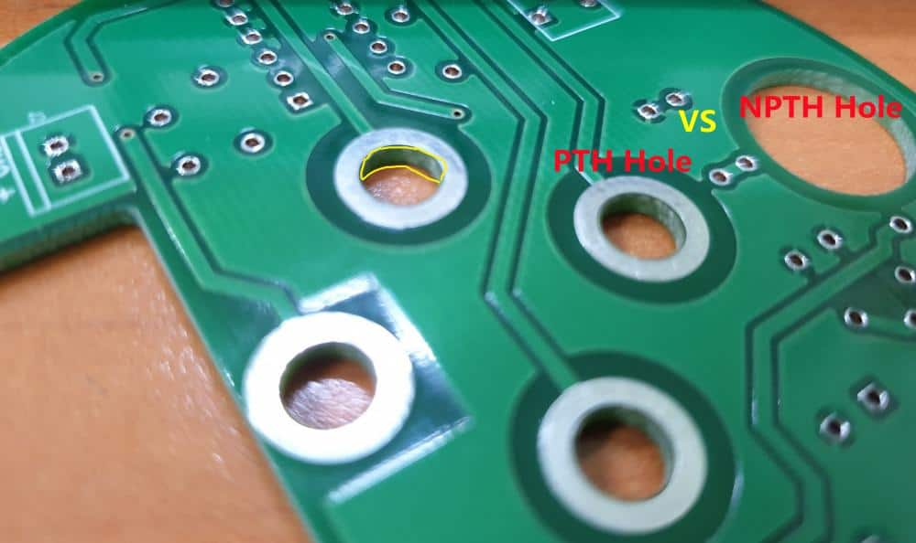
PCB Thermal Management –Design of Thermal via
Device-to-board edge thermal resistance of a PCB ∼ 20 to 60°C/W)
Thermal vias should just be part of a larger thermal management strategy for superior thermal management of a PCB.
Placement of thermal vias in a PCB board to aid heat transfer, you should check your placement against your design rules and constraints.

Slide 16
PCB Thermal Management – Metal Coins
https://emsxchange.com/pcb-thermal-management-metal-coins/

Slide 17
A True Design Reason behind Geometry of Natural Systems…..
African Elephant
Mammoths
Indian Elephant

Slide 18
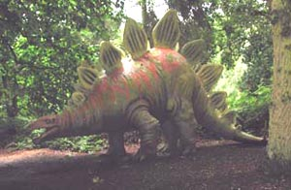
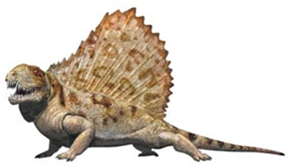
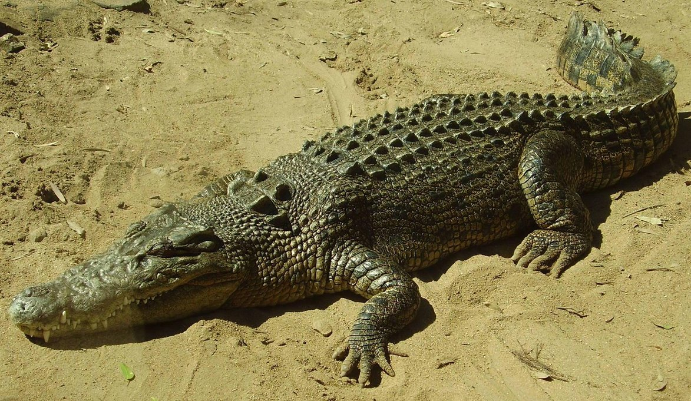
An Evolution to Perfection of Heat Transfer is Sustainable

Slide 19
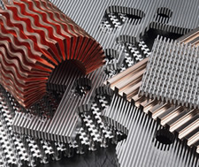
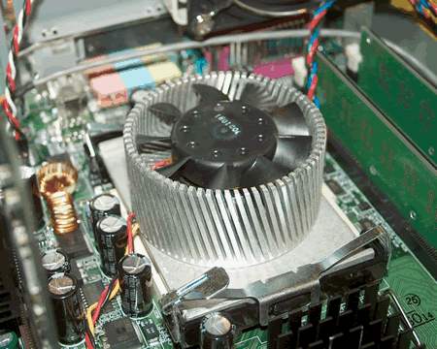
A Reason behind Survival of Electronic Systems

Slide 20
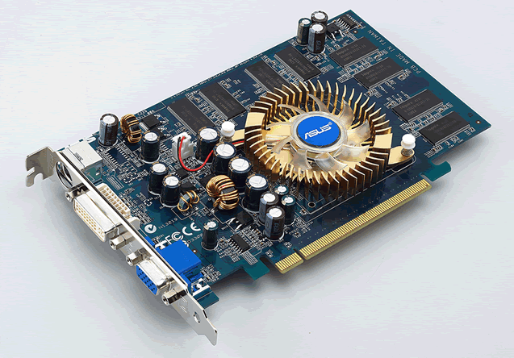
Forced Convection with Short Fins

Slide 21
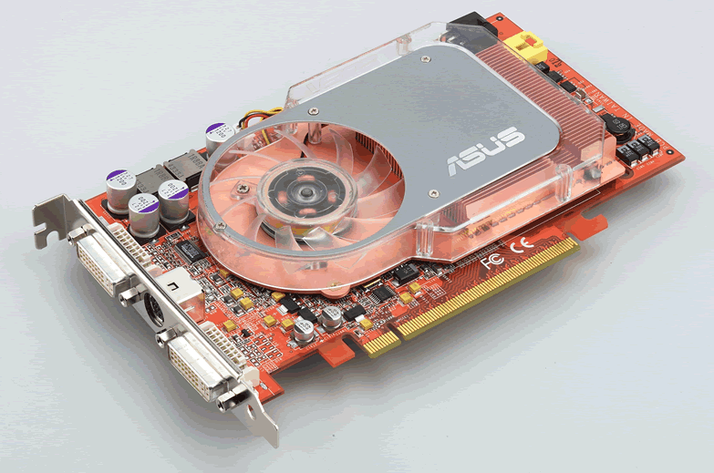
Guided air flux down the longitudinal fins

Slide 22
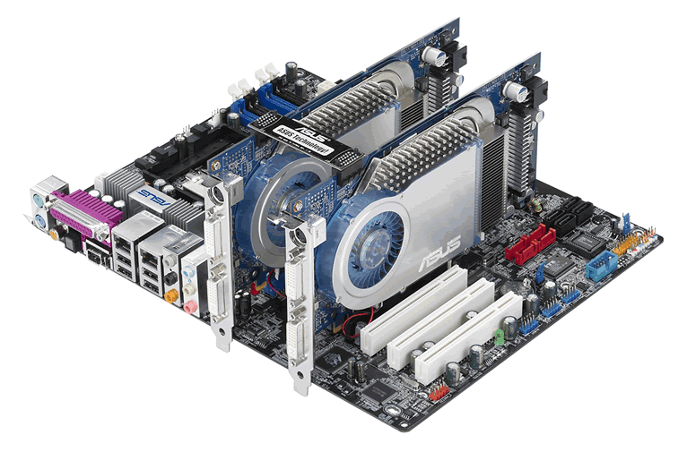
Combined two kinds of the pin fins

Slide 23
Basics of Heat Sinks
Thermal conductivity and cooling surface area must always be weighed against material and manufacturing costs.
Most heat sinks are made from aluminum, because of its low thermal resistance, light weight, and low cost.
Copper is also used for heat sinks; although lower in thermal resistance than aluminum, its cost and greater weight make it less desirable for many applications.

Slide 24
Types of Heat Sinks
Stamped heat sinks are made from a single sheet of metal, which is cut and bent to give the desired thermal properties.
Extruded heat sinks are very cost effective and provide good thermal performance.
Many basic shapes can be provided off-the-shelf.
Heat Sink Castings provide a cost-effective solution for high-volume, stable applications.
Bonded-fin heat sinks are made by bonding fins, fabricated from sheet metal or through extrusion, to an extruded base.
This process increases the surface area over a similar extruded piece, reducing the thermal resistance by A ^{1/2to 2/3}.
Folded-fin Heat Sinks : are bonded-fin assemblies with complex fin shapes.
By folding the fins over themselves, these assemblies provide a large surface area in a confined space.

