Slide 1
Convection Cooling for Thermal Management of PCBs
P M V Subbarao
Professor
Mechanical Engineering Department
Removal of Heat from Boundary of PCB

Slide 2
Heat Transfer is an Action: Path Function
Cold Surroundings
PCB as a Hot Thermodynamic System

Slide 3
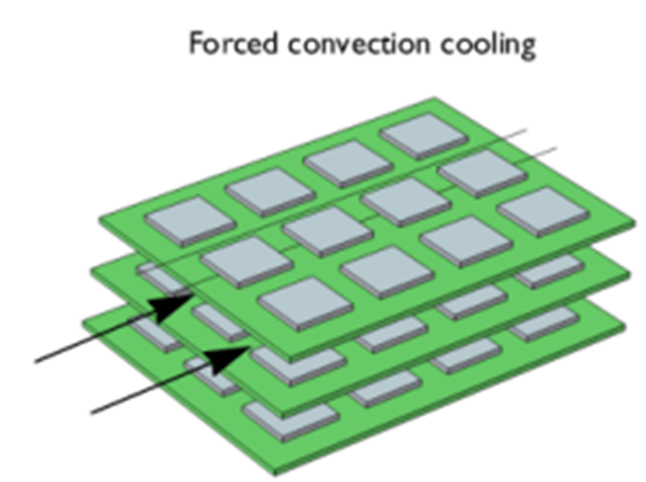
Newton’s Cooling of PCBs

Slide 4
Current Needs of A PCB
Past!!!!

Slide 5
Forced Convection Cooling of PCBs
Forced air cooling: Well Known Theory and Models
Several different length scales are involved:
Electronic System level length-scale ~ 100 cm (Re ~ 100,000)
Printed Circuit Board level ~ 10 cm (Re ~ 10,000)
Chip level ~ 1 cm (Re ~ 1000)

Slide 6
Flow and Heat Transfer Characteristics
System level flow
Laminar or transitional
Recirculation regions
Swirl
PCB-level and chip-level flows
Local roughness,
Elevated free-stream turbulence, and
Substrate conduction effects

Slide 7
Usability of Available Knowledge Framework: Scaling Laws
Generalized relationships are difficult to obtain for electronics cooling geometries
Geometries have two attributes: size and shape
Reynolds number scaling requires identical shapes (only size may change)
Changing chip protrusion height leads to a new shape
Changing chip spacing leads to a new geometry
Same problem occurs when board spacing is varied
Even the hydraulic diameter does not account for different shapes, because of flow bypass

Slide 8
Forced Convection Cooling of Cards and Board
1
T∝
l
S
b
in
2
t
L
Simplifications
2 -D Channel
S << W
Steady - state

Slide 9
Analytical Convective Heat Transfer
1701 Newton’s law of cooling.
1822: Fourier’s Conduction Equation.
Ernst Kraft Wilhelm Nußelt (Nusselt) is the first contributor to analytical convection heat transfer.
For a century Fourier’s work was only analytical work available in heat transfer.
In 1915 Nusselt cut the Gordian knot.
In a single stroke, Nusselt used Dimensional Analysis to prove that there exist a functional form essential for all analytical/experimental works in convection heat transfer.

Slide 10
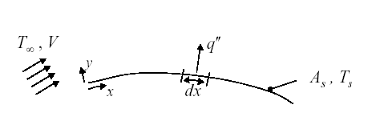
Analysis of Heat Transfer in Equilibrium Layer
At Thermodynamic equilibrium
$$T_{fluid,wall}=T_{wall}$$
At the wall for fluid layer :
$$−k_{fluid}A\left\{\frac{∂T}{∂y}\right\}=hA\left\{T_{fluid,wall}−T_{∞}\right\}$$
$$h=−\frac{k_{fluid}{\left.\left\{\frac{∂T}{∂y}\right\}\right|}_{wall−layer}}{\left\{T_{wall}−T_{∞}\right\}}$$

Slide 11
Estimation of Heat Transfer Coefficient
$$h=−\frac{k_{fluid}{\left.\left\{\frac{∂T}{∂y}\right\}\right|}_{wall}}{\left\{T_{wall}−T_{∞}\right\}}$$
Estimation of heat transfer coefficient is basically computation of temperature profile in equilibrium fluid layer.
Provoked a general theoretical and experimental study to understand how the equilibrium layer is developed.
The global geometry of the solid wall and flow conditions will decide the structure of stagnant layer.
Basic Geometry : Internal Flow or External Flow.

Slide 12
In search of A Dimensionless Parameter for Convection
$$q^{′′}=h\left(T_{s}−T_{∞}\right)=−k{\left.\frac{∂T}{∂y}\right|}_{y=0}$$
$${\left.\frac{∂T}{∂y}\right|}_{y=0}=\left(\frac{\text{Temperature} \text{scale}}{\text{Length} \text{scale}}\right){\left.\frac{∂θ}{∂y^{∗}}\right|}_{y^{∗}=0}$$
$$h\left(T_{s}−T_{∞}\right)=−k_{fluid}{\left.\left(\frac{T_{∞}−T_{s}}{L}\right)\frac{∂θ}{∂y^{∗}}\right|}_{y^{∗}=0}$$
$${\left.\frac{∂θ}{∂y^{∗}}\right|}_{y^{∗}=0}=\frac{hL}{k_{fluid}}$$
$$=f\left(x^{∗},{Re}_{L}{,}\frac{dp^{∗}}{dx^{∗}},Pr\right)$$

Slide 13
In search of A Dimensionless Parameter for Convection
This dimensionless temperature gradient at the wall is named as
Nusselt Number:
$$Nu=\frac{hL}{k_{fluid}}=\frac{\frac{L}{k_{fluid}}}{\frac{1}{h}}=\frac{\text{Conduction} \text{resistance}}{\text{Convection} \text{resistance}}$$
$$Nu={\left.\frac{∂θ}{∂y^{∗}}\right|}_{y^{∗}=0}=\frac{hL}{k_{fluid}}=f\left(x^{∗},{Re}_{L}{,}\frac{dp^{∗}}{dx^{∗}},Pr\right)$$
Local Nusselt Number

