Slide 1
Analysis of Forced Convection Heat Transfer in PCBs
P M V Subbarao
Professor
Mechanical Engineering Department
Strategy for Preliminary Estimation of Convection Capacity at Boundary of PCB

Slide 2
Heat Transfer is an Action: Path Function
Cold Surroundings
$$\iint{q^{′′}dA}$$
PCB as a Hot Thermodynamic System

Slide 3
Strategic Realization of Newton’s Cooling of PCBs

Slide 4
A Dimensionless Parameter for Convection
The dimensionless temperature gradient$\left\{{\left.\frac{∂θ}{∂y^{∗}}\right|}_{y^{∗}=0}\right\}$ at the wall is named as Nusselt Number:
$$Nu=\frac{hL}{k_{fluid}}=\frac{\frac{L}{k_{fluid}}}{\frac{1}{h}}=\frac{\text{Conduction} \text{resistance}}{\text{Convection} \text{resistance}}$$
$$Nu={\left.\frac{∂θ}{∂y^{∗}}\right|}_{y^{∗}=0}=\frac{hL}{k_{fluid}}=F\left(x^{∗},{Re}_{L}{,}\frac{dp^{∗}}{dx^{∗}},Pr\right)$$
Local Nusselt Number.
∴Estimation and control of temperature gradient on the surface of a PCB determines the capacity of Convection cooling

Slide 5
Analogy Between Momentum Transfer & Convection Heat Transfer !?!?!
$$Nu={\left.\frac{∂θ}{∂y^{∗}}\right|}_{y^{∗}=0}=\frac{hL}{k_{fluid}}=F\left(x^{∗},{Re}_{L}{,}\frac{dp^{∗}}{dx^{∗}},Pr\right)$$
$$C_{f}=\frac{τ_{wall}}{{ρ{\bar{u}}^{2}}/2}=\frac{μ{\left\{−\frac{du}{dr}\right\}}_{wall}}{{ρ{\bar{u}}^{2}}/2}=G\left(x^{∗},{Re}_{L}{,}\frac{dp^{∗}}{dx^{∗}}\right)$$
There must be an analogy between Momentum and Convection Heat Transfer.
Extension of Geometric Similarity to Transport Similarity
Similarity variable may be Prandtl Number!!!?!??!

Slide 6
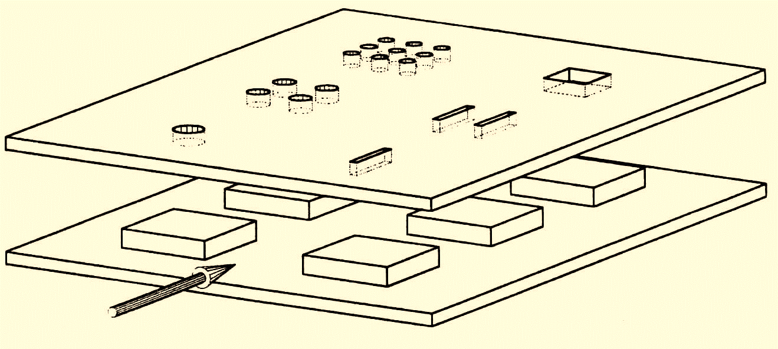
Non-dimensional Conservation Laws for Steady Incompressible 2-D Convection Systems
In dimensionless variables the steady incompressible Navier-Stokes equations in two dimensions may be written:
$$\frac{∂u^{∗}}{∂x^{∗}}+\frac{∂v^{∗}}{∂y^{∗}}=0$$
$$u^{∗}\frac{∂u^{∗}}{∂x^{∗}}+v^{∗}\frac{∂u^{∗}}{∂y^{∗}}=−\frac{∂p^{∗}}{∂x^{∗}}+\frac{1}{Re}\left(\frac{∂^{2}u^{∗}}{∂{x^{∗}}^{2}}+\frac{∂^{2}u^{∗}}{∂{y^{∗}}^{2}}\right)$$
$$u^{∗}\frac{∂v^{∗}}{∂x^{∗}}+v^{∗}\frac{∂v^{∗}}{∂y^{∗}}=−\frac{∂p^{∗}}{∂y^{∗}}+\frac{1}{Re}\left(\frac{∂^{2}v^{∗}}{∂{x^{∗}}^{2}}+\frac{∂^{2}v^{∗}}{∂{y^{∗}}^{2}}\right)$$
$$\left\{u^{∗}\frac{∂θ}{∂x^{∗}}+v^{∗}\frac{∂θ}{∂y^{∗}}\right\}=\frac{1}{Re×Pr}\left(\frac{∂^{2}θ}{∂{x^{∗}}^{2}}+\frac{∂^{2}θ}{∂{y^{∗}}^{2}}\right)$$

Slide 7
Occurrence of Mechanical Equilibrium in Flow through Parallel PCBs
The entry of flow into a pipe/duct is controlled by the law of occurrence of mechanical equilibrium between fluid and walls of pipe/ducts.
The size of fluid layer under the influence of mechanical equilibrium slowly is increases from entrance to inside….
The region of the flow in which the effects of the viscous shearing forces (Forces leading to Mechanical equilibrium) are felt is called the velocity (Momentum) boundary layer.

Slide 8
Occurrence of Thermal Equilibrium in Flow through Parallel PCBs
The fluid under mechanical equilibrium is subject to zeroth law of thermodynamics.
Conduction heat transfer is responsible for the onset of thermal equilibrium.
The size of fluid layer under the influence of thermal equilibrium also slowly is increases from entrance to inside….
The region of the flow, which has the dominance of conduction heat transfer is called the temperature (Thermal) boundary layer.

Slide 9
Simultaneous Occurrence of Thermal and Mechanical Equilibrium
The hypothetical boundary surface divides the flow in a pipe into two regions:
1a. The momentum boundary layer region, in which the viscous effects and the velocity changes are significant.
1b. The thermal boundary layer region, in which the conduction heat transfer is significant.

Slide 10
Simultaneous Occurrence of Thermal and Mechanical Equilibrium
2a. The irrotational (core) flow region, in which the frictional effects are negligible, and the velocity remains essentially constant in the radial direction.
2b. The uniform temperature region, in which the convection heat transfer is significant.

Slide 11
Transport Similarity
Estimate Convection thru Learning of Fluid Flow

Slide 12
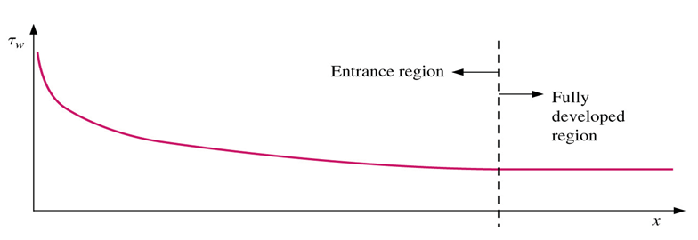
Resistance to flow & Operational Cost of Duct Flow
$$τ_{wall}=μ{\left.\frac{∂V}{∂y}\right|}_{wall}$$
Newton’s Law of Viscosity:
$$d{F_{shear−}}_{wall}=\left\{μ{\left.\frac{∂V}{∂y}\right|}_{wall}\right\}Pdx$$

Slide 13
Cooling of PCB & the Benefit
$$q^{′′}={hAdT=−k}_{f}{\left.\frac{∂T}{∂y}\right|}_{wall}$$
Newton’s Law of cooling:
Thermal Boundary Layer
Plug Fluid
$${δ\dot{Q}}_{cooling}=−\left\{k_{fluid}{\left.\frac{∂T}{∂y}\right|}_{wall}\right\}Pdx$$
$$q^{′′}$$

Slide 14
Condition for Steady flow with Wall Resistance
$$d{F_{shear−}}_{wall}=\left\{μ{\left.\frac{∂V}{∂y}\right|}_{wall}\right\}πDdx$$
For Steady flow:
$$d{F_{shear−}}_{wall}=\left\{μ{\left.\frac{∂V}{∂y}\right|}_{wall}\right\}Pdx=ΔpA_{fluid}$$
$$d{F_{shear−}}_{wall}$$

Slide 15
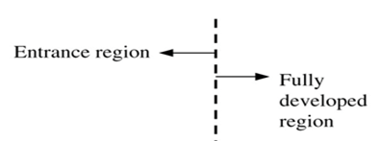
Negative Pressure Gradient for Steady flow
For Steady flow:
$$d{F_{shear−}}_{wall}=\left\{μ{\left.\frac{∂V}{∂y}\right|}_{wall}\right\}Pdx=dpA_{fluid}$$
$$\frac{dp}{dx}$$

Slide 16
Heating of Flow with Cooling of PCB
Thermal Boundary Layer
Plug Fluid
$${δ\dot{Q}}_{cooling}=−\left\{k_{fluid}{\left.\frac{∂T}{∂y}\right|}_{wall}\right\}Pdx={\dot{m}}_{fluid}c_{p}\left[dT_{fluid}\right]$$
$$q^{′′}$$

Slide 17
Condition for Steady flow with Wall Resistance
For Steady flow:
$$\frac{dp}{dx}=\frac{P}{A_{fluid}}\left\{μ{\left.\frac{∂V}{∂y}\right|}_{wall}\right\}→Δp\left(x\right)=\frac{P}{A}\int_{0}^{x}{\left\{μ{\left.\frac{∂V}{∂y}\right|}_{wall}\right\}dx}$$

Slide 18
Heating of Fluid due to Cooling of PCB
Thermal Boundary Layer
Plug Fluid
$${ δ\dot{Q}}_{cooling}=−\left\{k_{fluid}{\left.\frac{∂T}{∂y}\right|}_{wall}\right\}A_{fluid}dx$$
$$→{\dot{Q}}_{cooling}=−\int_{0}^{x}{\left\{k_{fluid}{\left.\frac{∂T}{∂y}\right|}_{wall}\right\}A_{fluid}dx}$$
= ${\dot{m}}_{fluid}c_{p}\left[T_{fluid,out}−T_{fluid,in}\right]$

