Slide 1
Transport Analogy of Forced Convection Heat Transfer in PCBs
P M V Subbarao
Professor
Mechanical Engineering Department
Convection Heat Transfer is analogous to Momentum Transfer…

Slide 2
Condition for Steady flow through a PCB Channel
For Steady flow:
$$\frac{dp}{dx}=\frac{P}{A_{fluid}}\left\{μ{\left.\frac{∂V}{∂y}\right|}_{wall}\right\}→Δp\left(x\right)=\frac{P}{A}\int_{0}^{x}{\left\{μ{\left.\frac{∂V}{∂y}\right|}_{wall}\right\}dx}$$

Slide 3
Heating of Fluid due to Cooling of PCB
Thermal Boundary Layer
Plug Fluid
$${ δ\dot{Q}}_{cooling}=−\left\{k_{fluid}{\left.\frac{∂T}{∂y}\right|}_{wall}\right\}A_{fluid}dx$$
$$→{\dot{Q}}_{cooling}=−\int_{0}^{x}{\left\{k_{fluid}{\left.\frac{∂T}{∂y}\right|}_{wall}\right\}A_{fluid}dx}$$
= ${\dot{m}}_{fluid}c_{p}\left[T_{fluid,out}−T_{fluid,in}\right]$

Slide 4
Flow That follows Poiseuille’s Laws
Regardless of duct shape, the entrance lengths can be correlated
for laminar flow in the form:
$$L_{e}=0.5+0.05{Re}_{}{{×D}_{h}}$$
$$L_{T}=\left\{L_{e}=0.5+0.05{Re}_{}{{×D}_{h}}\right\}×Pr$$

Slide 5
Condition for Steady and Fully Developed flow with Wall Resistance
For Steady flow:
$$\frac{dp}{dx}=\frac{4}{D}\left\{μ{\left.\frac{∂V}{∂y}\right|}_{wall}\right\}→Δp\left(x\right)=\int_{0}^{x}{\left\{μ{\left.\frac{∂V}{∂y}\right|}_{wall}\right\}dx}$$
For Steady fully Developed flow:
A Negative Constant
$$μ\left\{\frac{∂^{2}u}{∂y^{2}}+\frac{∂^{2}u}{∂z^{2}}\right\}=\frac{dp}{dx}$$

Slide 6
Forced Convection Cooling of Cards and Board
1
T∝
l
S
b
in
2
t
L
$$μ\left\{\frac{∂^{2}u}{∂y^{2}}+\frac{∂^{2}u}{∂z^{2}}\right\}=\frac{dp}{dx}$$
Simplifications
2 -D Channel
S << W
Steady - state
$\left(\frac{∂^{2}u^{∗}}{∂{y^{∗}}^{2}}+\frac{∂^{2}u^{∗}}{∂{z^{∗}}^{2}}\right)$= $Re ×\frac{dp^{∗}}{dx^{∗}}$
$\frac{∂^{2}u^{∗}}{∂{y^{∗}}^{2}}$ = $Re ×\frac{dp^{∗}}{dx^{∗}}$

Slide 7
Simple Modeling Forced Convection Flow of Cards and Boards
Fully Developed Laminar flow between parallel Plates:
$u\left(y\right)=−\frac{1}{2μ}\frac{dp}{dx}\left(y_{o}^{2}−y^{2}\right)$
$u_{mean}=\frac{1}{y_{o}}\int_{0}^{y_{o}}{u\left(y\right) }dy=−\frac{1}{3μ}\frac{dp}{dx}y_{o}^{2}$
$u\left(y\right)=1.5×u_{mean}\left(1−\left[\frac{y^{2}}{y_{o}^{2}}\right]\right)$
$\frac{dp}{dx}=−\frac{3μu_{mean}}{y_{o}^{2}}$
Pressure drop for a PCB Channel of length L:
$\frac{∆p}{L}=\frac{3μu_{mean}}{y_{o}^{2}}$

Slide 8
Friction Factor for a PCB Channel
Overall Friction Factor:
$f≡\frac{\frac{Δp}{L}}{4\left(\frac{ρu_{mean}^{2}}{2}\right)\left(\frac{1}{D}\right)}$
$f=\frac{\frac{3μu_{mean}}{y_{o}^{2}}}{4(ρu_{mean}^{2}/2)(1/D_{e})}$
$D_{e}=\frac{4A}{ρ}=4y_{o}$
$y_{o}^{2}=\frac{D_{e}}{16}$
$f=\frac{3μ×\left(2D_{e}\right)}{\frac{4}{16}ρu_{mean}^{}D_{e}^{2}}$ = $\frac{24μ}{ρu_{mean}^{}}$

Slide 9
HEAT TRANSFER TO FULLY DEVELOPED DUCT FLOW
O(0)
If O(1)
$$\left\{u^{∗}\frac{∂θ}{∂x^{∗}}+v^{∗}\frac{∂θ}{∂y^{∗}}\right\}=\frac{1}{Re×Pr}\left(\frac{∂^{2}θ}{∂{x^{∗}}^{2}}+\frac{∂^{2}θ}{∂{y^{∗}}^{2}}\right)$$
$$u^{∗}\frac{∂θ}{∂x^{∗}} =\frac{1}{Re×Pr}\left(\frac{∂^{2}θ}{∂{y^{∗}}^{2}}\right)$$
Possibility of Transport Analogy…..
$\frac{∂^{2}u^{∗}}{∂{y^{∗}}^{2}}$ = $Re ×\frac{dp^{∗}}{dx^{∗}}$
$\frac{∂^{2}θ}{∂{y^{∗}}^{2}}$= $\left(Re×Pr\right) u^{∗}\frac{∂θ}{∂x^{∗}}$

Slide 10
HEAT TRANSFER TO FULLY DEVELOPED DUCT FLOW
$\frac{∂^{2}θ}{∂{y^{∗}}^{2}}$= $\left(Re×Pr\right) u^{∗}\frac{∂θ}{∂x^{∗}}$
Evolution of Fluid Mean Temperature in Developed Region:
The key question about the heat transfer to duct flow is the relationship between
the wall–fluid temperature difference and
the wall–fluid heat transfer rate (or the longitudinal temperature variation of the stream).

Slide 11
HEAT TRANSFER TO FULLY DEVELOPED DUCT FLOW
$\frac{∂^{2}θ}{∂{y^{∗}}^{2}}$= $\left(Re×Pr\right) u^{∗}\frac{∂θ}{∂x^{∗}}$
Evolution of Fluid Mean Temperature in Developed Region:
Without loss of generality, consider a duct of depth S, average axial velocity U, and mass flow rate $\dot{m}=ρUA_{fluid}$.
From the thermodynamics of flow systems, the heat transferred from the wall to the stream equals the enthalpy gain experienced by the stream.

Slide 12
HEAT TRANSFER TO FULLY DEVELOPED DUCT FLOW
$\frac{∂^{2}θ}{∂{y^{∗}}^{2}}$= $\left(Re×Pr\right) u^{∗}\frac{∂θ}{∂x^{∗}}$
Evolution of Fluid Mean Temperature in Developed Region:
The first law of thermodynamics generates:
$q^{′′}Pdx=\dot{m}×c_{p}×dT_{fluid,mean}$= $ρUA_{fluid}×c_{p}×dT_{fluid,mean}$
$${\frac{dT_{fluid−mean}}{dx}=\frac{P}{A}×\frac{1}{ρc_{p}U}×q}^{′′}$$

Slide 13
HEAT TRANSFER TO FULLY DEVELOPED DUCT FLOW
Evolution of Fluid Mean Temperature in Developed Region:
$${\frac{dT_{fluid−mean}}{dx}=\frac{P}{A}×\frac{1}{ρc_{p}U}×q}^{′′}$$
The Fluid Mean temperature T_{fluid-mean} appearing in the first law analysis of the duct ‘‘control volume’’ is the bulk temperature of the stream.

Slide 14
Fluid Temperature Profile in FULLY DEVELOPED DUCT FLOW
$\frac{∂^{2}θ}{∂{y^{∗}}^{2}}$= $\left(Re×Pr\right) u^{∗}\frac{∂θ}{∂x^{∗}}$
$${\frac{dT_{fluid−mean}}{dx}=\frac{P}{A}×\frac{1}{ρc_{p}U}×q}^{′′}$$
$$θ=\frac{T_{wall}−T_{fluid−local}}{T_{wall}−T_{fluid−mean}}=\frac{f\left(x^{∗},y^{∗}\right)}{g\left(x^{∗}\right)}$$
$\frac{∂^{2}u^{∗}}{∂{y^{∗}}^{2}}$ = $Re ×\frac{dp^{∗}}{dx^{∗}}$
What is constant in thermally developed flow?

Slide 15
Fluid Temperature Profile in FULLY DEVELOPED DUCT FLOW
$$u\frac{∂T}{∂x}=α\frac{∂^{2}T}{∂y^{2}}$$
$$u\left(y\right)=1.5×u_{mean}\left(1−\left[\frac{y^{2}}{y_{o}^{2}}\right]\right)$$
$$1.5×u_{mean}\left(1−\left[\frac{y^{2}}{y_{o}^{2}}\right]\right)×\frac{∂T}{∂x}=α\frac{∂^{2}T}{∂y^{2}}$$
The boundary conditions are:
$\frac{∂T}{∂y}=0 at y=0$ & $k\frac{∂T}{∂y}=q^{′′} at y= y_{0}$

Slide 16
Fluid Temperature Profile in FULLY DEVELOPED DUCT FLOW
The temperature profile in fully developed flow is:
$$T\left(y\right)=T_{wall}−1.5\frac{q^{′′}}{ky_{0}}\left(\frac{5}{12}y_{0}^{2}−\frac{y^{2}}{2}+\frac{y^{4}}{{12y}_{0}^{2}}\right)$$

Slide 17
Forced Convection Cooling
$$Nu={\left.\frac{∂θ}{∂y^{∗}}\right|}_{y^{∗}=0}=\frac{hL}{k_{fluid}}=f\left(x^{∗},{Re}_{L}{,}\frac{dp^{∗}}{dx^{∗}},Pr\right)$$
Nusselt Number is constant in thermally Developed flow:
$$Nu≡\frac{hD_{e}}{k}=−\frac{D_{e}{\left(\frac{∂T}{∂y}\right)}_{o}}{T_{o}−T_{m}}$$
$$Nu=7.6$$
Isothermal Walls
Iso-heat flux Walls
Nu = 8.23

Slide 18
Fluid Flow /Convection Heat Transfer Analogy
Thomas Stanton (engineer) (1865–1931) invented Transport Analogy.
He used to characterize heat transfer in forced convection flows using fluid flow field and developed a dimensionless number.
This number is titled as Stanton number.
Stanton Number
Applying to Channel with Isothermal walls:
$S_{t}×Pr=\frac{7.6}{Re}$
$f=\frac{24}{Re}$

Slide 19
Fluid Flow/Heat Transfer Analogy
Applying to Channel with Isoflux walls
Laminar, fully-developed, channel

Slide 20
Turbulent, Fully-Developed Channel
Empirical Correlation for Friction Factor
Smooth channel

Slide 21
Turbulent, Fully-Developed Channel
Development of Correlations for Nu Variation using Transport Similarity:
$$f=0.046{Re}^{−0.2}$$
Transport Analogy using Liminar flows
$$S_{t}Pr=\frac{f}{3}$$
$$S_{t}Pr=\frac{0.046{Re}^{−0.2}}{3}$$
$$\frac{Nu}{Re}=\frac{0.046{Re}^{−0.2}}{3}$$
$$Nu=0.0153{ Re}^{0.8}$$

Slide 22
Turbulent, Fully-Developed Channel
Experimental Correlations for Nu
(Kays)
(Colburn)

Slide 23
Turbulent, Fully-Developed Channel
Development General Transport Analogy:
(Colburn)
$$S_{t}Pr=\frac{0.023{Re}^{0.8}{Pr}^{1/3}}{Re}$$
$$S_{t}{Pr}^{2/3}=\frac{0.023}{{Re}^{0.2}}$$
$$f=0.046{Re}^{−0.2}$$
$$S_{t}{Pr}^{2/3}=2f$$

Slide 24
Asymmetric Heating PCB Channels
Parallel Plate Channel : Laminar Flow
$${Nu}_{i}=\frac{5.385}{1−0.346×\left\{\frac{q_{o}^{′′}}{q_{i}^{′′}}\right\}}$$
$${Nu}_{o}=\frac{5.385}{1−0.346×\left\{\frac{q_{i}^{′′}}{q_{o}^{′′}}\right\}}$$
$$q_{o}^{′′}=q_{i}^{′′} ⇒{Nu}_{o}={Nu}_{i}=8.23$$

Slide 25
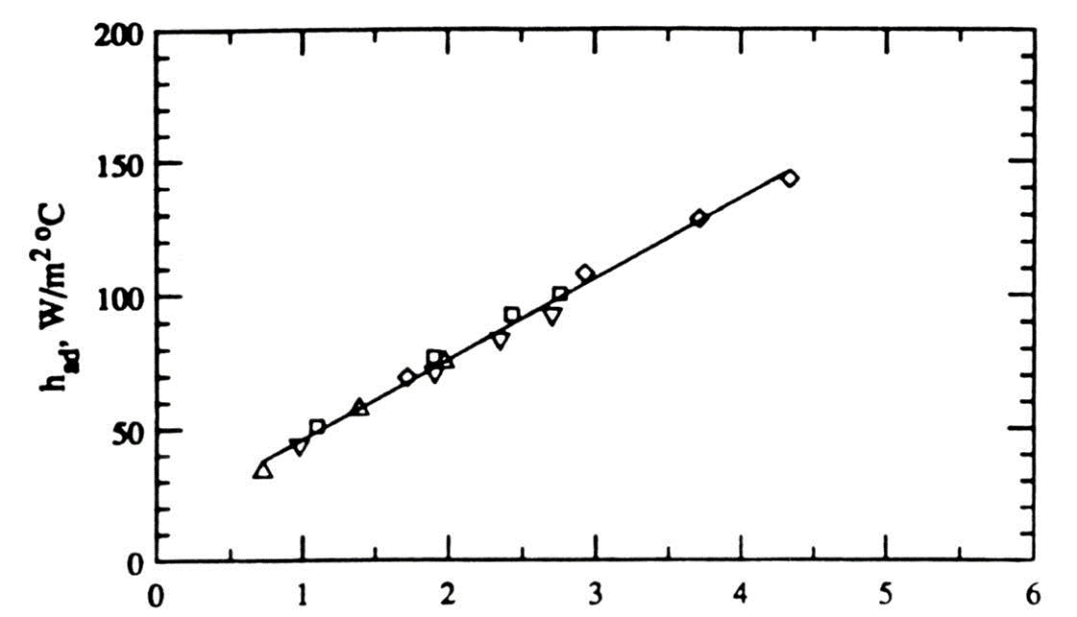
Effect of Turbulence Intensity on Heat Transfer Coefficient
$$u_{rms}=\sqrt{\int_{0}^{T}{{\left\{u\left(t\right)−\overline{U}\right\}}^{2}dt}, m/s}$$

Slide 26
Enhancement of Forced Convection from PCBs
Inherent enhancement
Protrusions
Vibrations
Electrical fields
Enhancement by control of geometric layout
Staggering chips on the board
Optimal streamwise spacing
Displaced promoters and flow modulation
Wires, rods attached to the opposite wall of the channel
Modulate flow at an appropriate frequency

Slide 27
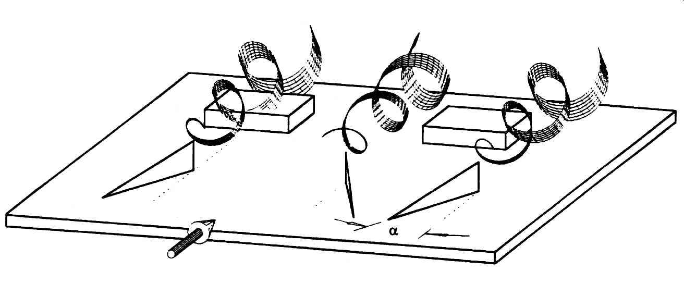
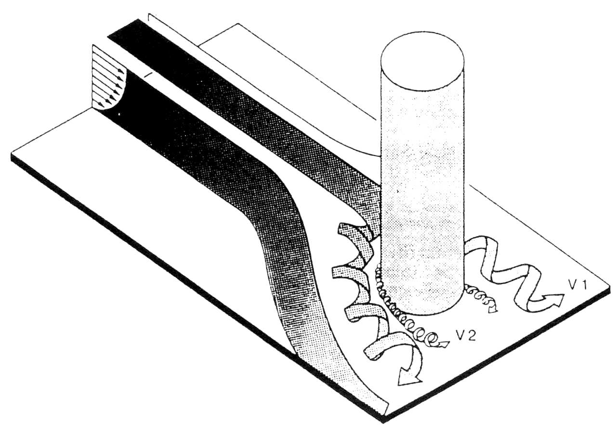
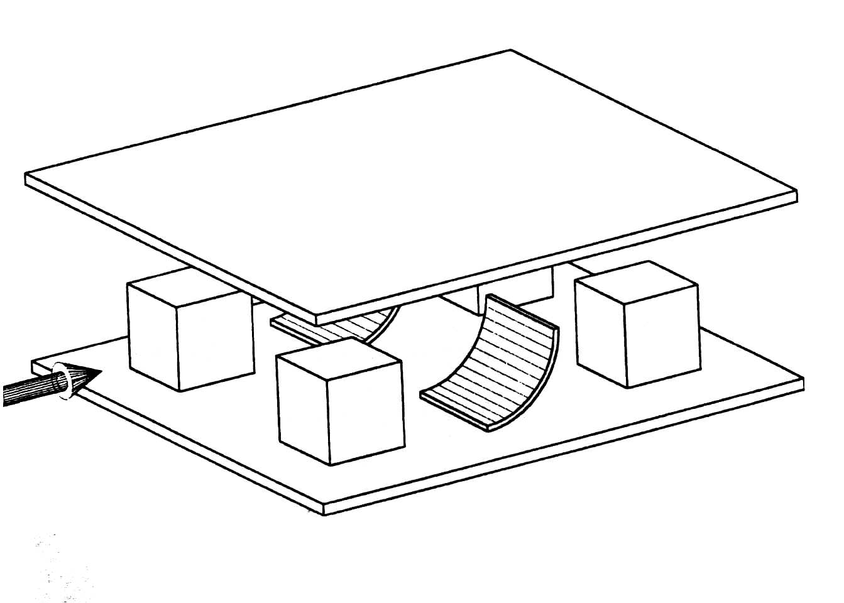
Enhancement of Forced Convection from PCBs
Vortex generators and barriers
Delta-wing vortex generators
Scoops
Wall-mounted cylinders

Slide 28
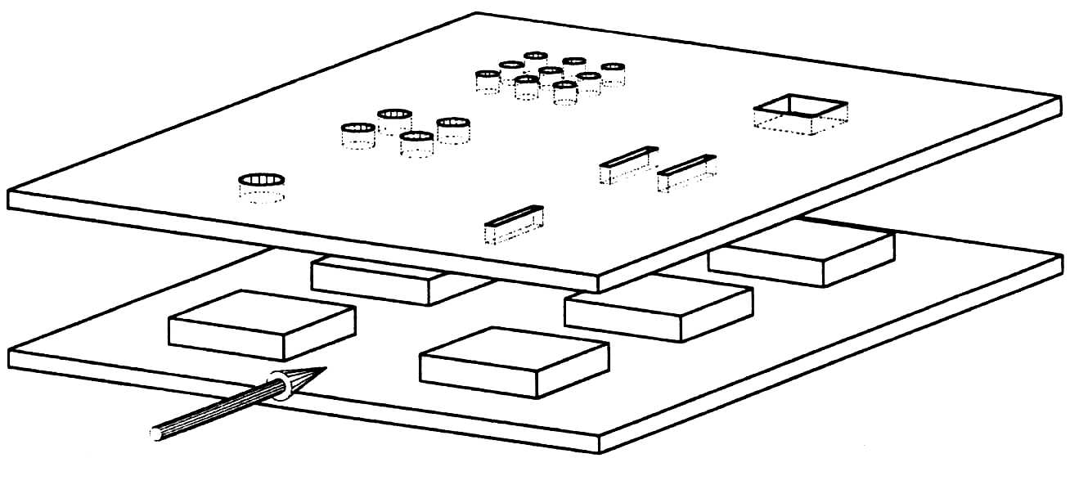
Enhancement of Forced Convection from PCBs
Impinging jets
Free Jets
Submerged jets
Compact heat sinks
Microchannel heat sinks
Porous metallic matrices
Hybrid techniques

Slide 29
Closure
Analytical studies are tricky because of lack of geometric similarity (have to depend on experimental and numerical input)
Entrance effects are substantial and cannot be neglected
Need to be careful in interpreting data and using the appropriate heat transfer coefficient
Package length scale is the most representative dimension
Substrate conduction plays an important part
Several enhancement techniques can be successfully applied

