Slide 1
Extended Surfaces for Better Thermal Management of Chip on Board
P M V Subbarao
Professor
Mechanical Engineering Department
Shape Evolution of Heat Exchanging Surfaces…

Slide 2
Forced Convection Cooling of Chips Using Air

Slide 3
Analytical Convective Heat Transfer
1701 Newton’s law of cooling.
1822: Fourier’s Conduction Equation.
In the 1807 memoir, Fourier successfully developed a formula to use Newton’s Law as
$$q_{wall}^{′′}=\frac{\dot{Q}}{A}=h\left\{T_{wall}−T_{∞}\right\}$$
This was incorporated by Fourier into his epoch-making convective boundary condition.
In 1915 Nusselt cut the Gordian knot.
Boundary layer conduction was used as boundary condition to define Nu or h.
Blending of Convection & Conduction in to GDE was a need for design high energy dissipating systems.
1945 - GARDNER-MURRAY Ideas.

Slide 4
Clues from Nature: Blending of Convection or Radiation in Conduction Equation
Continuous Convection or Radiation heat transfer to/from fin surface
Extended surface
Conduction heat transfer to /from body.
Body to gain or loose heat
Conduction through the fin is strengthened or weakened by continuous convection or radiation from/to fin surface.

Slide 5
Mathematical Ideas are More Natural
Reptiles, mammals and birds like high steady body temperatures.
They have sophisticated ways to manage flows of heat between their bodies and the environment.
Body shape enters the physics of body cooling.
It also helps to explain the odd appendages like crests and sails that decorated extinct reptiles like Stegosaurus or mammal-like reptiles like Dimetrodon.
Theoretical Biologists did Calculations to show these structures could act as very effective heat exchange fins.
These fins are allowing animals with crests to heat their bodies up to high temperatures much faster than animals without them.

Slide 6
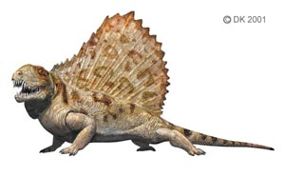
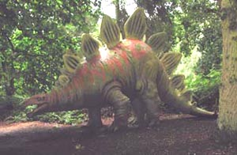
Natural Geometries for Convection Cooling
An optimum body size is essential for the ability to regulate body temperature by blood-borne heat exchange.
For animals in air, this optimum size is a little over 5 kg.
For animals living in water, the optimum size is much larger, on the order of 100 kg or so.
This may explain why large reptiles today are largely aquatic and terrestrial reptiles are smaller.

Slide 7
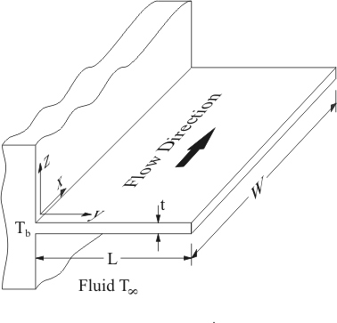
Amalgamation of Conduction and Convection/Radiation
$${\dot{Q}}_{convection−out}$$
$${\dot{Q}}_{conduction−in}$$
$${\dot{Q}}_{conduction−out}$$

Slide 8
Basic Geometric Features of Fins
profile
PROFILE AREA
cross-section
CROSS-SECTION AREA

Slide 9
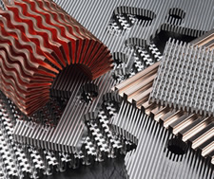
Innovative Fin Designs

Slide 10
Single Fins :Shapes
Longitudinal or strip
Radial
Pins

Slide 11
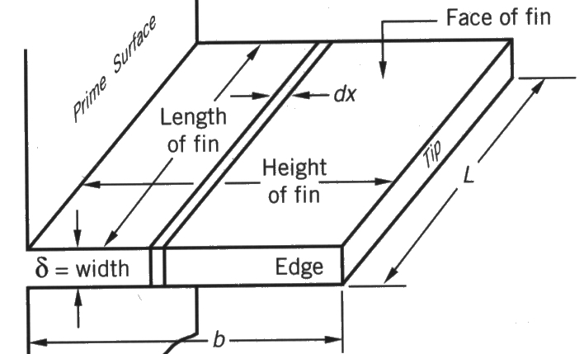
Anatomy of A STRIP FIN
Δx
Flow Direction
thickness
x

Slide 12
GARDNER-MURRAY ANALYSIS : ASSUMPTIONS
Steady state one dimensional conduction Model.
No Heat sources or sinks within the fin .
Thermal conductivity constant and uniform in all directions.
Heat transfer coefficient constant and uniform over fin faces.
Surrounding temperature constant and uniform.
Base temperature constant and uniform over fin base.
Fin width much smaller than fin height.
No bond resistance between fin base and prime surface.
Heat flow off fin proportional to temperature excess.

Slide 13
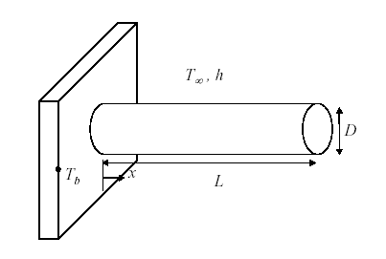
Slender Fins
Δx
thickness
$$\frac{D}{L} or \frac{δ}{L} or \frac{δ}{b}<<1$$

Slide 14
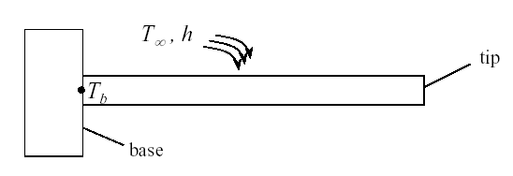
Steady One-dimensional Conduction through Fins
q_{conv} or q_{radiation}
q_{x}
q_{x+dx}
Conservation of Energy:
$${\dot{Q}}_{cond,x}={\dot{Q}}_{cond,x+Δx}+{\dot{Q}}_{convection}$$
OR
$${\dot{Q}}_{cond,x}={\dot{Q}}_{cond,x+Δx}+{\dot{Q}}_{radiation}$$

Slide 15
Transverse Heat Transfer in A Fin
$${\dot{Q}}_{convection}=h\left(∆A\right) \left(T−T_{∞}\right)$$
$$=h\left(PΔx\right)(T−T_{∞})$$
Δx
thickness
OR
$${\dot{Q}}_{radiation}=h_{rad}\left(PΔx\right)(T−T_{∞})$$
$$h_{rad}=σε\left(T_{guess}^{2}+T_{∞}^{2}\right)\left(T_{guess}+T_{∞}^{2}\right)$$

Slide 16
Governing Differential Equation for Conjugate Heat Transfer
$\dot{Q}$_{conv}
q_{x}
q_{x+dx}
Energy Conservation Equation per unit length of fin :
$$\frac{{\dot{Q}}_{cond,x+Δx}−{\dot{Q}}_{cond,x}}{Δx}+hP(T−T_{∞})=0$$
Taking limit Δx tends to zero and using the definition of derivative:
$$\frac{d\dot{Q}}{dx}+hP(T−T_{∞})=0$$

Slide 17
Governing Differential Equation for Conjugate Heat Transfer
$\dot{Q}$_{conv}
q_{x}
q_{x+dx}
$$\frac{d\dot{Q}}{dx}+hP(T−T_{∞})=0$$
Substitute Fourier’s Law of Conduction:
$$\frac{d\left(−kA_{c}\frac{dT}{dx}\right)}{dx}+hP(T−T_{∞})=0$$

Slide 18
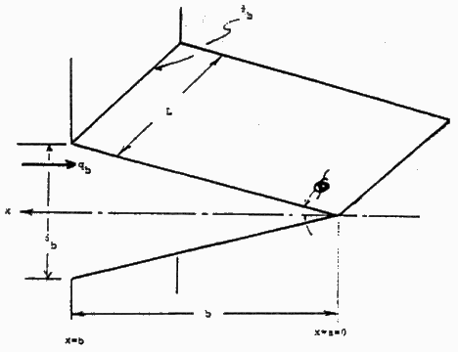
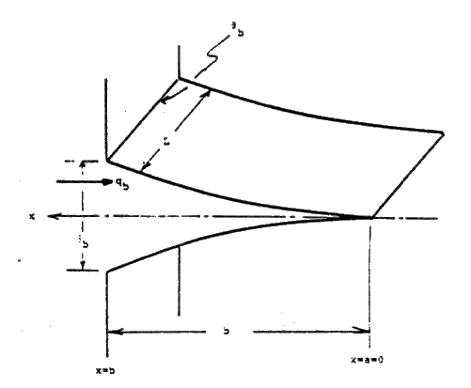
Types of Strip Fins with Reduced Weight
$$\frac{d\left(kA_{c}\frac{dT}{dx}\right)}{dx}−hP(T−T_{∞})=0$$
$$θ_{b}$$
L
x
q_{b}
$$φ$$
Straight fin of triangular profile rectangular C.S.
$$δ_{b}$$
$$A_{c}(x)=δL\frac{x}{b}$$
x=b
b
x=0
$$θ_{b}$$
Straight fin of parabolic profile rectangular C.S.
L
x
q_{b}
$$A_{c}(x)=δL{\left\{\frac{x}{b}\right\}}^{2}$$
$$δ_{b}$$
x=b
b
x=0

Slide 19
Fins with Cartesian Geometry Heat Transfer
$$\frac{d\left(kA_{c}\frac{dT}{dx}\right)}{dx}−hP(T−T_{∞})=0$$
Straight fin of triangular profile Circular C.S.
$$A_{c}(x)=\frac{π}{4}{\left\{\frac{D}{b}\right\}}^{2}x^{2}$$
Straight fin of parabolic profile rectangular C.S.
$$A_{c}(x)=\frac{π}{4}{\left\{\frac{D}{b}\right\}}^{4}x^{4}$$

Slide 20
Fins with Cylindrical Geometry Heat Transfer
$$\frac{d\left(kA_{c}\frac{dT}{dr}\right)}{dr}−hP(T−T_{∞})=0$$
Circumferential fin of rectangular profile
$$A_{c}(r)=2πrδ$$
Straight fin of triangular profile
$$A_{c}(r)=2π\left\{\frac{δ}{R}\right\}r^{2}$$

Slide 21
Strip Fin with constant cross section area:
$$kA_{c}\frac{d^{2}T}{dx^{2}}−hP(T−T_{∞})=0$$
$$\frac{d^{2}T}{dx^{2}}−\frac{hP}{kA}(T−T_{∞})=0$$
$$m^{2}=\frac{hP}{kA}$$

Slide 22
The Fin Factor
$$P=πd\text{ \& }A=\frac{πd^{2}}{4}$$
Fin factor for pin Fin:
$$\text{m}\text{=}\sqrt{\left(\frac{\text{hP}}{kA}\right)}=\sqrt{\frac{4h}{kd}}$$
Fin factor for strip Fin:
$$P=2\left(L+δ\right)\text{ \& }A=L×δ$$
$$\text{m}\text{=}\sqrt{\left(\frac{\text{hP}}{kA}\right)}=\sqrt{\frac{2h\left(L+δ\right)}{kLδ}}≈\sqrt{\frac{2h}{kδ}}$$

Slide 23
GDE for Constant CS Area Fins
$$\frac{d^{2}T}{dx^{2}}−m^{2}(T−T_{∞})=0$$
Define:
$$θ=T−T_{∞}$$
$$\frac{d^{2}θ}{dx^{2}}−m^{2}θ=0$$
At the base of the fin:
$$θ_{base}=T_{base}−T_{∞}$$

Slide 24
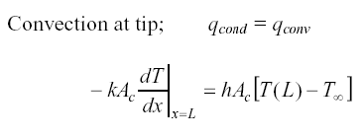
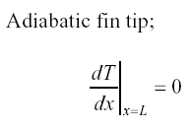
Conditions at the Tip of A Fin

Slide 25
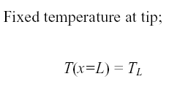
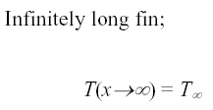
Conditions at the Tip of A Fin

Slide 26
Linear Second order ODE with Constant Coefficients
$$\frac{d^{2}θ}{d^{2}x}−m^{2}θ=0$$
This equation has two linearly independent solutions.
The general solution is the linear combination of those two independent solutions.
Each solution function θ_{ι}(x) and its second derivative must be constant multiple of each other.
Therefore, the general solution function of the differential equation above is:
$$θ\left(x\right)=C_{1}e^{mx}+C_{2}e^{−mx}$$

