Slide 1
Design of Fins for Thermal Management of Chip on Board
P M V Subbarao
Professor
Mechanical Engineering Department
Enhancement of Cooling Rate per Unit Weight of Additional Convection Surface…

Slide 2
Strip Fin Equation : Linear Second order ODE with Constant Coefficients
$$\frac{d^{2}θ}{d^{2}x}−m^{2}θ=0$$
This equation has two linearly independent solutions.
The general solution is the linear combination of those two independent solutions.
Each solution function θ_{ι}(x) and its second derivative must be constant multiple of each other.
Therefore, the general solution function of the differential equation above is:
$$θ\left(x\right)=C_{1}e^{mx}+C_{2}e^{−mx}$$

Slide 3
Most Practicable Tip Boundary Condition
Convection cooling at the tip: ${\left.\dot{Q}\right|}_{conduction−tip=}={\left.\dot{Q}\right|}_{convection−tip=}$
$$−kA_{c}{\left.\frac{dT}{dx}\right|}_{x=b}=hA_{c}\left[T_{tip}−T_{∞}\right]$$
Corrected condition length for adiabatic tip:
$$b_{corr−adi}=b+\frac{δ}{2}$$

Slide 4
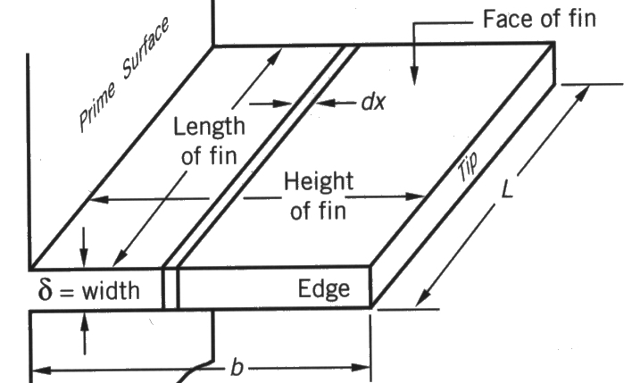
Longitudinal Fin : Adiabatic Tip
Shit the origin x=0 to the tip:
Δx
The boundary condition are:
$$θ(\text{x}\text{=}b_{c})=θ_{\begin{aligned}&b_{c} \\ &\end{aligned}}$$
thickness
$$\dot{Q}(\text{x}\text{=0})\text{=0}$$
x
Use the boundary conditions s to get
$$θ\left(x=b_{c}\right)=θ_{b_{c}}=C_{1}e^{mb_{c}}+C_{2}e^{−mb_{c}}$$
and
$$\dot{Q}\left(x=0\right)=kA_{c}{\left.\frac{dθ}{dx}\right|}_{x=0}=0$$
$$kLδ\left\{C_{1}−C_{2}\right\}=0$$

Slide 5
Longitudinal Fin : Adiabatic Tip
Insulated tip condition shows that:
Δx
$$C_{1}=C_{2}=C \\ θ_{b}=C\left\{e^{mb_{c}}+e^{−mb_{c}}\right\}$$
thickness
x
Base condition shows that:
$$θ_{b}=C\left\{e^{mb_{c}}+e^{−mb_{c}}\right\}⇒C=\frac{θ_{b_{c}}}{\left\{e^{mb_{c}}+e^{−mb_{c}}\right\}}$$
$$θ\left(x\right)=\frac{θ_{b}}{\left\{e^{mb_{c}}+e^{−mb_{c}}\right\}}\left\{e^{mx}+e^{−mx}\right\}$$
$$=θ_{b}\frac{\cosh\left(mx\right)}{\cosh\left(mb_{c}\right)}$$

Slide 6
Rate of Heat Removed by the Fin
The heat flow through the fin at any location x is:
$$\dot{Q}\left(x\right)=kδL\frac{dθ}{dx}=kδL\frac{d}{dx}\left(θ_{b}\frac{\cosh\left(mx\right)}{\cosh\left(mb_{c}\right)}\right)$$
$$\dot{Q}\left(x\right)=kδLmθ_{b}\frac{\sinh\left(mx\right)}{\cosh\left(mb_{c}\right)}$$
And at x= $b_{c}$ (heat entering fin base) :
$${\dot{Q}}_{b_{c}}=kδLmθ_{b}\tanh\left(mb_{c}\right)$$
Rate of Heat Removed from the base with the Fin:
$${\dot{Q}}_{b_{c}}={\left(2hkδ\right)}^{1/2}Lθ_{b_{c}}\tanh\left(mb_{c}\right)$$
Rate of Heat Removed from the base without the Fin:
$${\dot{Q}}_{b_{c}−w/ofin}=hLδθ_{b_{c}}$$
$$∆\dot{Q}= {\dot{Q}}_{b_{c}}={\left(2hkδ\right)}^{1/2}Lθ_{b_{c}}\tanh\left(mb_{c}\right)$$

Slide 7
Additional Cooling of Base due to Added Fin
Additional cooling of Base due to fin:
$$∆\dot{Q}= {\dot{Q}}_{{base}_{}}−{\dot{Q}}_{{base}_{}−\frac{w}{ofin}}$$
$={\left(2hkδ\right)}^{1/2}Lθ_{b_{c}}\tanh\left(mb_{c}\right)−$ $hLδθ_{b_{c}}$
$$=Lθ_{b_{c}}\left\{{\left(2hkδ\right)}^{1/2}\tanh\left(mb_{c}\right)− hδ \right\}$$
Additional material volume: $V_{fin}=Lbδ$

Slide 8
Cost – Benefit Analysis of Fins
The benefit of a fin is defined as effectiveness of a fin.
An ideal fin will have highest value of effectiveness.
An ideal fin is the one whose temperature is equal to temperature of the surface.
This is possible only if the thermal conductivity of fin material is infinitely high.
The effectiveness of an actual fin material is always lower than an ideal fin.
The relative performance of a given fin is defined as efficiency of a fin.

Slide 9
Cost – Benefit Analysis of Fins
Provision of fins on a surface requires more material and hence more capital cost.
A judicial decision is necessary to select correct factors of fin design.
Best fin design should have higher benefits with a lower amount of material.

Slide 10
Effectiveness of A Fin : Strip Fin
The fin effectiveness, ε_{fin} , is defined as the ratio of the heat dissipation with fin to the heat dissipation without a fin.
$$ε_{fin}=\frac{{\dot{Q}}_{base−withfin}}{{\dot{Q}}_{base−withoutfin}}$$
$$ε_{fin,\text{adiabatic}}=\frac{{\left(2hkδ\right)}^{1/2}L\tanh\left(mb_{c}\right)\left(T_{base}−T_{∞}\right)}{hA_{cs}\left(T_{base}−T_{∞}\right)}$$

Slide 11
Ideal Fin & Efficiency of Strip Fin
An ideal fin is made of a material with infinite thermal conductivity and hence the entire fin will operate at the base temperature excess
$${\dot{Q}}_{\text{ideal}}=h\overset{2\left(L+δ\right)b}{\overbrace{\left(\text{SURFACE}\right)}}θ_{b_{}}≈2hLbθ_{b_{}}$$
The fin efficiency, η, is defined as the ratio of the actual heat dissipation to the ideal heat dissipation if the entire fin were to operate at the base temperature excess
$$η=\frac{{\dot{Q}}_{actual}}{{\dot{Q}}_{\text{ideal}}}$$
For Adiabatic strip fin:
$${\dot{Q}}_{act−adi}=\sqrt{hPkA_{cs}}\left(T_{base}−T_{∞}\right)\tanh\left(mb_{c}\right)$$
$$η_{adi}=\frac{\sqrt{hPkA_{cs}}θ_{b_{}}\tanh{m}b_{c}}{2hLbθ_{b_{}}}$$
$$η_{adi}=\frac{\tanh{m}b_{c}}{mb_{c}}$$

Slide 12
Longitudinal Fin of Rectangular Profile: Adiabatic tip
$$θ\left(x\right)=θ_{b}\frac{\cosh\left(mx\right)}{\cosh\left(mb_{c}\right)}$$
Temperature Excess Profile
Heat Dissipated = Heat Entering Base of the fin
$${\dot{Q}}_{b_{}}=kδLmθ_{b}\tanh\left(mb_{c}\right)$$
$$ε_{fin,\text{adiabatic}}=\frac{{\left(2hkδ\right)}^{1/2}L\tanh\left(mb_{c}\right)\left(T_{base}−T_{∞}\right)}{hA_{cs}\left(T_{base}−T_{∞}\right)}$$
$$η_{adi}=\frac{tanh\left(mb_{c}\right)}{mb_{c}}$$
Fin Efficiency

Slide 13
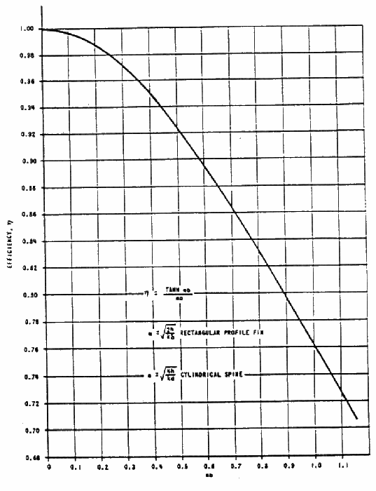
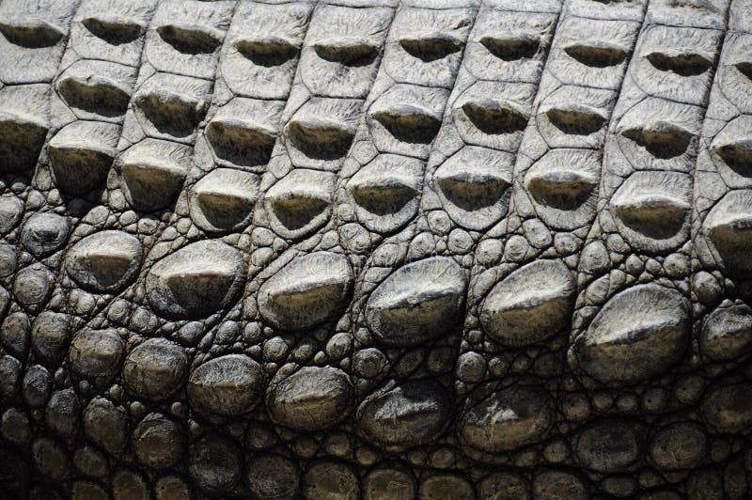
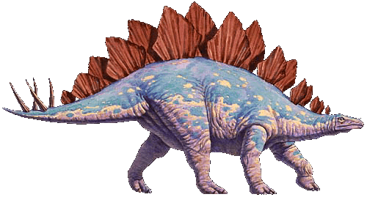
Fin Efficiency
mb_{c}

Slide 14
The Fin Usefulness Criterion Strip Fin
The usefulness criterion:
Says that maximum cooling is facilitated by a fin, when the conductance of the fin surface conductance just equals twice the fin internal conductance.
This says that
makes the use of a fin a big win
is a borderline type of situation and
tends to make the fin act as an insulator.

Slide 15
Strip Fin of Least Material
The heat flux is not constant throughout the fin surface area.
It decreases as some function of distance from the fin base.
Two models are possible:
For a constant heat flux, the cross-section of the fin must also decrease as some function of distance from the base.
Schmidt reasoned that the problem reduced to the determination of a fin width function, δ(x), that would yield minimum profile area.
$A_{P}=\int_{0}^{b}{δ\left(x\right)dx}$
Volume of material used for fin: ${V=LA}_{P}=L\int_{0}^{b}{δ\left(x\right)dx}$

Slide 16
Longitudinal Fin of Least Material Constant Heat Flux Model
$$\dot{Q}=−kA_{cs}\frac{dθ}{dx}$$
Consider
With A a function of x. Then
$$\frac{dθ}{dx}=−\frac{\dot{Q}}{kA_{cs}}$$
For a constant heat flux (with k a constant by assumption):
and
which is a linear temperature excess profile

Slide 17
Shape of Constant Heat Flux Longitudinal Fin
$$\frac{d\left(kA_{c}\frac{dT}{dx}\right)}{dx}−hP(T−T_{∞})=0$$
For a constant heat flux with constant material properties :
$$\frac{d\left(kA_{c}C_{1}\right)}{dx}−hP\left\{C_{1}x+C_{2}\right\}=0$$

