Slide 1
Design of Least Weight Fins for Thermal Management of Chip on Board
P M V Subbarao
Professor
Mechanical Engineering Department
Enhancement of Cooling Rate per minimum Weight of Additional Convection Surface…

Slide 2
Design Formulae for Strip Fins
$$θ\left(x\right)=θ_{b}\frac{\cosh\left(mx\right)}{\cosh\left(mb_{c}\right)}$$
Temperature Excess Profile
Heat Dissipated = Heat Entering Base of the fin
$${\dot{Q}}_{b_{}}=kδLmθ_{b}\tanh\left(mb_{c}\right)$$
$$ε_{fin,\text{adiabatic}}=\frac{{\left(2hkδ\right)}^{1/2}L\tanh\left(mb_{c}\right)\left(T_{base}−T_{∞}\right)}{hA_{cs}\left(T_{base}−T_{∞}\right)}$$
$$η_{adi}=\frac{tanh\left(mb_{c}\right)}{mb_{c}}$$
Fin Efficiency

Slide 3
Strip Fin of Least Material OPTIMUM SHAPES
A strip fin with least profile area will have least weight.
Least profile area for a given rate of heat transfer can be modified as maximum rate of heat transfer for a given profile area A_{p}
For a strip fin of length L :
$$m={\left(\frac{2h}{kδ}\right)}^{1/2}$$
$${\dot{Q}}_{b_{}}=kδLmθ_{b}\tanh\left(mb_{c}\right)$$
$$mb_{c}={\left(\frac{2h}{kδ}\right)\left(b+2δ\right)}^{1/2}$$
$$≈b{\left(\frac{2h}{kδ}\right)}^{1/2}$$
With
$$A_{p}=δb$$
$$∴mb_{c}=A_{p}\left(\frac{2h}{k}\right)δ^{−3/2}$$
$${\dot{Q}}_{b_{}}=kδLmθ_{b}tanh\left\{A_{p}\left(\frac{2h}{k}\right)δ^{−3/2}\right\}{}$$
Hence

Slide 4
Optimum Profile Geometry
: Strip Fin
$${\dot{Q}}_{b_{}}=kδLmθ_{b}tanh\left\{A_{p}\left(\frac{2h}{k}\right)δ^{−3/2}\right\}{}$$
$$β_{ff}$$
$$\frac{d{\dot{Q}}_{b}}{dβ_{ff}}=0$$
Find the condition for
and get
$$3β_{ff}\text{sec}{\text{h}}^{2}β_{ff}=\tanh{β_{ff}}$$
Solving iteratively gives β_{ff} = 1.4192
$$β_{ff}=A_{p}\left(\frac{2h}{k}\right)δ^{−3/2}⇒δ={\left[\frac{A_{p}}{1.4192}{\left(\frac{2h}{k}\right)}^{1/2}\right]}^{2/3}=0.7918{\left(\frac{2hA_{p}^{2}}{k}\right)}^{1/3}$$
$$b_{opt}=\frac{A_{p}}{δ}=1.2629{\left(\frac{kA_{p}}{2h}\right)}^{1/3}$$
As the optimum dimensions for a given A_{p}

Slide 5
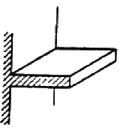
Performance of Optimum Profiles :
STRIP FINS
Heat dissipated by an optimal strip fin
$${\dot{Q}}_{b_{opt−fin}}=kδLmθ_{b}\tanh\left(β_{ff−opt}\right)$$
$${\dot{Q}}_{b_{opt−fin}}={\sqrt{\left(2hkδ\right)}L θ}_{b}\tanh\left(\text{1.4192}\right)$$
tanh (1.4192) = 0.8894
$${\dot{Q}}_{b_{opt−fin}}={0.3896\sqrt{\left(hkδ\right)} L θ}_{b}$$
Optimum fin thickness
$$δ_{opt}={\left[\frac{A_{p}}{1.4192}{\left(\frac{2h}{k}\right)}^{1/2}\right]}^{2/3}=0.7918{\left(\frac{2hA_{p}}{k}\right)}^{1/3}$$

Slide 6
Performance of Optimum Profiles
Rate of base cooling by the optimal fins
$${\dot{Q}}_{b−opt}=0.3896L\sqrt{\left(hk\right)}\left[0.7918{\left(\frac{2hA_{p}^{2}}{k}\right)}^{1/3}\right]θ_{b}$$
Optimal Profile area for a required rate of cooling at base:
$$A_{profile−opt}=\frac{0.5043}{h^{2}k}×{\left\{\frac{{\dot{Q}}_{base}}{{L θ}_{base}}\right\}}^{3}$$
$$η_{opt−fin}=62.7\%$$

Slide 7
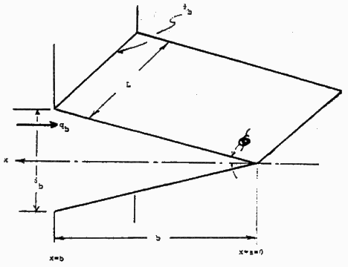
Longitudinal Fin of Triangular Profile
$$\frac{d\left(kA_{c}\frac{dT}{dx}\right)}{dx}−hP(T−T_{∞})=0$$
$$θ_{b}$$
L
x
q_{b}
$$φ$$
$$δ_{b}$$
$$A_{c}(x)=δL\frac{x}{b}$$
x=b
b
x=0
$$\frac{d\left(kδL\frac{x}{b}\frac{dT}{dx}\right)}{dx}−hP(T−T_{∞})=0$$
$\frac{kδL}{b}\frac{d\left(x\frac{dT}{dx}\right)}{dx}−hP(T−T_{∞})$=0
$$\frac{kδL}{b}\left\{x\frac{d^{2}T}{dx^{2}}+\frac{dT}{dx}\right\}−hP\left(T−T_{∞}\right)=0$$

Slide 8
Longitudinal Fin of Triangular Profile
$$\frac{kδL}{b}\left\{x\frac{d^{2}T}{dx^{2}}+\frac{dT}{dx}\right\}−hP\left(T−T_{∞}\right)=0$$
$$θ_{b}$$
L
The particular solution for
is:
x
q_{b}
$$φ$$
$$δ_{b}$$
x=b
b
x=a=0
The fin heat dissipation is:
$${\dot{Q}}_{b}=\left(2hθ_{b}\frac{L}{m}\right)\frac{I_{1}\left(2mb\right)}{I_{0}\left(2mb\right)}$$
The fin efficiency is:

Slide 9
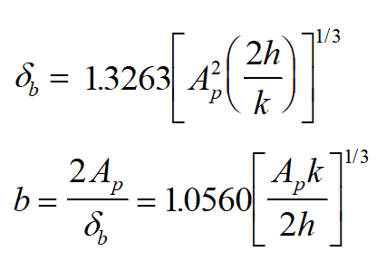
Optimum Geometry of Longitudinal Fin of Triangular Profile

Slide 10
Comparison of Longitudinal Fin Profiles
$$A_{profile−opt}=\frac{0.5043}{h^{2}k}×{\left\{\frac{{\dot{Q}}_{base}}{{L θ}_{base}}\right\}}^{3}$$
Rectangular Profile:
$$A_{profile−opt}=\frac{0.3471}{h^{2}k}×{\left\{\frac{{\dot{Q}}_{base}}{{L θ}_{base}}\right\}}^{3}$$
Triangular Profile:
For the same material, surrounding conditions and $\frac{{\dot{Q}}_{base}}{{L θ}_{base}}$, which is basically the user’s design requirement.
Triangular profile requires only about 68.8%
as much metal as rectangular profile.

Slide 11
n^{th} order Longitudinal Fins
$${ x}^{n}\frac{d^{2}θ}{dx^{2}}+nx^{n−1}\frac{dθ}{dx}−m^{2}b^{n}θ=0$$
$$m={\left(\frac{2h}{kδ_{b}}\right)}^{1/2}$$

Slide 12
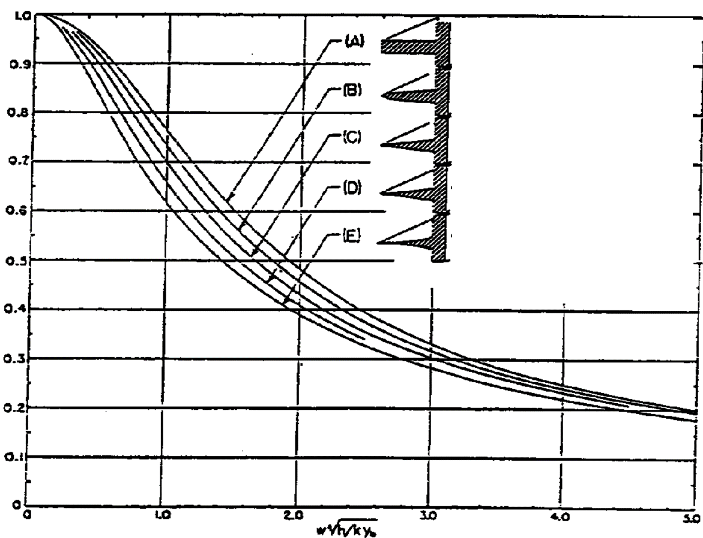
Performance of n^{th} order Longitudinal Fins
$$η_{fin}$$

Slide 13
Selection of Material for Longitudinal Fins
$$A_{profile−opt}=\frac{0.5043}{h^{2}k}×{\left\{\frac{{\dot{Q}}_{base}}{{L θ}_{base}}\right\}}^{3}$$
Rectangular Profile:
$$A_{profile−opt}=\frac{0.3471}{h^{2}k}×{\left\{\frac{{\dot{Q}}_{base}}{{L θ}_{base}}\right\}}^{3}$$
Triangular Profile:
Consider three materials:
$$ρ \left[{\text{kg}}/{m^{3}}\right]$$
$$k \left[W/{\text{mK}}\right]$$
Steel
Aluminum
Copper
7249
2704
8895
43.3
202.5
389.4

Slide 14
Selection of Material for Longitudinal Fins
Fin mass is proportional to A_{p}.
A_{p} is inversely proportional to thermal conductivity.
$$\frac{m_{material2}}{m_{material1}}∝\frac{\frac{ρ_{material2}}{k_{material2}}}{\frac{ρ_{material1}}{k_{material1}}}$$
$$m∝\frac{ρ_{material}}{k_{material}}$$
For given h, θ_{b}, and Q_{b}:
$$\frac{\text{ALUMINUM}}{\text{STEEL}}=\frac{\left(2704\right)\left(43.3\right)}{\left(7249\right)\left(202.5\right)}=0.080$$
$$\frac{\text{COPPER}}{\text{STEEL}}=\frac{\left(8895\right)\left(43.3\right)}{\left(7249\right)\left(389.4\right)}=0.136$$
$$\frac{\text{ALUMINUM}}{\text{COPPER}}=\frac{\left(2704\right)\left(389.4\right)}{\left(8895\right)\left(202.5\right)}=0.585$$

Slide 15
Comparison of Longitudinal Fin
In both fins, profile area varies as the cube of ${\left\{\frac{{\dot{Q}}_{base}}{{L θ}_{base}}\right\}}^{3}$
To double the heat flow, you use two fins
or make one fin eight times as large.
There is a virtue in using short stubby fins.

Slide 16
Fin Arrays & Additional Thermal Resistance

Slide 17
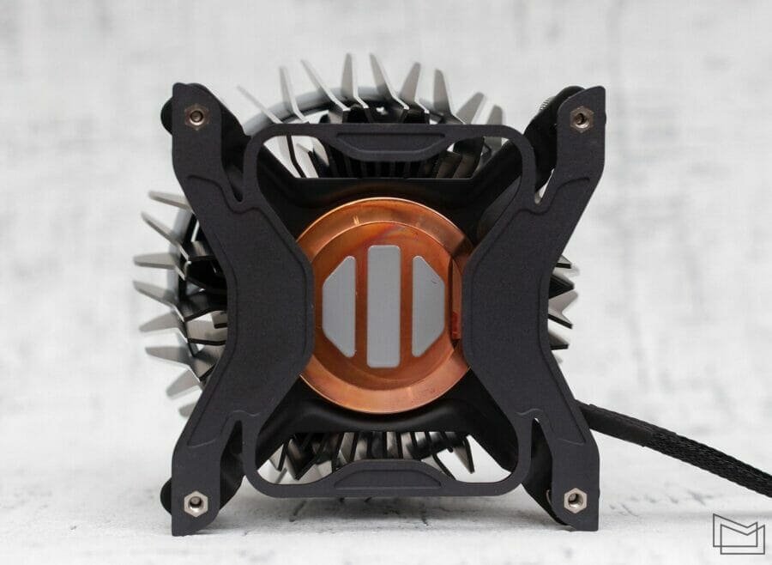
Heat Sink for i9 Processor

