Slide 1
Thermal Management of Electronics using Fin Array Systems
P M V Subbarao
Professor
Mechanical Engineering Department
Several Ants can kill A Powerful Cobra……

Slide 2
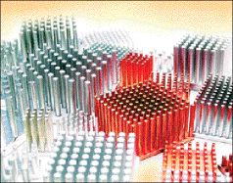
Heat Generation in A Processor is A Cobra

Slide 3
Comparison of Longitudinal Fin
In both fins, profile area varies as the cube of ${\left\{\frac{{\dot{Q}}_{base}}{{L θ}_{base}}\right\}}^{3}$
To double the heat flow, you use two fins
or make one fin eight times as large.
There is a virtue in using short stubby fins.

Slide 4
Fin Arrays & Additional Thermal Resistance

Slide 5
Basics of Fin Arrays
Natural Convection
Plate-Fin Arrays
Pins and Triangles
Forced Convection Plate
Fin Heat Sinks
analytical modeling and optimization
numerical modeling
Heat Sink Prototyping/manufacturing

Slide 6
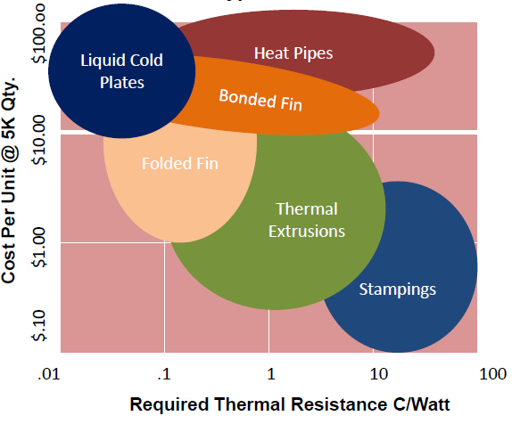
Cost of Heat Sinks

Slide 7
Prototyping of Heat Sinks
Thermal conductivity and cooling surface area must always be weighed against material and manufacturing costs.
Most heat sinks are made from aluminum, because of its low thermal resistance, light weight, and low cost.
Copper is also used for heat sinks; although lower in thermal resistance than aluminum, its cost and greater weight make it less desirable for many applications.
Stamped heat sinks made from a single sheet of metal, which is cut and bent to give the desired thermal properties.
Extruded heat sinks are very cost effective and provide good thermal performance.
Many basic shapes can be provided off-the-shelf.
Heat Sink Castings provide a cost-effective solution for high-volume, stable applications.

Slide 8
Prototyping of Heat Sinks
Bonded-fin heat sinks are made by bonding fins, fabricated from sheet metal or through extrusion, to an extruded base.
This process increases the surface area over a similar extruded piece, reducing the thermal resistance by A ^{1/2to 2/3}.
Folded-fin Heat Sinks are bonded-fin assemblies with complex fin shapes.
By folding the fins over themselves, these assemblies provide a large surface area in a confined space.

Slide 9
Heat Sinks: Special Terms and Definitions
Heat Load (W) = Amount of heat energy produced - Wattage. Usually defined as:
(voltage drop across device) x (current flowing through device)
Ambient Temperature (T_{amb}) Temperature of air immediately around Device to be cooled
Maximum Junction Temperature, (T_{jmax}), the maximum allowable temperature that the Device will see at its silicon junction

Slide 10
Division of Heat Sink Thermal Resistance
Thermal Resistance (R_{Θ}) (*C/W) – (Sometimes written as R_{th})
The resistance that the Heat Energy meets as its flows from hot, (Device) to cold, (Ambient).
Junction to the case of the package (supplied by manufacturer). R_{Θcs}
Thermal Resistance of the Thermal Interface Material, (TIM), used between Device and Heat Sink, R_{Θim}
R_{Θsa} = Thermal Resistance of the Heat Sink to the Ambient (surrounding air).

Slide 11
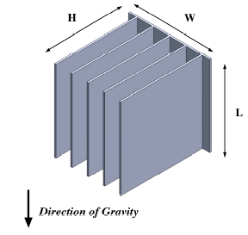
Natural Convection Cooled Fin Arrays (Heat Sinks)
Effective natural-convection-cooled heat sinks are vital to the future of electronics cooling as the demand low energy in comparison to other cooling methods.
The industry standard for a natural-convection-cooled heat sink usually involves a vertically oriented base-plate with an evenly spaced rectangular plate fin array.

Slide 12
Fin Arrays – Thermal Resistance
Processor manufacturer specifies maximum allowable module case temperature, T_{case}, and the module power dissipation.
Manufacturer also spefies interfacing paste specification as the thermal resistance at the module-to-heat sink interface, R_{int}.
The maximum allowable temperature at the heat sink attachment surface, T_{base}, is given by
T_{case}
T_{base}

Slide 13
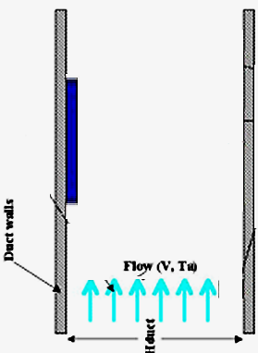
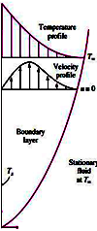
Temperature of A Hot Chip: Natural Convection
In Natural convection, the critical parameters include local ambient air temperature (T∞) and height of the plate.
The airflow duct cross-sectional area (W_{duct}, H_{duct}) donnot play an important role if they are not disturbing the convection.

Slide 14
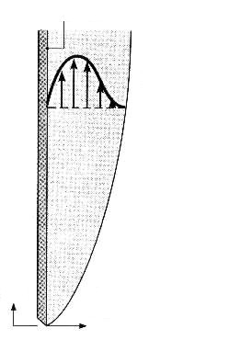
Laminar Free Convection on Vertical Surface
As y → ∞ : u = 0, T = T∞
As y → 0 : u = 0, T = T_{s}
With little or no external driving flow, Re ≅ 0 and forced convection effects can be safely neglects
u(x,y)
g
x
y
u
v

Slide 15
Empirical Correlations Natrual Convection
Typical correlations for heat transfer coefficient developed from experimental data are expressed as:
For Turbulent
For Laminar

Slide 16
Empirical Correlations Natrual Convection
Alternative applicable to entire Rayleigh number range (for constant Ts)

