Slide 1
Thermal Management of Electronics using Natural Convection Fin Array Systems
P M V Subbarao
Professor
Mechanical Engineering Department
Low energy Cooling Systems……

Slide 2
Natural Convection Cooled Fin Arrays (Heat Sinks)
Natural convection and radiation modes of heat transfer are commonly applied cooling techniques for electronic equipment of low to moderate power density.
The main advantages of natural convection are high reliability, low noise, and low power consumption.
Air movement in a naturally ventilated cabinet is induced by a pressure difference between the interior and exterior of the cabinet.
This pressure difference occurs due to a density gradient in the air, which produces a force that pushes the air upward and out.

Slide 3
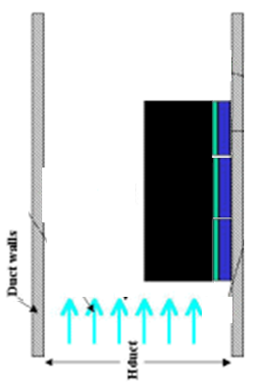
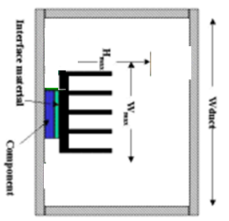
Best Orientation for Natural Convection Heat Sinks
View from Top

Slide 4
Orientation of Fins & Quantity of Convection Fluid Flow rate

Slide 5
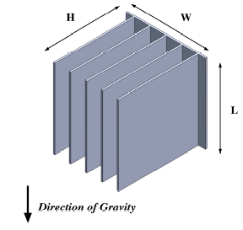
Thermal Resistance of Natural Convection Cooled Fin Arrays (Heat Sinks)
The maximum allowable heat sink resistance, R_{max-hs}, is then given by
$R_{max−hs}=\frac{T_{base}−T_{air−in}}{P_{processor}={\dot{Q}}_{diss}}$
The constructional details of a heat sink will decide the value of thermal resistance of a heat sink.
$R_{max−hs}=\frac{1}{h×\left(A_{base}+N_{fin}η_{fin}A_{fin}\right)}$
The parameter the gap, b, between the fins may be determined from
$b=\frac{W−N_{fin}t_{fin}}{N_{fin}−1}$

Slide 6
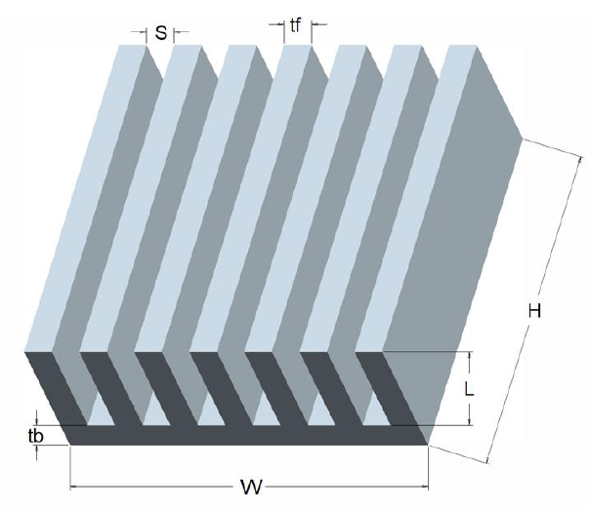
Natural Convection Analysis
The arrangement of fins in a heat sink creates a special fluid flow system.
This is classified as a natural convection fluid flow upward through the rectangular U-channels, or ducts, formed by the fins.
Elenbass (1942) carried out first analytical modelling of this special problem.
Elenbass found that optimal spacing for natural convection between isothermal parallel plates as:
$$S_{opt}=\frac{50×L}{Gr×Pr}$$
L
H

Slide 7
Natural Convection Analysis
Van De Pol and Tierney proposed modified Elenbass's equation for the U-channels formed by rectangular vertical fins.
Special characteristic dimension responsible for natural convection is defined as: $r=\frac{2HS}{H+S}$
The non-dimensional spacing factor is defined as: $a=\frac{S}{H}$
Special Raleigh number is defined for Natural Convection in a U-channel:${Ra}^{∗}=\frac{r}{L}×{Gr}_{r}×Pr$
$${Gr}_{r}=\frac{gβ\left(∆T\right)r^{3}}{ν^{2}}$$
L
H

Slide 8
Nusselt Number Correlation for Natural Convection in a U-Channel
${Nu}_{r}=\frac{{Ra}^{∗}}{Ψ}×\left\{1−e^{\left[−Ψ{\left(\frac{0.5}{{Ra}^{∗}}\right)}^{3/4}\right]}\right\}$
$Ψ=\frac{24\left(1−0.483e^{\frac{0.17}{a}}\right)}{{\left\{\left[1+\frac{a}{2}\right]\right\}×\left[1+\left(1−e^{−.83a}\right)×\left(9.14\sqrt{a}e^{−300S}−0.61\right)\right]}^{3}}$
S in mm only!
All physical properties except β are evaluated at the surface temperature;
β is evaluated at the ambient fluid temperature.
L
H

Slide 9
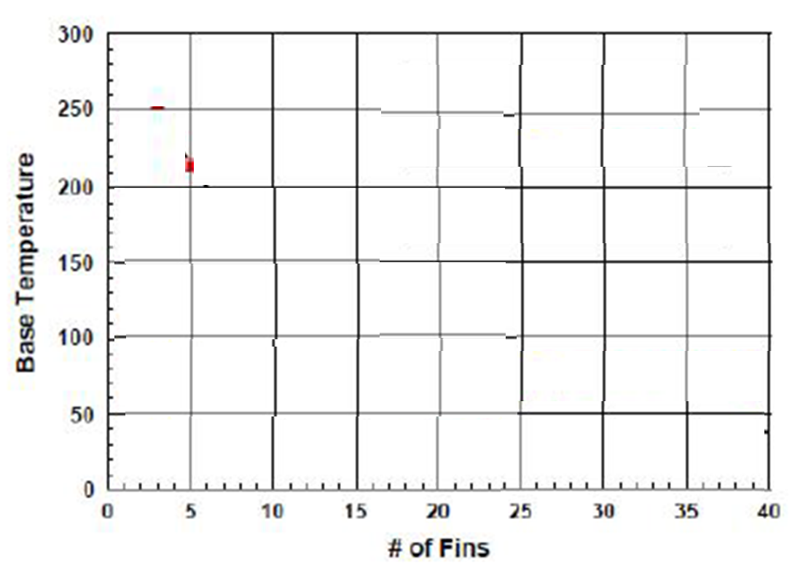
Effect of Number of Fins: Natural Convection Analysis
Heat Sink Base Temperature
Bulk Velocity of Convected fluid
Bulk temperature of hot fluid at the exit

Slide 10
Simplified Correlations
$h_{\text{opt}}=\frac{5k_{fluid}}{{4S}_{opt}}$
$S_{opt}={\left\{\frac{50Lν^{2}}{gβ\overline{θ}Pr}\right\}}^{0.25}$
$Where, \bar{θ}=η_{fin}θ_{base}$
Heat flow from each optimum fin:
$$\frac{\dot{Q}}{L}=1.258θ_{b}(h_{opt}^{2}A_{p}k)^{0.333}$$

Slide 11
Radiation correction to Simplified Correlations
$h_{\text{o}v}=h_{NC}+h_{rad}$
$h_{rad}=σε\frac{{\left(T_{base}+273\right)}^{4}−{\left(T_{∞}+273\right)}^{4}}{T_{base}−T_{∞}}$
Heat flow from each optimum fin:
$$\frac{\dot{Q}}{L}=1.258θ_{b}(h_{Ov}^{2}A_{p}k)^{0.333}$$

Slide 12
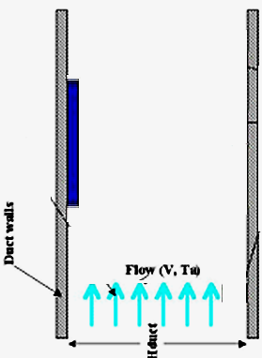
Temperature of Hot Chip: Forced Convection
In forced convection, the critical parameters include local upstream air temperature (T_{a}) and velocity (V)
The airflow duct cross-sectional area (W_{duct}, H_{duct}) play an important role in plate heat transfer.

Slide 13
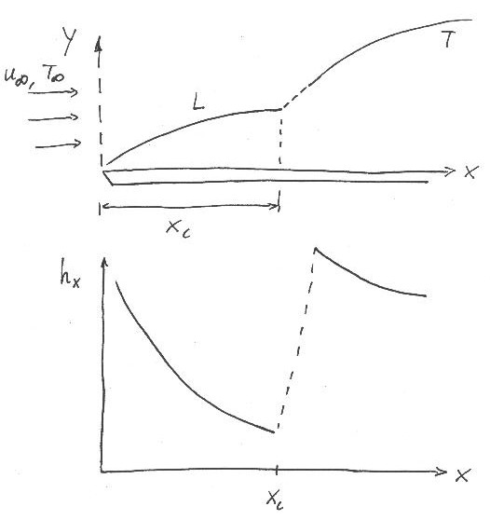
Flat Plate Boundary Layer Trasition
Important point:
Typically, a turbulent boundary layer is preceded by a laminar boundary layer first upstream
∴ need to consider case with mixed boundary layer conditions!
$${\bar{h}}_{x}=\frac{1}{L}\left[\int_{0}^{xc}{h_{lam}dx }+\int_{xc}^{L}{h_{turb}dx }\right]$$

Slide 14
Flat Plate Boundary Layer Trasition
Leading
Edge
X_{c}
Trailing
Edge
L
$$h_{avg,L}=\frac{1}{L}\left\{\int_{0}^{x_{c}}{h_{lam,x}dx}+\int_{x_{c}}^{L}{h_{turb,x}dx}\right\}$$

Slide 15
Correlations for Flat Plate Boundary Layer
: Forced Convection Cooling
For a smooth flat plate: Re_{xc} = 5 X 10⁵
$$Nu_{avg,L}=\left[0.037{Re}_{L}^{4/5}{−}871\right]pr^{1/3}$$
For very large flat plates: L >> X_{c}, in general for Re_{L} > 10⁸
$$Nu_{avg,L}=0.037{Re}_{L}^{4/5}{p}r^{1/3}$$

Slide 16
Rig For Performance Evaluation of Heatsink
View from Top

