Slide 1
Thermal Management of Electronics using Forced Convection Fin Array Systems
P M V Subbarao
Professor
Mechanical Engineering Department
Externally Driven and Controlled Cooling Systems……

Slide 2
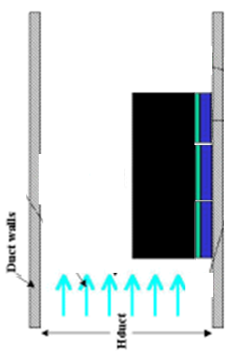
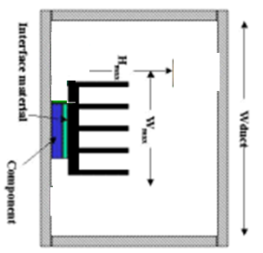
Rig For Performance Evaluation of A Heatsink
View from Top

Slide 3
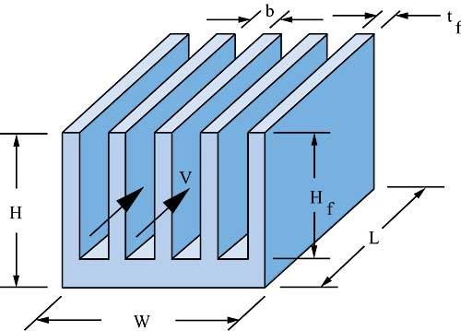
Design of Forced Convection Heat Sinks
Analytical modeling
Maximization of heat dissipation
Least-material optimization
Design for manufacture

Slide 4
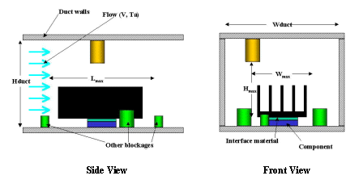
Geometrical & Thermal Design Constraints
In forced convection, the critical parameters for heat sink design include local upstream air temperature (T_{a}) and velocity (V)
The airflow duct cross-sectional area (W_{duct}, H_{duct}) play an important role in heat sink design.

Slide 5
Geometrical & Thermal Design Constraints
The most important factor for the airflow available is the maximum volume the heat sink can occupy.
W_{max}, L_{max}, and H_{max}
The design must accommodate the component specifications, such as the power dissipated (P) and the maximum junction temperature (T_{jmax}).
The maximum heat sink weight, also play a role in the design.
Another important factor during the design phase is the maximum allowable cost of the thermal solution

Slide 6
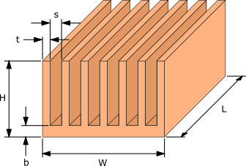
Design Calculations for Fin Arrays – Thermal Resistance
$$T_{base}=T_{case}−{qint}_{mod}$$
$$H_{fin}=H−b$$
T_{base}
R_{int}
T_{case}

Slide 7
Design Calculations for Fin Arrays – Thermal Resistance
The maximum allowable heat sink resistance, R_{max}, is then given by
$$R_{max,{t}h}=\frac{T_{base}−T_{air,in}}{q_{mod}}$$
The thermal resistance of the heat sink is given by
$$R_{\text{heat} \text{sink}}=\frac{1}{h\left(A_{base}+N_{fin}η_{fin}A_{fin}\right)}$$
The gap, S, between the fins may be determined from
$$S=\frac{W−N_{fin}.δ_{fin}}{N_{fin}−1}$$

Slide 8
Forced Convection in A U Channel
The velocity of the air flow between the fins (U-Channel) decides the value of heat transfer coefficient.
This velocity and fin spacing will also decide the flow regime.
The bulk mean flow velocity in a fin spacing (U-Channel) is estimated using:
$v_{f}=\frac{\dot{V}}{H_{fin}×\left(N_{fin}−1\right)S}$
$\dot{V} ,$the volume flow rate of the air approaching the heat sink is the same as the volume flow rate of the air passing through the heat sink!
The smaller the fin spacing,S the higher the velocity of air, V_{f} flowing between the fins.

Slide 9
Constraint on Fin Spacing
The smaller the fin spacing,S the higher the velocity of air, v_{flow} flowing between the fins.
The higher the air velocity the more effective the cooling of the fins.
A hypothetical effort to optimize the heat sink dimensions the spacing between the fins would be a very small value since the air velocity and hence rate of cooling increases with decreasing fin spacing.
In real world applications the flow is supplied by a fan or blower.
The flow rate would not be fixed, it would be limited by the increase in pressure drop across the heat sink that would occur as the spacing between the fins, S decreases.

Slide 10
Characteristics of Fan & Heat Sink Pair
The first step in designing a heat sink is to determine the operating point of the fan and heat sink combination.
When a fan or blower is paired with a heat sink the performance of the fan will depend on the design of the heat sink.
Every fan has a unique pressure/flow rate performance curve in which the flow rate is inversely proportional to the pressure drop across the fan.
Heat sinks demand a flow rate performance curve that is the pressure drop across the heat sink is proportional to nearly square of the flow rate.
The resulting flow rate through a fan/heat sink combination is the intersection of the fan and heat sink pressure/flow rate curves.

Slide 11
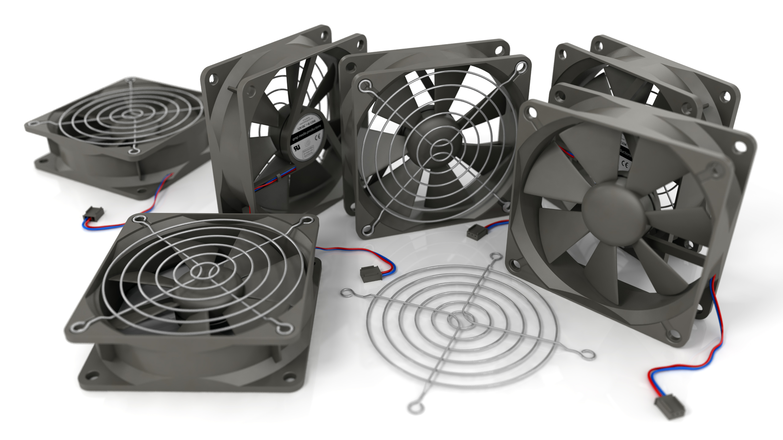
Testing of Fans

Slide 12
Fan Characteristic Curve

Slide 13
Flow Characteristics of A Heat Sink
The fan curves are typically provided by the fan manufacturer and are often quite non-linear.
This information is not enough to fix the flow rate in a heat sink.
Viscous fluid mechanics of heat sink is necessary to fix the flow rate.
The equation for the pressure drop across the heat sink is given by equation:
${∆p}_{heat−sink}=\left(K_{entrance}+4\frac{f_{app}L}{D_{h}}+K_{exit}\right)×\frac{ρv_{f}^{2}}{2}$
The density of the air ρ is calculated the at the ambient air temperature.

Slide 14
Flow Characteristics of A Heat Sink
${∆p}_{heat−sink}=\left(K_{entrance}+4\frac{f_{app}L}{D_{h}}+K_{exit}\right)×\frac{ρv_{f}^{2}}{2}$
The density of the air ρ is calculated the at the ambient air temperature.
The variables K_{entrance} and K_{exit} are the pressure loss coefficients due to sudden entry and sudden exit respectively of the air as the flow enters and exits the heat sink.
The hydraulic diameter of the passage between the fins D_{h} can be approximated as 2S.

Slide 15
Flow resistance of A Heat Sink
General equations for pressure loss coefficients are a function of the frontal area and blockage factor.
Define blockage factor as
$σ=\frac{S}{S+t_{fin}}$
$K_{entrance}=0.4×\left(2−σ^{2}\right)$
$K_{exit}=\left(1−{2.4σ+σ}^{2}\right)$

Slide 16
Friction Factor for Open Channel Flows
$${∆p}_{heat−sink}=\left(K_{entrance}+4\frac{f_{app}L}{D_{h}}+K_{exit}\right)×\frac{ρv_{f}^{2}}{2}$$
Open Channel flows are very common in civil engineering applications.
Friction factor for fully developed open channel flow is:
$f{Re}_{Dh}=\frac{24}{{\left[1+\frac{S}{H_{f}}\right]}^{2}×\left[1−\frac{195S}{π^{5}H_{f}}tanh\left(\frac{πH_{f}}{2S}\right)\right]}$
${Re}_{Dh}= \frac{v_{flow}D_{h}}{ν}$

Slide 17
Apparent Friction Factor for Developing flow in U-Channel
The fully developed flow in a U-Channel i.e., fully developed fully developed flow is valid for very long Channels, where velocity profile remains constant along flow direction.
Heat sink length is generally much smaller than fully developed length.
S. Muzychka and M. M. Yovanovich (1996) developed a model to predict friction factors in non-circular ducts for developing laminar flow as:
$$f_{apparent}=\frac{\sqrt{\left[{\left(\frac{3.44}{\sqrt{L^{∗}}}\right)}^{2}+{\left(f{Re}_{Dh}\right)}^{2}\right]}}{\left(f{Re}_{Dh}\right)}$$

Slide 18
Matching of Fan & Heat Sink Pair
To determine the operating point of the fan/heat sink pair, fan characteristic curve must be equated to heat sink flow characteristic equation.
$∆p_{developed−by−fan}−∆p_{loss−in−heat sink}=0$

Slide 19
Fan and Heat Sink Pair
Fan Flow Curve
Heat Flow Curve

Slide 20
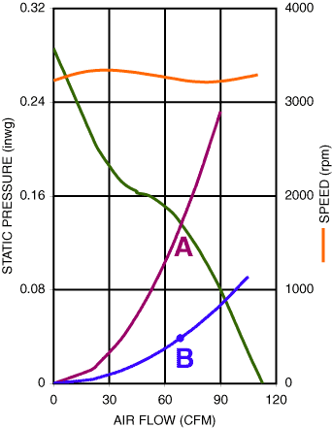
Fan and Heat Sink Pairs

Slide 21
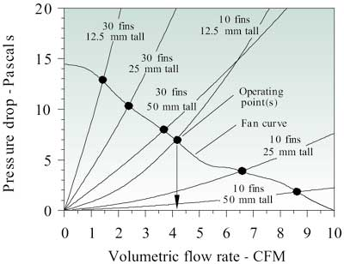
Type of fin Vs Operation Point

Slide 22
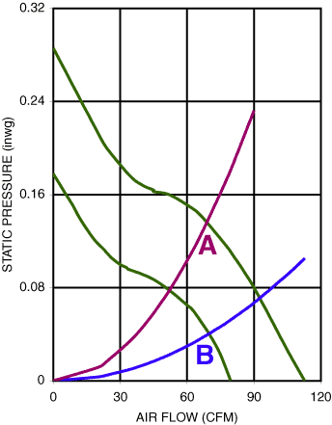
Effect of Changing A Fan

Slide 23
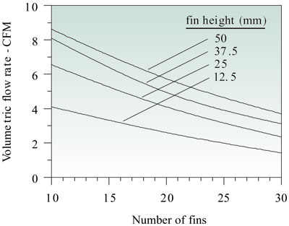
Effect of number of fins and fin height

Slide 24
Optimizing the fin spacing
The spacing between the fins that provides the maximum rate of heat transfer, s_{opt} is calculated using equation 9 in which μ and α are the viscosity and thermal diffusivity of air respectively.
A. Bejan and E. Sciubba (1992) developed an equation for optimal spacing:
$$S_{opt}=2.73\frac{μα\sqrt{L}}{∆p_{fan}}$$
μ and α are the viscosity and thermal diffusivity of air respectively.
The optimum fin spacing, s_{opt} is a function of the pressure drop across the fan, ΔP_{fan} and hence the heat sink, ΔP_{hs}.
The pressure across the system determines the flow rate through the heat sink.

Slide 25
Conjugate Model for Thermal Resistance of A Heat Sink
P. M. Teertstra, M. M. Yovanovich, J. R. Culham, and T. F. Lemczyk (1999) developed an analytical equation for forced covenction heat transfer in plate fin heat sinks.

Slide 26
Conjugate Model for Thermal Resistance of A Heat Sink
${Nu}_{u−c}= {\left[{\left(\frac{{Re}_{S}^{∗}Pr}{2}\right)}^{−3}+{\left(0.664\sqrt{{Re}_{S}^{∗}} {pr}^{1/3}×\sqrt{1+\frac{3.65}{\sqrt{{Re}_{S}^{∗}}}}\right)}^{−3}\right]}^{{−1}/3}$=

Slide 27
Thermal Resistance of Heat Sink under Forced Convection Cooling
The Nusselt Number based on conjugate heat transfer is:
${Nu}_{hs}=\frac{tanh\left\{\sqrt{2{Nu}_{u−c}\frac{k}{k_{f}} \frac{H_{f}}{S_{opt}} \frac{H}{t_{fin}}} \left(\frac{t_{fin}}{L}+1\right)\right\}}{\sqrt{2{Nu}_{u−c}\frac{k}{k_{f}} \frac{H_{f}}{S_{opt}} \frac{H}{t_{fin}}} \left(\frac{t_{fin}}{L}+1\right)}×{Nu}_{u−c}$
The average heat transfer coefficient, h_{fhs} from the heat sink fins is calculated using above equation.
$h_{hs}=\frac{{Nu}_{hs}k_{f}}{S_{opt}}$

Slide 28
Total Thermal Resistance of A Heat Sink including Base
$R_{hs−tot}=\frac{1}{h_{hs}A_{hs}}+\frac{b}{k_{hs}WL}$
$$A_{hs}=L\left(S_{opt}+2H_{f}\right)×\left(N_{fin}−1\right)$$

Slide 29
Effect of Constant air velocity on Performance of Longitudinal Fin Array

Slide 30
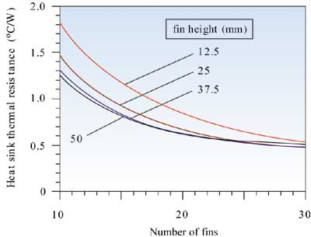
Constant Volumetric Flow Rate

Slide 31
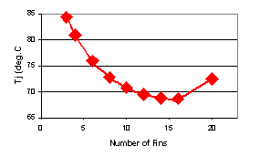
Junction Temperature Vs Number of Fins
For a selected Fan

Slide 32
Thermal Resistance

Slide 33
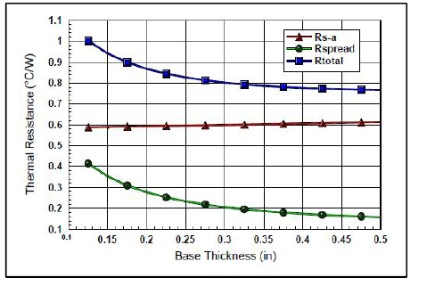
Forced Convection w/Spreading at Specific Airflow

Slide 34
Cooling Medium
Adding a fan to any heat sink changes from passive cooling, using ambient airflow, to active cooling.
Adding a fan to a typical heat sink almost always improves thermal performance.
A 50 mm square heat sink with 12 mm height, for example, has a thermal resistance of 5 °C/W with natural convection. Adding a fan drops this resistance to 1.2 °C/W.
Most demanding applications use liquid cooling in place of air cooling further improves heat sink performance.
To dissipate 1000 watts of heat with a 10 °C temperature rise would take thousands of times less volumetric water flow than airflow.
Liquid cooling can dissipate more heat with considerably less flow volume,
maintain better temperature consistency, and do it with less local acoustic noise.

