Slide 1
Selecting the Right Heat Sink for your Design – Steps for Heat Sink Calculation and Selection
P M V Subbarao
Professor
Mechanical Engineering Department
Design Level – 1

Slide 2
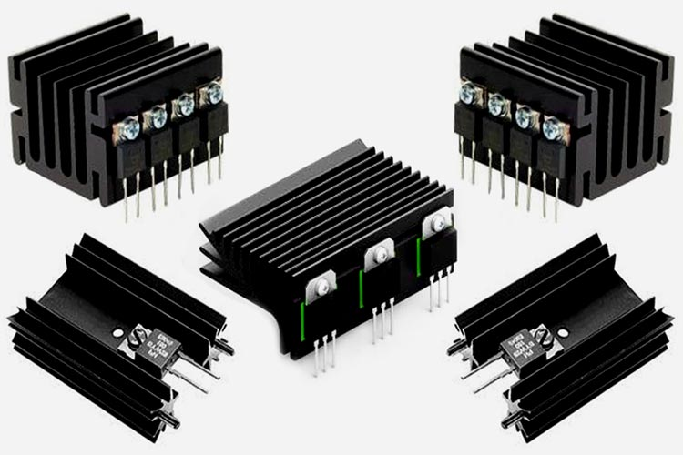
Heat Sinks for Low Power Electronic Processors

Slide 3
Major Heat Sink Design Consideration factors
Device Operating Temperature Range (Ambient Temperature)
System IP Rating
Product Size
System Cost
Availability of Convection mode cooling options
Insulation/Isolation Requirements
Component Package

Slide 4
Step 1: Determine Power Dissipation by the Device:
The first step to determine the Heat Sink design is to determine how much power is dissipated from the Semiconductor device.
There are different methodologies applied to calculate the Power Loss in the Semiconductor device.
The device power dissipation can be easily calculated for Linear Power Supplies.

Slide 5
LM 317 : Voltage Regulator
LM317: Design output Specification are 5V @ 0.5A for maximum input of 12V.
The power dissipated by LM317 is → (12-5) × 0.5 = 3.5W.

Slide 6
Thermal resistance values from the Datasheet
The maximum operating virtual junction temperature Tj = 125˚C.
∴Under any operating conditions, the Tj should be managed below 125˚C.

Slide 7
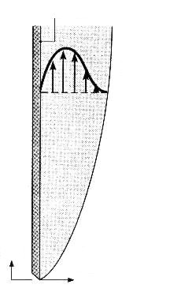
Natural Convection Heat Transfer from Surface of LM317
u(x,y)
g
x
u
y
v
For Turbulent
For Laminar

Slide 8
Natural Convection Heat Transfer from Surface of LM317
u(x,y)
g
x
u
y
v
$$hA\left(T_{s}−T_{∞}\right) ∝ P_{diss}$$
$$\frac{1}{hA} ∝ P_{diss}^{−n}$$
$$h ∝ P_{diss}^{n}$$
$$hA ∝ P_{diss}^{n}$$

Slide 9
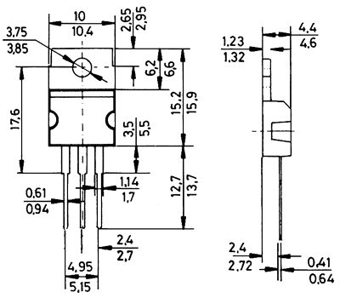
Thermal Resistances of LM 317
u(x,y)
g
x
u
y
v

Slide 10
Natural Convection Cooling of LM 317 w/o Heat ink
After Obtaining the maximum junction temperature rating, it is important to determine the thermal resistance of the device.
In order to determine the thermal resistance, we have to finalize which type of package is used for our design.
If the designer is determined to use the TO-220 package, the Junction-to-ambient thermal resistance R_{th}(JA) = 50˚C/W.

Slide 11
Need for a Heat Sink
The maximum junction temperature without a heat sink can be calculated as:
$T_{junction}=T_{amb}+R_{th}×P_{diss}<\text{125˚}\text{C}$
Maximum allowable ambient temperature w/0 heat sink.
The maximum junction temperature is:
$T_{amb}+50×3.5=\text{125˚}\text{C}$
If the device is used without a heat sink, the maximum allowable ambient temperature is -50˚C!
In general, the operational junction temperature must be less than the maximum allowable junction temperature.

Slide 12
Need for a Heat Sink
The maximum junction temperature without a heat sink can be calculated as:
$T_{junction}=T_{amb}+R_{th}×P_{diss}$
For an ambient temperature of 35˚C
The maximum junction temperature is:
$T_{junction−max}=35+50×3.5$ = 210 ˚C
If the device is used without a heat sink, the maximum junction temperature of the device reaching 210˚C.
This should be reduced below 125˚C and hence the Heat Sink should be used.

Slide 13
Selection of A Heat Sink

Slide 14
Thermal Compounds, Adhesives and Interface Materials

Slide 15
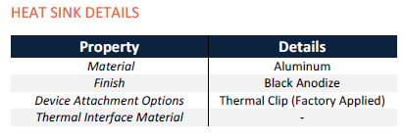
AAVID : Board Level Cooling – Channel 7021

Slide 16
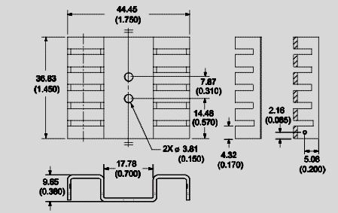
AAVID : Board Level Cooling – Channel 7021

Slide 17
LM317 Mounted on Heat Sink
$$T_{base}=f\left(P_{diss}\right)$$

Slide 18
Base Temperature of Heat Sink: 7021

Slide 19
Target Junction Temperature:
As per the datasheet Value, the maximum allowed Junction temperature is 125˚C.
But, to improve efficiency and product lifetime, 80% of the max rating is preferred in the industry.
So, the target Junction temperature can be 100˚C.
The target junction temperature rating varied based on the applications.

Slide 20
Selection of Maximum Ambient Temperature:
Different electronics products will operate in different environments.
Some systems will operate in fully air-conditioned units, some systems used in exposed open areas, and some of them placed near hot machinery.
So, based on the environmental conditions, the designer has to identify and choose the system working environment conditions and choose the maximum ambient temperature.
Here the LM317 is used in indoor applications and the maximum ambient temperature is taken as 35˚C.

Slide 21
Allowable Thermal Resistance Value
Based on previous discussions, the required thermal resistance of the whole system can be calculated using the below relation.

