Slide 1
Selecting the Right Heat Sink for your Design – Steps for Heat Sink Calculation and Selection - 3
P M V Subbarao
Professor
Mechanical Engineering Department
Design Level – 2to 3

Slide 2
Intel GMA 3100 Graphics Card
Dimensions: 9.9 mm × 10.20 mm
Thermal power dissipation: 13W
Maximum allowable Junction temperature: 125°C
Junction to casing resistance: 2.5°C/W

Slide 4
Thermal Compounds, Adhesives and Interface Materials

Slide 5
First Choice of Natural Convection Heatsinks
https://wakefieldthermal.com/content/data_sheets/2021_data_sheets/Wakefield-Thermal-Extrusion-Profile-Guide.pdf

Slide 6
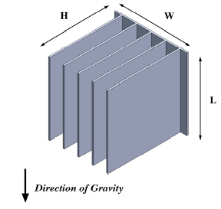
Natural Convection Cooled Fin Arrays (Heat Sinks)

Slide 7
Standard Extruded Heatsink Data Sheet
General Rule Natural Convection use Thin Fins – ~0.050”-0.060” Thickness (Flow velocity ∼ 2.5 cm/s
General Rule Forced Convection use Thicker Fins - ~0.060”-0.100” Thickness
Consider Adding Serrated-Fins to Increase Surface Area and Reduce Heat Sink
Thermal Resistance – 20-30% of the total thermal resistance can typically be achieved.

Slide 8
Length Correction Factor

Slide 9
Length Correction

Slide 10
Temperature Correction Factor
As ΔT Decreases, the Heat Sink Efficiency Decreases…

Slide 11
Natural Convection Heat Sinks

Slide 13
Thermal Resistance of Natural Convection Cooled Fin Arrays (Heat Sinks)
The maximum allowable heat sink resistance, R_{max-hs}, is then given by
$R_{max−hs}=\frac{T_{base}−T_{air−in}}{P_{processor}={\dot{Q}}_{diss}}$
The constructional details of a heat sink will decide the value of thermal resistance of a heat sink.
$R_{max−hs}=\frac{1}{h×\left(A_{base}+N_{fin}η_{fin}A_{fin}\right)}$
The parameter the gap, b, between the fins may be determined from
$b=\frac{W−N_{fin}t_{fin}}{N_{fin}−1}$

Slide 14
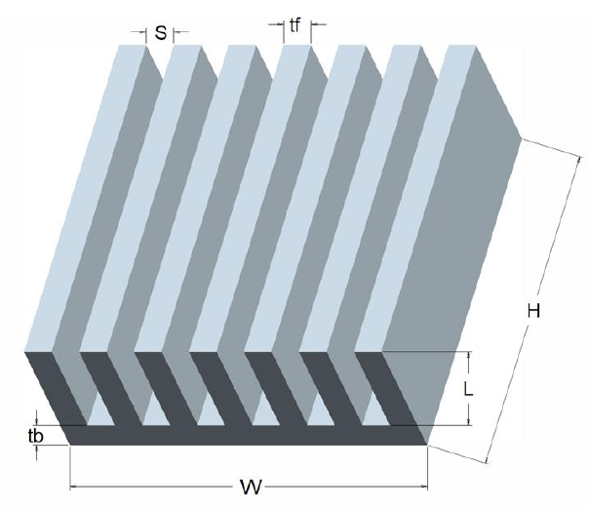
Natural Convection Analysis
The arrangement of fins in a heat sink creates a special fluid flow system.
This is classified as a natural convection fluid flow upward through the rectangular U-channels, or ducts, formed by the fins.
Elenbass (1942) carried out first analytical modelling of this special problem.
Elenbass found that optimal spacing for natural convection between isothermal parallel plates as:
$$S_{opt}=\frac{50×L}{Gr×Pr}$$
L
H

Slide 15
Natural Convection Analysis
Van De Pol and Tierney proposed modified Elenbass's equation for the U-channels formed by rectangular vertical fins.
Special characteristic dimension responsible for natural convection is defined as: $r=\frac{2HS}{H+S}$
The non-dimensional spacing factor is defined as: $a=\frac{S}{H}$
Special Raleigh number is defined for Natural Convection in a U-channel:${Ra}^{∗}=\frac{r}{L}×{Gr}_{r}×Pr$
$${Gr}_{r}=\frac{gβ\left(∆T\right)r^{3}}{ν^{2}}$$
L
H

Slide 16
Nusselt Number Correlation for Natural Convection in a U-Channel
${Nu}_{r}=\frac{{Ra}^{∗}}{Ψ}×\left\{1−e^{\left[−Ψ{\left(\frac{0.5}{{Ra}^{∗}}\right)}^{3/4}\right]}\right\}$
$Ψ=\frac{24\left(1−0.483e^{\frac{0.17}{a}}\right)}{{\left\{\left[1+\frac{a}{2}\right]\right\}×\left[1+\left(1−e^{−.83a}\right)×\left(9.14\sqrt{a}e^{−300S}−0.61\right)\right]}^{3}}$
S in mm only!
All physical properties except β are evaluated at the surface temperature;
β is evaluated at the ambient fluid temperature.
L
H

Slide 17
Forced Convection Heat Sinks

