Slide 1


Advanced Heat Sinks for Thermal Management of High-Power Electronics
P M V Subbarao
Professor
Mechanical Engineering Department
Principle of Sweating for cooling of A Body …

Slide 2

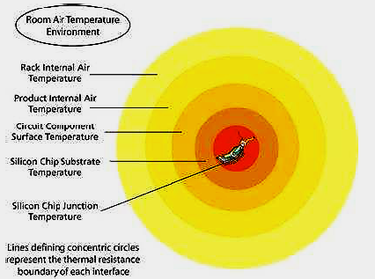
Thermal Boundaries or Gradients in Hot Chip with Air as A Coolant

Slide 3
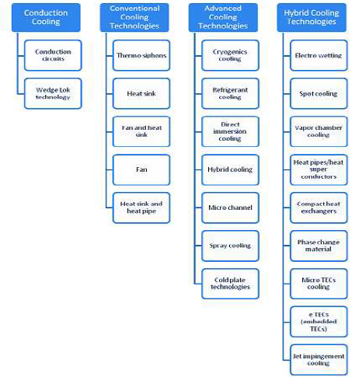
Current & Future Cooling Technologies for Thermal Management

Slide 4
Vapor chambers
The property of excellent thermal conductance obtainable by a two-phase liquid as heat transfer medium has boosted the use of sweating heat sinks consumption across many industrial related applications.
One of such simple heat sink is known as Vapor Chamber Heat Sink.

Slide 5
Principle of Thermal Management thruVapor chambers
When vapour chamber device is close to a heat source the working fluid absorbs heat and converts into vapours which increases localized vapour pressure.

Slide 6
Principle of Thermal Management thruVapor chambers
This increase in vapour pressure acts as driving force, which drives vapours to go to a low pressure condenser region where the heat is removed and vapours are again converted back to liquid state.

Slide 7
Principle of Thermal Management thruVapor chambers
By taking benefits of the very useful phase-change heat transfer mechanism across the liquid-vapour
interfaces, this heat transportation process takes place almost under isothermal environment at
a small saturation pressure variation

Slide 8
Thermal Conductance of Vapor chambers
Material Thermal Conductivity (W/m.°C)
Vapor Chambers 50,000-200,000
Diamond 2000
Copper 386
Aluminium 180

Slide 9
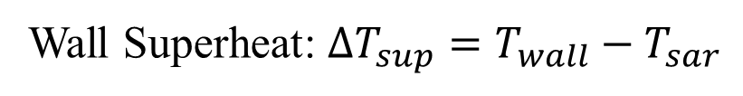
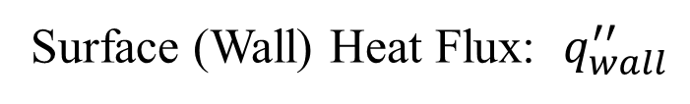
Basic Parameters to Define Boiling in Vapor chambers
Surface (Wall) Heat Flux: $q_{wall}^{′′}$
Wall Superheat: ${∆T_{sup}=T}_{wall}−T_{sar}$

Slide 10
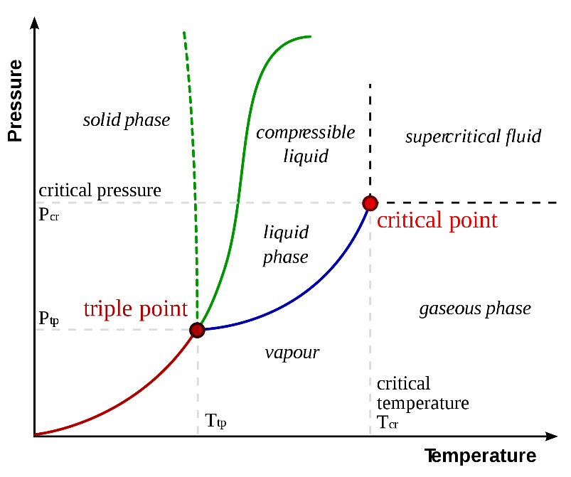
Pressure-Temperature Curves

Slide 11
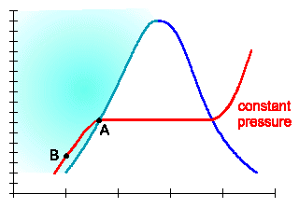
Saturation Dome for Boiling
T, °C
Specific Enthalpy, h (kJ/kg)

Slide 12
Saturation Properties of Water
Temperature | Pressure | Specific Volume, m3/kg |  | v_{g}/v_{f}
⁰C | MPa | Saturated Liquid v_{f} | Saturated Vapour v_{g}
100 | 0.1013 | 0.001044 | 1.673 | 1602.5
120 | 0.1985 | 0.00106 | 0.8919 | 841.4
150 | 0.4759 | 0.00109 | 0.3928 | 360.4
200 | 1.554 | 0.001156 | 0.1274 | 110.2
250 | 3.973 | 0.001251 | 0.05013 | 40.1
300 | 8.581 | 0.001404 | 0.02167 | 15.4

Slide 13
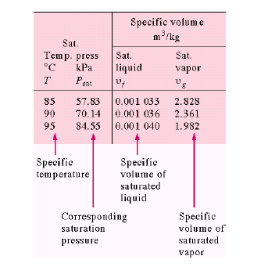
Saturation Properties of Water
v_{g}/v_{f}
2738
2279
1906

Slide 14
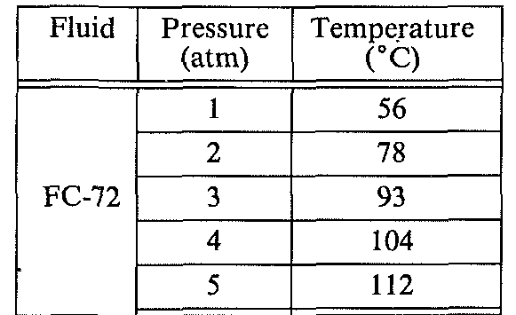
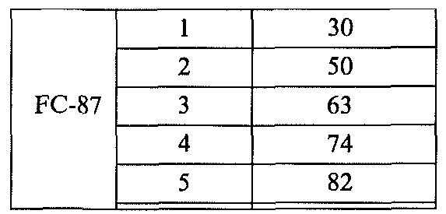
3M™ Fluorinert™ Electronic Liquids

Slide 15
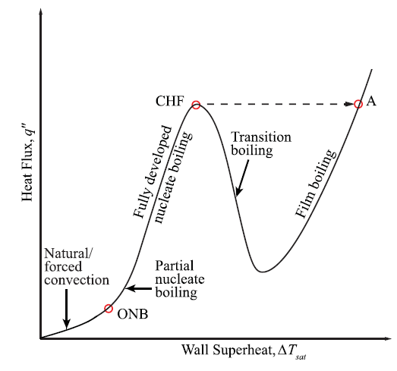
The Boiling Curve

Slide 16
Critical Heat Flux in Vapour Chambers
The microelectronics and power electronics industries are now facing the challenge of removing very high heat fluxes of 300 W/cm² or more.
The challenge is more tough, while maintaining chip operating temperature below the targeted temperature, such as 85°C for CPUs.
Critical heat flux (CHF) refers to the value of heat flux at which there is a sharp drop in local heat transfer coefficient
This is due to the replacement of liquid by vapor adjacent to the heat transfer surface.
Cooling systems for microprocessor chips and power electronics, knowledge of the CHF is essential.

Slide 17
Critical Heat Flux
This knowledge helps in determining the upper operating limit of the cooling system for safe operation.
Two-phase flow boiling in microchannels seems to be the most promising approach.
An understanding of micro-channel Critical Heat Flux (CHF) is needed to determine the maximum heat dissipation rates and safe operating limit of electronic systems.

Slide 18
POOL BOILING
Pool boiling is the process in which the heating surface is exposed to a large body of stagnant liquid.
The relative motion of the vapor produced and the surrounding liquid near the heating surface is primarily due to the buoyancy effect of the vapor.
Nevertheless, the body of the liquid as a whole is essentially at rest.
Though the study on the boiling process can be traced back to as early as the eighteen century, the extensive study on the effect of the very large difference in the temperature of the heating surface and the liquid, ΔT, was first done by Nukiyama (1934).

Slide 19
Onset of Nucleate Boiling
Vapor may form from a liquid
(a) at a vapor-liquid interface away from surfaces,
(b) in the bulk of the liquid due to density fluctuations, or
(c) at a solid surface with pre-existing vapor or gas pockets.
In each situation one can observe the departure from a stable or a metastable state of equilibrium.

Slide 20
Onset of Nucleate Boiling
The first physical situation can occur at a planar interface when the liquid temperature is fractionally increased above the saturation temperature of the vapor at the vapor pressure in the gas or vapor region.
Thus, the liquid "evaporates" into the vapor because its temperature is maintained at a temperature minimally higher than its vapor "saturation" temperature at the vapor system pressure.
Evaporation is the term commonly used to describe such a situation which can also be described on a microscopic level as the imbalance between molecular fluxes at these two distinctly different temperatures.

Slide 21
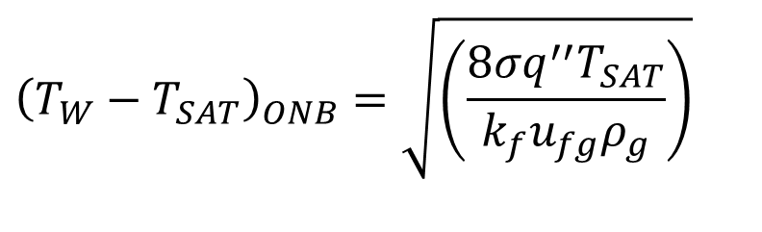
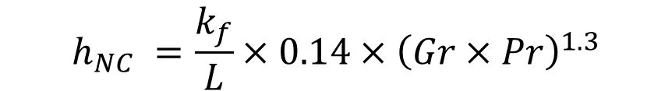

Model for Prediction of ONB
$${\left(T_{W}−T_{SAT}\right)}_{ONB}=\sqrt{\left(\frac{8σq^{′′}T_{SAT}}{k_{f}u_{fg}ρ_{g}}\right)}$$
To find the particular heat flux and superheat pair natural convection mode of heat transfer that would exist prior to boiling is considered.
$$q_{ONB}^{′′}=h_{NC}\left(T_{wall}−T_{sat}\right)$$
Where
$$h_{NC} =\frac{k_{f}}{L}×0.14×{\left(Gr×Pr\right)}^{1.3}$$
For water at atmospheric pressure this model predicts an “Onset of Nucleate Boiling" for a superheat less than 1⁰C, with a cavity size of about 50 microns.
In practice the superheat may be as high as 10⁰C for very smooth, clean metallic surfaces.

Slide 22
Pool Boiling Critical Heat Flux
Critical heat flux (CHF) in pool boiling is an interesting phenomenon.
If one controls the input heat flux, there comes a point where the heat flux is increased further the heater surface temperature undergoes a drastic increase.
This increase originally was not well understood.
Kutateladze (1951) offered the analogy that this large abrupt temperature increase was caused by a change in the surface geometry of the two phases.
In fact, Kutateladze first empirically correlated this phenomenon as analogous to a gas blowing up through a heated porous plate cooled by water above it.
At a certain gas volumetric flow rate (or superficial velocity, ) the liquid ceases to contact the heated surface and the gas forms a continuous barrier.

Slide 23
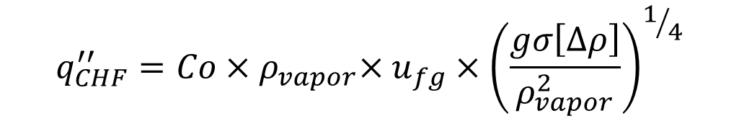
Model for CHF in Pool Boiling
$$q_{CHF}^{′′}={Co{×ρ}_{vapor}×u}_{fg}×{\left(\frac{gσ\left[∆ρ\right]}{ρ_{vapor}^{2}}\right)}^{1/4}$$
where the constant, Co, is found to be in the range of 0.12 to 0.18.

Slide 24
Film Boiling and the Minimum Film
Boiling Point
Once the critical heat flux is exceeded the heater surface is blanketed by a continuous vapor film; i.e., film boiling.
Under this condition one must find the heat transfer resistance of this vapor film as well as consider the additional effect of radiation heat transfer at very high heater surface temperatures through this vapor film (> 1000⁰ C).
Bromley (1950) used the approach first developed by Nusselt for film condensation to predict the film boiling heat transfer coefficient for a horizontal tube

Slide 25
Structure of Vapor Chamber

