Slide 1
Structure of Vapor Chambers for Thermal Management of High-Power Electronics
P M V Subbarao
Professor
Mechanical Engineering Department
Evaporative Cooling of Hot Chip Casing…

Slide 2
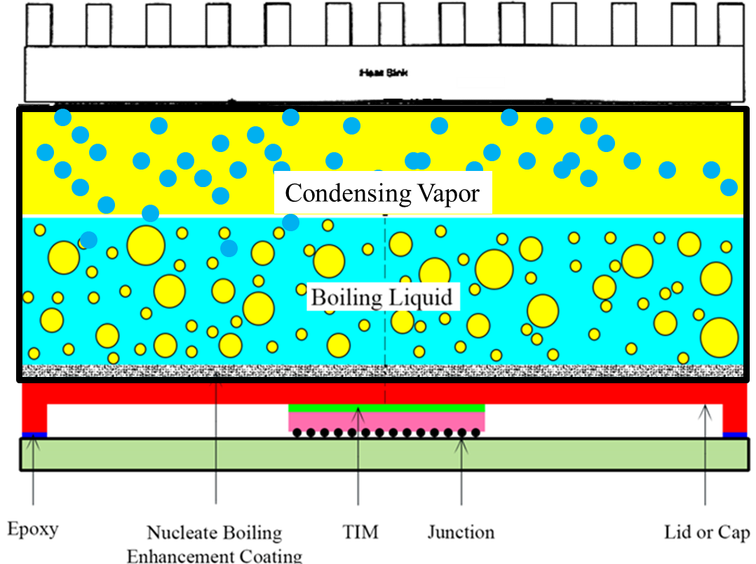
Physics of Vapor Chamber
Vapor chamber is mostly a vacuum chamber having very small wall thickness.
There is a working fluid in liquid (electronic liquids) form within that vacuum chamber.
When heat is applied to base of the VC the liquid vaporizes rapidly and vapors fills the chamber very quickly.
Whenever vapors come in contact with cold surface, they get condensed, hence rejecting the heat.

Slide 3
Physics of Vapor Chamber
This operation cycle continues as condensed working fluid is returned to the evaporation section.
The transportation of condensed liquid is mostly done by gravity.
The vapor bubbles can move freely in any direction so heat spread in all directions is possible and may generate hot spots on casing surface.
There is a need for some special agent which can direct the vapors in a planned direction!?!?!?

Slide 4
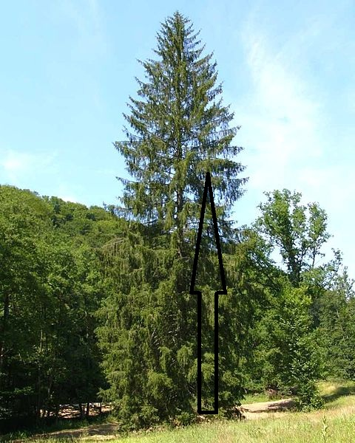
The Action Responsible for Creation of Life on Earth
Capillary action is evident in nature all around us.
The properties allow the water to be transpired by the xylem in the plant.
The water starts in the roots and proceeds upward to the highest branches of the plant.

Slide 5
Structure of Vapor Chamber

Slide 6
Wick
Wick is the important feature in a Vapor Chamber.
Wick provides capillary action which helps the condensed liquid to move back to evaporation surface.
Wick also ensures the proper distribution of the liquid along the evaporation surface.
Wick also helps in nucleate boiling of the working fluid.
Keeping this in view the wick should be capable to hold sufficient amount of working fluid.
As the wick can affect heat transfer from evaporation surface to the working fluid so its heat transfer capabilities must also be good.

Slide 7
Wick
Wick should provide significant amount of capillary pressure to the working fluid.
The capillary pressure must be greater than the vapor pressure and fluid pressure drop across wick thickness.
This property of wick depends on the type of wick structure.
There are three main types of wick structure.
• Sintered Powder Wick
• Grooved Wick
• Wire Mesh/ Screen Wick

Slide 8
Types of Wicks used in Vapor Chamber
Sintered Powder
Grooved
Wire Mesh

Slide 9
Selection of Wick

Slide 10
Characteristics of a Wick Structure
Size of pores
Number of pores per unit volume
Continuity of the passage way
Important: liquid motion in the wick depends on the dynamic balance between the effects of capillary pressure and internal resistance to the flow
A small pore size increases the capillary action, since the capillary pressure is inversely proportional to the effective capillary radius of the mesh.
But the friction force also increases when pore size is reduced.
The optimum pore size will be different for different fluids and different orientations of the heat pipe.
An improperly designed wick will result in an inadequate liquid supply and eventual failure of the Vapor Chamber.

Slide 11
Physics of Capillary Fed Boiling

Slide 12
Physics of Capillary Fed Boiling

Slide 13
Physics of Capillary Fed Boiling

Slide 14
Selection of Working Fluid
The working fluids for vapor chamber are mostly evaluated by using merit number.
$$N_{l}=\frac{σρ_{l}u_{fg}}{μ_{l}}$$
Where, ρ_{l} = Liquid density , σ = Surface tension, u_{fg} = Latent Heat and μ_{l} = Fluid viscosity.
High liquid density and latent heat decrease the fluid flow hence decrease the amount of power transported, while high surface tension increase the pumping capability.
A low liquid viscosity reduces the liquid pressure drop for a given power.

Slide 15
Merit Number of Selected Working Fluids

Slide 16
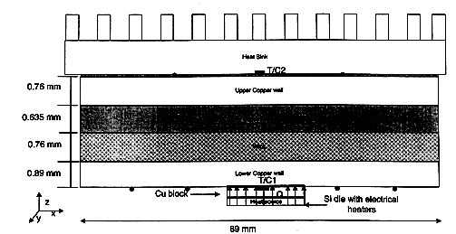
Effective thermal conductivity of vapor space
The vapor space is main heat transporting agent in vapor chamber.
It is also responsible for uniform heat transfer hence preventing any chance of hot spots.
Theeffective heat transfer of vapor space can be calculated using Prasher’s approach (2003).

Slide 17
Effective thermal conductivity of vapor space
Prasher’s Model (2003):
$$k_{vapor−VC}=\frac{u_{fg}^{2}p_{v}ρ_{v}D_{v}^{2}}{12{Rμ}_{v}T^{2}}$$
u_{fg} = Latent Heat of evaporation (J Kg-1)
p_{v} = Vapor pressure (N m-2)
ρ_{v} = Vapor Density (Kg m-3)
D_{v} = Thickness of vapor space (m)
R = Gas constant per unit mass (J kg-1)
μ_{v} = Viscosity (Kg m-1 s-1)

Slide 18
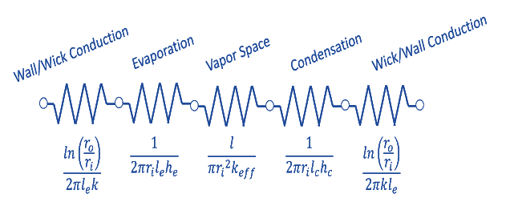
Limitations of vapor chamber
The most important feature of a vapor chamber is amount of power it can transfer.
Vapor chambers are able to transfer much higher power compared to best metallic spreaders for given temperature gradient.
The limitation to maximum power transferred can be heat source, heatsink capacity or vapor chamber internal limitations.

Slide 19
Limitations of vapor chamber
Temperature drops across a vapor chamber are;
Conduction through bottom wall and wick
Evaporation
Vapor Space
Condensation
Conduction through top wick and wall

Slide 20
Selection of Wick Thickness for VC
Overall Thermal Conductance of VC
Heat Carrying Capacity of Wick
= vapor carrying capacity ×$u_{fg}$
$${\dot{Q}}_{CCW}={\dot{m}}_{CCW}×u_{fg}$$
$$P_{diss}$$
Optimal Thickness of Wick

Slide 21
Thermal Model of A Heat Sink with VC

Slide 22
Chip Junction Temperature with VC

Slide 23
Chip Junction Temperature w/o VC

Slide 24
Temperature Distribution in VC

Slide 25
Effect of Heat Sink Size

Slide 26
Separation of Condenser from Evaporator

