Slide 1
Information Entropy vs Thermodynamic Entropy
P M V Subbarao
Professor
Mechanical Engineering Department
Thermal Management is necessary to Handle Irreversible Nature of Real Electronics ..
How to Progress Towards Green Computing?

Slide 2
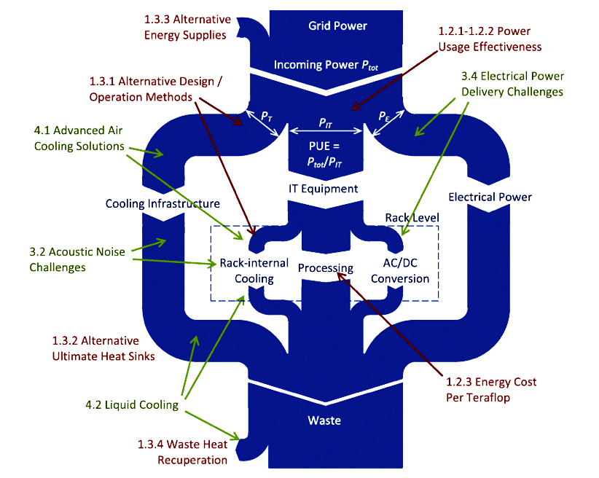
A Macro Level Thermo-scientific Analysis of A Data Centre
Data Center
Sankey Diagram

Slide 3
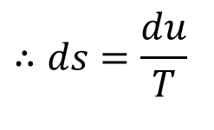
Entropy change of an incompressible substance: Solids and Liquids
For most liquids and all solids, the density is not changed as pressure changes, that is, dv=0.
Gibbsian equation states that Tds=du+pdv=du+, du=CdT.
For an incompressible substance C_{p}=C_{v}=C is a function of temperature only.
$$∴ds=\frac{du}{T}$$
$$⇒ds=\frac{C\left(T\right)dT}{T}$$
$$s_{2}−s_{1}=\int_{1}^{2}{ds}=\int_{T_{1}}^{T_{1}}{\frac{C\left(T\right)dT}{T}}$$
Integrating from state 1 to state 2
$$s_{2}−s_{1}≅C_{avg}\int_{T_{1}}^{T_{1}}{\frac{dT}{T}}$$
Where, C_{avg} is the averaged specific heat over the given temperature range.
An isentropic process in any electric/electronic device will keep it Diabatic system.

Slide 4
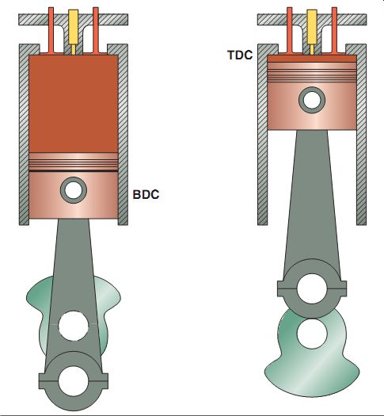
Solids as Selfless Power Work Transmission Units
$$s_{2}−s_{1}≅C_{avg}\int_{T_{1}}^{T_{1}}{\frac{dT}{T}}$$

Slide 5
Entropy change of an Electronic device
For most of the electronic devices (as they use solid substance), the density is not changed as pressure changes, that is, dv=0.
However, they perform iff when there is an electrical work transfer
For an electronic device with heat transfer
$$Tds=CdT+δW_{elec}$$
Every ideal electronic device is a diabatic device and hence, it is an isentropic system.
An irreversible electronic system dissipates some/large of the electrical into heat.
This leads to increase in temperature/internal energy of the device and ΔS >0, without any heat addition!
This ΔS is known as entropy generation!

Slide 6
Information Theory
Conceptually, information can be thought of as being stored in or transmitted as variables.
A variable is a unit of storage that can take any one of several different specified values, at different times.
A process is followed for taking on those values.
∴ The information is about the process behind the variable taking or changing a value with time.

Slide 7
Entropy of A Variable
The entropy of a variable is the "amount/quality of information" contained in the variable.
This amount is determined not just by the number of different values the variable can take on.
The information in a variable is tied to the amount of surprise that value of the variable causes when revealed.
Shannon’s entropy quantifies the amount of information in a variable.
Shannon’s entropy metric is a measure of the absolute minimum amount of storage and transmission needed for succinctly capturing any information.

Slide 8
Definition of Shannon’s Entropy
Shannon’s Entropy metric also suggests a way of representing the information calculated using fewer number of bits.
This translates to the amount of storage (e.g. number of bits) required to store the variable.
An intuitively be understood as “the amount of information” in that variable.
Shannon Entropy:
$$S=\sum_{j=0}^{\left|N\right|}{P\left(j\right)\ln\left\{\frac{1}{P\left(j\right)}\right\}}$$
P(j) is the probability of occurrence of j^{th} state of a system.
Shannon’sEntropy is a direct measure of the number of bits needed to store the information in a variable, as opposed to its raw data.
Thus, entropy is a direct measure of the “Newness of information" in a variable.

Slide 9
Negentropy
For a binary system there are two states, zero and one, with corresponding probabilities P₀ and P₁, where P₀ = 1-P₁.
For a stream of N independent bits, the entropy is
$$S=−N\left\{P_{1}\ln{P_{1}}+\left(1−P1\right)\ln\left(1−P1\right)\right\}$$
For an unbiased random stream of N independent bits
$$S=−N\ln{2}$$
This represents the situation where a bit stream is both random and unbiased and contains no information.
In general, information is characterized by the deviation from N log 2.
Brillouin refers to this quantity as Negentropy.

Slide 10
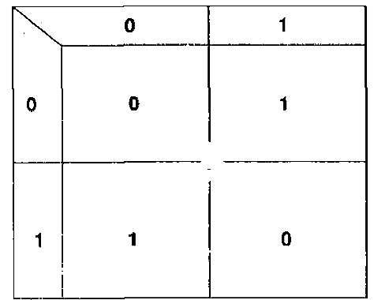
Binary Operations with Two Bit Streams
Consider the exclusive-OR combination, of two binary bit streams as depicted below:
The truth table for this process is:
B
A
C
The output of an Exclusive-OR gate ONLY goes “HIGH” when its two input terminals are at “DIFFERENT” logic levels with respect to each other.

Slide 11
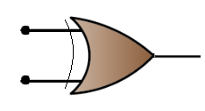
Reversible Operation with XOR Gate
The truth table for this process is:
B
A
Provided that the bit stream B is retained, the exclusive-OR operation is reversible.
That is, recombination of C with B will yield the bit stream A.
S(A)
S(C)
C
S(B)
S(B)
Reversible XOR combination of two binary bit streams.
This exclusive-OR gate combines bit streams A and B having entropies S(A) and S(B).
Either A or B must be retained for the process to be reversible.
This XOR combination of C and B will yield A.

Slide 12
Reversible Operation with XOR Gate
The truth table for this process is:
S(A)
B
A
S(C)
S(B)
C
S(B)
If the inputs are designated by bit streams A and B, it is straightforward to determine the output stream C.
Likewise, if the inputs are specified in terms of the probabilities that bits in A and B are either one or zero, it is simple to calculate the corresponding probabilities for bits in the output C.
Once these probabilities are known, it is possible to compute the entropies S(A), S(B) and S(C).

Slide 13
Shannon’s Theroy for Two Bit Streams
The truth table for this process is:
S(A)
B
A
S(C)
S(B)
C
S(B)
Application of Shannon’s theory to above problem gives:
$$S\left(A\right)+S\left(B\right)=S\left(A,B\right)=S\left(C,B\right)$$
where S(A, B) is the joint entropies of A & B
S(C, B) are the joint entropies of C & B
$$S\left(A,B\right)=\sum_{i=0}^{\left|N\right|}{}\sum_{j=0}^{\left|M\right|}{P\left(i,j\right)\ln\left\{\frac{1}{P\left(i,j\right)}\right\}}$$
where P(i, j) is the joint probability of states i and j of streams A and B respectively.

Slide 14
Thermodynamics of Two-Bit Stream Computation
Thermodynamic point of view of this XOR operation is isentropic, or an entropy-conserving process.
Shannon‘s theory is entirely consistent with the notion that an isentropic process is reversible.
As per Shannon’s theory, it is the joint entropy of streams A and B that is conserved.

Slide 15
Information Theory to Thermodynamics
Shannon’s theory of information is largely unconcerned with energy, and as a result has little to do with thermodynamics.
By associating a binary bit with a quantum of energy, this is easily changed.
For the current discussion, let the energy of a bit be E when the bit is 1, and be zero when the bit is 0.
This is arbitrary.
It is straight forward to treat this energy as microscopic energy equivalent to U.
In this case ΔU is occurring not due to change in temperature, but due to computational state of the system.
This permits us to define a Boltzmann factor, and introduces the concepts of heat, work, reservoirs, and equilibrium.

Slide 16
Computational Entropy & Temperature
Recall the fundamental definition of temperature as the relation
$$T={\left.\frac{∂U}{∂S}\right|}_{v=\text{constant}}$$
The relation between the energy of a bit as another microscopic component of internal energy is determined by the probabilityP₁.
If a system of N bits has the value of one for m times, such that
$$P_{1}=\frac{m}{N}$$
The total energy is
$$ΔU=NP_{1}u_{com}=mu_{com}$$
It is now possible to express the entropy of a stream of N independent bits in terms of ΔU.
$$T_{comp}={\left.\frac{∂U}{∂S}\right|}_{pure−comp}$$

Slide 17
Computational or Information Entropy
For a given value of ΔU, there are numerous permutations of bits that yield m ones and (N - m) zeros.
If each of these g(ΔU) permutation states is equally likely, one can define the entropy as
$$S\left(ΔU\right)=\ln\left\{g\left(ΔU\right)\right\}$$
Where g(ΔU) is named as a degeneracy function.
Using simple probability
$$g\left(ΔU\right)=\left(\begin{matrix}N \\ m\end{matrix}\right)≡\frac{N!}{m!\left(N−m\right)!}$$

Slide 18
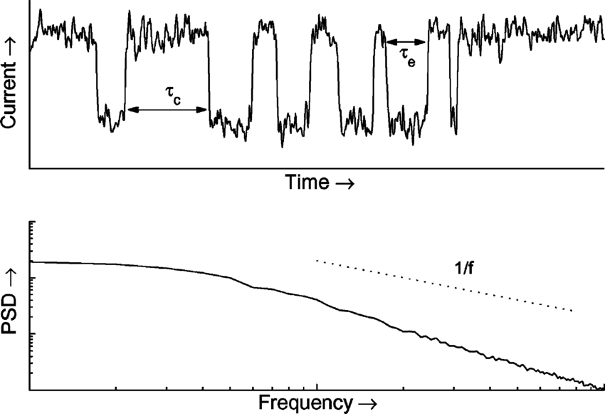
Extension of Boltzmann theory :Energy consumption by An Irreversible Electronic Device
Ideal electrical work to be consumed for a bit of computation is:
$$W_{electric−input}=Q_{diss}=kT\ln{(}2)$$
At a room temperature of 298K, W_{ideal-input} = 0.018eV.
Thermal noise on gates of minimum‐width segments of FET gates leads to channel fluctuations below ~1‐2 eV.
Thermal noise of a MOSFET with a 0.18-m gate area.

Slide 19
Extension of Boltzmann theory :Energy consumption by An Irreversible Electronic Device
Ideal electrical work to be consumed for a bit of computation is:
$$W_{electric−input}=Q_{diss}=kT\ln{(}2)$$
At a room temperature of 298K, W_{ideal-input} = 0.018eV.
Thermal noise on gates of minimum‐width segments of FET gates leads to channel fluctuations below ~1‐2 eV.
Increases leakage, impairs device performance.
ITRS has minimum gate energy asymptoting to ~2 eV
Also, real logic circuits incur many further overhead factors:
Transistor width 10‐20× min.
Parasitic (junction, etc.) transistor capacitances (~2×)

Slide 20
Extension of Boltzmann theory :Energy consumption by An Ideal Electronic Device
Ideal electrical work to be consumed for a bit of computation is:
At a room temperature of 298K, W_{ideal-elec-input} = 0.018eV.
Ideal Electronic Devices are Adiabatic and requires no cooling.

Slide 21
Actual Energy consumption by An Irreversible Electronic Device
At a room temperature of 298K, W_{ideal-input} = 0.018eV.
Thermal noise on gates of minimum‐width segments of FET gates leads to channel fluctuations below ~1‐2 eV.
Increases leakage, impairs device performance.
ITRS has minimum gate energy asymptoting to ~2 eV
Also, real logic circuits incur many further overhead factors leading to more losses:
Transistor width 10‐20× min.
Parasitic (junction, etc.) transistor capacitances (~2×)

Slide 22
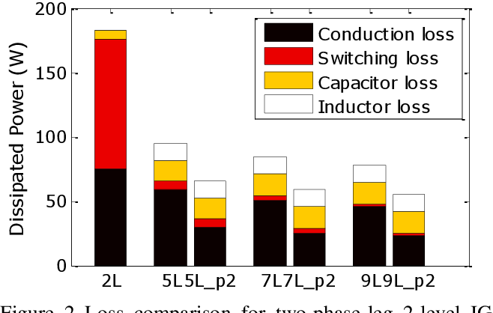
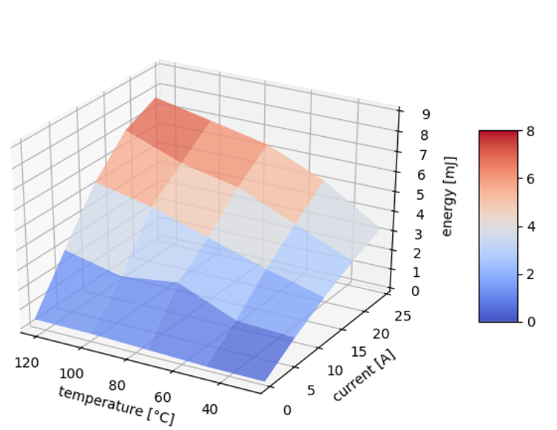
Energy consumption by An Irreversible Electronic Device
Multiple (~2) transistors fed by each input to a given logic gate
Fan‐out to a few (~3) logic gates
Parasitic wire capacitance (~2×)
Due to all these overheads, the electrical work input to each bit in real logic circuits is many times larger than the min.‐width gate energy 375‐600× (!) larger.
Practical bit energy for irreversible logic asymptotes to ~1 keV!
Practical, real‐world logic circuit designs can’t just magically cross this ~500× architectural gap!
Thermodynamic limits imply much larger practical limits!

Slide 23
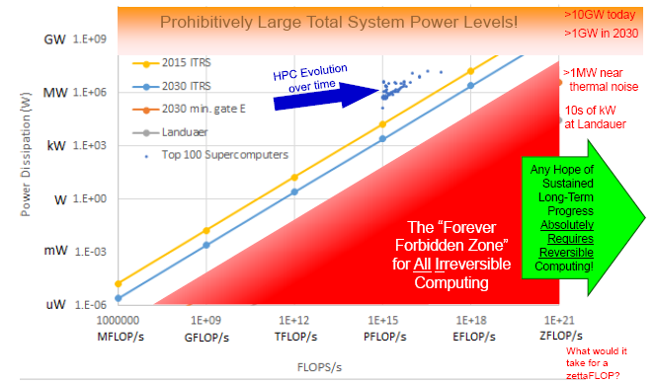
Evolution of Irreversible Computing

Slide 24
Second Law of Thermodynamics for Electronic Systems
Heat generation is an unavoidable by-product of operating electronics.
It is impossible to construct an Electric/Electronic System which produces no effect other than the consumption of Electric power from a source and the production of an equivalent amount of Electronic Services
It is impossible to develop an electric/electronic device with zero heat generation.
It is difficult to operate electronics at ambient temperature.

