Slide 1


Heat Pipe Heat Sinks
P M V Subbarao
Professor
Mechanical Engineering Department
I I T Delhi
Heat Exchange through Another Natural Action….

Slide 2

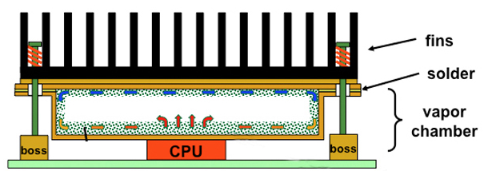
Need for Separation of Condenser from Evaporator

Slide 3


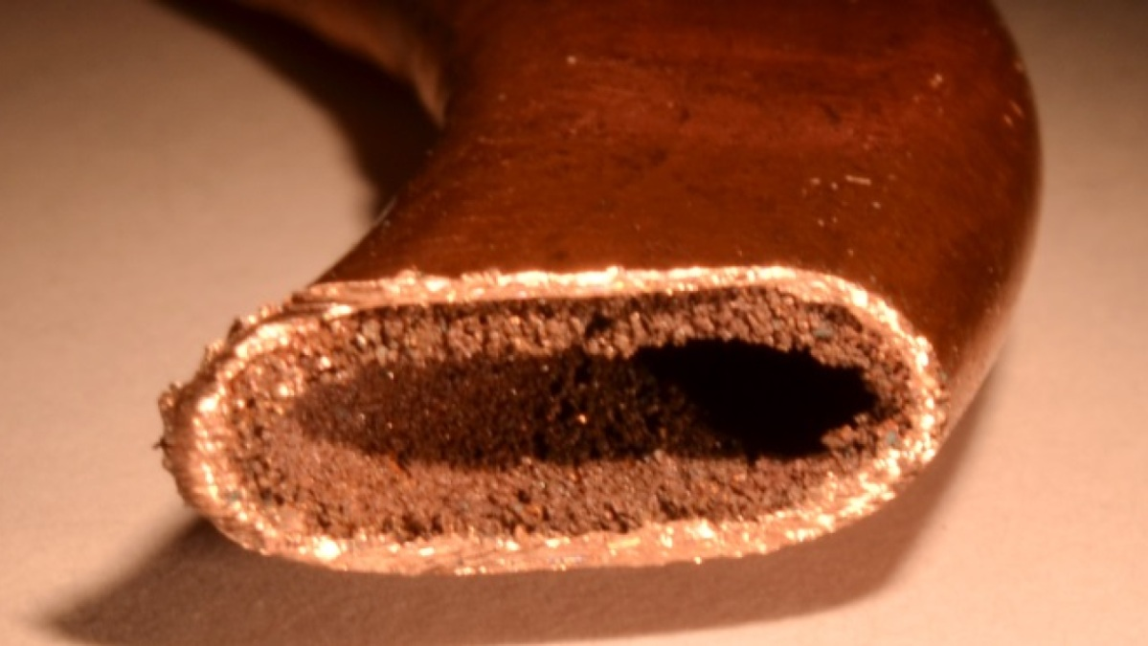
Vertical Stacking to Lateral Stacking of VC
Capillary Transport of liquid
Adiabatic Transport of Vapor
Evaporative Cooler
Condenser

Slide 4


Heat Pipe Heat Sinks
Evaporative Cooler
Capillary Transport of liquid
Adiabatic Transport of Vapor
Condenser

Slide 5
Heat Pipes
A heat pipe is basically a sealed slender tube containing a wick structure lined on the inner surface and a small amount of fluid such as electronic fluid at the saturated state.
The type of fluid and the operating pressure inside the heat pipe depend on the operating temperature of the heat pipe.
This is a simple device that can transfer large quantities of heat over fairly large distances essentially at a constant temperature without requiring any power input.
A patent for the heat pipe was filed in the United States in 1942, but they didn’t get the name “heat pipe” until 1963.
In the late 1960s, NASA employed heat pipes for heat management in their satellites, and it was around that time that other various applications of heat pipes began to develop.

Slide 6
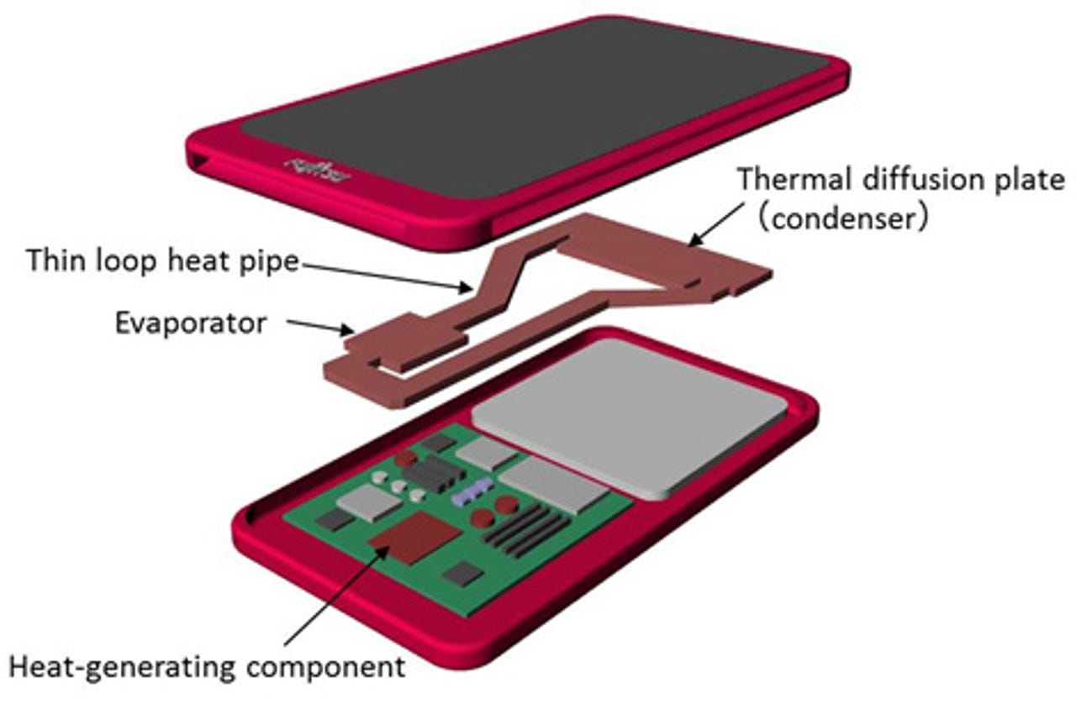
Heat Pipe Heat Sinks
In 1978 heat pipes were used by an electronics manufacturer for the heat management of power transistors in audio amplifiers.
Uses of heat pipes increased into the 1980s in the field of electronics such as inverters.
Miniaturized heat pipes were first used for the heat management of CPUs in laptop PCs in 1994.
Since then the use of miniature heat pipes has only increased for that purpose in CPUs and other components that generate a high level of heat generation in laptop PCs.
Later introduction of compact, high-performance communication devices such as smart phones, heat pipes with even smaller profiles have also made appearances.

Slide 7
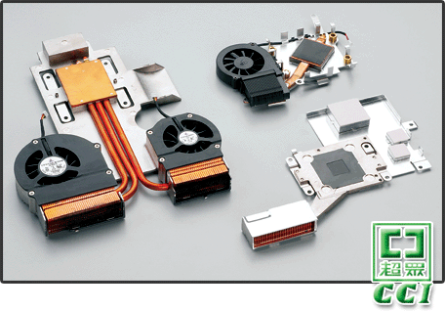
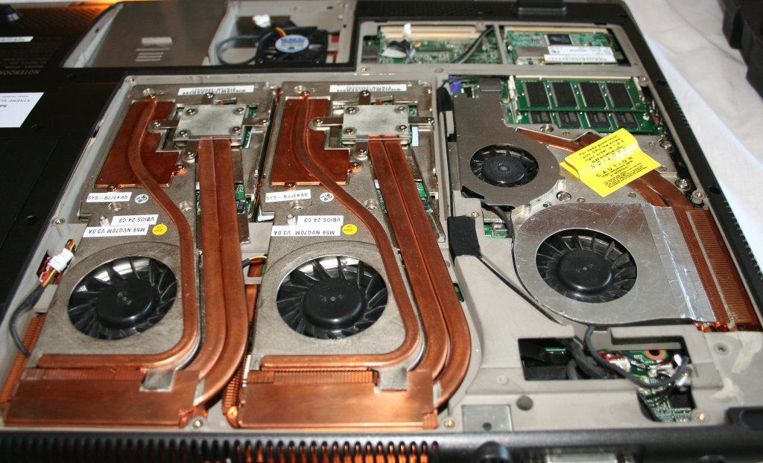
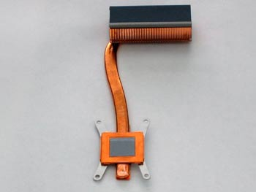
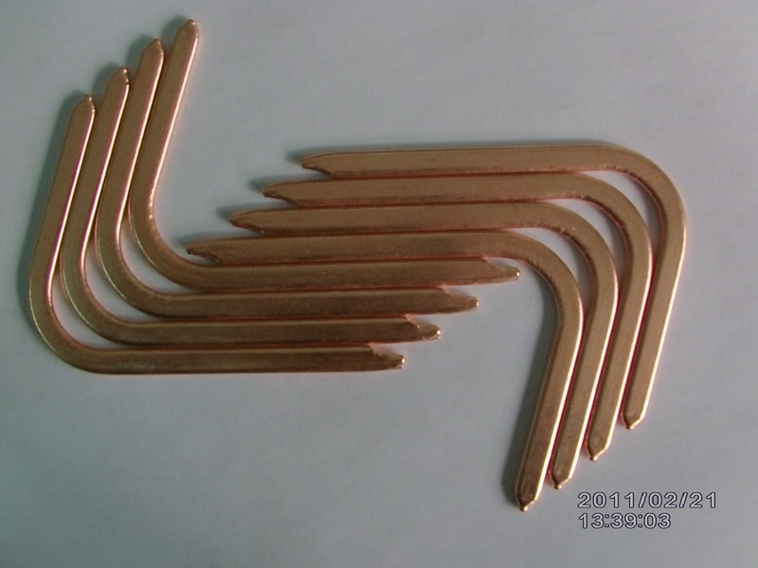
Heat pipe in a Notebook

Slide 8
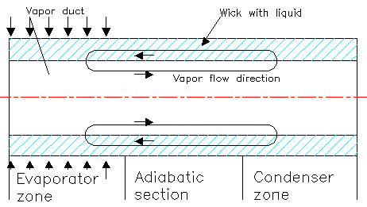
Structure of A Heat Pipe

Slide 9
Essential Materials in A Heat Pipe Heat Exchanger
The three basic components of a heat pipe are:
The container
The working fluid
The wick or capillary structure

Slide 10
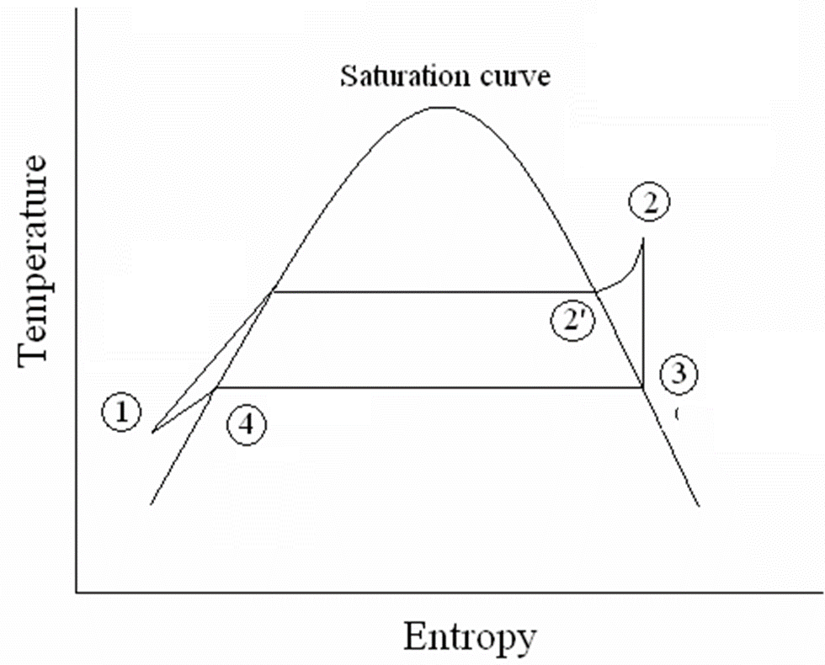
Ideal Thermodynamic Cycle for a Heat Pipe
Evaporative Cooler
Adiabatic pipe section
Condenser
wick

Slide 11
Steps in Heat Pipe Design
1) Investigate and determine the following operational parameters:
a. Heat load and geometry of the heat source.
b. Possible heat sink location, the distance and orientation relative to the heat source.
c. Temperature profile of heat source, heat sink and ambient
d. Environmental condition (such as existence of corrosive gas)
2) Select the pipe material, wick structure, and working fluid.
a. Determine the working fluid appropriate for your application
b. Select pipe material compatible to the working fluid
c. Select wick structure for the operating orientation
d. Decide on the protective coating.
3) Determine the length, size, and shape of the heat pipe.

Slide 12
Type of Fluid
Helium: –271 ºC to –268 ºC.
Nitrogen: -210 ºC to –150 ºC.
Water: 5 ºC to 230 ºC.
Mercury: 200 ºC to 500 ºC.
Lithium: 850 ºC to 1600 ºC.
Thus, a wide temperature range is covered.

Slide 13
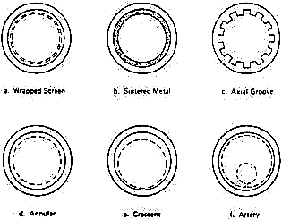
Wick Structures

Slide 14
Characteristics of a Wick Structure
Size of pores
Number of pores per unit volume
Continuity of the passage way
Important: liquid motion in the wick depends on the dynamic balance between the effects of capillary pressure and internal resistance to the flow
A small pore size increases the capillary action, since the capillary pressure is inversely proportional to the effective capillary radius of the mesh.
But the friction force also increases when pore size is reduced.
The optimum pore size will be different for different fluids and different orientations of the heat pipe.
An improperly designed wick will result in an inadequate liquid supply and eventual failure of the heat pipe.

Slide 15
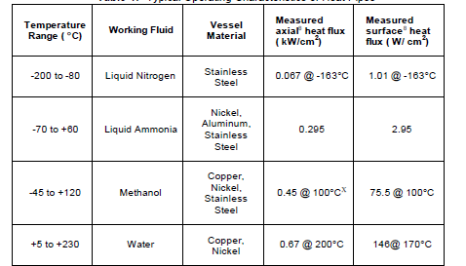
Typical Operating Characteristics of Heat Pipes : Low Temperature Applications

Slide 16
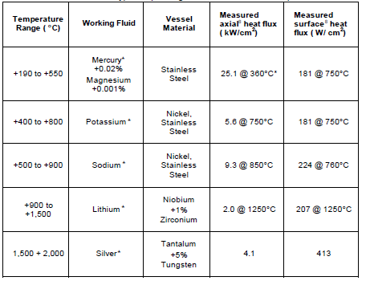
Typical Operating Characteristics of Heat Pipes : Low Temperature Applications

Slide 17
One Dimensional Steady Models : Heat Pipe
p_{liquid,low}
p_{liquid,high}
T_{high}
T_{low}
p_{vapour,,low}
p_{vapour,,high}

Slide 18
Liquid and Vapour Pressure Distribution
Vapour
Δp_{vapour}
p
p_{v}-p_{l}
Δp_{liquid}
Liquid
Dry Point
x
Wet Point

Slide 19
Condition for Operation
For a heat pipe to function properly, the net capillary pressure difference between wet and dry points must be greater than the summation of all the pressure losses.
Various pressure losses are :
Pressure gradient across phase transition in evaporator.
Pressure gradient across phase transition in Condenser.
Normal hydrostatic pressure drop.
Axial hydro static pressure drop.

Slide 20
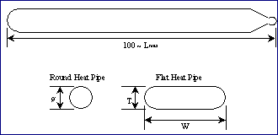
Standard Heat Pipe

Slide 21
Heat Pipes with Water as Working Fluids in copper water groove at Vertical Orientation.

Slide 22
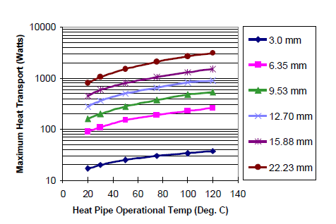
Performance of copper water groove heat pipe at vertical orientation (gravity assist)

Slide 23
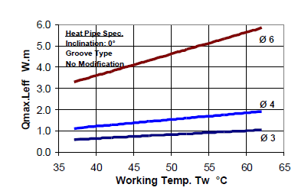
The performance of various groove wick copper water heat pipes

Slide 24
Four heat transport limitations of a heat pipe
The four heat transport limitations can be simplified as follows;
1) Sonic limit – the flow rate that vapor travels from evaporator to condenser.
2) Entrainment limit – Friction between working fluid and vapor that travel in opposite directions.
3) Capillary limit – the rate at which the working fluid travels from condenser to evaporator through the wick.
4) Boiling limit – the rate at which the working fluid vaporizes from the added heat

