Slide 1


Operational Aspects of Heat Pipe Heat Sinks
P M V Subbarao
Professor
Mechanical Engineering Department
I I T Delhi
Limits of Operation to Achieve High Thermal Conductance….

Slide 2

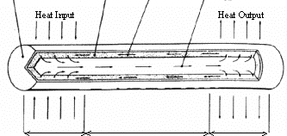
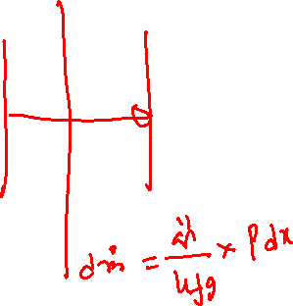
Operational Principle of a Conventional Heat Pipe
container
wick
Vapor flow
Liquid flow
Evaporator section
Adiabatic section
Condenser section

Slide 3
Four heat transport limitations of a heat pipe
The four heat transport limitations can be simplified as follows;
1) Sonic limit – the flow rate that vapor travels from evaporator to condenser.
2) Entrainment limit – Friction between working fluid and vapor that travel in opposite directions.
3) Capillary limit – the rate at which the working fluid travels from condenser to evaporator through the wick.
4) Boiling limit – the rate at which the working fluid vaporizes from the added heat

Slide 4
General Representation of Heat Pipe

Slide 5

Heat transfer limitations of water wick heat pipe with sintered capillary structure
Heat pipe inner diameter 20 mm, total length 2 m, axial orientation 90°, spherical diameter of copper powder 0.85 mm, porosity 0.55, width of capillary structure 6 mm.

Slide 6
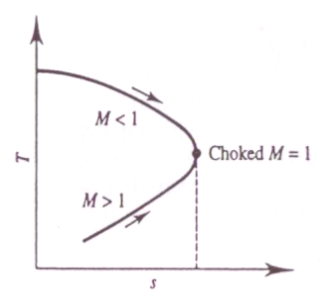
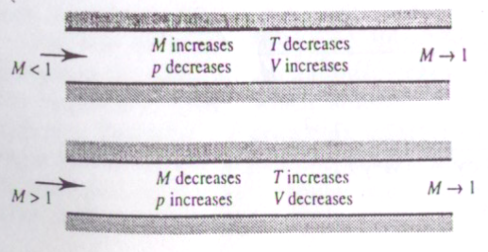
Frictional Compressible Flow through A Pipe
M | dM | dp | dT | dV
<1 | +ve | -ve | -ve | +ve
>1 | -ve | +ve | +ve | -ve

Slide 7
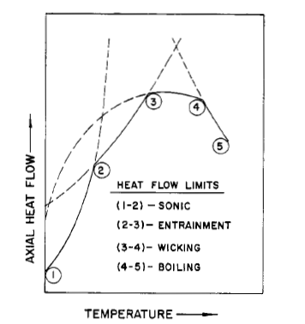
Sonic Limitations of A Heat Pipe
Sonic limit

Slide 8
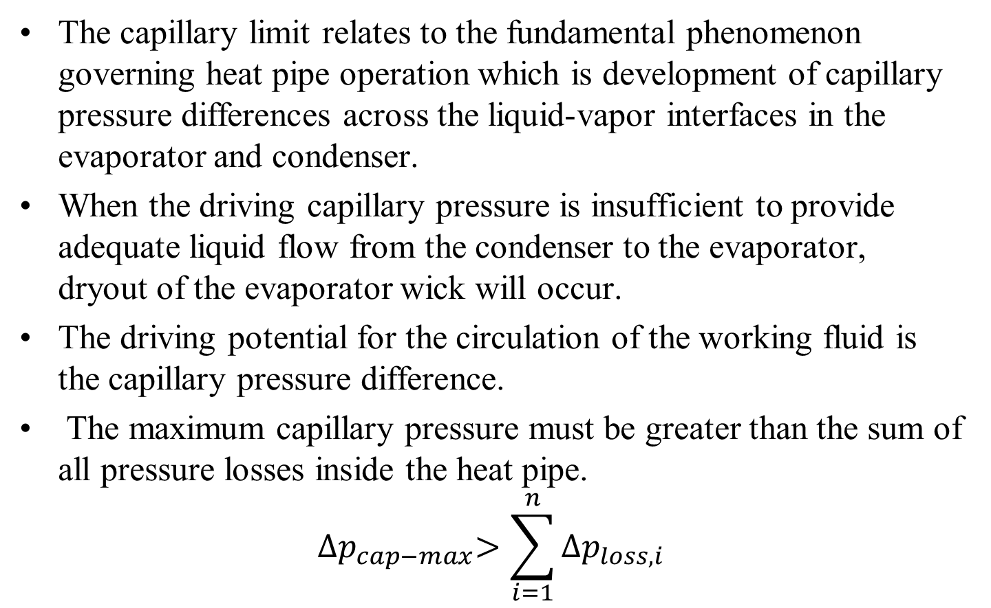
Capillary limitation
The capillary limit relates to the fundamental phenomenon governing heat pipe operation which is development of capillary pressure differences across the liquid-vapor interfaces in the evaporator and condenser.
When the driving capillary pressure is insufficient to provide adequate liquid flow from the condenser to the evaporator, dryout of the evaporator wick will occur.
The driving potential for the circulation of the working fluid is the capillary pressure difference.
The maximum capillary pressure must be greater than the sum of all pressure losses inside the heat pipe.
$${∆p}_{cap−max}>\sum_{i=1}^{n}{{∆p}_{loss,i}}$$

Slide 9
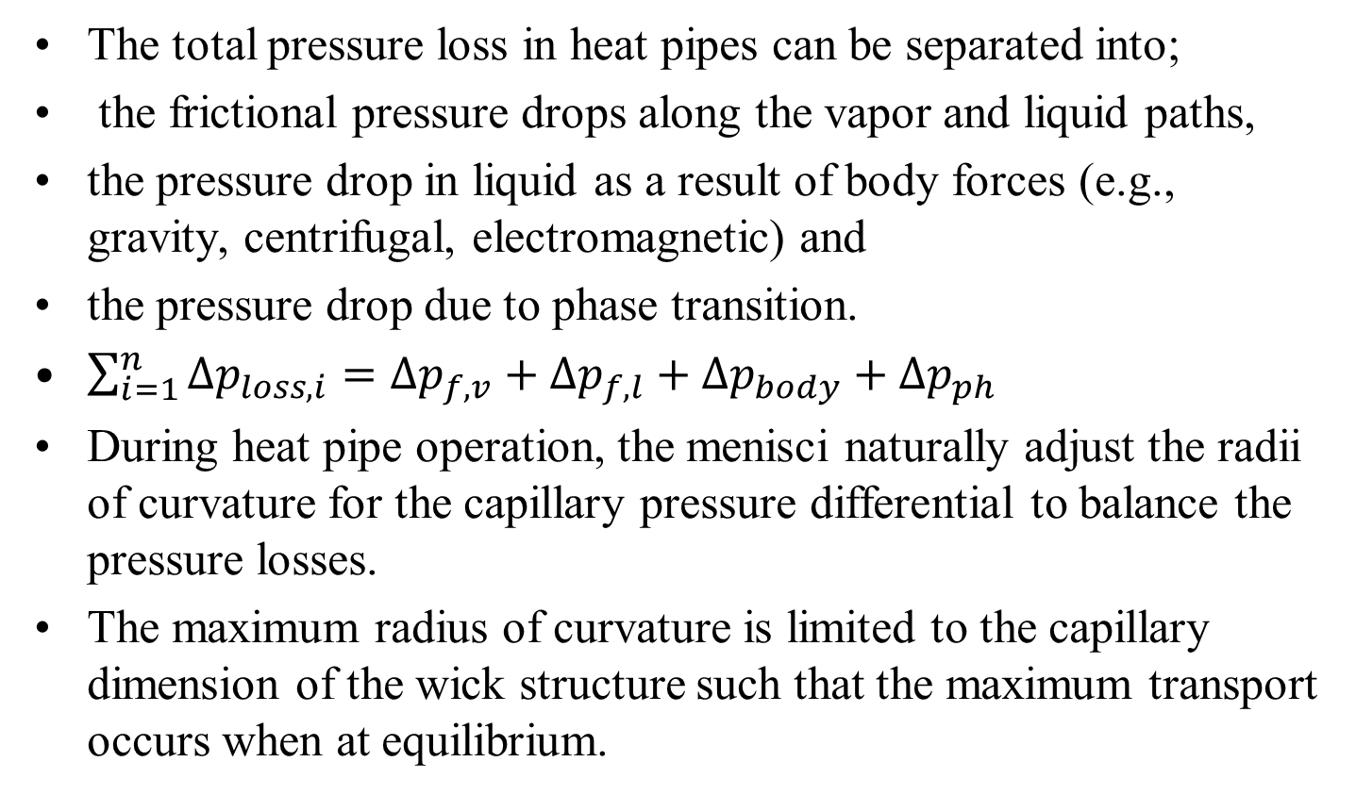
Total Pressure Loss in a Heat Pipe
The total pressure loss in heat pipes can be separated into;
the frictional pressure drops along the vapor and liquid paths,
the pressure drop in liquid as a result of body forces (e.g., gravity, centrifugal, electromagnetic) and
the pressure drop due to phase transition.
$\sum_{i=1}^{n}{{∆p}_{loss,i}}={∆p}_{f,v}+{∆p}_{f,l}+{∆p}_{body}+{∆p}_{ph}$
During heat pipe operation, the menisci naturally adjust the radii of curvature for the capillary pressure differential to balance the pressure losses.
The maximum radius of curvature is limited to the capillary dimension of the wick structure such that the maximum transport occurs when at equilibrium.

Slide 10
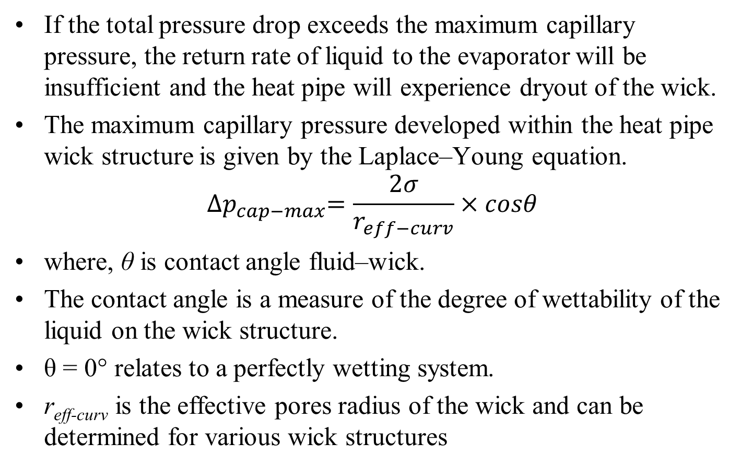
Total Pressure Loss in a Heat Pipe
If the total pressure drop exceeds the maximum capillary pressure, the return rate of liquid to the evaporator will be insufficient and the heat pipe will experience dryout of the wick.
The maximum capillary pressure developed within the heat pipe wick structure is given by the Laplace–Young equation.
$${∆p}_{cap−max}=\frac{2σ}{r_{eff−curv}}×cosθ$$
where, θ is contact angle fluid–wick.
The contact angle is a measure of the degree of wettability of the liquid on the wick structure.
θ = 0° relates to a perfectly wetting system.
r_{eff-curv} is the effective pores radius of the wick and can be determined for various wick structures

Slide 11

Capillary limitation
The capillary limitation in heat pipes occurs when the net capillary forces generated by the vapor–liquid interfaces in the evaporator and condenser are not large enough to overcome the frictional pressure losses due to fluid motion.
This causes the heat pipe evaporator to dry out and shuts down the transfer of heat from the evaporator to the condenser.
For most heat pipes, the maximum heat transfer rate due to capillary limitation can be expressed as
where, K is the wick permeability (m2), A_{w} is the wick cross-sectional area (m²), ρ_{l} is the liquid density (kg/m³), μ_{l} is the liquid viscosity (N ・ s/m²), r_{eff} is the wick capillary radius in the evaporator (m), g is the acceleration due to gravity (9.8 m/s2), and l_{t} is the total length of the pipe (m)

Slide 12
Sizing Limitations of A Heat Pipe
Capillary limit
Sonic limit

Slide 13
Viscous limitation
When the heat pipe operates at low temperatures, the available vapor (saturation) pressure in the evaporator region may be very small.
It is of the same magnitude as the required pressure gradient to drive the vapor from the evaporator to the condenser.
In this case, the total vapor pressure will be balanced by opposing viscous forces in the vapor channel.
Thus, the total vapor pressure within the vapor region may be insufficient to sustain an increased flow.
This low-flow condition in the vapor region is referred to as the viscous limit.

Slide 14

Viscous limitation
As the viscous limit occurs at very low vapor pressures, the viscous limit is most often observed in longer heat pipes.
Also seen during frozen startup conditions as the saturation pressure of the fluid is low.
Busse provided an analytical investigation of the viscous limit.
The model first assumed an isothermal ideal gas for the vapor and that the vapor pressure at the condenser end was equal to zero, which provides the absolute limit for the condenser pressure.
Using these assumptions, a was developed and expressed as

Slide 15
Viscous limitation
where, r_{v} is the cross-sectional radius of the vapor core (m),
l_{v} is the latent heat of vaporization (J/kg),
μ_{v} is the vapor viscosity in the evaporator (N ・ s/m²),
l_{eff} is the effective length of the heat pipe (m), P_{v} (Pa) and ρ_{v} (kg/m³) are the vapor pressure and density at the evaporator end of the heat pipe.

Slide 16
Entrainment limitation
Examination of the basic flow conditions in a heat pipe shows that the liquid and vapor flow in opposite directions.
The interaction between the countercurrent liquid and vapor flow results in viscous shear forces occurring at the liquid–vapor interface, which may inhibit liquid return to the evaporator.
In the most severe cases, waves may form and the interfacial shear forces may become greater than the liquid surface tension forces, resulting in liquid droplets being picked up or entrained in the vapor flow and carried to the condenser.
In a majority of cases studied, the wick structure of the heat pipe was flooded (i.e., excess liquid), which allowed entrainment to occur.
The most common approach to estimating the entrainment limit in heat pipes is to use a Weber number criterion.

Slide 17


Entrainment limitation
To prevent entrainment of liquid droplets in the vapor flow, the Weber number must be less than unity.
The maximum transport capacity based on entrainment can be written as

Slide 18
Boiling limitation
At higher heat fluxes, nucleate boiling may occur in the wick structure, which may allow vapor to become trapped in the wick, thus blocking liquid return and resulting in evaporator dryout.
This phenomenon, referred to as the boiling limit, differs from the other limitations.
It depends on the radial or circumferential heat flux applied to the evaporator, as opposed to the axial heat flux or total thermal power transported by the heat pipe.
Determination of the heat flux or boiling limit is based on nucleate boiling theory and is comprised of two separate phenomena:
Bubble formation,
Subsequent growth or collapse of the bubbles.

Slide 19


Boiling limitation
Bubble formation is governed by the size (and number) of nucleation sites on a solid surface and the temperature difference between the heat pipe wall and the working fluid.
The temperature difference, or superheat, governs the formation of bubbles and can typically be defined in terms of the maximum heat flux as
where, λ_{eff} is the effective thermal conductivity of the liquid–wick combination.
The critical superheat ΔTc is defined by as

Slide 20
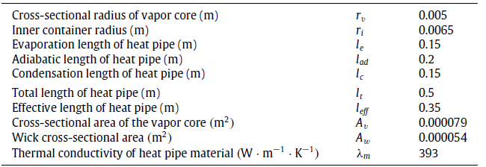
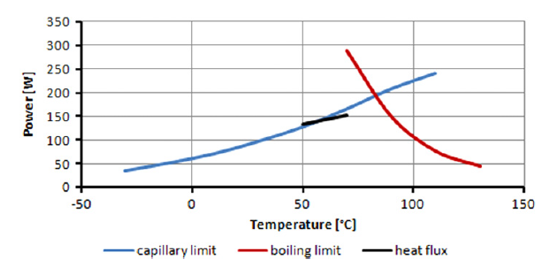
Case Study: Ethanol heat pipe with sintered wick structure

Slide 21
Gas Dynamics of Heat Pipe

Slide 22
Static Pressure Distribution in A Heat Pipe

Slide 23
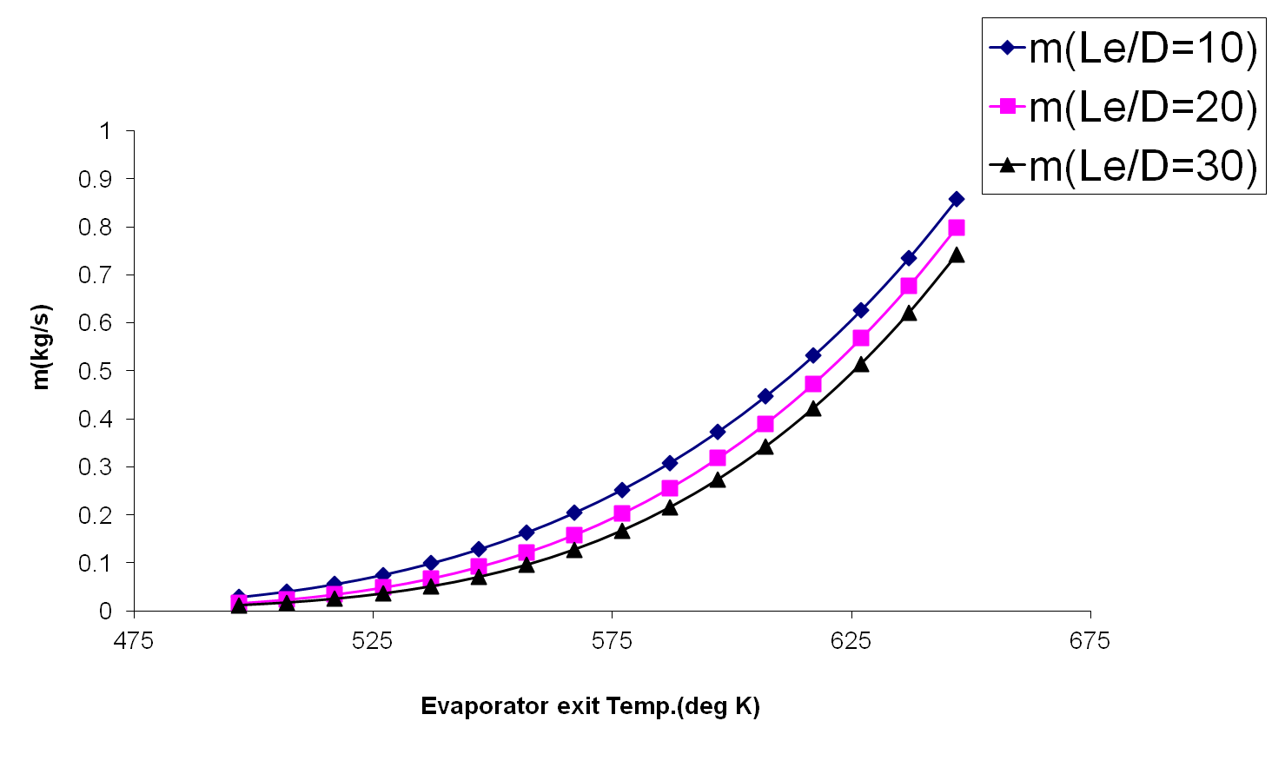
Mass flow rate vs Evaporator exit temperature

Slide 24
Sonic Heat Flux Limit
D=0.0114m

Slide 25
Heat transport limits

Slide 26
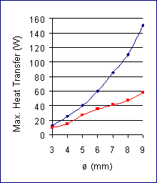

Performance of Heat Pipe

Slide 27
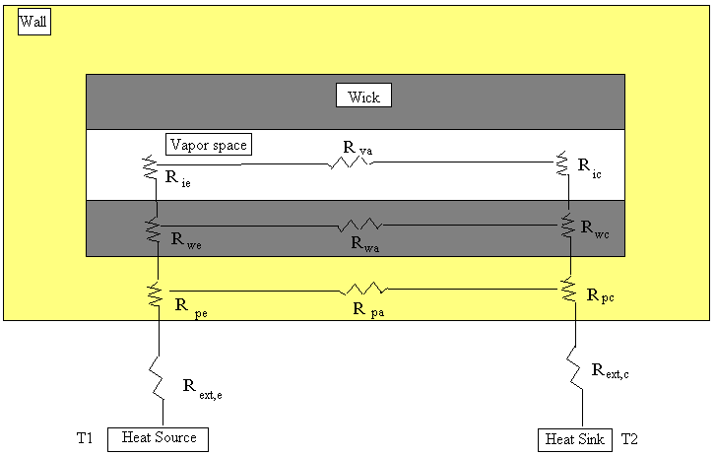
Thermal Resistance of A Heat Pipe

Slide 28
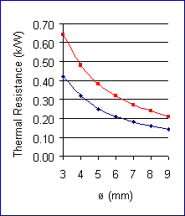
Thermal Resistance of Heat Pipe

