Slide 1


High Performance Ultra Thin Heat Pipe Cooling Module for Mobile Handheld Electronic Devices
P M V Subbarao
Professor
Mechanical Engineering Department
I I T Delhi
Cutting Edge Mechanical Engineering for Next-Gen digital World….

Slide 2

Main References
Review of applications and developments of ultra-thin micro heat pipes forelectronic cooling, Heng Tanga, Yong Tanga, Zhenping Wana, Jie Lia, Wei Yuana, Longsheng Lua, Yong Lia, Kairui Tangb, Applied Energy 223 (2018) 383–400.
Investigation of ultra-thin flattened heat pipes with sintered wick structure, Yong Li , Jiabin He a, Hengfei He , Yuying Yan , Zhixin Zeng, Bo Li, Applied Thermal Engineering 86 (2015).

Slide 3
Introductory Remarks
Portable electronic devices such as smartphones, tablets and ultra-books are becoming thin and small.
Regardless to this trend of miniaturization, these portable devices are filled with several user-friendly features and applications.
The mobile hand-held electronics market is dominated by smart phones because of their handiness with a lot of user-friendly applications.
Smart phones are packed up with many heat generating components such as
high-performance chipsets,
graphic cards and
larger sized batteries to meet the continued consumer demand.

Slide 4
Thermo-graphic view of a smart phone skin temperature
After 10 min of gaming operation.

Slide 5
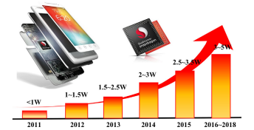
Power consumption of CPU processors of mobile phones

Slide 6
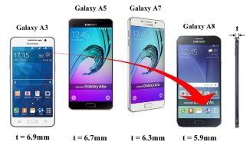
Variation in thickness of SAMSUNG smartphones.

Slide 7
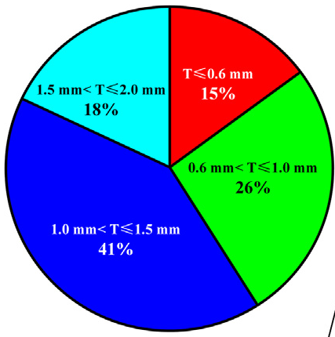
21st Century Developments : Thickness of UTHP

Slide 8
Thermal Management System for Smart Phone: Pre 2010
A common thermal management system for smart phones uses a graphite sheet (having high in plane thermal conductivity) in combination with a metal plate (Mg, Al, SUS, Cu etc.
This solution has its limitation due to high heat dissipation as well as high cost of the graphite when considering the high volume production.

Slide 9
Need For Better Thermal Management
In response to the problem of current solution of graphite sheet, ultra-thin heat pipe has become a strong candidate to solve the issue.
Few Smart phones already started using the ultra-thin heat pipe solution in 2014 and 2016 respectively.

Slide 10
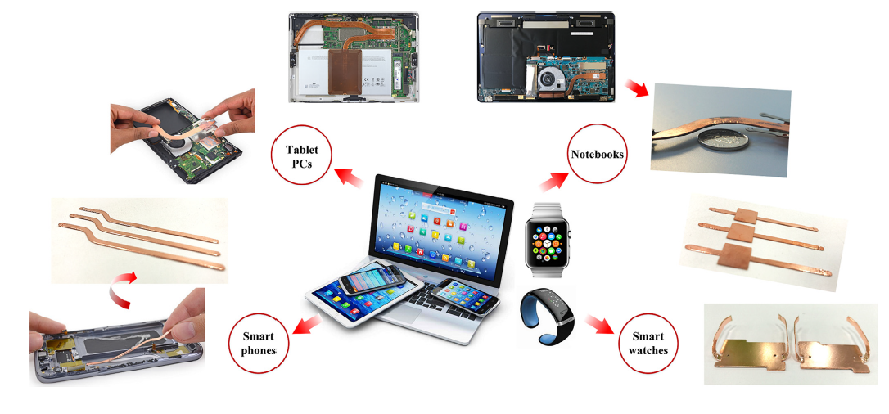
Applications of UTHPs in portable electronic devices

Slide 11
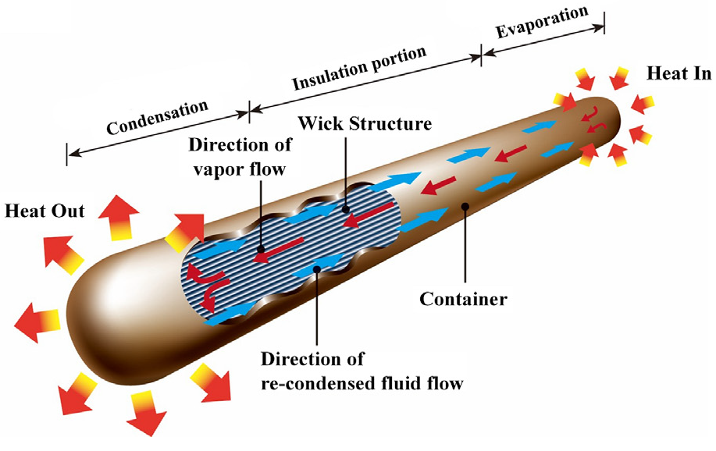
Ultra-thin flat-plate heat pipes
A flat-plate heat pipe is a chamber of low thickness filled with a two-phase working fluid.
It can be divided into flattened heat pipes (FHPs) and vapour chambers (VCs) based on the packaging forms.
The FHPs are fabricated by flattening conventional cylindrical heat pipes directly, and the composition and operational principles are similar to that of the micro heat pipes.

Slide 12
Ultra-thin flat-plate heat pipes
The manufacturing process of FHPs is highly efficient and flexible.
Certain deficiencies of FHPs, such as a small external surface area and single shape, permit them to be mainly used in small mobile devices such as smartphones and tablets.

Slide 13
Images of UFHPs
vapour chamber
Flattened heat pipe

Slide 14
Dimensions of a Typical UTHP

Slide 15
Flattening by cylindrical heat pipes
Flattening by cylindrical heat pipes, which can be combined with the fabrication process of traditional cylindrical heat pipes.
This is more efficient and flexible compared to that of bonding technology, rendering it more suitable for industrialized manufacturing.
This has been the most commonly used packaging technology for UTHPs.
Main methods for FBCH:
Lateral compression
Cold-roll-forming technology

Slide 16
Challenges in Fabrication of UTHPs
A buckling phenomenon is observed on the central line of the flattened heat pipe fabricated via lateral compression technology.
Two kinks are formed, one at the top and one at the bottom of the heat pipe.
Cold-roll-forming technology is not suitable for the fabrication of flattened heat pipes with variable thicknesses or with various cross-sectional shapes along its longitudinal direction.

Slide 17
A phase-change Flattening Process
A phase-change flattening process, based on the operating principle of the heat pipe is a an advanced manufacturing process , which was proposed n 2016.
This was successfully employed to fabricate UTHPs with sufficient flatness.

Slide 18
An Advanced Machine Tool

Slide 19
Flip in Fluid Paths
This shift in fluid paths can significantly reduce the vapour flow resistance because of the smooth inner wall of the container.

Slide 20
Flip in Fluid Paths
This shift guarantees sufficient volume for the vapour flow channels under extremely low thickness conditions

Slide 21
Wick structures of ultra-thin heat pipes
Special types of wick structures have been proposed to study the thermal performance of UTHPs
Broadly Merging
Microgroove wick structure &
Sintered wick structure
into Composite wick structure.
The capillary pressure and permeability of a wick are two key parameters

Slide 22
Revisit to Fundamental Physic of Heat Pipes

Slide 23
Novel Fluid Flows

Slide 24
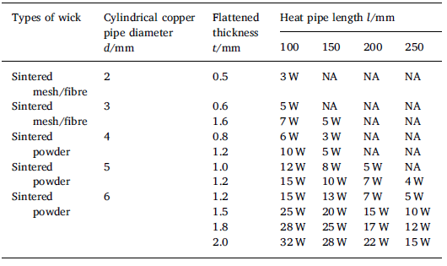
Maximum heat transfer capability of UTHPs

Slide 25
Prototype Model of UTHP

Slide 26
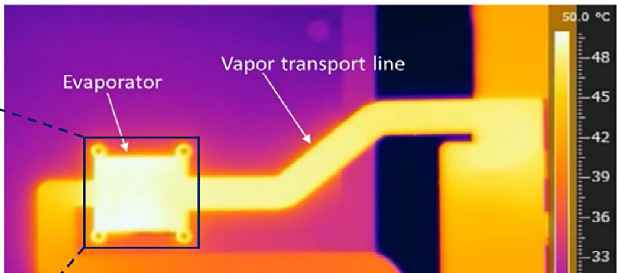
Infrared Image of UTHP

Slide 27
Diagram of the UTHP experimental system

Slide 28
Thermal Resistance of UTHP

Slide 29
Thermal Response of UTHP

