Slide 1



Investigation of ultra-thin flattened heat pipes
P M V Subbarao
Professor
Mechanical Engineering Department
I I T Delhi
Design Principles of Mass Production of Micro Heat Pipes….

Slide 2

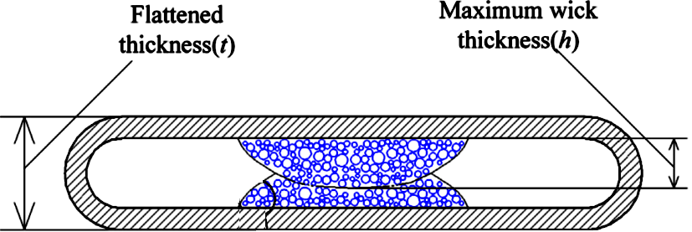
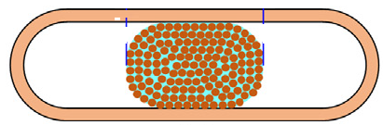
Structure of Flattened Heat Pipes
Bilateral Arch Shape Wick
Sintered Wick
Spiral Woven Mesh Wick
Band-Shape Wick

Slide 3
Flattened Heat Pipe
Modern Flattening process led to discovery of centrally located wick heat pipe.
Two popular shapes are:
Bilateral Arch Shaped Sintered Wick (BASSW)
Band Shaped Spiral Woven Mesh Wick (BSSWMW)
The vapor flow channels are located on the two sides of the flattened copper container to ensure the fluency of vapor flow.
Design parameters are:
Maximum wick thickness (h_{w}),
Flattened thickness (h_{f}),
Copper powder particle/wire size (d_{p}).

Slide 4
Design of Flattened Heat Pipe
Separate models are required to estimate the thermal resistances of evaporation and condensation.
The evaporation heat transfer model is based on boiling in porous media.
The film condensation model is based on original Nusselt's analysis about the laminar film condensation on the outer surface of the porous medium.

Slide 5
The Multiphase Flow and Heat Transfer in
UTFHP

Slide 6
Central Location of Wick : Advantages
The manufacturing procedures of the structure are simple and cost efficient.
The manufacturing parameters of the wick structure are flexible to change and the optimized parameters for enhanced thermal performance can be adjusted through process development and optimizations.
The locations of the vapor flow channels on both sides of the structure guarantee volume for vapor flow channels even under conditions of ultra-thin thickness.
Vapor flow resistance is significantly reduced because of the smooth inner wall of the copper container.

Slide 7
Central Location of Wick : Advantages
The overall thermal resistance of the UTHPs will be lower in BASSW.
5. The wick structure in arced-shape can provide sufficient area for vaporeliquid interface, on which evaporation and condensation occur.
Advantages (1) to (3) guarantee the feasibility of UTHP manufacturing while advantages (4) to (5) improve the thermal performance of UTHPs.
Ensures an excellent anti-dry out feature and low thermal resistances.

Slide 8
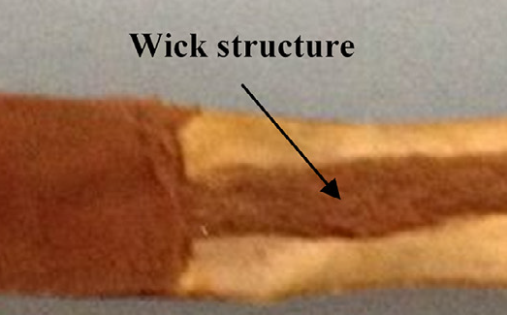
Micro-Structure of Wicks
Woven
Sintered

Slide 9
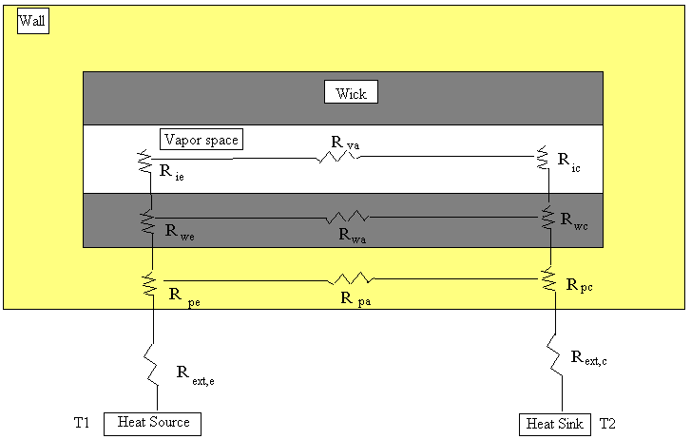
Thermal Resistance of A UTFHPipe

Slide 10
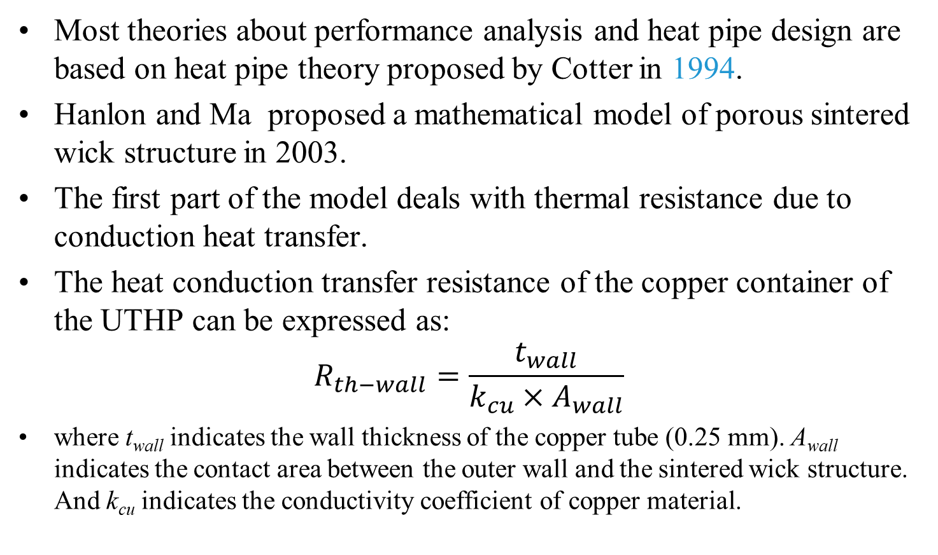
Macroscopic Thermal Resistance of UTFHPs
Most theories about performance analysis and heat pipe design are based on heat pipe theory proposed by Cotter in 1994.
Hanlon and Ma proposed a mathematical model of porous sintered wick structure in 2003.
The first part of the model deals with thermal resistance due to conduction heat transfer.
The heat conduction transfer resistance of the copper container of the UTHP can be expressed as:
$$R_{th−wall}=\frac{t_{wall}}{{k_{cu}×A}_{wall}}$$
where t_{wall} indicates the wall thickness of the copper tube (0.25 mm). A_{wall} indicates the contact area between the outer wall and the sintered wick structure. And k_{cu} indicates the conductivity coefficient of copper material.

Slide 11

Typical Contact areas of the evaporator and condenser sections in UTFHP

Slide 12


The effective thermal conductivity of the porous medium
The effective thermal conductivity of the porous medium of the copper powders is a function of solid conductivity (k_{s}), working fluid conductivity (k_{l}), and porosity (ε).
The effective thermal conductivity and thermal resistance of the wick can be determined by:

Slide 13
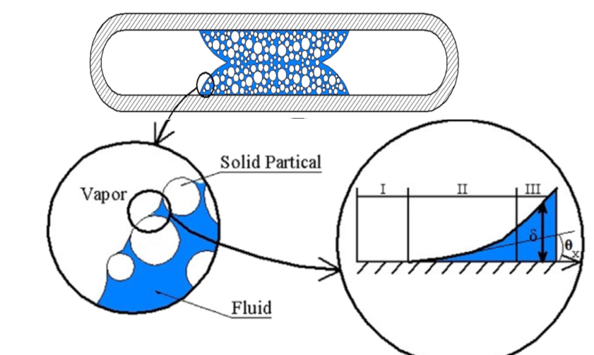
Thermal Resistance of Evaporation process
The meniscus formed among the copper particles/wires.
An assumption here is that only evaporation occurs at the liquid-vapor interface in the evaporator section.

Slide 14
Thermal Resistance of Evaporation Processor
Non-evaporating,
Evaporating film, and
Meniscus film regions.
Ma and Peterson (1997) stated that the thin film region between the particles in the wick structure located in the evaporator section can be divided into three regions:

Slide 15
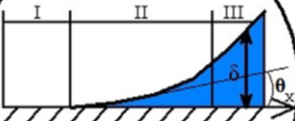
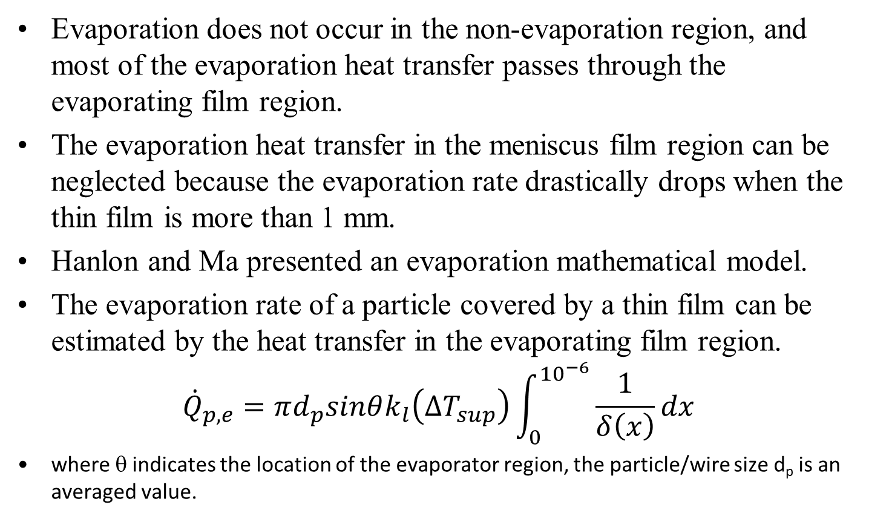
Physics of Evaporation in Porous Medium
Evaporation does not occur in the non-evaporation region, and most of the evaporation heat transfer passes through the evaporating film region.
The evaporation heat transfer in the meniscus film region can be neglected because the evaporation rate drastically drops when the thin film is more than 1 mm.
Hanlon and Ma presented an evaporation mathematical model.
The evaporation rate of a particle covered by a thin film can be estimated by the heat transfer in the evaporating film region.
$${\dot{Q}}_{p,e}=πd_{p}sinθk_{l}\left({∆T}_{sup}\right)\int_{0}^{{10}^{−6}}{\frac{1}{δ\left(x\right)}dx}$$
where θ indicates the location of the evaporator region, the particle/wire size d_{p} is an averaged value.

Slide 16
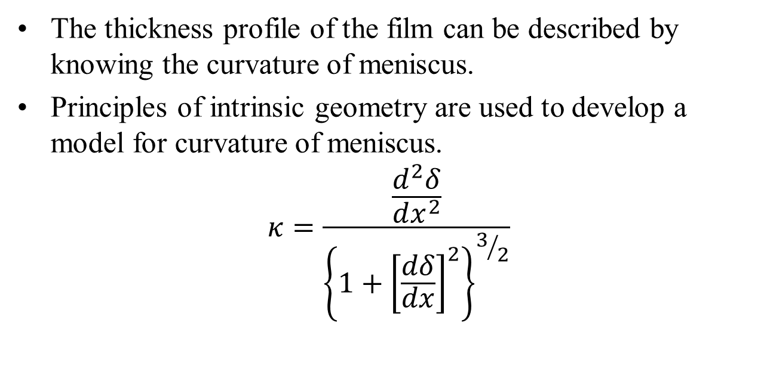
Physics of Evaporation in Porous Medium
The thickness profile of the film can be described by knowing the curvature of meniscus.
Principles of intrinsic geometry are used to develop a model for curvature of meniscus.
$$κ=\frac{\frac{d^{2}δ}{dx^{2}}}{{\left\{1+{\left[\frac{dδ}{dx}\right]}^{2}\right\}}^{3/2}}$$

Slide 17
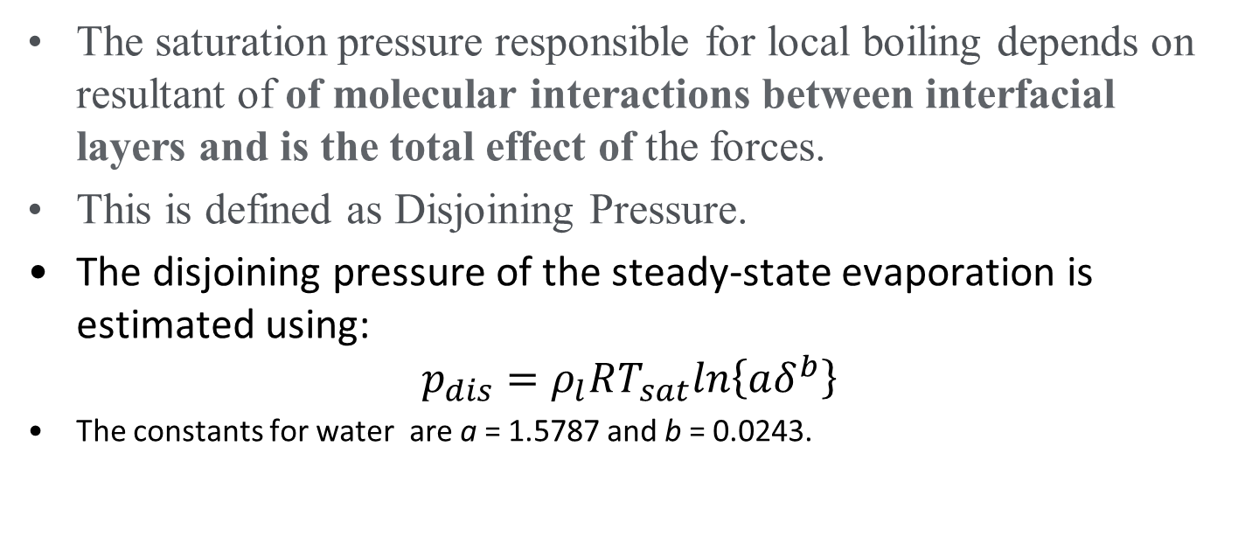
Physics of Evaporation in Porous Medium
The saturation pressure responsible for local boiling depends on resultant of of molecular interactions between interfacial layers and is the total effect of the forces.
This is defined as Disjoining Pressure.
The disjoining pressure of the steady-state evaporation is estimated using:
$$p_{dis}=ρ_{l}RT_{sat}ln\left\{aδ^{b}\right\}$$
The constants for water are a = 1.5787 and b = 0.0243.

Slide 18
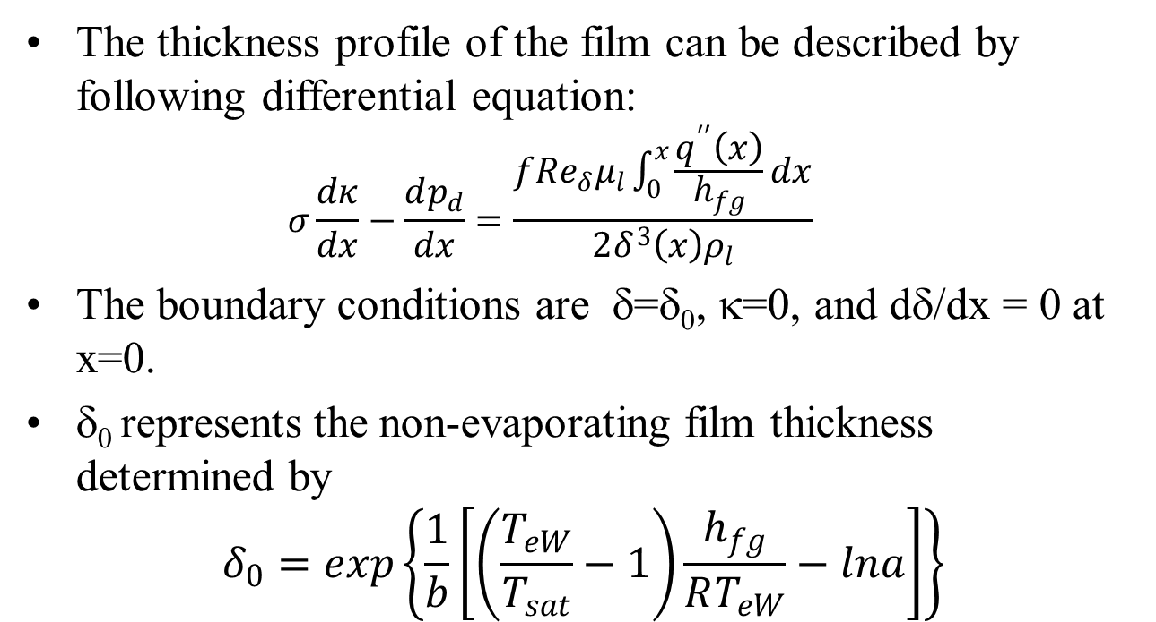
Physics of Evaporation in Porous Medium
The thickness profile of the film can be described by following differential equation:
  $$σ\frac{dκ}{dx}−\frac{dp_{d}}{dx}=\frac{f{Re}_{δ}μ_{l}\int_{0}^{x}{\frac{q^{′′}\left(x\right)}{h_{fg}}dx}}{2δ^{3}\left(x\right)ρ_{l}}$$
The boundary conditions are δ=δ₀, κ=0, and dδ/dx = 0 at x=0.
δ₀ represents the non-evaporating film thickness determined by
$$δ_{0}=exp\left\{\frac{1}{b}\left[\left(\frac{T_{eW}}{T_{sat}}−1\right)\frac{h_{fg}}{RT_{eW}}−lna\right]\right\}$$

Slide 19

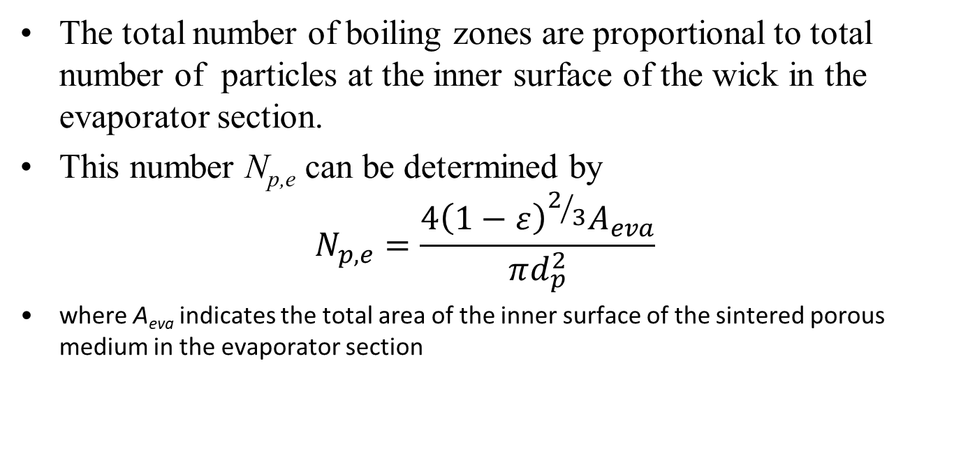
Total Number of Boling Zones
The total number of boiling zones are proportional to total number of particles at the inner surface of the wick in the evaporator section.
This number N_{p,e} can be determined by
$$N_{p,e}=\frac{4{\left(1−ε\right)}^{2/3}A_{eva}}{πd_{p}^{2}}$$
where A_{eva} indicates the total area of the inner surface of the sintered porous medium in the evaporator section

Slide 20
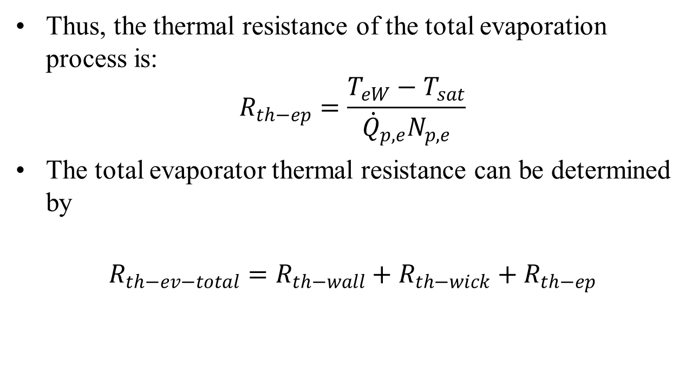
Thermal Resistance of Evaporator
Thus, the thermal resistance of the total evaporation process is:
$$R_{th−ep}=\frac{T_{eW}−T_{sat}}{{\dot{Q}}_{p,e}N_{p,e}}$$
The total evaporator thermal resistance can be determined by
$$R_{th−ev−total}=R_{th−wall}+R_{th−wick}+R_{th−ep}$$

Slide 21
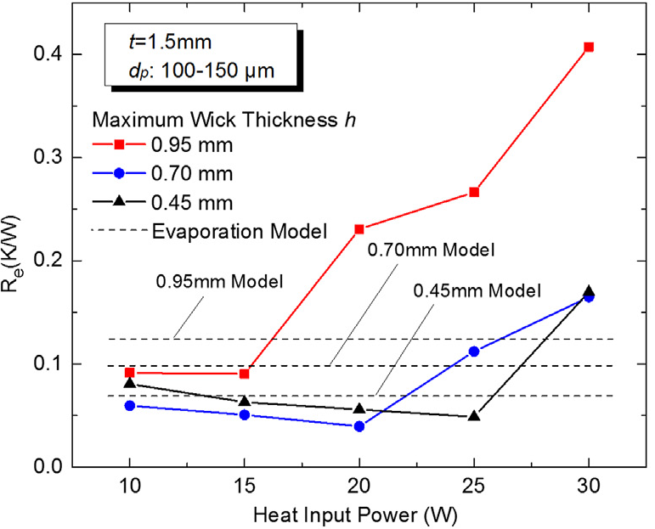
Evaporator Thermal Resistance: Effect of Wick Thickness

Slide 22
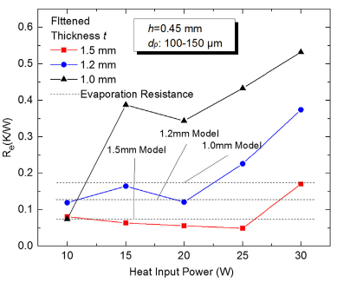
Evaporator Thermal Resistance: Effect of Flattened Thickness

Slide 23
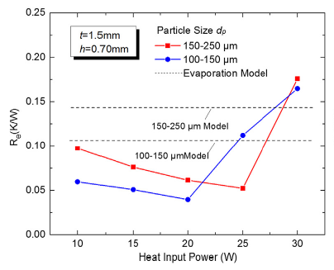
Evaporator Thermal Resistance: Effect of Particle size

Slide 24
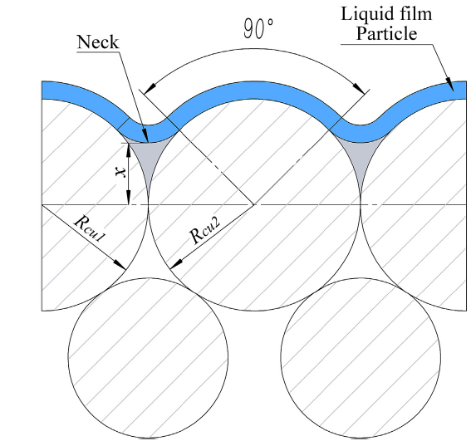
Thermal Resistance of Condenser
Condensation in the condenser section is considered as the laminar film condensation on the outer surface of the particles.
The condensation film varies in thickness because the particle positions change due to the gravity force effect.
In 2014, Florez et al. proposed an effective thermal conductivity model for thin film generated due to condensation on sintered porous media made from metal powders.

Slide 25
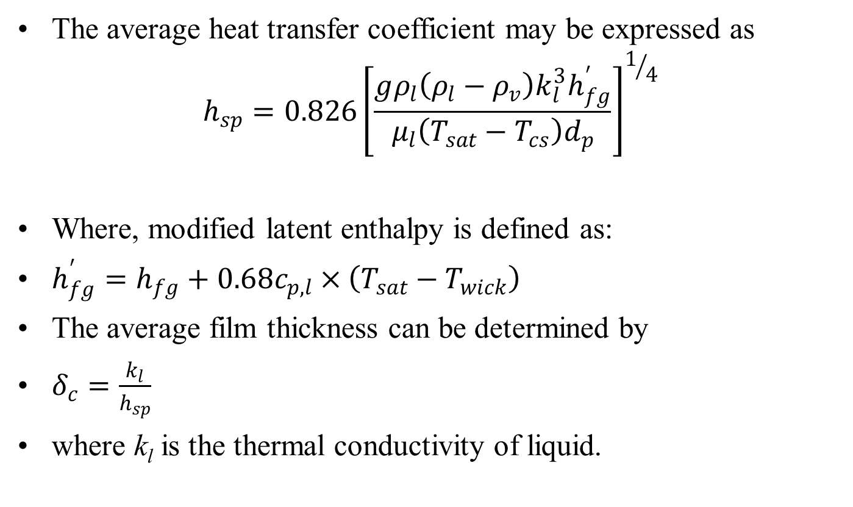
Thermal Resistance of Condenser
The average heat transfer coefficient may be expressed as
$$h_{sp}=0.826{\left[\frac{gρ_{l}\left(ρ_{l}−ρ_{v}\right)k_{l}^{3}h_{fg}^{′}}{μ_{l}\left(T_{sat}−T_{cs}\right)d_{p}}\right]}^{1/4}$$
Where, modified latent enthalpy is defined as:
$h_{fg}^{′}=h_{fg}+0.68c_{p,l}×\left(T_{sat}−T_{wick}\right)$
The average film thickness can be determined by
$δ_{c}=\frac{k_{l}}{h_{sp}}$
where k_{l} is the thermal conductivity of liquid.

Slide 26
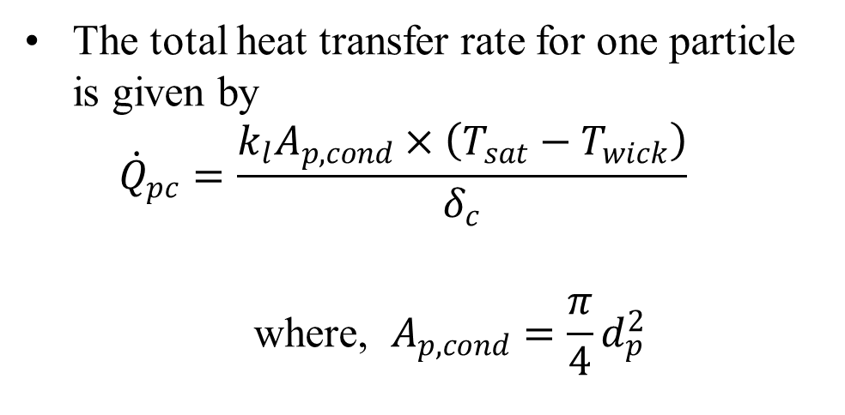
Thermal Resistance of Condenser
The total heat transfer rate for one particle is given by
$${\dot{Q}}_{pc}=\frac{k_{l}A_{p,cond}×\left(T_{sat}−T_{wick}\right)}{δ_{c}}$$
$$\text{where}\text{, }A_{p,cond}=\frac{π}{4}d_{p}^{2}$$
Ap,con is the effective condensation area of one particle and is estimated to be one forth of the surface area

Slide 27
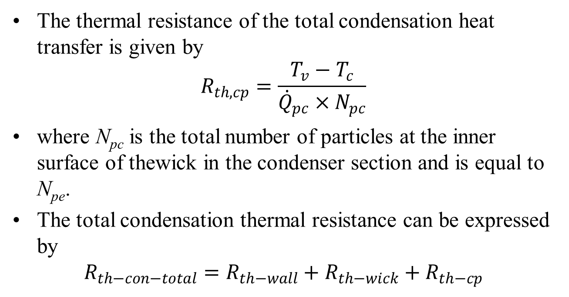
Thermal Resistance of Condenser
The thermal resistance of the total condensation heat transfer is given by
$$R_{th,cp}=\frac{T_{v}−T_{c}}{{\dot{Q}}_{pc}×N_{pc}}$$
where N_{pc} is the total number of particles at the inner surface of thewick in the condenser section and is equal to N_{pe}.
The total condensation thermal resistance can be expressed by
$$R_{th−con−total}=R_{th−wall}+R_{th−wick}+R_{th−cp}$$

Slide 28
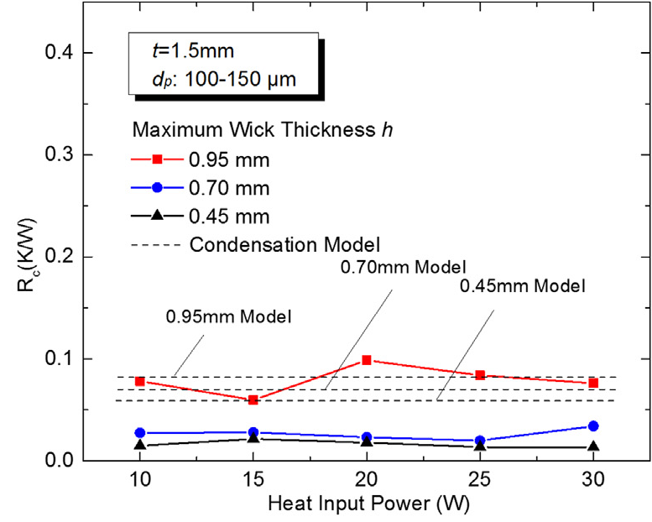
Condenser Thermal Resistance: Effect of Wick Thickness

Slide 29
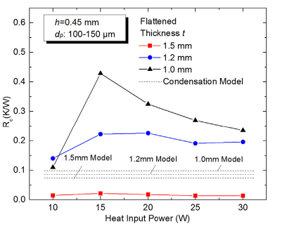
Condenser Thermal Resistance: Effect of Flattened Thickness

Slide 30
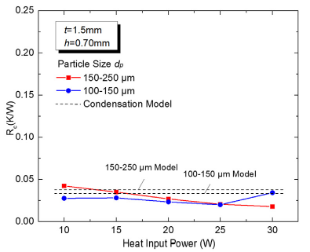
Condenser Thermal Resistance: Effect of Particle size

Slide 31
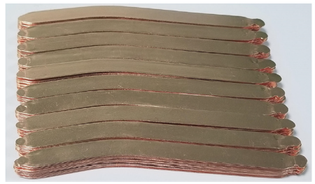
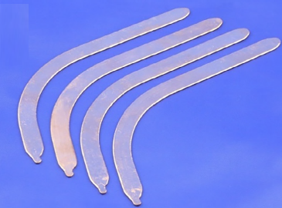
UTFHP Samples

Slide 32
UTHP Test Rig

Slide 33
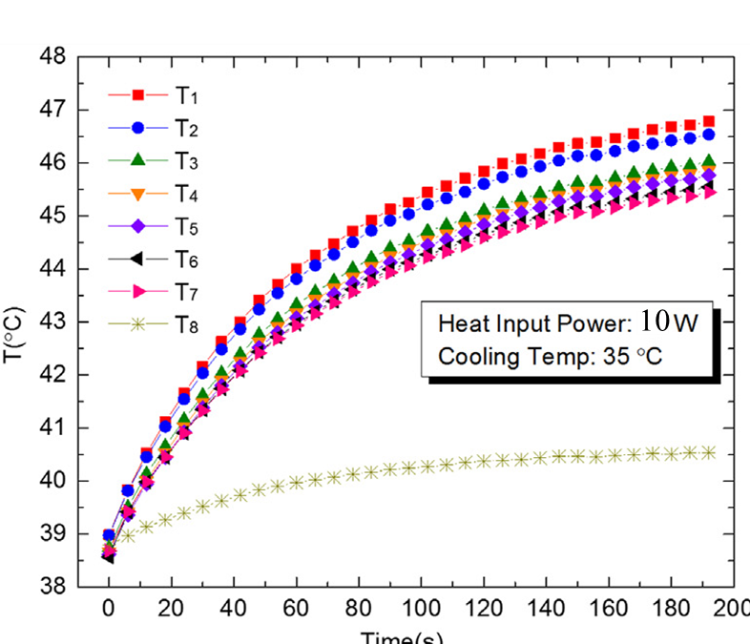
Thermal Performance of UTFHP

Slide 34
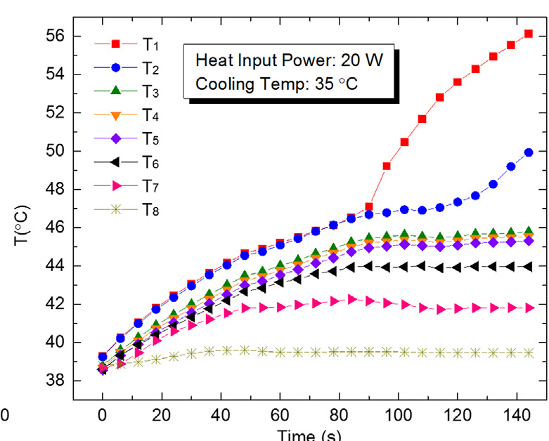
Thermal Performance of UTFHP

