Slide 1
Thermal management of electronic devices using Direct Immersion Boiling Process
P M V Subbarao
Professor
Mechanical Engineering Department
I I T Delhi
Exclusive Thermo-fluids for Electronics….…..

Slide 2
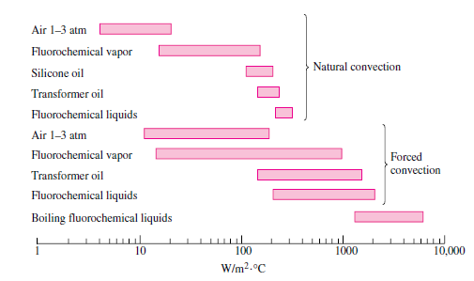
Typical heat transfer coefficients for various dielectric Liquids

Slide 3
Initial Remarks
Two-phase cooling systems can reduce the use of accessory equipment, such as chillers, pumps, and fans, potentially improving the energy efficiency of data centers.
These systems can avoid the surface temperature symmetry of electronic devices.
Improves heat dissipation efficiency.
Liquid-cooled DC systems have become popular for recent ICT equipment due to their energy-efficient heat removal capacity up to more than 100 W/cm².

Slide 4
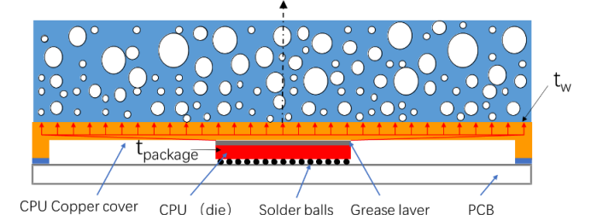
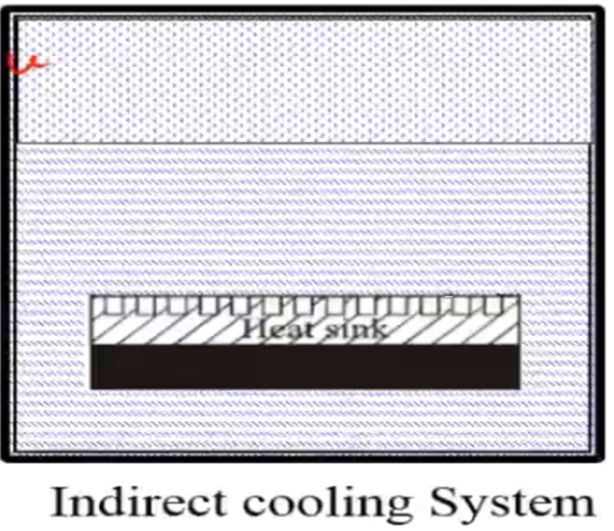
Classification of Convection Cooling Systems

Slide 5
Direct Cooling by Boiling Process
Boiling processes can be divided into;
Pool boiling
External flow boiling
Hybrid configurations with their combinations
The Pool Boiling (PB) is the simplest scheme among the above-mentioned boiling configurations.
PB has significant benefit of so-called passive cooling without requiring pumping power or moving parts in the system.

Slide 6
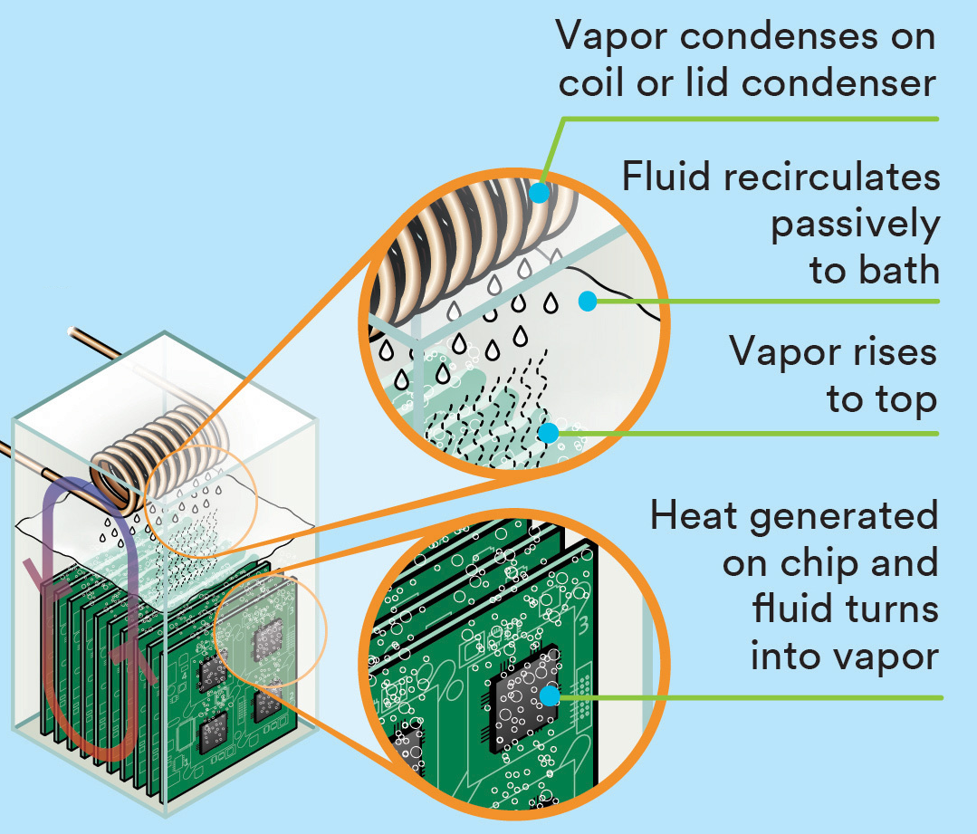
Two-phase Immersion Cooling Cycle of Gigabyte Servers

Slide 7
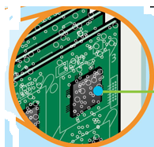
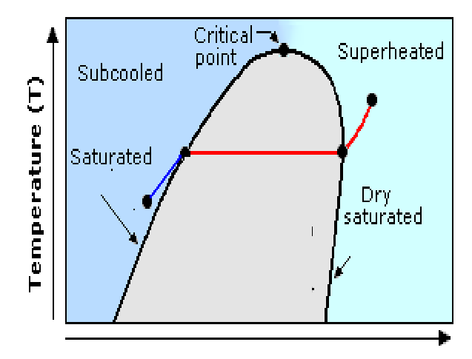
Case Temperature vs Coolant Pressure
Select fluid at a given pressure in a tank
Liquid
Liquid
Liquid
SaturaredLiquid + Vapour
vapour
Single phase cooling conditions:
Coolant can take a heat of mcΔT.
Ex: 1gm of water with 10 °C raise in temperature can carry a heat of 42J.
Internal Energy, kJ

Slide 8
Case Temperature vs Coolant Pressure
Liquid
Liquid
Liquid
SaturaredLiquid + Vapour
vapour
Two phase cooling may be possible.
Coolant can take a heat of mu_{fg}.
Ex: 1gm of water becoming steam can carry a heat of ∼ 2500J.
Boiling coolant can develop compact and efficient cooling systems.
Internal Energy, kJ

Slide 9
Basic Definitions for Boiling Heat Transfer Process
Liquid
Liquid
Liquid
SaturaredLiquid + Vapour
vapour
Initial studies showed that heat flux (q”) plays an important role along wall superheat in boiling process.
Internal Energy, kJ

Slide 10
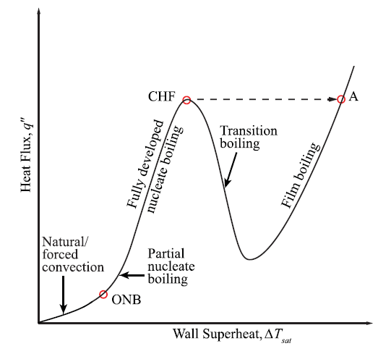
Boiling Curve &Modes of Boiling

Slide 11
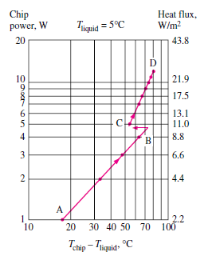
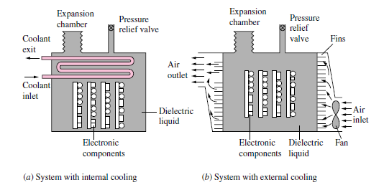
All-liquid immersion cooling systems

Slide 12
Boiling Curve &Modes of Boiling

Slide 13
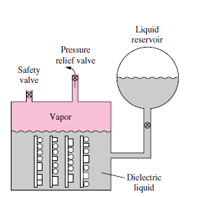
A simple open-loop immersion cooling system

Slide 14
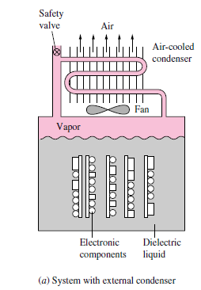
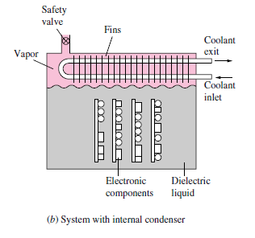
Closed-loop immersion cooling systems

Slide 15
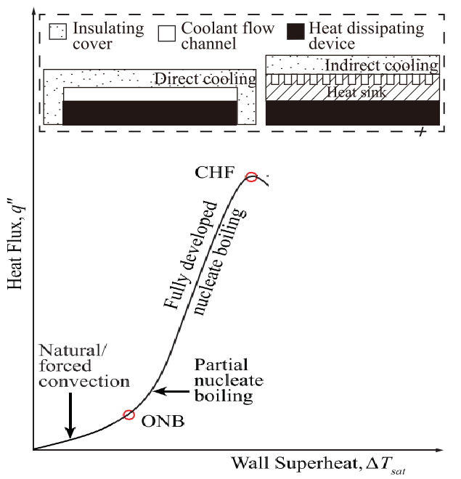
Heat Sinks to Maintain Safe Margin
$$Safe Margin$$

Slide 16
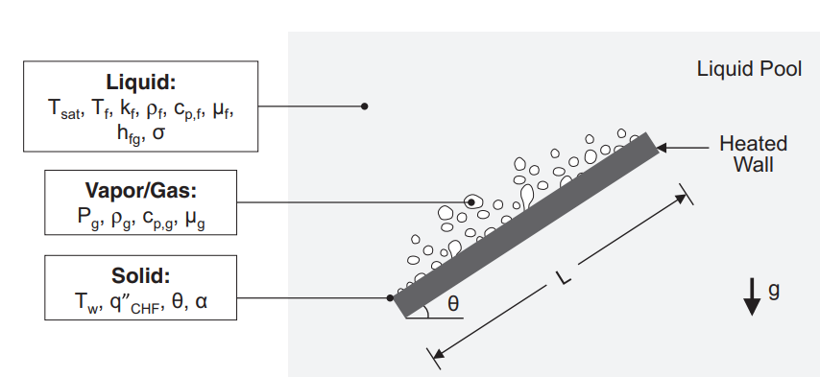
Nucleate Pool Boiling: Bubble Dynamics

Slide 17
Bubble growth on CPU Direct-Cooling
The process of liquid nucleate boiling includes three basic heat transfer episodes:

Slide 18
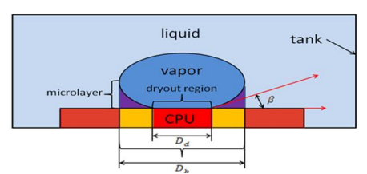
Episode 1: Immediately after Departure of Bubble
The departure of bubble from the CPU wall leads to occurrence of the unsteady heat transfer process between the liquid and the heating surface (CPU wall).
The lower temperature liquid enters the heating surface and the nearby space is occupied by the original bubble.
This new liquid will be in direct contact with the heating surface for a period of time.
∴ A heat flux q”_{re} is required for reconstruction of the thermal boundary layer just after the bubble breaks away.
The duration of occurrence of this heat flux is names as the waiting time before the bubble starts to grow.

Slide 19
Episode 2
This episode starts with initiation of bubble growth.
A thin layer of liquid at the bottom of the bubble absorbs heat from the heating surface and vaporizes when the bubble grows.
The evaporation heat flux q”_{me} is provided to the growth of the vapor bubble through heat conduction of the liquid microlayer.
The growth time from the beginning of the bubble growth to when it leaves will have evaporation heat flux.

Slide 20
Episode 3
The ever present natural convection heat transfer process between the heating surface and the liquid.
The natural convective heat flux density q”_{nc} of the area is not affected by the growth and separation of the bubble.
The growth and separation of the bubble on the heating surface cause disturbance to the nearby liquid, which greatly intensifies this process.
Figure shows a schematic diagram of heat growth for a vapor bubble on the wall of the CPU.
The total heat flux density on the wall is given by the following Equation:
$$q_{w}^{′′}=\frac{q_{me}^{′′}t_{gr}+q_{re}^{′′}t_{wi}}{t_{gr}+t_{wi}}+q_{nc}^{′′}$$

Slide 21
Nucleate Pool Boiling: Bubble Diameter
The average diameter of bubble departing from hot surface of a processor is:

Slide 22
Nucleate Pool Boiling: Minimum Wall Superheat
The minimum degree of superheat required to nucleate pool boiling depends on a non-dimensional number known as Jacob Number

Slide 23
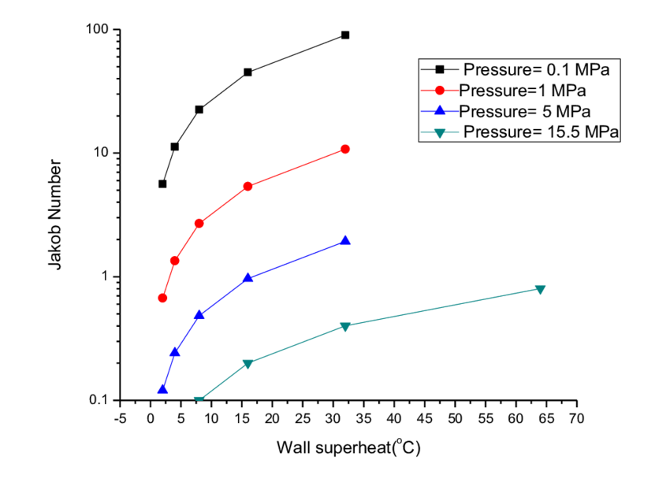
Nucleate Pool Boiling: Minimum Wall Superheat

Slide 24
Models for Nucleate Pool Boiling
Jacob Number is function of Reynolds and Prandtl numbers
The value of s varies in the range 1 – 1.7.
C_{NBHT} is to be determined for every case.

Slide 25
Nucleate Pool Boiling : Selection of Pressure

Slide 26
Correlations for Heat Transfer Coefficient
Considering its complexity, there is no widely accepted analytical equation for boiling heat transfer at presen
In order to meet the needs of engineering, many researchers use a large number of experimental data to obtain many boiling heat transfer equations.
Three boiling heat transfer equations have been considered as more useful here:
Shiraishi Correlation

Slide 27
Correlations for Heat Transfer Coefficient
Cooper Correlation
Kutateladze Correlation

Slide 28
Predicted & Measured Heat Transfer Coefficient

Slide 29
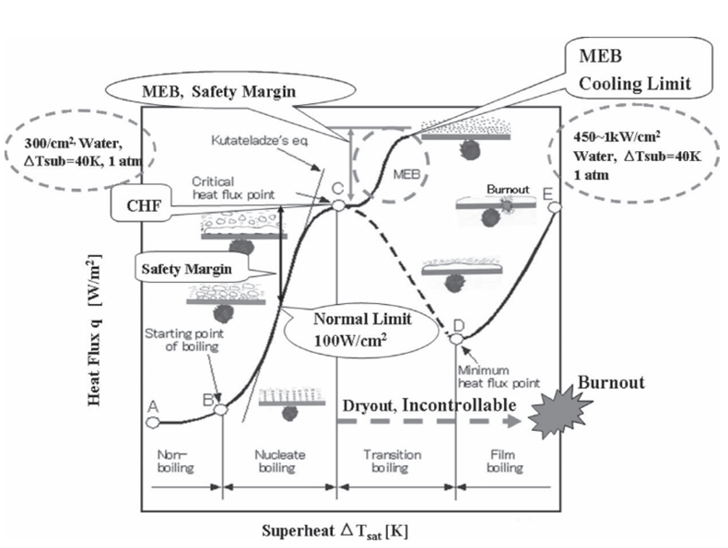
Two Phase Cooling Above Critical Heat Flux

