Slide 1

Thermal management of electronic devices using Direct Immersion Flow Boiling Process
P M V Subbarao
Professor
Mechanical Engineering Department
I I T Delhi
Pumping of Saturated Liquids for Cooling of Electronics….…..

Slide 2

Comparative chart of heat transfer coefficient for different cooling systems
Liquid Boiling

Slide 3
Flow Boiling Heat Transfer
Flow boiling heat transfer has been exploited in high-power electronics component cooling, and nuclear reactors cooling.
To make these applications more efficient and to achieve a significant reduction in energy consumption, advances in flow boiling heat transfer processes are currently required.
New physics and mechanisms certainly stem from flow boiling in small domains.
FB will be vital in high-capacity miniature heat exchangers for cooling of electronic chips and computers, and miniature heat exchangers.
In thermal-fluid systems, flow boiling heat transfer is the main heat transfer mode compared to pool boiling.

Slide 4

Heat flux classification.

Slide 5
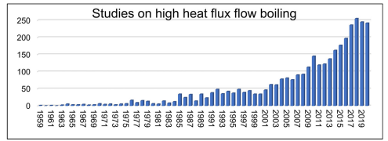
Focus of Research in Last Decade

Slide 6
Flow Boiling Process
Flow boiling occurs when all the phases are in bulk flow together in a channel.
The flow boiling is characterized by the forced convective flow over a surface induced by the external force, e.g. a pump.

Slide 7
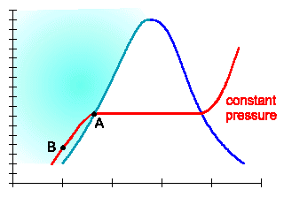
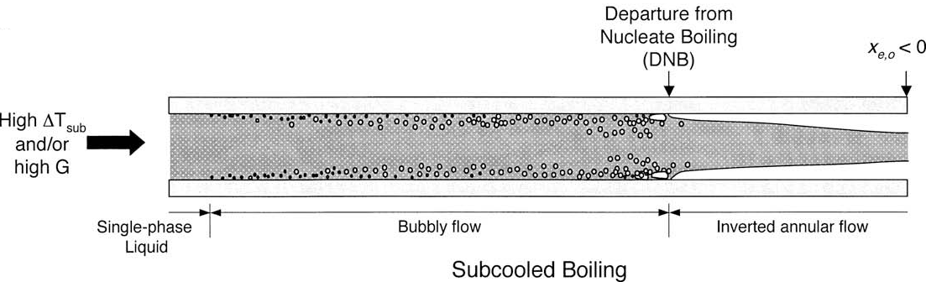
CHF mechanisms for flow boiling in uniformly heated channel: Subcooled Liquid
T, °C
Specific Enhalpy, h (kJ/kg)

Slide 8
Micro-Channel versus Macro-Channel Flow Boiling
Pipe diameters of 100–600 μm is classified as micro-channels.
Distinguishing between macro- and micro-channel flows cannot be based on channel size alone.
A channel may behave as a micro-channel for certain fluids and operating conditions and as a macro-channel for others.
For two-phase flow, this boundary is closely related to the ratio of bubble size to channel diameter,
The larger the ratio, the more likely that the flow will behave as a micro-channel flow.
This ratio is known as Confinement number.

Slide 9
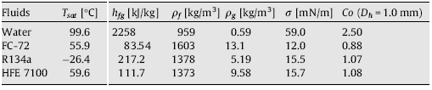
Micro-Channel Flow Boiling : Confinement Number
Confinement number, Co

Slide 10

Classification of heat exchanger for different hydraulic diameters

Slide 11
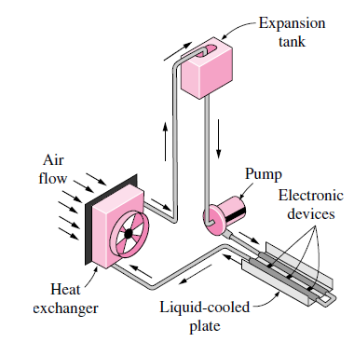
Indirect Liquid Cooling System

Slide 12
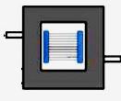
Micro-channel Heat Sinks

Slide 13
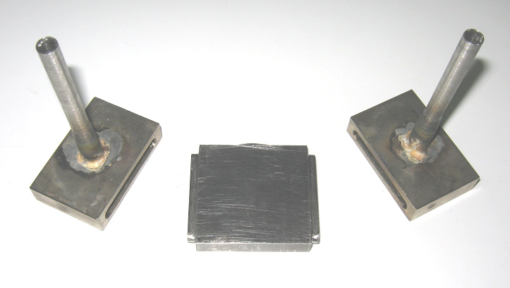
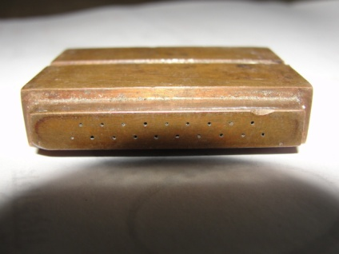
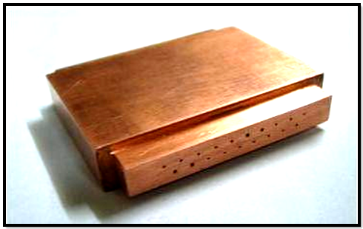
Micro-channel Heat Sinks @IIT Delhi
Heat sink consisting of 18 channels in 9x2 staggered format made by EDM process
-- The channels are 400 ± 09 μm hydraulic diameter having 40mm length.
-- Optical microscope, Make: Denolite AD4116T Premier, under 225 times magnification was used to determine the channel hydraulic diameter (400±09) µm.

Slide 14
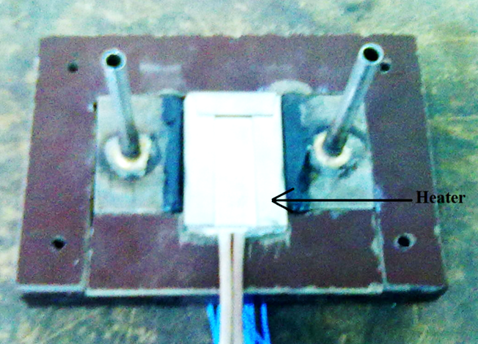
Dummy Electronic Device with Micro-channel Heat Sink

Slide 15
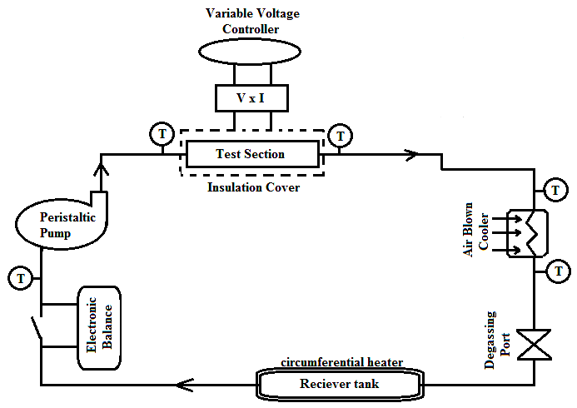
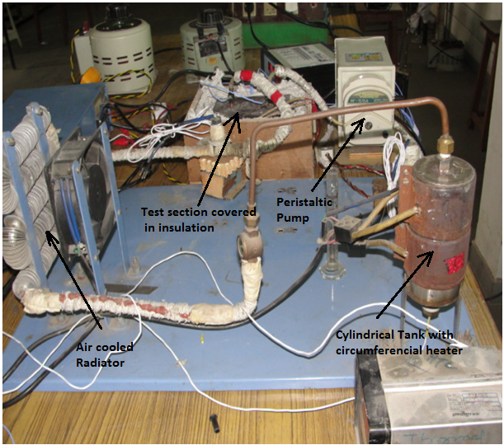
The Complete Experimental Facility

Slide 16
Flow Boling Studies

Slide 17
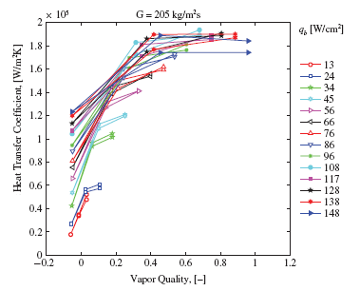
Heat transfer coefficient Vs local vapor quality

Slide 18
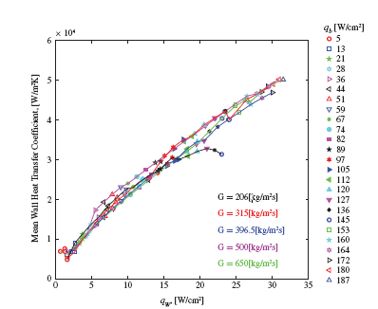
Average Heat transfer coefficient Vs Wall Heat flux

Slide 19
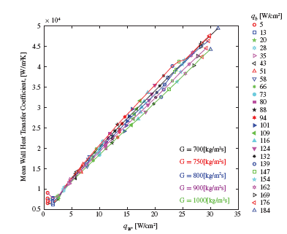
Heat transfer coefficient Vs local vapor quality

Slide 20
Correlation for CHF
CHF correlations are based on either inlet (upstream) channel conditions or outlet (local) conditions.
Pressure, mass velocity and diameter appear in both types of correlations.
However, the effect of inlet quality in inlet conditions correlations is expressed in terms of inlet enthalpy (or inlet subcooling or quality).
These correlations also account for quality variations along the channel through their dependence on channel length

Slide 21
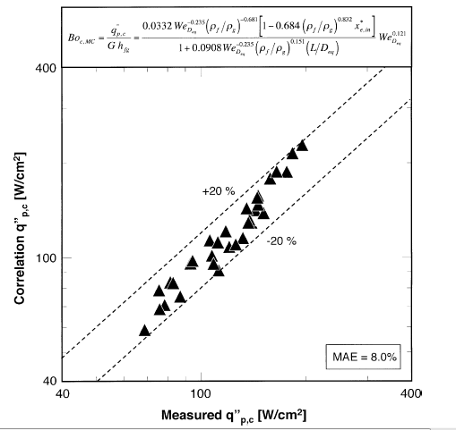

Slide 22
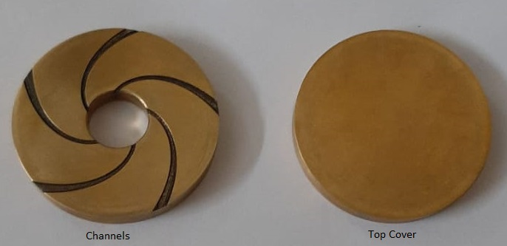
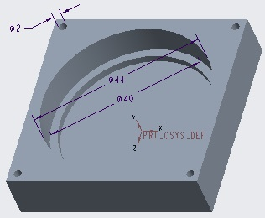
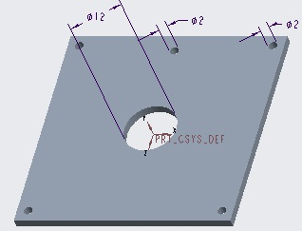
Radial Flow Heat Sinks
Material | Brass
Angular Spacing | 72º
Thickness (Substrate) | 5 mm each
Channel Depth | 200±10 µm
Manufacturing Method | Femtosecond Laser Machining
Material | Brass
Height X Width X Length | 15 X 50 X 50 mm
Manufacturing Method | 3 Axis CNC Machining

Slide 23
Nano refrigerants for Enhanced Flow Boiling Heat Transfer
Nanotechnology is a key technology in developing nano refrigerants.
Using nanofluids based on nanoparticle suspensions in a base fluid is one of the approaches to enhance boiling heat transfer.
The thermophysical properties essentially influence the cooling efficiency for traditional heat transfer coolants.
By the dispersion of solid particles, these properties, particularly thermal conductivity and viscosity, could be critically altered.
A nanofluid is a type of heat transfer fluid containing nanoparticles, which are uniformly suspended in a base liquid (typically 1-100 nm in size).

Slide 24
Nano refrigerants for Enhanced Flow Boiling Heat Transfer
Maxwell was the first physicist to suspend dispersed particles in liquids to obtain improved thermal properties.
Nowadays, the use of nanofluids has been explored in numerous fields and industries.
Nano refrigerant is one type of nanofluids, where a pure conventional coolant is the base fluid.
A higher thermal conductivity of nano refrigerants than the base refrigerant.
Refrigeration systems with the use of nano refrigerants also had a better performance than those with conventional coolant.

Slide 25
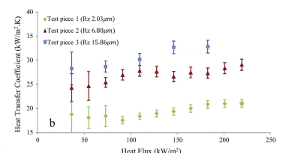
Surface Roughness for Enhanced Heat Transfer
G = 85kg/m², Dryness Fraction, x_{exit} = 0.3

Slide 26
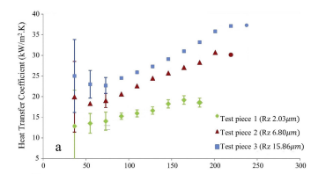
Surface Roughness for Enhanced Heat Transfer
G = 85kg/m², Dryness Fraction, x_{exit} = 0.5

Slide 27
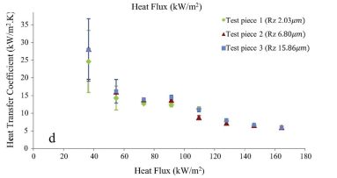
Surface Roughness for Enhanced Heat Transfer
G = 85kg/m², Dryness Fraction, x_{exit} = 0.8

Slide 28
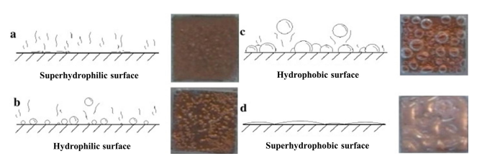
Surface Wettability for Enhanced Heat Transfer

