Slide 1

Thermal Management of Electronic facilities
P M V Subbarao
Professor
Mechanical Engineering Department
I I T Delhi
One pound of coal to create , package , store 2 megabytes of data

Slide 2

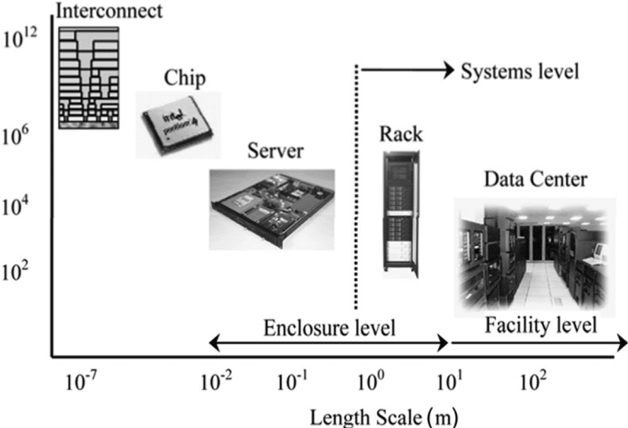
Holistic View of Thermal Management of Data Centers
Heat Generation Scale

Slide 3
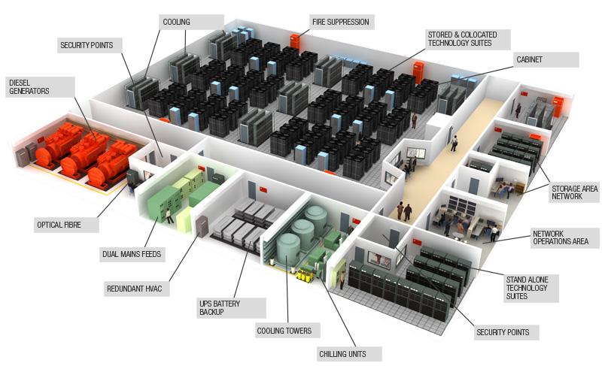
Anatomy of Data Center

Slide 4
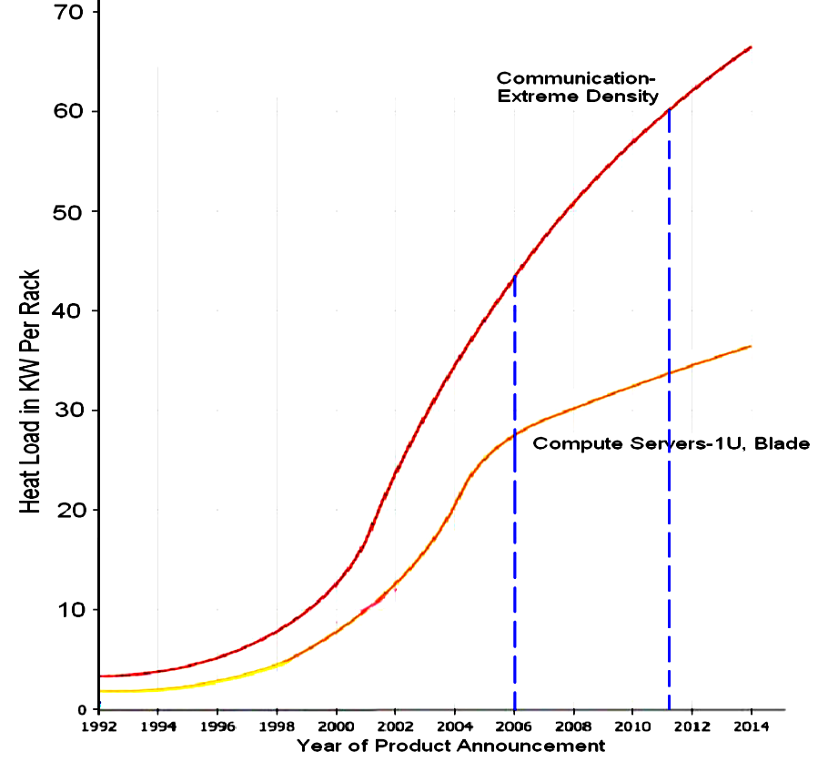
Typical air-cooling system in Sub-sections of A
Data Center

Slide 5
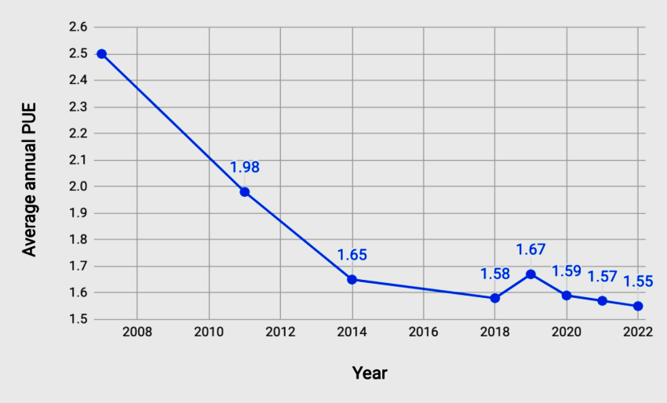
Thermal Management of Benchmarked facilities

Slide 6
First Question
What should the design specifications of new energy efficient thermal solutions be in the next generation data centers?

Slide 7
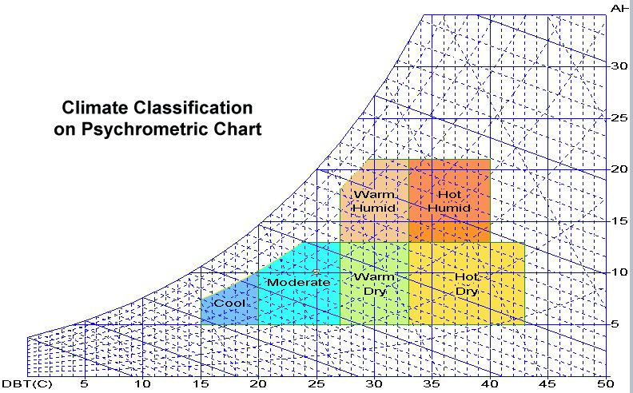
Specific Humidity
(gms of water vapour/kg of dry air)

Slide 8
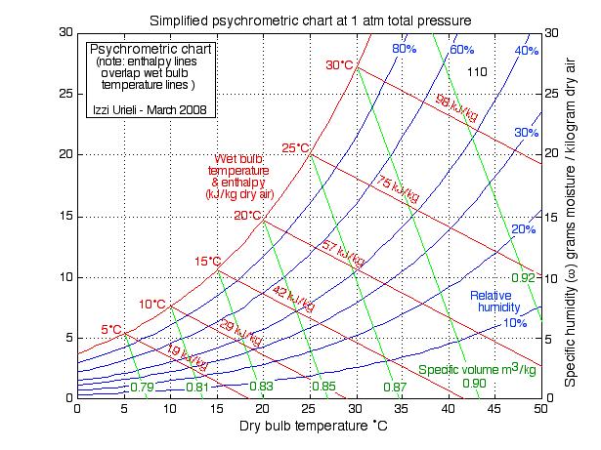
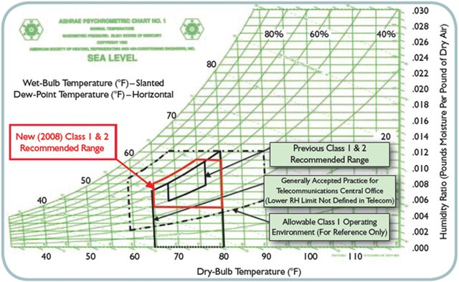
ASHRAE temperature & Humidity guidelines for data centers

Slide 9
Breakdown of energy end-use of data centers

Slide 10





Sample Data Center: PUE Impact
Assumptions
  5 Mw IT load
  $0.10/kW-hr
  7x24 operation
  Sample data center: PUE 2.0
  10 Mw purchase from utility
  $8.8 million annual power bill
  Best in class: PUE 1.4
  7 Mw purchase from utility
  $6.1 million annual power bill
Net Savings of $2.7 Million Annually Through Increased Efficiency

Slide 11
Brief Description of IIT Delhi DC
The server room contains 38 numbers of racks including 12 numbers of blank racks.
The average electricity load is 180 kW to 220 kW during the peak day use of the server.
The cooling of DC building is accomplished using:
Three number of water-cooled chillers, and
Four precision air conditioning units (PAC Units).
Heat rejection of the water-cooled chillers’ is taking place in Cooling Towers.
PAC unit contains in-built compressor units to reject heat to the air.
Chilled water plant is located at the terrace of the DC Block. The server room is being catered to by both PAC and chillers.

Slide 12
Case Study: IIT Delhi Data Center
One PAC and one Chiller is shown for the sake of simplicity.

Slide 13
Cooling of racks with raised floor of data center

Slide 14
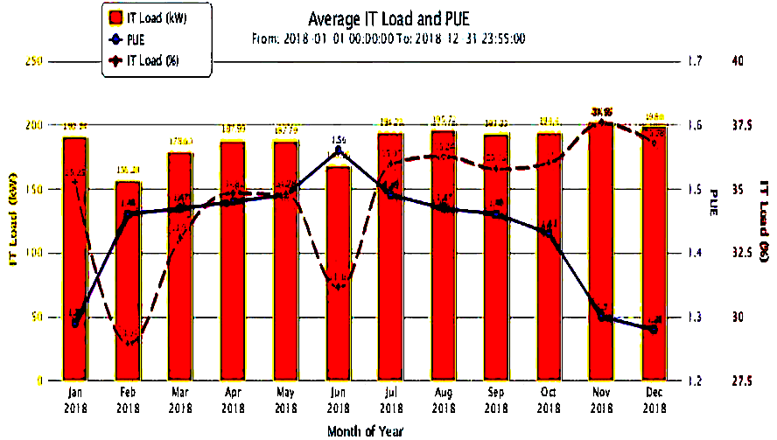
Energy consumption trend in DC- IITD

Slide 15
Cooling system used in DC.
Server Room : 4 × 11 TR(PAC)
Two Electrical Rooms: 7.5TR Each room with 2 units (PAC)
Two Battery Rooms: 2 TR Each room with 2 units (Split AC)
Communication Room: 2 × 3.5TR(PAC)
BMS Room: 2 × 2.5TR (Cassette AC)
Three Chillers: 3 × 76 TR
Two Cooling Towers: Each 231TR

Slide 16
Units of Refrigeration Capacity
Ton of Refrigeration (TR):
Ton of Refrigeration (abbreviated as TR) is an important historical unit of refrigeration capacity.
Originally 1 TR was defined as the rate of heat transfer required to make 1 ton of ice per day from water at 0ºC.
American Society of Heating, Refrigerating and Airconditioning Engineers (ASHRAE) defines 1 TR as equivalent to a refrigeration capacity of 3516.85 W.
Tons of Refrigeration or simply Tons is often used as a general term to indicate the capacity or size of the refrigeration plant.
Thus 1 TR air conditioner has a refrigeration capacity of 3516.85 W at the prescribed temperatures.

Slide 17
Schematic diagram of server cooling infrastructure

Slide 18
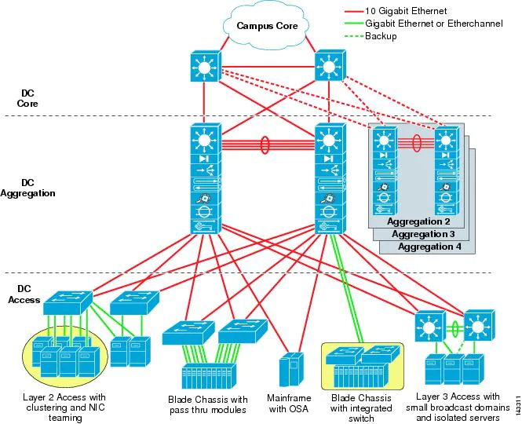
Thermodynamics of A Reversible Data Center
W_{ideal-input} = 0.018eV per bit of computation @298K
An insulated reversible data center will remain near diabatic.

Slide 19

Thermodynamics of An Irreversible Data Center
W_{irr-input} = 375 – 600 eV per bit of computation @298K
The temperature of an insulated data center will continuously increase.
Cooling is essential to keep at near diabatic.

Slide 20
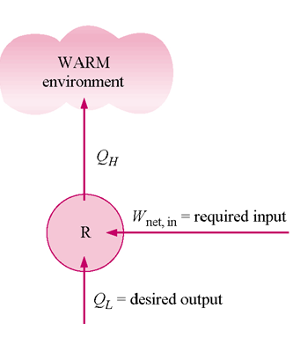
Thermodynamic cycle for Cooling An Irreversible Data Center
HP
W_{irr-input} = 375 – 600 eV per bit of computation @298K

Slide 21
Cooling and Energy Efficiency
Entire IT load on a data center is converted into thermal energy of a data center.
Cooling through heat transfer (removal) is predominantly collected using forced convection.
This requires an adequate supply of chilled coolant for continuous operation of Data centers.
Different cooling systems designs are innovated which are tailored to best cope with specific heat load magnitudes and to exploit favourable local climatic conditions

Slide 22
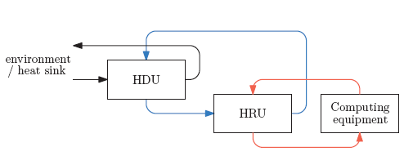
High Level Data Center Heat Cycle
The thermal energy generated by the computing equipment needs to be harvested into a heat-transfer medium such as air, or less commonly water, oil, and synthetic refrigerants.

Slide 23
High Level Data Center Heat Cycle
A Heat Recovery Unit (HRU) processes the warm coolant drawn from the equipment’s exhaust before recirculating it back to the computer room’s distribution setup at a lower temperature.
The HRU’s operation is supported by a secondary cooling loop that extends outside the physical boundaries of the computer room to a Heat Disposal Unit (HDU).

Slide 24
High Level Data Center Heat Cycle
The HDU is tasked to supply facility-wide cooling resources.
All the heat generated and additional power consumed by cooling systems is dumped into local outdoor atmosphere.

Slide 25
Classification of Heat Removal Methods

Slide 26
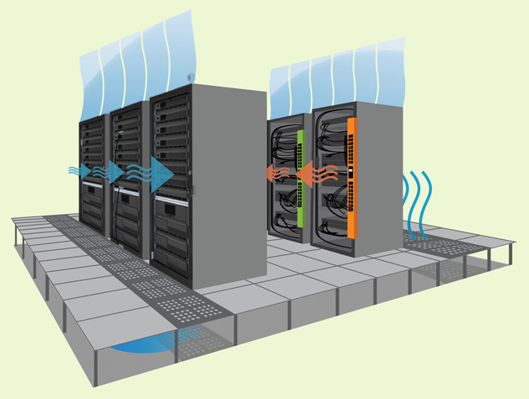
Cooling of racks with raised floor of data center

Slide 27
Rear Door Heat Exchanger (RDHX) for A Rack

