Slide 1

OPEN THERMAL DESIGN OF DATA CENTERS
P M V Subbarao
Professor
Mechanical Engineering Department
I I T Delhi
Flexible Thermal Environment for Electronics….

Slide 2

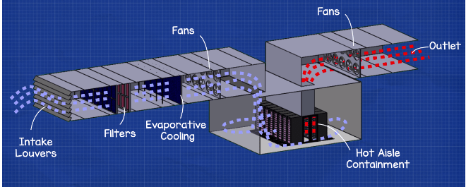
Types of Cooling Systems for DC
Free Cooling is a cost-effective way to ensure that your data center’s temperature flow is properly functioning.
In this technique, the cooling used are minimalistic and reduce the overall expenditures for cooling.
This method consists of two systems known as air-side economization and water-side economization.
Air-side economization uses air from the outdoors to regulate the equipment’s coolness.
This technique has its flaws since it can potentially allow pollutants and moisture from the outdoors to enter into the data center.

Slide 3
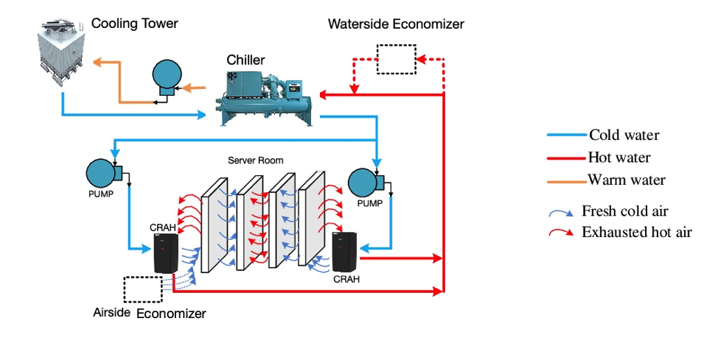
Types of Cooling Systems for DC
Chilled Water System:
Liquid cooling can be more efficient and direct in its cooling techniques.
This is due to the fact that chilled water can be directly targeted to the desired area, without it being necessary to supply cool air to all areas of the facility.
With the chilled water technique, the CRAH is connected to a chiller.
As the chilled water travels through coils, it engulfs the heat and deposits it into the chiller.
Once the water returns to the chiller, it merges with condenser water flowing through a cooling tower.

Slide 4
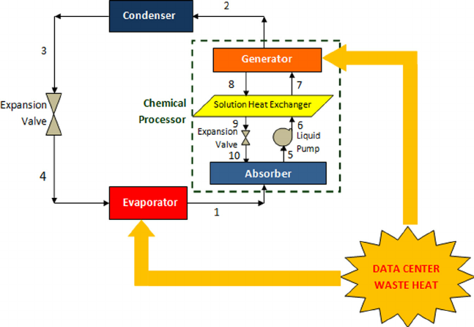
Types of Cooling Systems for DC
Pumped Refrigerant
This method pumps chilled water through a heat exchanger and utilizes a cold pumped refrigerant to draw out the heat.
The Pumped Refrigerant technique provides savings since it has the capacity to transmit energy from servers and it allows for humidification to be greatly reduced.

Slide 5
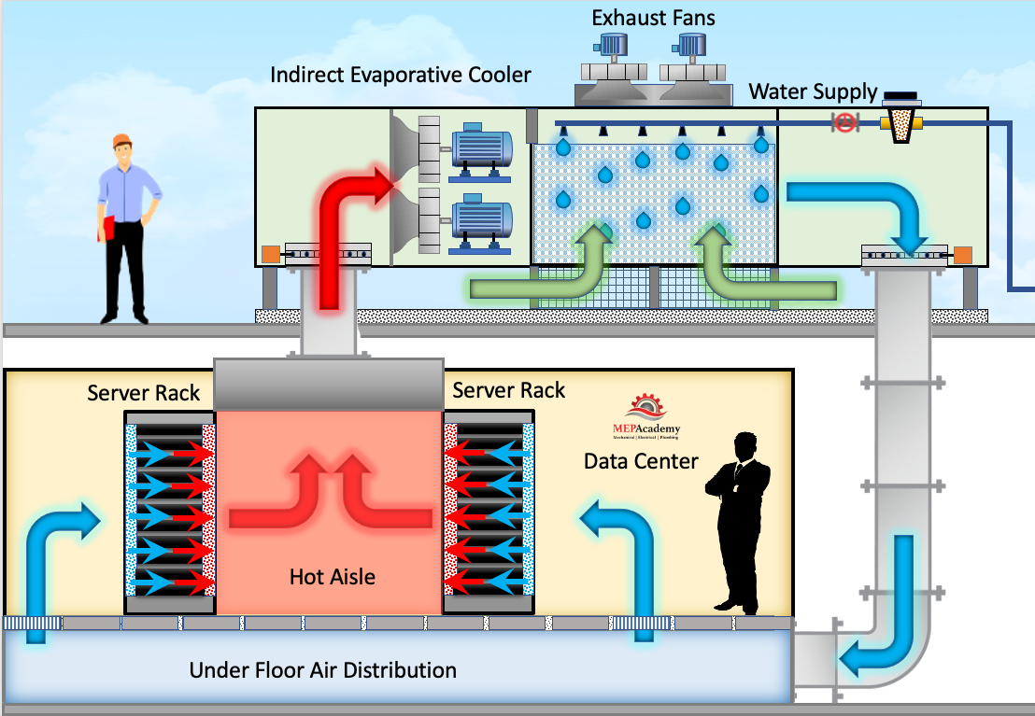
Types of Cooling Systems for DC
Indirect Air Evaporative System
With this technique, an air-duct that is connected to an indirect air evaporative cooler is utilized. This method is energy efficient and uses weather from the outdoors to cool the facility at times when it is cooler than the temperature inside. This air is used to add cooler air to the airflow within the data center.

Slide 6
Requirements of an Ideal Thermal Envirnoment
The requirements based on an ideal vision of the future design environment are classified into ten categories.
Quality, Sustainability, and Reliability
Reduction of Cost and Time-to-market
Lifecycle Mismatch
Environmentally benign and green system
Concurrency
Flexibility, adaptability, and mutability
Robustness
Mass customization
Continuous improvement and indefinite growth
Multiscale Systems

Slide 7
Open Thermo-fluid Engineering
Open thermo-fluid systems are systems of industrial products, services, and/or processes that are readily adaptable to changes in their environment.
OTE enable producers to remain competitive in a global marketplace through continuous improvement and indefinite growth of an existing technological base.
Multiscale Systems could be considered as a potential solution to approach an open thermofliud engineering system. solution in data centers.
Convection cooling systems are selected by understanding the different levels (scales) of thermal management problems in electronic enclosures.
Achieves the best overall effectiveness at the system level”

Slide 8
A blade server rack with involved scales

Slide 9
Air-cooled data center with involved scales

Slide 10
Scale -1 Engineering
Chip Level: This scale solution includes different methods to enhance heat dissipation from the chip itself.
It includes the design of effective heat sinks and micro heat exchangers attached to the chip for single or two-phase heat transfer.
Design of new high conductive thermal adhesives or innovative methods for the attachment the die to the heat spreader, including the use of solder maybe considered in this scale.
The theoretical limitation of the heat removal from the chip.

Slide 11
Scale -2 Engineering
Server Level: These scale solutions happen within or on the
printed circuit board of the server.
These solutions mostly are related to designing of different cold plates in combination with the chip scale solutions.
A Liquid Cooling System is a good example to use in this scale.
The innovative solutions in this scale should focus on effective directing of heat through a path from the chip to the board and finally to the ultimate ambient.

Slide 12
Scale -2 Engineering
Server Level:
The heat rejection through path of chip/substrate/board can be done by using additional solder balls as the thermal interconnects and heat spreaders or board-integrated liquid cooling as the board heat removal means.
Designing an air cooled base plate channel with implemented graphite foam.
Designing a microfibrous material as mini-heat exchangers is an innovative cooling system.

Slide 13
Scale -3 Engineering
Chassis Level:
In air cooling systems, this scale is used to install the designed fans.
This scale encompassing the space in front of each set of the
blade servers.
This scale plays a great role in applying various solutions to the rack, especially in combination with two previous scales.
Design and Installation a compact heat exchanger or refrigeration systems.

Slide 14
Scale -4 Engineering
Rack Level: This scale is suitable for using macro heat exchanger for heat removal from the hot air exiting through the rack before entering the room.
IBM rear door water-cooled heat exchanger is an innovative solution in this scale offered by IBM.
An air-water or air-refrigerant heat exchanger can be designed to install on the top or sides of the rack while they can directly use the chilled water flowing through the tubes in the plenum of the data center.

Slide 15
Scale -5 Engineering
Room Level: This scale has been the standard thermal solutions to a facility.
Computer Room Air Conditioning (CRAC) units were outcome of this scale.
Various researchers in the recent years developed methods to enhance the effectiveness of the typical air-cooling & supply systems and prevent the recirculation.
To optimize the configurations of the racks and CRAC units and the dimensions of the racks and room to prevent the recirculation is the major work element.
The heat transfer in this scale can be enhanced by using the different heat exchangers in possible connection with the rack (Scale 4).

Slide 16
Scale 6 Plenum Level

Slide 17
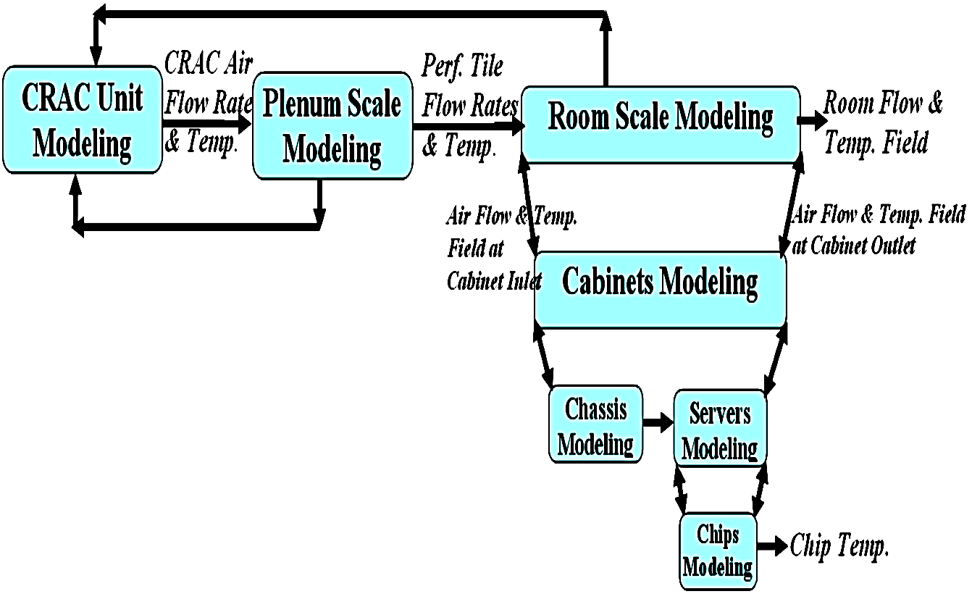
Design of Open Multiscale Solution

Slide 18
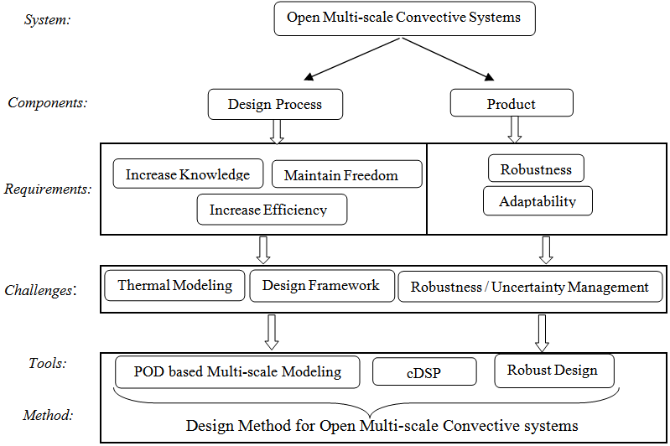
Methodology to Design open multi-scale convective systems

