Slide 1

DESIGN OF ADAPTIVE & EFFICIENT DATA CENTERS
P M V Subbarao
Professor
Mechanical Engineering Department
I I T Delhi
Flexible Thermal Environment for Electronics….

Slide 2

Multi-Scale Analysis of A DC

Slide 3
The Goal
Development of Advanced Thermal Architecture,
by
understanding the different levels (scales) of thermal problems in electronic enclosures.
Selection of technologies to address the problems at component levels and
to achieve the best overall effectiveness at the system level.

Slide 4
Multiscale water-cooling system

Slide 5
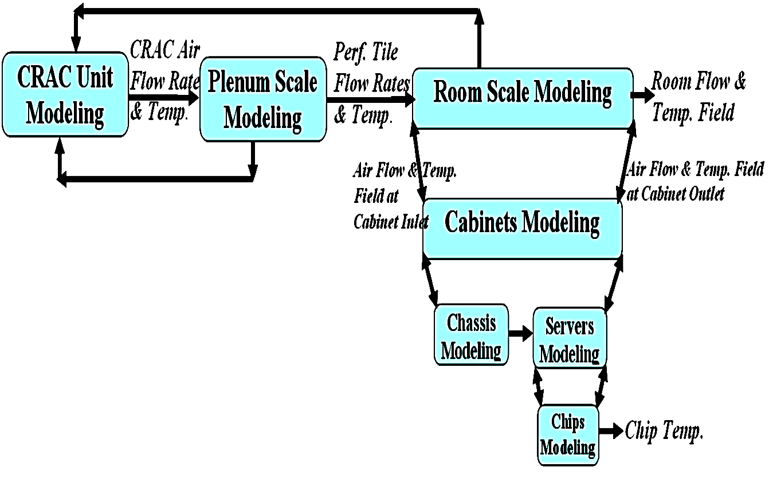
Design of Open Multiscale Solution
ENERGY EFFICIENT THERMAL MANAGEMENT OF DATA CENTERS VIA OPEN MULTI-SCALE DESIGN
By Emad Samadiani Georgia Institute of Technology
December 2009

Slide 6
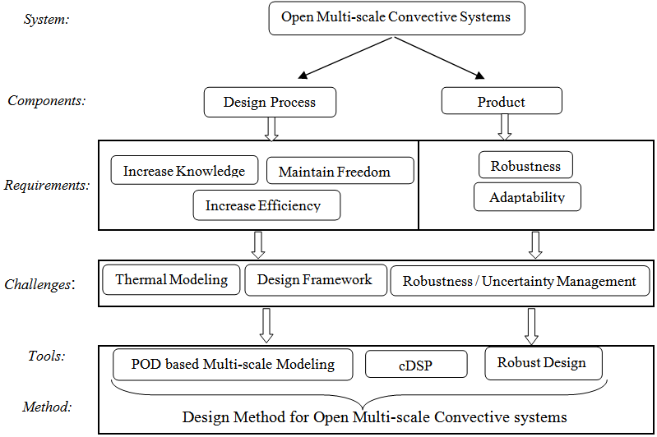
Methodology to Design open multi-scale convective systems

Slide 7
Compromise Decision Support Problem (cDSP)
The cDSP is a hybrid formulation based on Mathematical Programming and Goal Programming.
It is used to determine the values of the design variables, which satisfy a set of constraints and bounds and achieve as closely as possible a set of conflicting goals.
The structure of the cDSP is as follows:
Given: A feasible alternative, assumptions, parameter values and goals.
Find: Values of design and deviation variables.
Satisfy: System constraints, system goals, and bounds on variables
Minimize: Deviation variable that measures distance between goal targets and design points

Slide 8
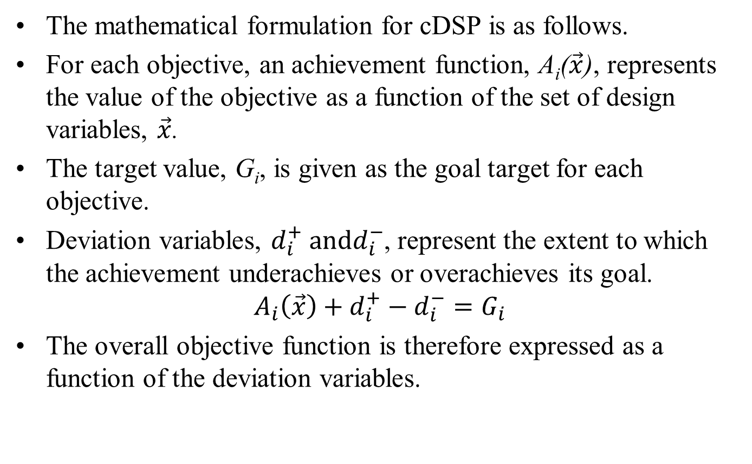
Mathematical Formulations fo cDSP
The mathematical formulation for cDSP is as follows.
For each objective, an achievement function, A_{i}($\vec{x}$), represents the value of the objective as a function of the set of design variables, $\vec{x}$.
The target value, G_{i}, is given as the goal target for each objective.
Deviation variables, $d_{i}^{+} andd_{i}^{−}$, represent the extent to which the achievement underachieves or overachieves its goal.
$$A_{i}\left(\vec{x}\right)+d_{i}^{+}−d_{i}^{−}=G_{i}$$
The overall objective function is therefore expressed as a function of the deviation variables.

Slide 9
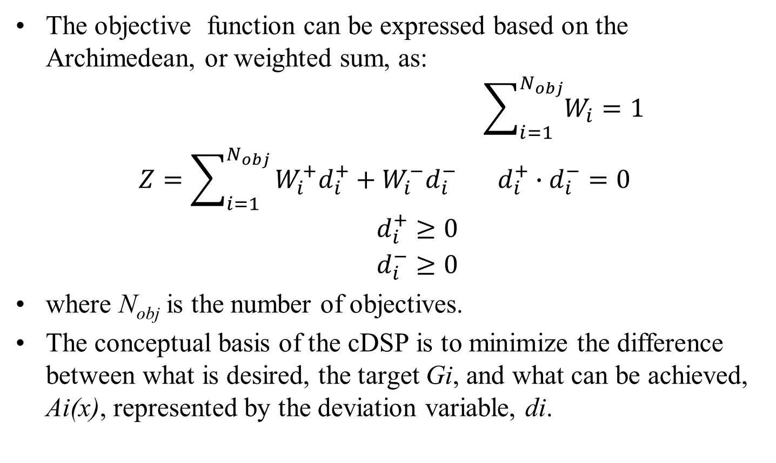
Mathematical Formulations fo cDSP
The objective function can be expressed based on the Archimedean, or weighted sum, as:
$$\begin{matrix} & \sum_{i=1}^{N_{obj}}{W_{i}=1} \\ Z=\sum_{i=1}^{N_{obj}}{W_{i}^{+}d_{i}^{+}+W_{i}^{−}d_{i}^{−}} & d_{i}^{+}∙d_{i}^{−}=0\end{matrix}$$
$$\begin{matrix} & d_{i}^{+}≥0 \\ & d_{i}^{−}≥0\end{matrix}$$
where N_{obj} is the number of objectives.
The conceptual basis of the cDSP is to minimize the difference between what is desired, the target Gi, and what can be achieved, Ai(x), represented by the deviation variable, di.

Slide 10
Mathematical Formulations fo cDSP
The key benefit of the cDSP is that the designer preferences over different goals can be applied by easily weighing the coefficients, W_{i}, of the deviation variables d_{i} associated with each goal.

Slide 11
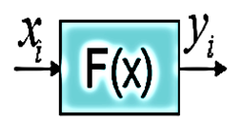
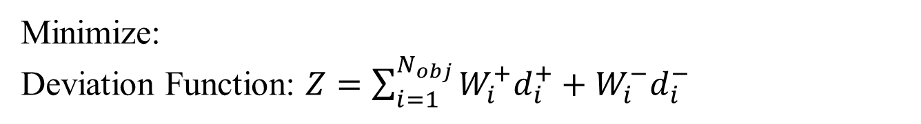

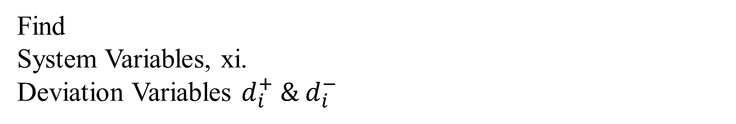
Compromise Decision Support Problem (cDSP)
Given
A system is to be improved by y_{i}= f(x_{i})
Find
System Variables, xi.
Deviation Variables $d_{i}^{+} \& d_{i}^{−}$
Satisfy
Inequality Constraints, $g_{i}\left(x\right) ≤0.$
Equality Constraints, $h_{i}\left(x\right)=0.$
Minimize:
Deviation Function: $Z=\sum_{i=1}^{N_{obj}}{W_{i}^{+}d_{i}^{+}+W_{i}^{−}d_{i}^{−}}$
A simulation model, f(x_{i}), relating the objective function to control variables is needed in the cDSP framework!?!?!

Slide 12
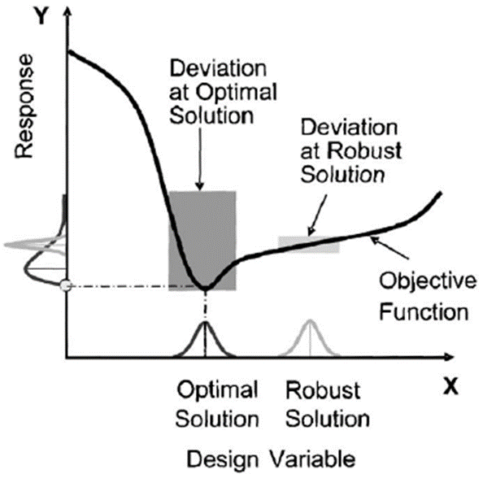
Robust Design for Goals

Slide 13
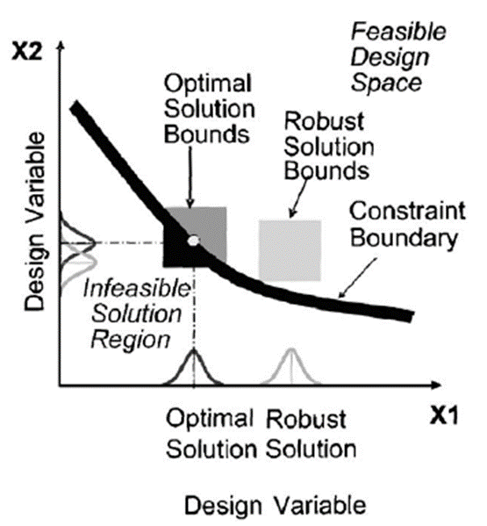
Robust Design for Constraints

Slide 14
Thermal Modeling Challenges
Predicting the flow and specially temperature fields inside data centers in terms of the involved design parameters is necessary for an energy efficient and Flexible (open) cooling system design.
Most of the designers simulate the air velocity and temperature fields in data centers are based on CFD/HT.
Meta-modeling and reduced order modeling techniques are tools to generate accurate and quick surrogate models for a complex system response.
The reduced order modeling technique namely the Proper Orthogonal Decomposition (POD) is more appropriate.

Slide 15
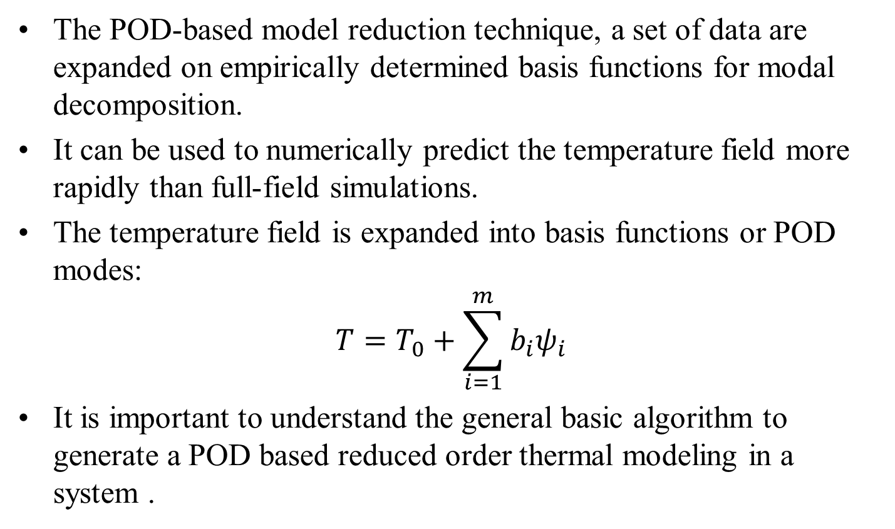
Proper Orthogonal Decomposition (POD) Modelling
The POD-based model reduction technique, a set of data are expanded on empirically determined basis functions for modal decomposition.
It can be used to numerically predict the temperature field more rapidly than full-field simulations.
The temperature field is expanded into basis functions or POD modes:
$$T=T_{0}+\sum_{i=1}^{m}{b_{i}ψ_{i}}$$
It is important to understand the general basic algorithm to generate a POD based reduced order thermal modeling in a system .

Slide 16
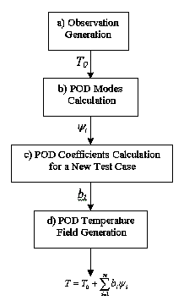
General algorithm for POD temperature field generation

Slide 17
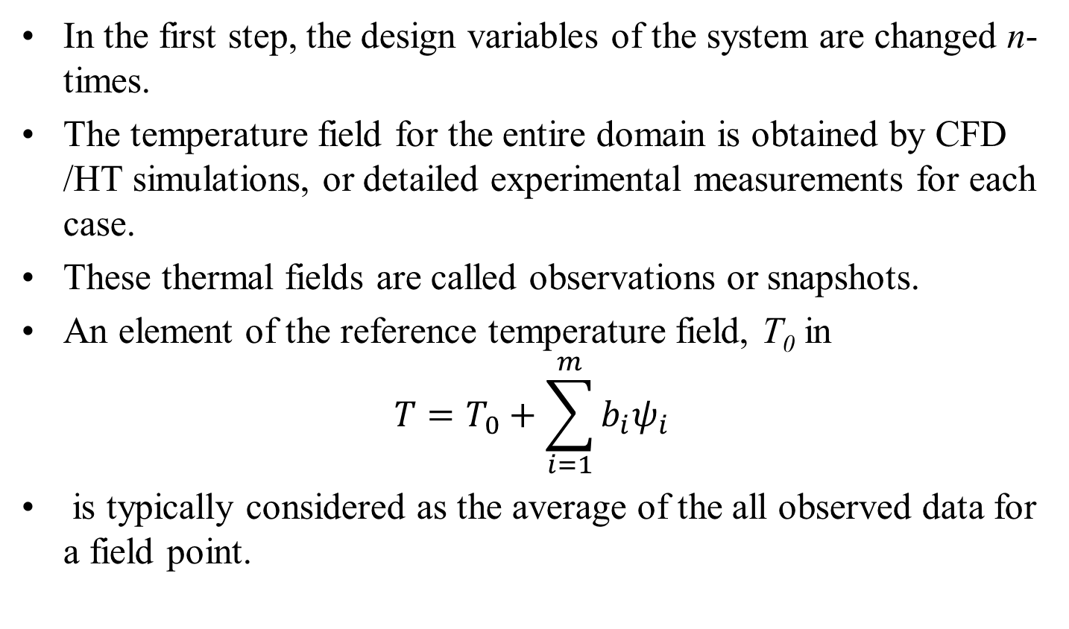
Observation Generation
In the first step, the design variables of the system are changed n-times.
The temperature field for the entire domain is obtained by CFD /HT simulations, or detailed experimental measurements for each case.
These thermal fields are called observations or snapshots.
An element of the reference temperature field, T₀ in
$$T=T_{0}+\sum_{i=1}^{m}{b_{i}ψ_{i}}$$
is typically considered as the average of the all observed data for a field point.

Slide 18
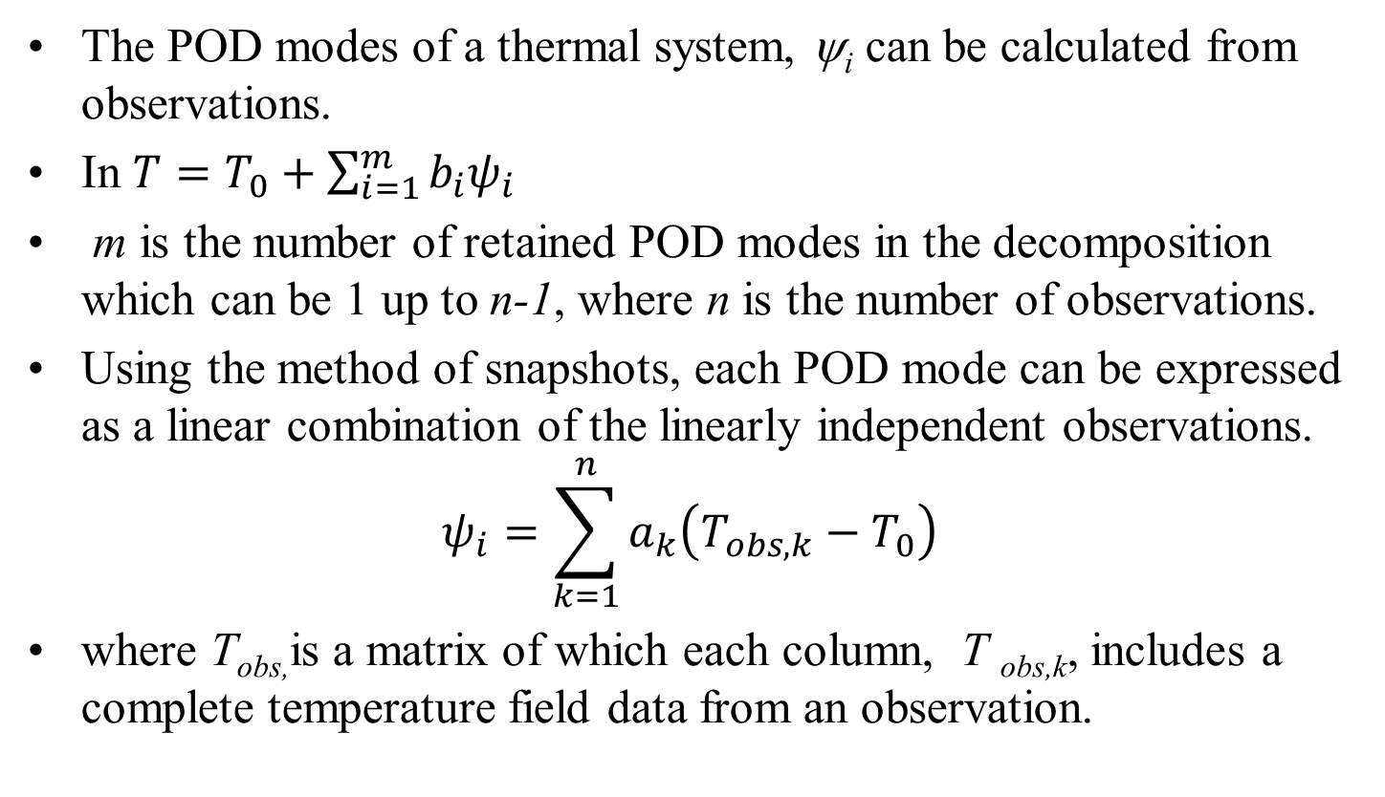
POD modes, ψ_{i}, Calculation
The POD modes of a thermal system, ψ_{i} can be calculated from observations.
In $T=T_{0}+\sum_{i=1}^{m}{b_{i}ψ_{i}}$
m is the number of retained POD modes in the decomposition which can be 1 up to n-1, where n is the number of observations.
Using the method of snapshots, each POD mode can be expressed as a linear combination of the linearly independent observations.
$$ψ_{i}=\sum_{k=1}^{n}{a_{k}\left(T_{obs,k}−T_{0}\right)}$$
where T_{obs,}is a matrix of which each column, T _{obs,k}, includes a complete temperature field data from an observation.

Slide 19
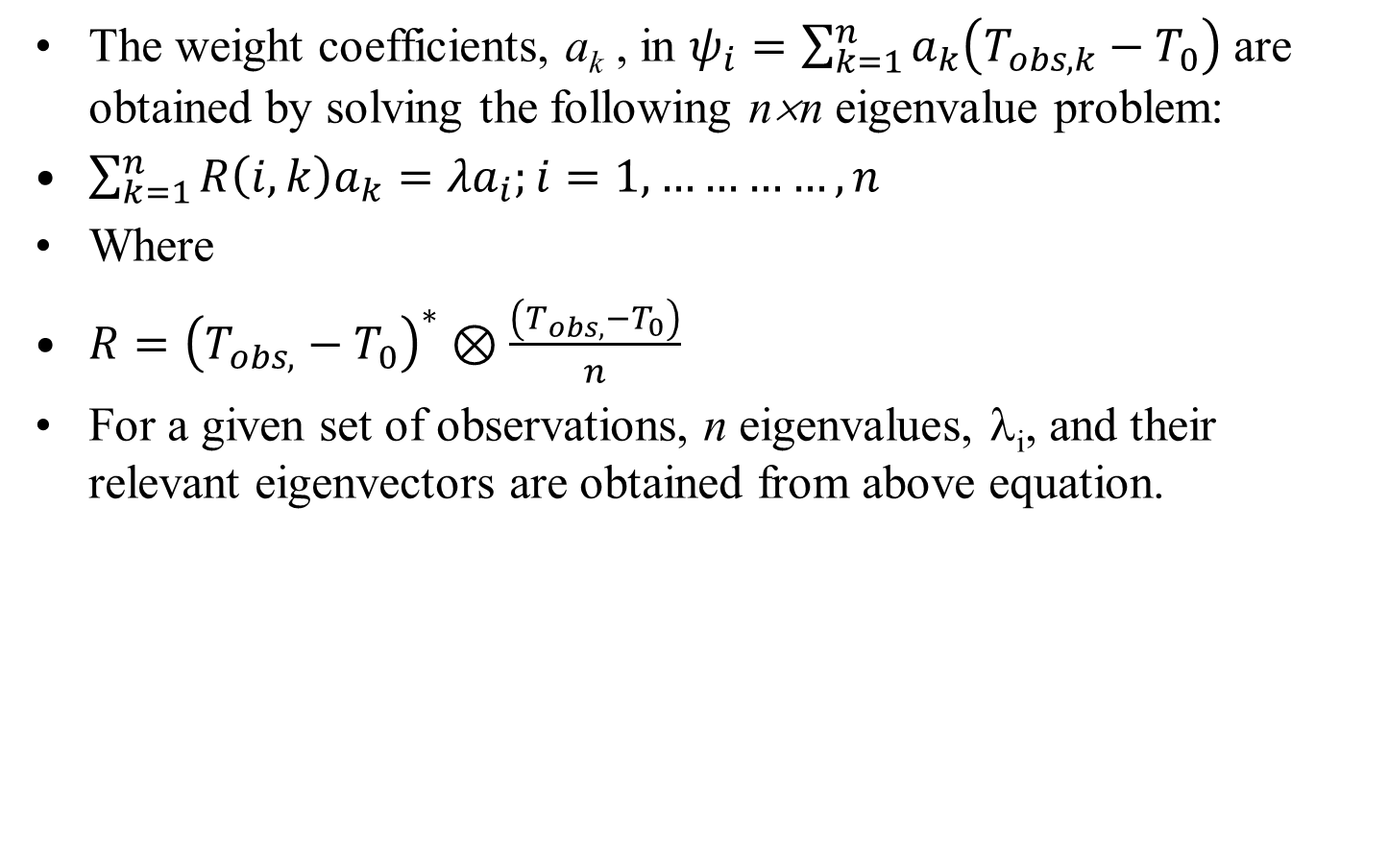
POD modes, ψ_{i}, Calculation
The weight coefficients, a_{k} , in $ψ_{i}=\sum_{k=1}^{n}{a_{k}\left(T_{obs,k}−T_{0}\right)}$ are obtained by solving the following n×n eigenvalue problem:
$\sum_{k=1}^{n}{R\left(i,k\right)a_{k}=λa_{i};i=1,…………, n}$
Where
$R={\left(T_{obs,}−T_{0}\right)}^{∗}⊗\frac{\left(T_{obs,}−T_{0}\right)}{n}$
For a given set of observations, n eigenvalues, λ_{i}, and their relevant eigenvectors are obtained from above equation.

Slide 20
POD modes, ψ_{i}, Calculation
Each eigenvector includes the weight coefficients, a_{k}, of the relative POD mode in above equation.
n POD modes are finally calculated.
The energy captured by each POD mode in the system is proportional to the relevant eigenvalue.
The eigenvalues are sorted in a descending order, so the first POD modes capture larger energy compared with the later modes.

Slide 21
POD coefficients, b_{i} , calculation for a New Test Case
This is the key step.
In this step, the POD can be used to create a reduced order thermal/fluid model as a function of the system design variables.
Generally, there are three methods to calculate the POD coefficients b_{i} for a new test case with a new set of design variables:
Galerkin Projection of the system POD modes onto the governing equations.
Interpolation among modal coefficients:
Flux Matching process

Slide 22
POD temperature field generation
Temperature field for the new test case is generated with calculated T₀ , ψ_{i}, and b_{i} for a new set. inside the entire domain.
This is repeated for different numbers of used POD modes, m.

Slide 23
Top View of One Quarter of A DC

Slide 24
Reference air temperature contours (ºC) at the racks inlets.

Slide 25
Reference air temperature contours (ºC) at the racks inlets.

Slide 26
Design parameters for the observations
An 18 Mode PoD was used for generation of Given temperature Field.

Slide 27
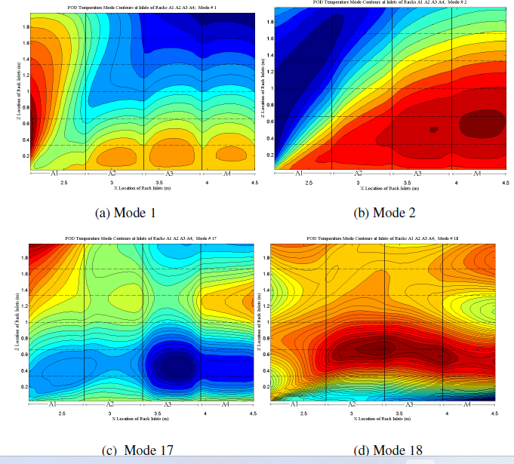
Temperature Distribution of Selected PoD Modes

Slide 28
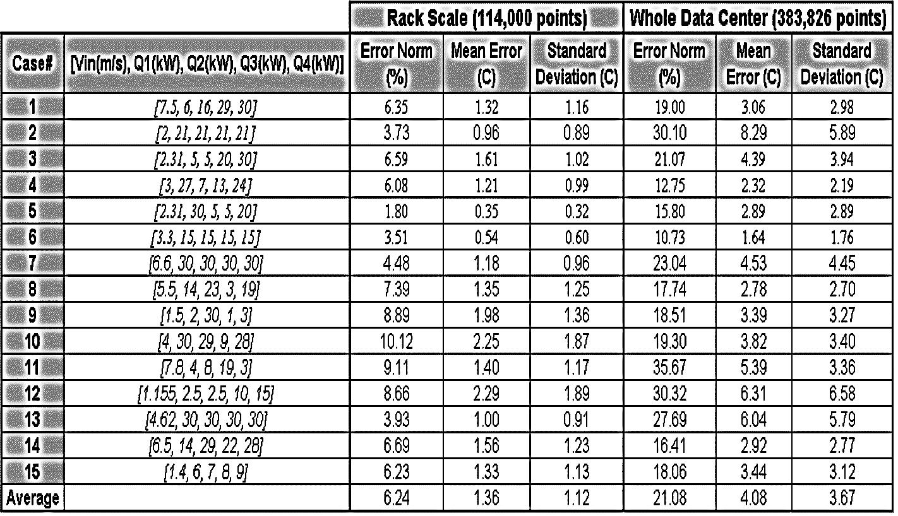
POD temperature error at rack scale and whole domain for fifteen test cases

Slide 29
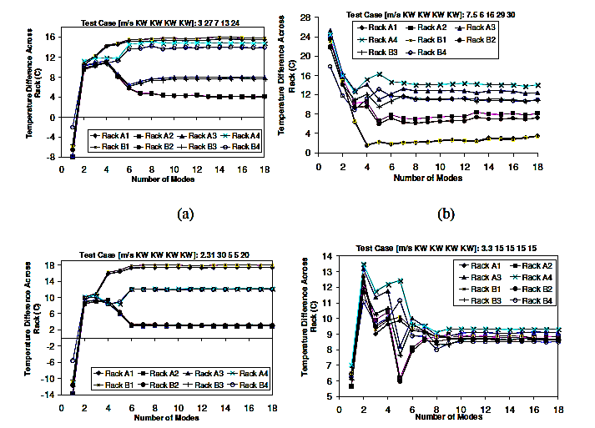
Average temperature difference (ºC) across eight racks for four test cases.

Slide 30
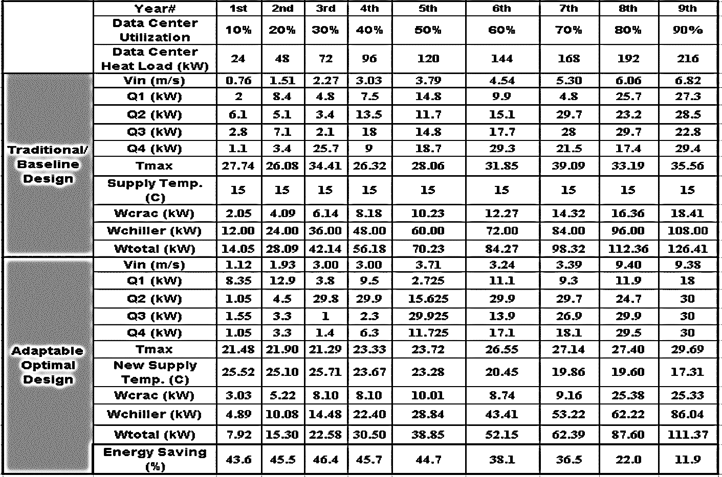
Adaptable optimal design versus baseline/traditional design

Slide 31
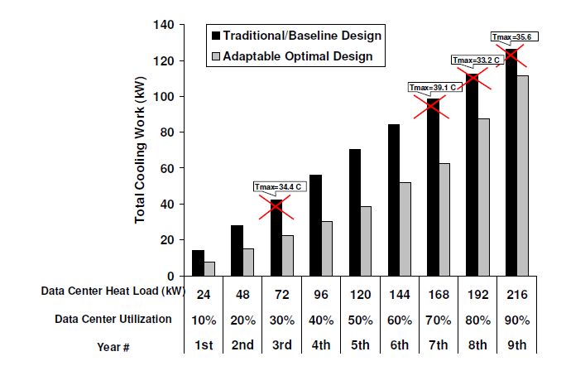
Total cooling energy consumption of adaptable and traditional designs for 9 years.

