Slide 1
Thermal Control of Space Electronics Systems
P M V Subbarao
Professor
Mechanical Engineering Department
I I T Delhi
Management of Systems with High External Heat Flux Loads…

Slide 2
Introduction
All components of space systems (electronic and non-electronic) have a range of allowable temperatures.
These component must be kept in this temperature range, to meet survival and operational requirements during all mission phases.
Spacecraft temperatures are determined by how much heat is absorbed, stored, generated, and dissipated by the spacecraft.
The goal is to use the appropriate technology to maintain the temperatures of spacecraft components within their limits, but the technology used to achieve this also has limits.
Important to verify that the technology used is applicable to the given design not only with respect to needed function, but to the environment (temperature limits) as well.

Slide 3
Thermal Analysis of Geostationary Satellite

Slide 4
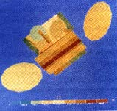
Methodology
Space programs, generally limited to very few models characterized by high cost (typically $50,000-100,000/Kg),
The main design features of this methodology are:
The TCS design has traditionally been a conservative process.
Use of previously flown materials, technology and concepts is encouraged.
The design is mainly based on an important use of analytical models.
Mockup and thermal tests are considered for final verification.

Slide 5
Simplified Overview of Orbiting Spacecraft Heating
https://www.nasa.gov/smallsat-institute/sst-soa/thermal-control/
Thermal control of a spacecraft is achieved by balancing the energy as:
$$\frac{dE_{SC}}{dt}={\dot{Q}}_{solar}+{\dot{Q}}_{albedo}+{\dot{Q}}_{planetshine }+{\dot{Q}}_{gen}−{\dot{Q}}_{out,rad}$$

Slide 6
Simplified Overview of Orbiting Satellite Heat Transfer Model
${\dot{Q}}_{gen}$ : Rate of Heat generation in the spacecraft/satellite due to electronic systems.

Slide 7
Simplified Overview of Orbiting Satellite Heat Transfer Model
${\dot{Q}}_{solar}$ : Rate of solar heat absorbed by the spacecraft.
Depends on the solar flux, which is determined by distance to the sun, the surface area viewing the sun (view factor), and the solar absorptivity of that surface.

Slide 8
Range of Thermal Radiation

Slide 9
Simplified Overview of Orbiting Satellite Heat Transfer Model
${\dot{Q}}_{albedo}$ Rate of heat absorption, due to the solar radiation reflected by the planet.
The amount absorbed by the spacecraft depends on the planet, the surface area viewing the planet (view factor), and the solar absorptivity of that surface.

Slide 10
Simplified Overview of Orbiting Satellite Heat Transfer Model
${\dot{Q}}_{planetshine }$ the amount of IR heating from the planet absorbed by the spacecraft.
This depends on the planet, the surface area viewing the planet (view factor), and the IR emissivity of that surface.

Slide 11
Simplified Overview of Orbiting Satellite Heat Transfer Model
$${\dot{Q}}_{in}={\dot{Q}}_{solar}+{\dot{Q}}_{albedo}+{\dot{Q}}_{planetshine }+{\dot{Q}}_{gen}$$
$${\dot{Q}}_{in}={\left(1+a\right)\dot{q}}_{solar}\hat{s}A_{sun}α+{\dot{q}}_{planetshine }A_{ps}+{\dot{Q}}_{gen}$$
a = Albedo factor (unitless)

Slide 12
Simplified Overview of Orbiting Satellite Heat Transfer Model
The area terms in this equation are dependent on the actual area exposed to the particular type of radiation.
$$\text{For} \text{the} \text{single}\text{−}\text{node} \text{model}\text{, }\text{all} \text{areas} \text{in} \text{the} \text{above} \text{equation} \text{are} \text{the} \text{area} \text{of} \text{the} \text{disk} \text{prole}\text{.}$$

Slide 13
Simplified Overview of Orbiting Satellite Heat Transfer Model
$${\dot{Q}}_{out,rad} is only the mode of heat lost by satellite!$$
The radiation leaving the satellite is described simply by the Stefan-Boltzmann law
$${\dot{Q}}_{out,rad}= σεA_{s}T_{S}^{4}$$

Slide 14
Simplified Overview of Orbiting Satellite Heat Transfer Model
$$\frac{d{\left(mcT\right)}_{SC}}{dt}={\left(1+a\right)\dot{q}}_{solar}\hat{s}A_{sun}α+{\dot{q}}_{planetshine }A_{ps}+{\dot{Q}}_{gen}$$
$$−σεA_{s}T_{S}^{4}$$
This equation involves aborptivity and emissivity values that depend on the thermo-optical properties of the spacecraft.

Slide 15
Instantaneous Position of Space System: β angle
$${\dot{Q}}_{solar}$$

Slide 16
Volume Average Satellite Temperature : Summer in Northern Hemi Sphere

Slide 17
Volume Average Satellite Temperature : Winter in Northern Hemi Sphere

Slide 18
Six Segment Model

Slide 19
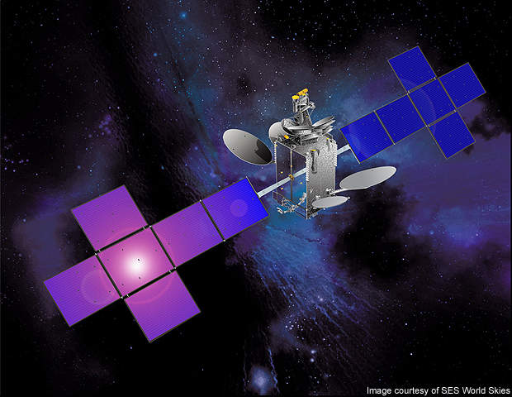
Telecommunication Sattellites
Telecommunication satellites are all based on the same overall design using a 3-axis stabilization process, in which the North and South panels act as radiators and so ensure heat removal.
Space-based communications in parallel with the evolution of space electronics (miniaturization, complexity, integration)dictate that the thermal control subsystem (TCS) can accommodate significant increases in spacecraft dimensions and waste heat generation.
At the same time, for obvious economic reasons, the operational lifetime in orbit must reach 15years for most satellite programs.

Slide 20
Telecommunication Sattellites
Assumptions obtained by thermal modeling are a possible source of errors.
Uncertainty margins (typically ±5°C) are taken into account bythermal designers in order to make “guaranteed predictions”.

Slide 21
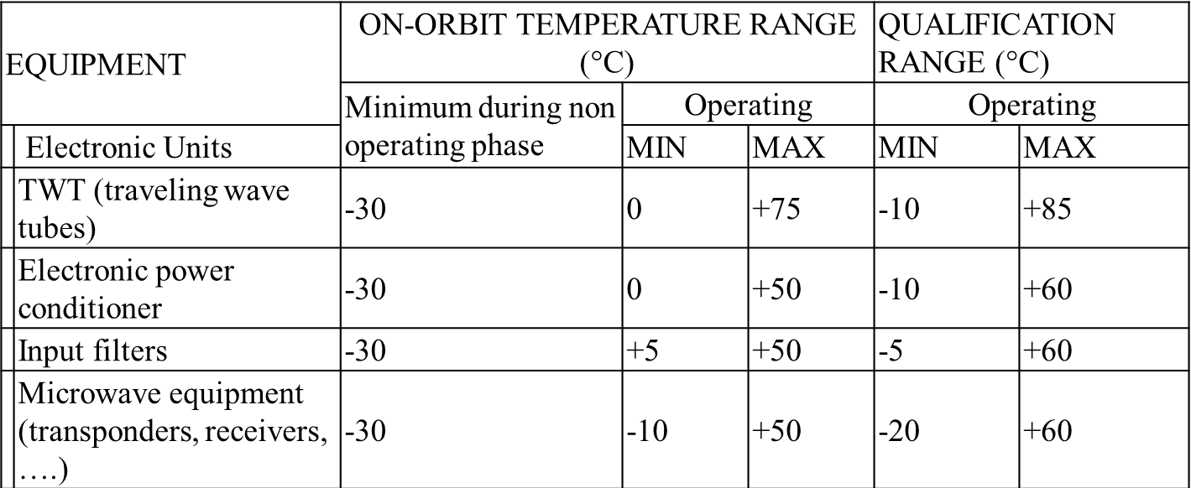
Space Electronic Equipment Temperature Limits and Design
A spacecraft contains many components which will function properly only if they are maintained within specified temperature ranges.
A classical set of temperature limits for on board equipment.

Slide 22
Space Equipment Temperature Limits and Design

Slide 23
CAD illustration of Telecom 2 satellite

Slide 24
INSPIRE-SAT 7 CubeSat

Slide 25
Radiation Enclosure Analysis of Satellites

