Slide 1

Radiation Analysis of Space Systems
P M V Subbarao
Professor
Mechanical Engineering Department
I I T Delhi
Thermal Management of Space Enclosures using Radiation Properties….

Slide 2

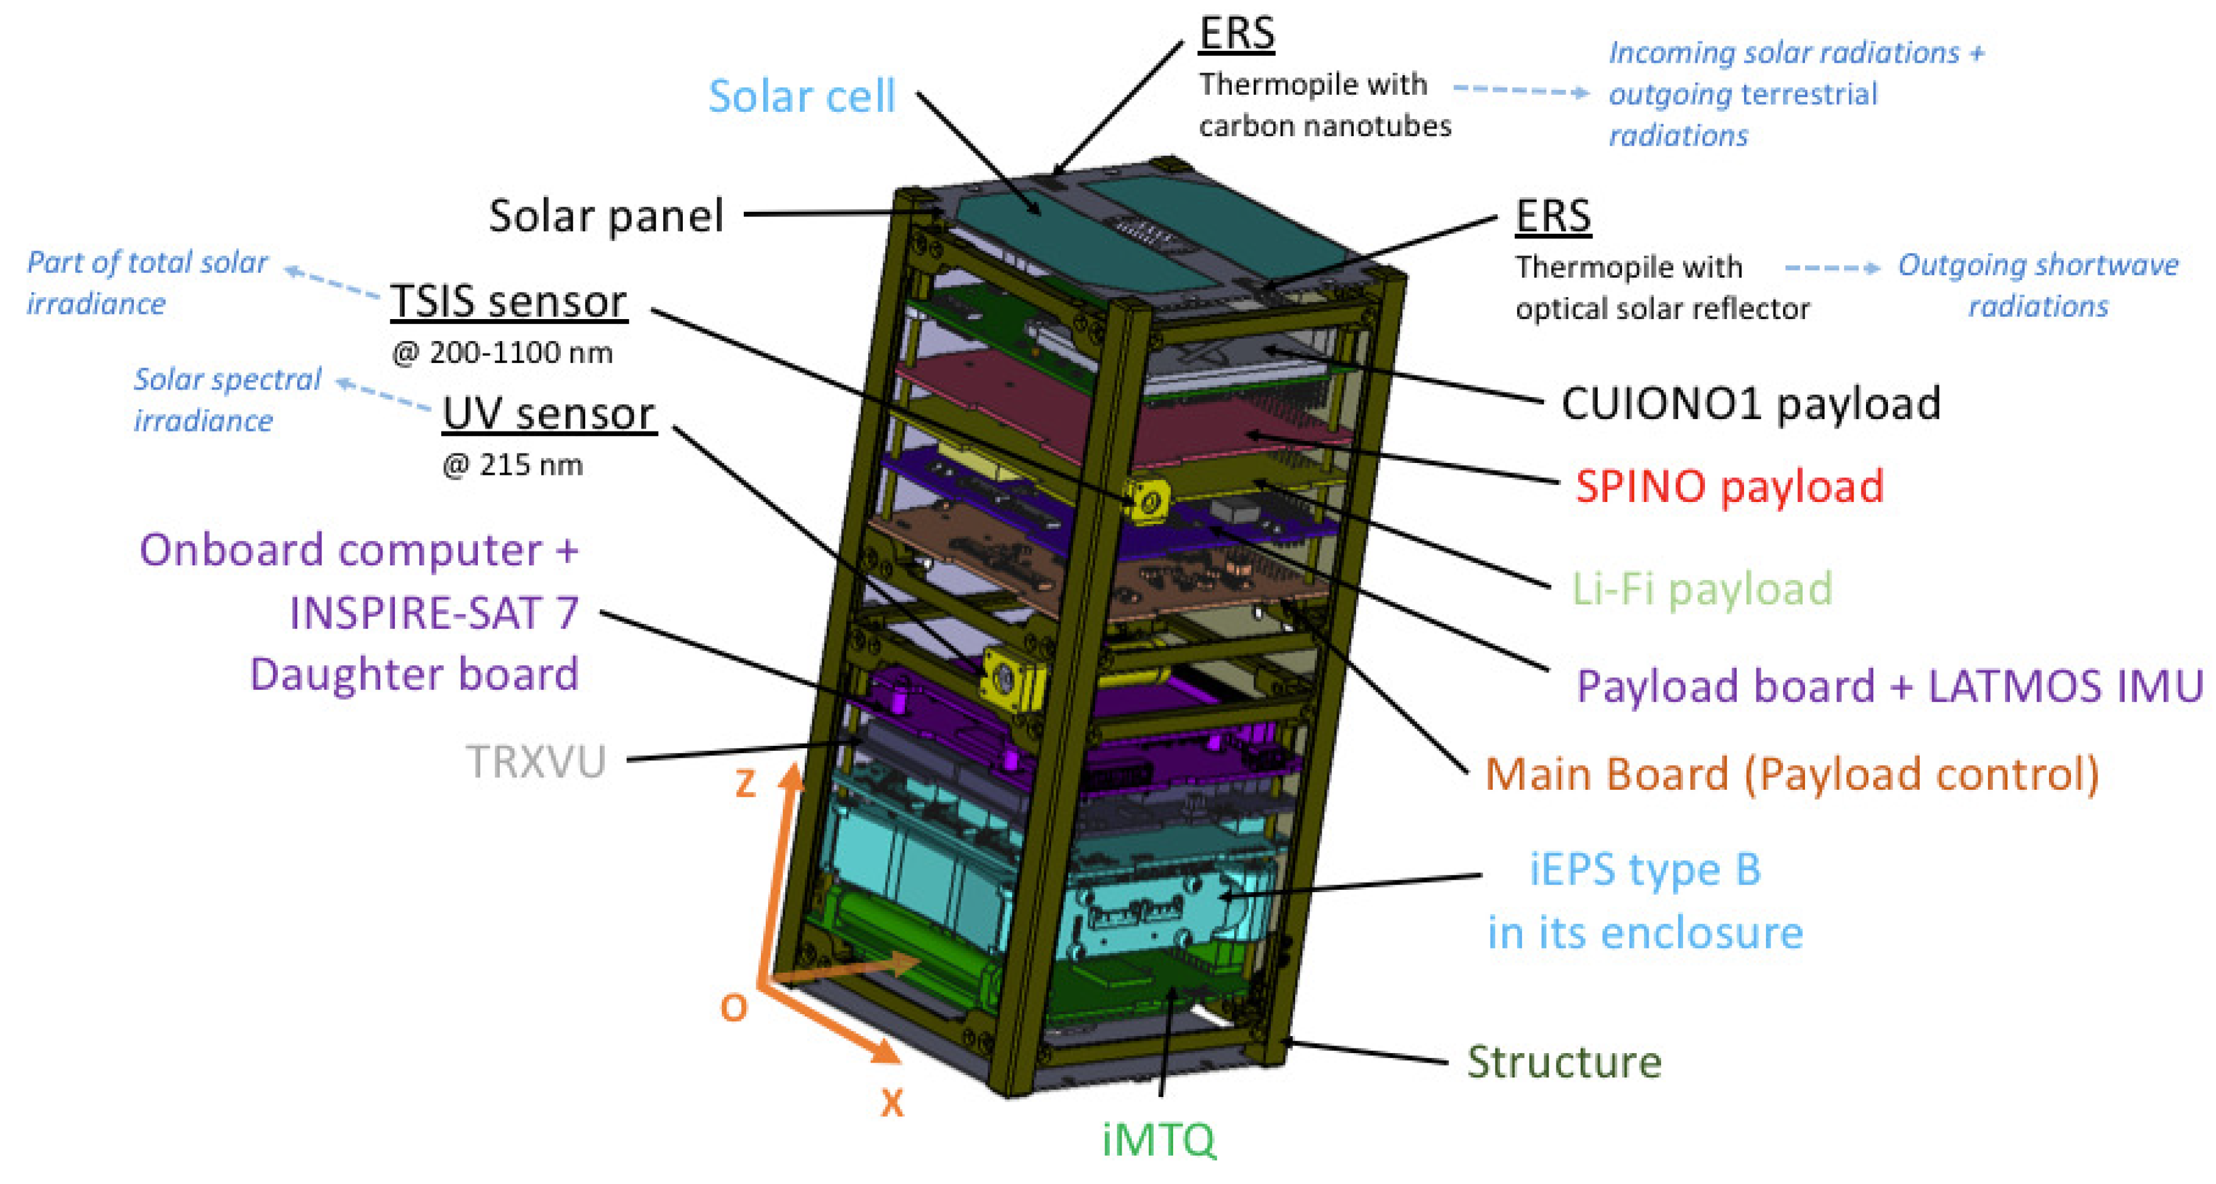
INSPIRE-SAT 7 CubeSat

Slide 3
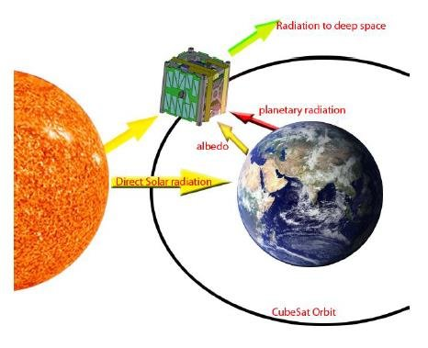
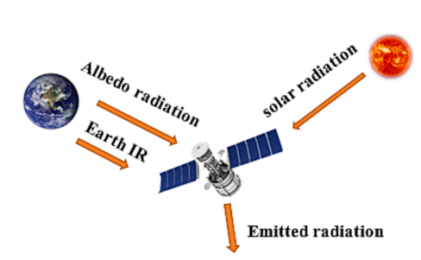
Sources of Heat Flux on the Walls of A Cubesat

Slide 4
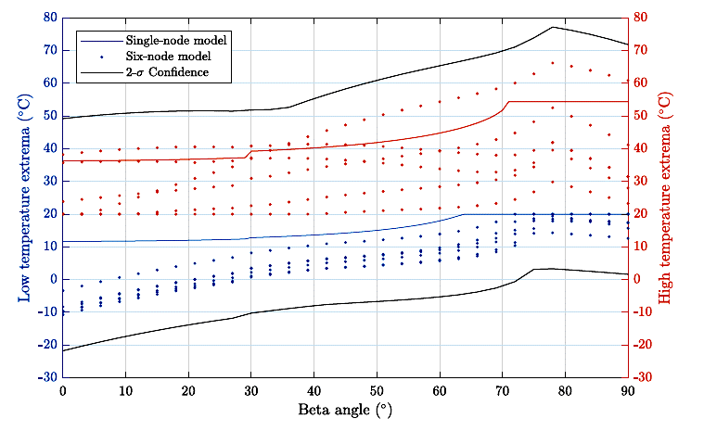
Variation of Temperature of Walls

Slide 5
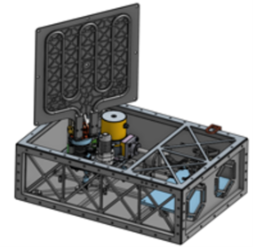
CubeSat prototype

Slide 6
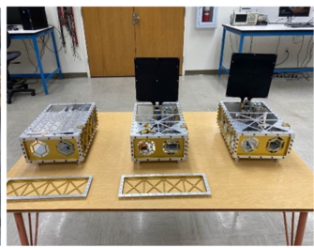
CubeSat prototypes

Slide 7
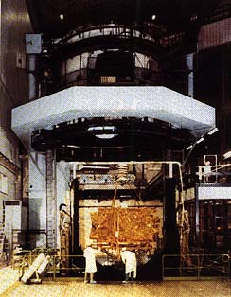
Solar Simulation
Thermal test chamber: 600 m³
Vacuum: 10 ⁻⁶ mmHg
Temperature: -170°C up to 120°C

Slide 8
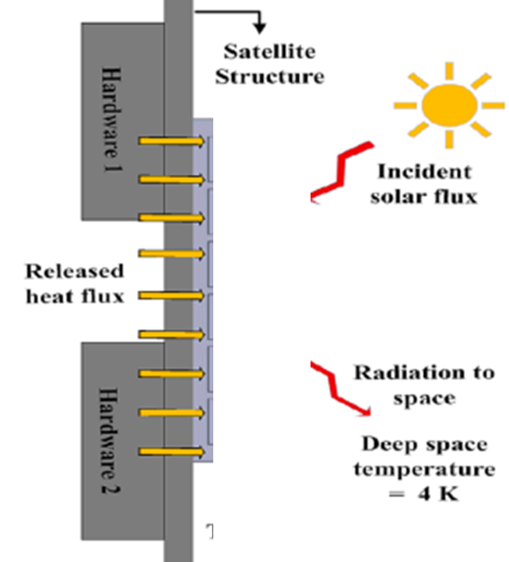
Thermal Conditions on Each wall

Slide 9
Real Opaque Surfaces
Kichoff’s Law: substances that are poor emitters are also poor absorbers for any given wavelength
At thermal equilibrium
Emissivity of surface (ε ) = Absorptivity(a)
Transmissivity of solid surfaces = 0
Emissivity is the only significant parameter
Emissivities vary from 0.1 (polished surfaces) to 0.95 (blackboard)

Slide 10
Complication
In practice, we cannot just consider the emissivity or absorptivity of surfaces in isolation.
Radiation bounces backwards and forwards between surfaces.
Use concept of “radiosity” (J) = emissive power for real surface and reflected radiation.

Slide 11
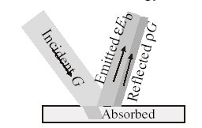

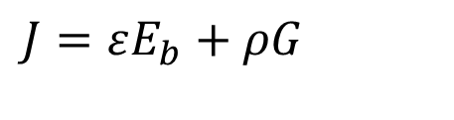
Radiosity of Real Opaque Surface
Consider an opaque surface.
If the incident energy flux is G, a part of it is absorbed and the rest of it is reflected.
The surface also emits an energy flux of E.
$$J=εE_{b}+ρG$$
Rate of Energy leaving a surface: J A
Rate of Energy incident on this surface: GA
Net rate of energy leaving the surface: A(J-G)
Rate of heat transfer from a surface by radiation: $\dot{Q}$ = A(J-G)
$$\dot{Q}=εE_{b}+ρG−G$$

Slide 12
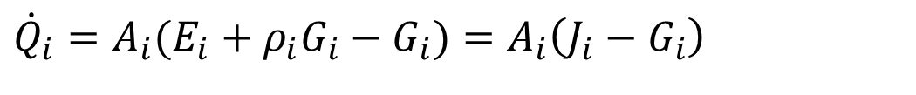
Enclosure of Real Surfaces
T₁,A₁
T_{N},A_{N}
T₂,A₁
J₁
J_{N}
J₂
.
.
.
.
ρ_{i}G_{i}
E_{i}
.
G_{i}
.
.
J_{i}
.
.
T_{i},A_{i}
.
For Every i^{th} surface
The net rate of heat transfer by radiation:
$${\dot{Q}}_{i}=A_{i}(E_{i}+ρ_{i}G_{i}−G_{i})=A_{i}\left(J_{i}−G_{i}\right)$$

Slide 13
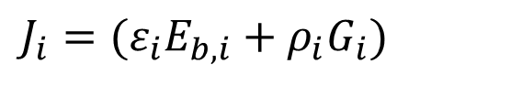
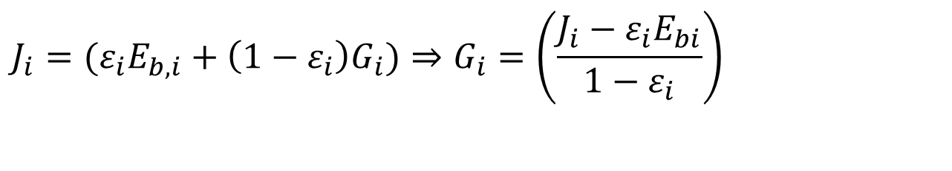
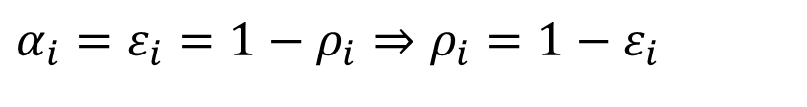
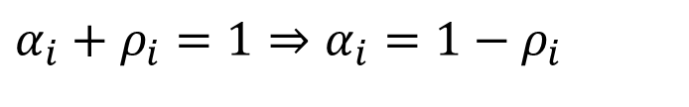
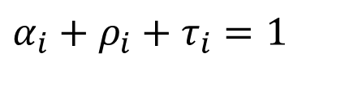
Enclosure of Real Surfaces
$$J_{i}=(ε_{i}E_{b,i}+ρ_{i}G_{i})$$
For any real surface:
$$α_{i}+ρ_{i}+τ_{i}=1$$
For an opaque surface:
$$α_{i}+ρ_{i}=1⇒α_{i}=1−ρ_{i}$$
If the entire enclosure is at Thermal Equilibrium, From Kirchoff’s law:
$$α_{i}=ε_{i}=1−ρ_{i}⇒ρ_{i}=1−ε_{i}$$
Substituting all above:
$$J_{i}=(ε_{i}E_{b,i}+\left(1−ε_{i}\right)G_{i})⇒G_{i}=\left(\frac{J_{i}−ε_{i}E_{bi}}{1−ε_{i}}\right)$$

Slide 14

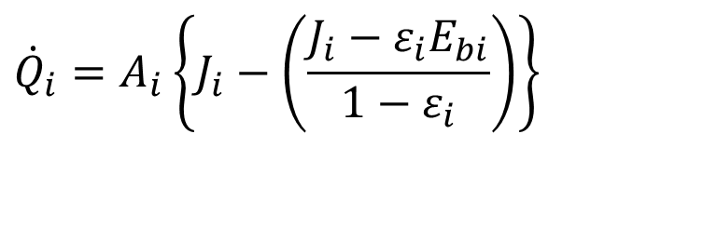
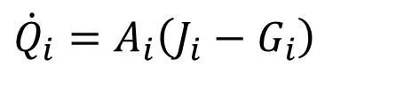
Enclosure of Real Surfaces
$${\dot{Q}}_{i}=A_{i}\left(J_{i}−G_{i}\right)$$
$${\dot{Q}}_{i}=A_{i}\left\{J_{i}−\left(\frac{J_{i}−ε_{i}E_{bi}}{1−ε_{i}}\right)\right\}$$
$${\dot{Q}}_{i}=A_{i}\left\{\frac{E_{bi}−J_{i}}{\frac{1−ε_{i}}{ε_{i}}A_{i}}\right\}$$

Slide 15
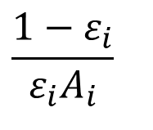
Surface Resistance of A Real Surface
Real Surface Resistance
Black body
E_{bi}
J_{i}
Actual Surface
Q_{i}
$$\frac{1−ε_{i}}{ε_{i}A_{i}}$$
J_{i}
.
r_{i}G_{i}
E_{i}
E_{bi} –J_{i} : Driving Potential
G_{i}
$$\frac{1−ε_{i}}{ε_{i}A_{i}}$$
:surface radiative resistance
.
Q_{i}

Slide 16
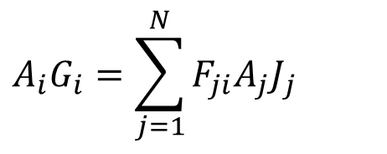
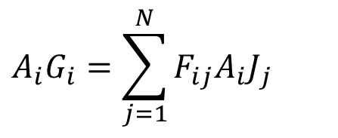
Radiation Exchange between Real Surfaces
To solve net rate of Radiation from a surface, the radiosity J_{i} must be known.
It is necessary to consider radiation exchange between the surfaces of enclosure.
The irradiation of surface i can be evaluated from the radiosities of all the other surfaces in the enclosure.
From the definition of view factor : The total rate at which radiation reaches surface i from all surfaces including i, is:
$$A_{i}G_{i}=\sum_{j=1}^{N}{F_{ji}A_{j}J_{j}}$$
From reciprocity relation
$$A_{i}G_{i}=\sum_{j=1}^{N}{F_{ij}A_{i}J_{j}}$$

Slide 17
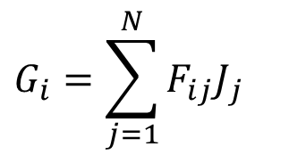
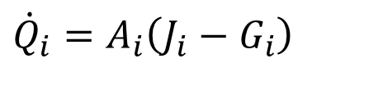
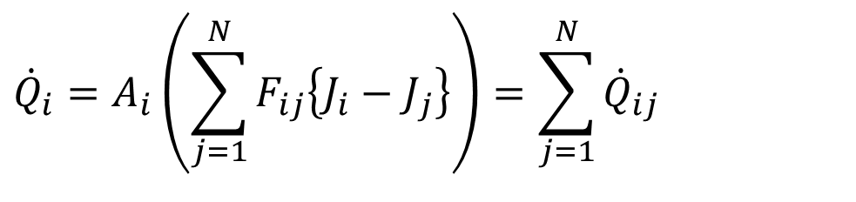
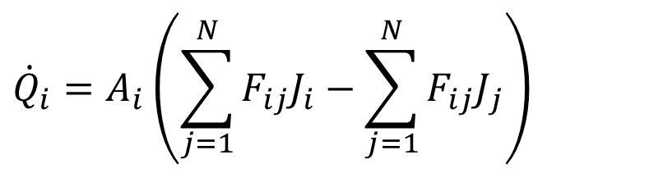
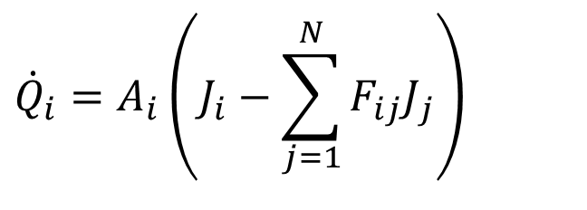
Radiation Exchange between Real Surfaces
$$G_{i}=\sum_{j=1}^{N}{F_{ij}J_{j}}$$
$${\dot{Q}}_{i}=A_{i}\left(J_{i}−G_{i}\right)$$
$${\dot{Q}}_{i}=A_{i}\left(J_{i}−\sum_{j=1}^{N}{F_{ij}J_{j}}\right)$$
$${\dot{Q}}_{i}=A_{i}\left(\sum_{j=1}^{N}{F_{ij}J_{i}}−\sum_{j=1}^{N}{F_{ij}J_{j}}\right)$$
$${\dot{Q}}_{i}=A_{i}\left(\sum_{j=1}^{N}{F_{ij}\left\{J_{i}−J_{j}\right\}}\right)=\sum_{j=1}^{N}{{\dot{Q}}_{ij}}$$

Slide 18
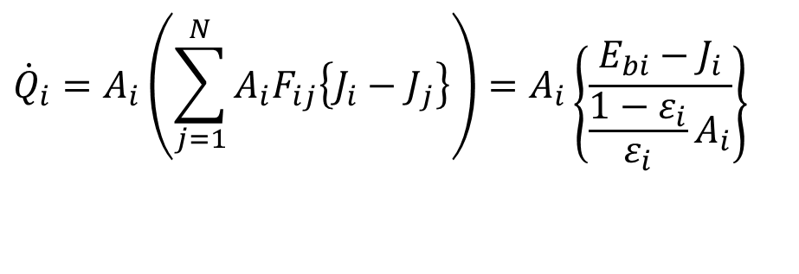
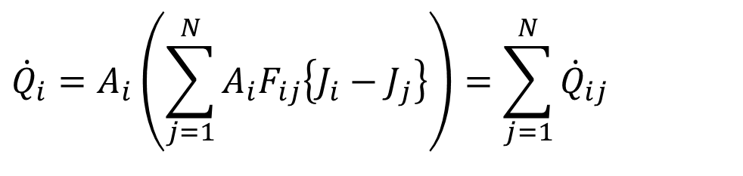

Radiation Exchange between Real Surfaces
$${\dot{Q}}_{i}=A_{i}\left(\sum_{j=1}^{N}{A_{i}F_{ij}\left\{J_{i}−J_{j}\right\}}\right)=\sum_{j=1}^{N}{{\dot{Q}}_{ij}}$$
This result equates the net rate of radiation transfer from surface i, Q_{i} to the sum of components Q_{ij} related to radiative exchange with the other surfaces.
Each component may be represented by a network element for which (J_{i}-J_{j}) is driving potential and (A_{i}F_{ij})⁻¹ is a space or geometrical resistance.
$${\dot{Q}}_{i}=A_{i}\left(\sum_{j=1}^{N}{A_{i}F_{ij}\left\{J_{i}−J_{j}\right\}}\right)=A_{i}\left\{\frac{E_{bi}−J_{i}}{\frac{1−ε_{i}}{ε_{i}}A_{i}}\right\}$$

Slide 19
Geometrical (View Factor) Resistance

Slide 20
Relevance?
“Heat-transfer coefficients”:
  view factors (can surfaces see each other? Radiation is “line of sight” )
  Emissivities (can surface radiate easily? Shiny surfaces cannot)

Slide 21
Basic Concepts of Network Analysis
Analogies with electrical circuit analysis
Blackbody emissive power = voltage
Thermal Resistance (Real +Geometric) = resistance
Heat-transfer rate = current

Slide 22


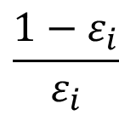




Resistance Network for i^{th} surface interaction in an Enclosure
Q_{i1}
T₁,A₁
J₁
T_{N},A_{N}
T₂,A₁
Q_{i2}
J₁
J_{N}
J₂
.
.
.
J₂
.
E_{i}
r_{i}G_{i}
$$\frac{1}{A_{i}F_{i→1}}$$
.
G_{i}
$$\frac{1}{A_{i}F_{i→2}}$$
J_{i}
.
.
E_{bi}
J_{i}
.
Q_{i3}
.
Q_{i}
$$\frac{1}{A_{i}F_{i→3}}$$
J₃
.
T_{i},A_{i}
$$\frac{1−ε_{i}}{ε_{i}}$$
$$\frac{1}{A_{i}F_{i→N−1}}$$
$$\frac{1}{A_{i}F_{i→N}}$$
J_{N-1}
J_{N}
Q_{iN-1}
_{QiN}

Slide 23
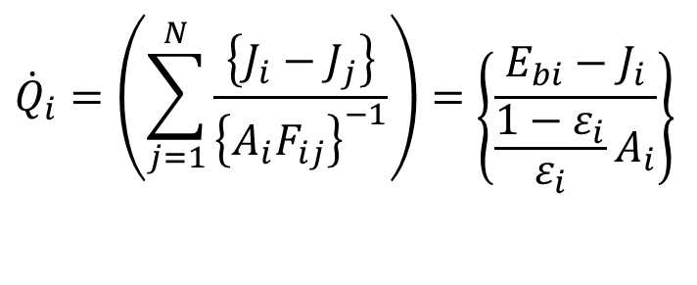
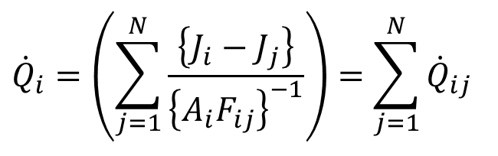
Design of Radiation Enclosure
Oppenheium suggested the use of network representation to design radiation enclosures.
The method provides a useful tool for visualizing radiation exchange in the enclosure.
The design is direct and simple if the temperature Ti, of each surface is known.
$${\dot{Q}}_{i}=\left(\sum_{j=1}^{N}{\frac{\left\{J_{i}−J_{j}\right\}}{{\left\{A_{i}F_{ij}\right\}}^{−1}}}\right)=\left\{\frac{E_{bi}−J_{i}}{\frac{1−ε_{i}}{ε_{i}}A_{i}}\right\}$$
$${\dot{Q}}_{i}=\left(\sum_{j=1}^{N}{\frac{\left\{J_{i}−J_{j}\right\}}{{\left\{A_{i}F_{ij}\right\}}^{−1}}}\right)=\sum_{j=1}^{N}{{\dot{Q}}_{ij}}$$

Slide 24
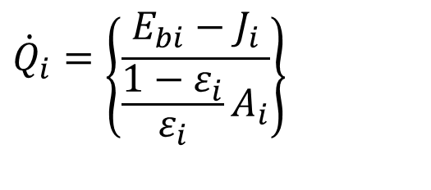

Design of Radiation Enclosure
Realistic Designs involve selection of materials, surfaces area, shape to get an enclosure with all the surface temperatures are below/above acceptable level.
In general the rate of heat generated/ absorbed by a surface, Q_{i}, is known by other application issues.
Then the network equation is:
$${\dot{Q}}_{i}=\left(\sum_{j=1}^{N}{\frac{\left\{J_{i}−J_{j}\right\}}{{\left\{A_{i}F_{ij}\right\}}^{−1}}}\right)$$
This results in a set of N linear, algebraic equations to be solved for the N unknowns, J₁,J₂, …… J_{N}.
With knowledge of the J_{i}, following equation will give the temperatures of i^{th} surface.
$${\dot{Q}}_{i}=\left\{\frac{E_{bi}−J_{i}}{\frac{1−ε_{i}}{ε_{i}}A_{i}}\right\}$$

Slide 25
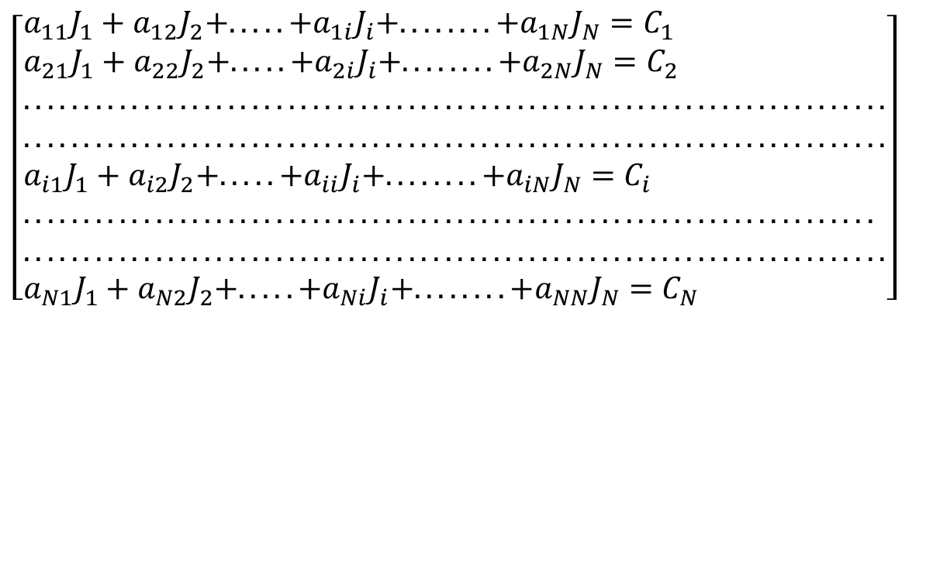
Design of Radiation Enclosure
For any number N of surfaces in the enclosure, the foregoing problem may be solved by matrix inversion.
$$\left[\begin{aligned}&a_{11}J_{1}+a_{12}J_{2}+.....+a_{1i}J_{i}+........+a_{1N}J_{N}=C_{1} \\ &a_{21}J_{1}+a_{22}J_{2}+.....+a_{2i}J_{i}+........+a_{2N}J_{N}=C_{2} \\ &........................................................................ \\ &........................................................................ \\ &a_{i1}J_{1}+a_{i2}J_{2}+.....+a_{ii}J_{i}+........+a_{iN}J_{N}=C_{i} \\ &....................................................................... \\ &........................................................................ \\ &a_{N1}J_{1}+a_{N2}J_{2}+.....+a_{Ni}J_{i}+........+a_{NN}J_{N}=C_{N}\end{aligned}\right]$$

Slide 26
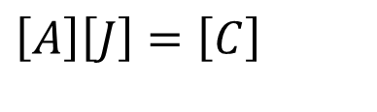
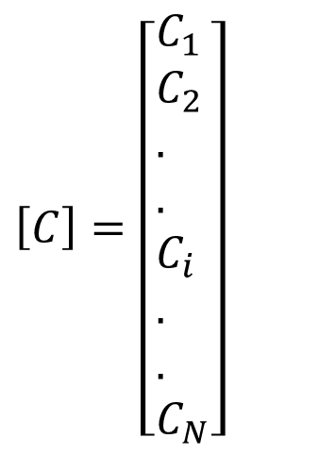
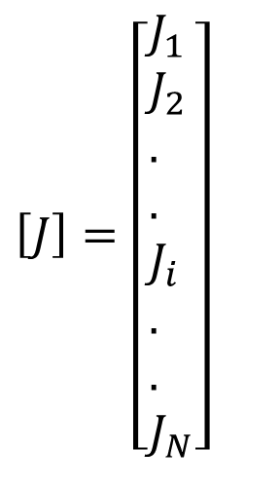
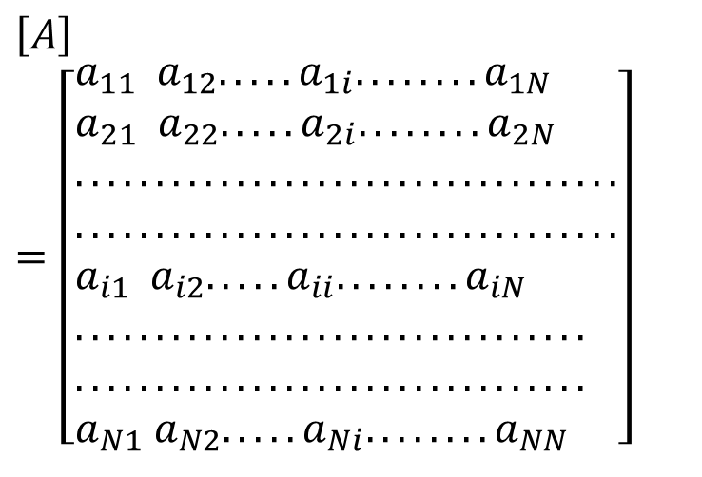
Design of Radiation Enclosure
Where the coefficients a_{ii} and C_{i} are known quantities.
In matrix form these equations may be expressed as:
$$\left[A\right]\left[J\right]=\left[C\right]$$
where
$$\left[A\right]=\left[\begin{aligned}&a_{11} a_{12}.....a_{1i}........a_{1N} \\ &a_{21} a_{22}.....a_{2i}........a_{2N} \\ &.................................. \\ &.................................. \\ &a_{i1} a_{i2}.....a_{ii}........a_{iN} \\ &................................ \\ &................................ \\ &a_{N1} a_{N2}.....a_{Ni}........a_{NN}\end{aligned}\right]$$
$$\left[J\right]=\left[\begin{aligned}&J_{1} \\ &J_{2} \\ &. \\ &. \\ &J_{i} \\ &. \\ &. \\ &J_{N}\end{aligned}\right]$$
$$\left[C\right]=\left[\begin{aligned}&C_{1} \\ &C_{2} \\ &. \\ &. \\ &C_{i} \\ &. \\ &. \\ &C_{N}\end{aligned}\right]$$

Slide 27
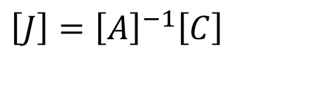
Design of Radiation Enclosure
The unknown radiosites, J_{i} are found using:
$$\left[J\right]={\left[A\right]}^{−1}\left[C\right]$$

Slide 28
The Two-Surface Enclosure
Surface 1
Surface 2

Slide 29
Key Points for Two-Surface Example
How to do view factor arithmetic
How to use the concepts of view factors, surface resistances and view factor resistances to solve radiation problems
How to develop radiation networks
Application: storage of very cold (cryogenic) fluids (e.g. LH₂), Protection of Nuclear Reactor.
Popular as Radiations Shields.
Radiation shields are constructed from low emissivity (high reflectivity) materials.

Slide 30
Step 1: Sketch the Situation
T₁
T₂

Slide 31
Step 2: Sketch Radiation Network
Surface and view factor resistances important
One surface resistance for each surface
One view factor resistance if one surface can see another

Slide 32
Design of Radiation Enclosure

Slide 33
Step 3: View Factor Concept: “Ant on Surface”
Surface 1 (hemisphere):
When looking towards surface 2 (disk), can see both surfaces 1 and 2 (concave surface)
0 < F₁₁ < 1, 0 < F₁₂ < 1
Surface 2 (disk)
When looking towards surface 1, hemisphere, cannot see itself (flat or convex)
F₂₂ = 0

Slide 34
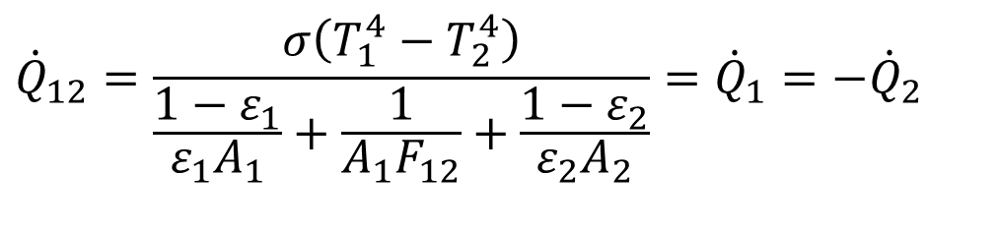
View Factor Arithmetic
F₂₁ = 1 - F₂₂ = 1
F₁₂ = A₂ F₂₁ / A₁
$${\dot{Q}}_{12}=\frac{σ\left(T_{1}^{4}−T_{2}^{4}\right)}{\frac{1−ε_{1}}{ε_{1}A_{1}}+\frac{1}{A_{1}F_{12}}+\frac{1−ε_{2}}{ε_{2}A_{2}}}={\dot{Q}}_{1}=−{\dot{Q}}_{2}$$

Slide 35
Three-Surface Enclosure

Slide 36
Key Points for Three-Surface Example
Include a third sufrace, an adiabatic wall.
How to treat adiabatic (= well-insulated) walls?
Application: performance analysis of solar energy collectors.
Development of Ideal Reradiators.
The term reradiator is common to many industrial applications.
This idealized surface is characterized by real surfaces that are well insulated on one side and for which convection effects may be neglected on radiating side.
With Q₃ = 0, it follows from fundamentals that:
$$Q_{i}=A_{3}(E_{3}+ρ_{3}G_{3}−G_{3})=A_{3}\left(J_{3}−G_{3}\right)=0$$
J₃=G₃=E₃=E_{b,3}

Slide 37
Example
Heating panels are located uniformly on the roof of a furnace, which is being used to dry out a bed of grains, which is situated on the floor.

Slide 38
Situation
Perfect Reradiators
Bed of grains on the floor

Slide 39
In What Context Might This Calculation Be Carried Out?
Suppose that you knew that the panels may burn out due to overheating if the panel temperature rises above a critical value.
Such a burn out would mean replacing the panels (expensive) and might also be a safety hazard (possibility of fire).
You would want to limit the energy input, because the panel temperature will rise as the energy input increases if the floor temperature stays the same.
This analysis would then tell you the critical heat flux.
The insulation on the adiabatic walls will also degrade, possibly with hazardous consequences, if the wall temperature gets too high (say at T_{crit}).
We can also estimate the wall temperature.

Slide 40
Interpretation
All of the adiabatic walls see the same view of the other walls, so they can all be treated as one surface
Bed of grains on the floor

Slide 41
Treatment of Adiabatic Walls
There is no heat flow through these walls (i.e. no equivalent of current), so
The emissivity of these walls does not matter.
The “blackbody” emissivity and the radiosity are the same, so
The temperature can be estimated from the radiosity.
These walls are just blank nodes in a radiation network.
Also called as Perfect Reradiators.

Slide 42
General Procedure
Draw up radiation network (always first)
In any order
  calculate view factors, then view factor and surface resistances, then total resistances
  calculate blackbody emissive powers (=voltages)
Calculate heat flows

Slide 43
Radiation Network
1
3
2

Slide 44
Explanation of Radiation Network
If a surface can see another surface, then there must be a view factor resistance between the two surfaces.
If the surface is not a blackbody, then it must have a surface resistance.
For an adiabatic surface, the surface resistance does not matter.

Slide 45
3-surface Radiation Network

Slide 46
What Temperature are the Adiabatic Walls at the Moment?
E_{b1}, E_{b2}, J₁, J₂ and J₃ all have units of W m⁻²
There is no practical difference between the radiosity (J₃) and the blackbody emissive power of the adiabatic walls.
If we know J₃, then we can calculate T₃ from:-

