Slide 1
State-of-the-Art Thermal Controls of Satellites
P M V Subbarao
Professor
Mechanical Engineering Department
I I T Delhi
Hardware Solutions for Thermal Management of Future Space Systems….

Slide 2
Smallsats

Slide 3
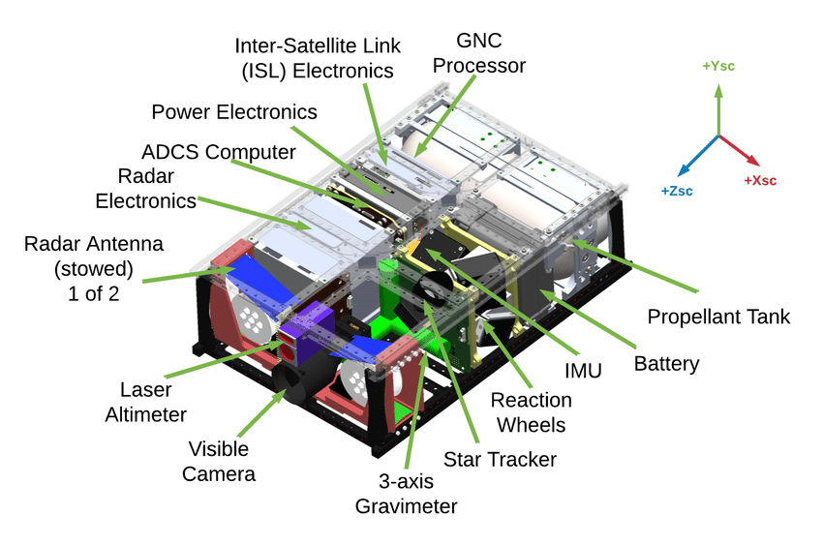
Inside A CubeSat

Slide 4
Thermal Control Challenges for Small Satellites

Slide 5
State-of-the-Art – Passive Thermal Control Systems
Passive thermal control maintains component temperatures without using powered equipment.
Passive systems are typically associated with low cost, volume, weight, and risk.
Advantageous to spacecraft with limited, mass, volume, and power, like SmallSats and especially CubeSats.
Examples of passive thermal control technology: MLI, coatings/surface finishes, interface conductance, heat pipes, sunshades, thermal straps, interface materials, and louvers.
Structural and electrical design methods also contribute to managing the thermal environment, passively.

Slide 6
Design Methods to Help Passive TCTs
Material selection : structural component materials chosen based on needed heat transfer through the structure.
A high or low thermal conductivity may be more advantageous based on the application.
Spacecraft orientation: Used only when orientation is not dictated by science objectives.
Changing orientation may only be needed during certain mission phases, during which larger amounts of heat are dissipated.
Used when, orienting the spacecraft helps in enhancing the radiator area facing deep space.

Slide 7
Design Methods to Help Passive TCTs
Thermal interfaces:
Controls the thermal contact resistance between component.
Heat transfer can be reduced by mounting a component through multiple stacked washers with low thermal conductivity.
Heat transfer can be increased by mounting components with more fasteners and can be further increased by using thermal interface materials between a component and mounting surface.

Slide 8
Circuit Board Design Considerations
Copper layers within each board can be increased, in number or thickness.
Conduct heat away from electrical components through the boards to their structural connection points.
Circuit boards can be mounted to increase heat transfer away from the boards to the structure, such as by mounting with wedge locks.
https://www.1-act.com/thermal-solutions/embedded-computing/ice-lok/

Slide 9
SmallSat Passive Thermal Technologies
Passive Technology | Description
Sprayable Thermal Control Coatings | Specialized liquid coatings applied to the spacecraft surfaces to manage and regulate the ratio of absorptivity and emissivity for optimal energy balance and thermal performance.
Films, Tapes, and MLI | Materials used to modify spacecraft surface property to manage and regulate temperature.
Thermal Straps | Provide a conductive link between a heat source and thermal sink to conductively transfer heat
Thermal Contact Conductance and Bolted Joint Conductance | Heat transfer by “contact” conductance between two surfaces pressed together by uniform pressure can be varied by using interface filler materials and conductive gaskets.
Sunshields | Deployed material that reduces the amount of incident solar flux on a spacecraft.

Slide 10
SmallSat Passive Thermal Technologies
Passive Technology |  | Description
Thermal Louvers | Controls heat transfer between spacecraft surfaces. | Controls heat transfer between spacecraft surfaces.
Deployable Radiators | Dedicated surface for dissipating excess heat via radiative heat transfer. | Dedicated surface for dissipating excess heat via radiative heat transfer.
Phase Change Materials | Energy is absorbed as material within a metal compartment changes phase because of exposure to a heat source. | Energy is absorbed as material within a metal compartment changes phase because of exposure to a heat source.
Thermal Switches | An electromechanical device which controls the flow of electrical current in response to temperature change. | An electromechanical device which controls the flow of electrical current in response to temperature change.

Slide 11
State-of-the-Art – Active Systems
Active thermal control methods rely on input power for operation.
More effective in maintaining tighter temperature control for components with stricter temperature requirements or higher heat loads.
Typical active thermal devices used on large-scale spacecraft include electrical resistance heaters, cryocoolers, thermoelectric coolers, and fluid loops.
Most of active thermal systems in small spacecraft are limited.
Due to the need for miniaturize existing actively controlled thermal techniques and reduce power requirements.

Slide 12
Active Thermal Technologies
Active Technology | (Description)
Electrical Heaters | Space heaters use an electrical-resistance element in between two sheets of flexible electrically insulating material.
Cryocoolers | Miniature refrigeration system designed to cool components to extremely low temperatures.
Thermoelectric Coolers (TEC) | miniature solid-state heat pumps which provide localized cooling via the Peltier effect, which is cooling resulting from passing electric current through a junction formed by two dissimilar metals
Fluid Loops | System that circulates a working fluid through the spacecraft to a heat sink.

Slide 13
Miniature Heaters

Slide 14
Miniature Heaters
Heaters
Active heaters controlled by mechanical thermostats or on-board computers are specially developed.
These heaters will help in thermal control of electronic equipment
within a narrow range of temperature (ambient ±20°C),
with external surface temperature differences ranging from -180°C up to + 150°C.
Heating elements are generally thermofoil conductive electrical elements embedded in a thin Kapton substrate.

Slide 15
CryoCoolers

Slide 16
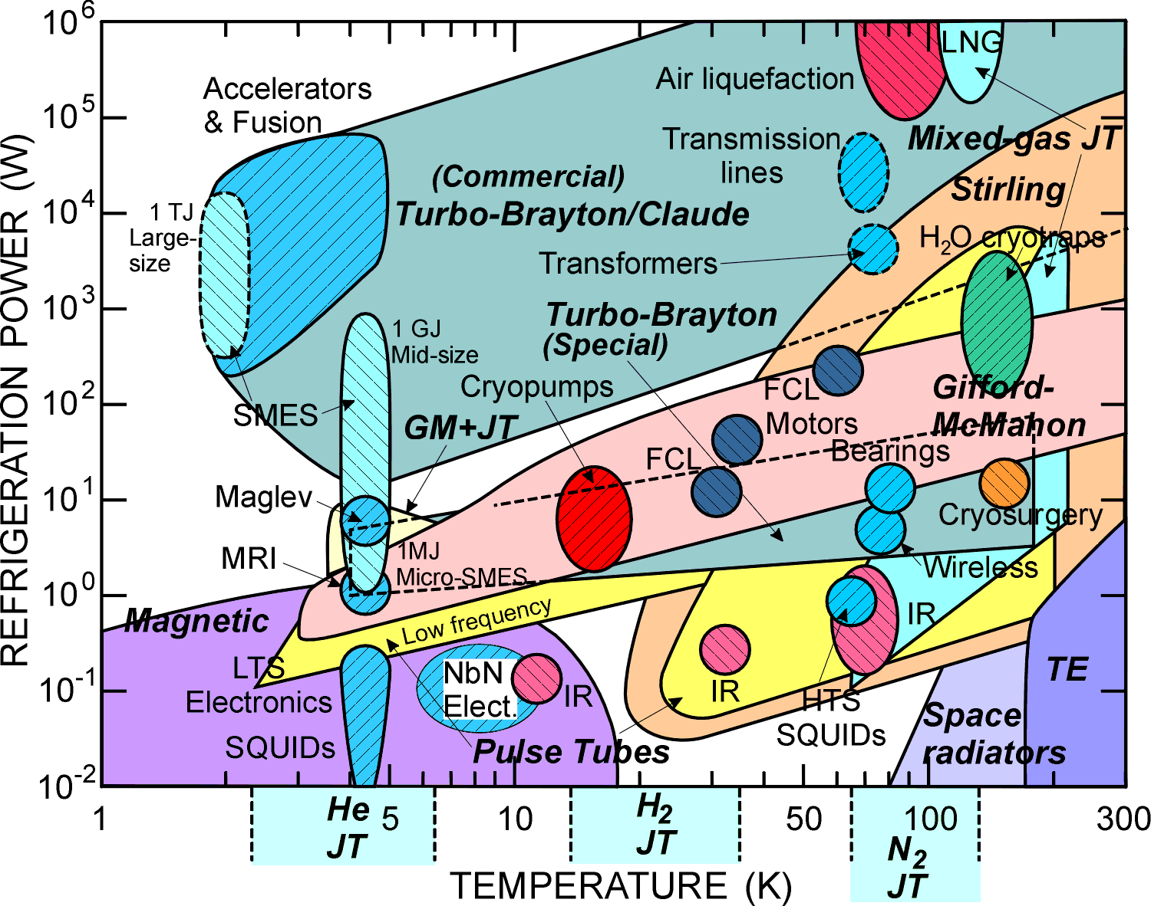
Crycooler Types and Applications

Slide 17
Cryocooler % Carnot at 80 K

Slide 18
GM Cryocooler Cycle

Slide 19
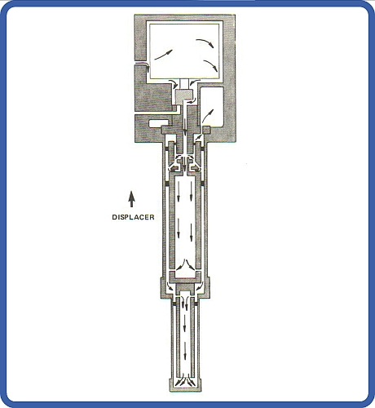
GM Cryocooler Operation
Steps 1 & 2
- High Pressure In
- Expansion
Steps 3 & 4
- Low Pressure Out
- Displacer move down

Slide 20
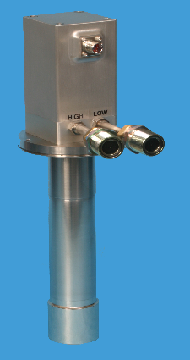
Examples of GM Cryocoolers
Sumitomo
35 W @ 50 K
1.5 W @ 4.2 K
18 kg
CryoMech
60 W @ 80 K

Slide 21
Miniature Cryocoolers

Slide 22
Q-Rad Deployable Radiator technology

Slide 23
Spacecraft Thermal Radiators
Radiators
The radiators use primary heat rejection surfaces:
They support high dissipating electronic units (traveling wave tubes and converters).
The structural composition of these panels is generally aluminum face sheet and honeycomb core.
They are designed for a maximum thermal efficiency achieved by using embedded heat pipes in association with a specific coating providing a high infrared emittance with a low solar absorptance (so called Optical Solar Reflectors).
For end of life conditions, heat rejection capability may reach upto 350 W/m² for a typical 40°C radiator temperature.

Slide 24
Radiator with copper backing

Slide 25
Miniature Heat Exchange
Ultra Additive Manufacturing

Slide 26
CubeSat prototype

Slide 27
Cryo-Cooler

Slide 28
Solar Simulation
A thermal vacuum test environment with solar simulation is essential for verification of the thermal mathematical models and TCS performances in a simulated orbital environment.
Solar heat fluxes are simulated by a set of Xenon lamps which illuminate the Spacecraft by focusing into a single collimated beam.
These huge test facilities are only available in a few locations in the world: Interspace in Toulouse has a facility, which includes other environmental tests (mechanical, EMC), thus permitting a certification of ”flight aptitude” for spacecraft before launch.

Slide 29
Solar Simulation
Thermal test chamber: 600 m³
Vacuum: 10 ⁻⁶ mmHg
Temperature: -170°C up to 120°C

Slide 30
Test Rigs for Subsystem

Slide 31
Goal of TCS
The complexity of space systems payloads is increasing.
The packaging of space electronic equipment must minimize the imposition of severe constraints on electronic designers.
The fundamental goal of TCS is to ensure a maximum junction temperature of 110°C, from a reliability point of view.

