Slide 1
Irreversible Nature of Practical Electronic Systems
P M V Subbarao
Professor
Mechanical Engineering Department
Thermal Management is A Necessity for Survival & Reliable Operation of Electronics ….

Slide 2
Boltzmann theory of Ideal Electronic Device
Ideal electrical work to be consumed for a bit of computation is:
$$W_{electric−input}=kT\ln{(}2)$$
According to Thermodynamics even this energy consumption process is an irreversible process.
Therefore, An Ideal computation process is thermodynamically Irreversible Electronic Device
$$W_{electric−input}=Q_{diss}=kT\ln{(}2)$$

Slide 3
An Ideal Electronic Device
Ideal electrical work to be consumed for a bit of computation is:
Ideal Electronic Devices can work as Adiabatic System and Requires NO Cooling.
At a room temperature of 298K, W_{ideal-elec-input} = 0.018eV.

Slide 4
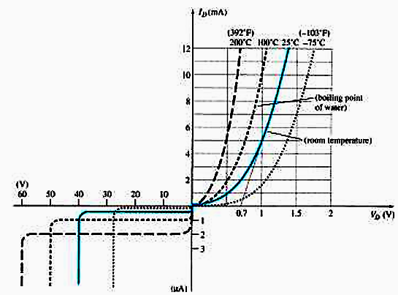
Extension of Boltzmann Theory
Ideal electrical work to be consumed for a bit of computation is:
$$W_{electric−input}=Q_{diss}=kT\ln{(}2)$$
At a room temperature of 298K, W_{ideal-input} = 0.018eV.
Why more energy is consumed at higher device temperatures?
Any excess energy must be dissipated and leads to Entropy Generation…

Slide 5
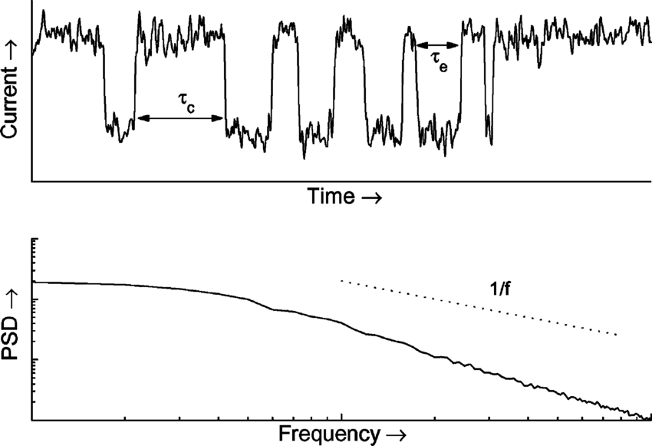
Thermal Noise
All materials produce noise at a power level proportional to the physical temperature of the material.
The noise is generated by random vibrations of conducting electrons and holes in the material.
This noise is often referred to as thermal noise.
Thermal noise is white and has a Gaussian amplitude distribution.
Thermal noise of a MOSFET with a 0.18-m gate area.
The total Power of thermal noise is:
$P_{Thermal−Noise}=kTB$
B is the Device Bandwidth

Slide 6
A Set of Irreversibilities in A Practical Computing/Electronic Device
Ideal electrical work to be consumed for a bit of computation is:
$$W_{electric−input}=Q_{diss}=kT\ln{(}2)$$
At a room temperature of 298K, W_{ideal-input} = 0.018eV.
Thermal noise on gates of minimum‐width segments of FET gates leads to channel fluctuations below ~1‐2 eV.
ITRS has minimum gate energy asymptoting to ~2 eV
Thermal noise increases leakage, impairs device performance.
Also, real logic circuits incur many further overhead factors:
Finite Transistor width demands 10‐20× min power.
Parasitic (junction, etc.) transistor capacitances (~2×)

Slide 7
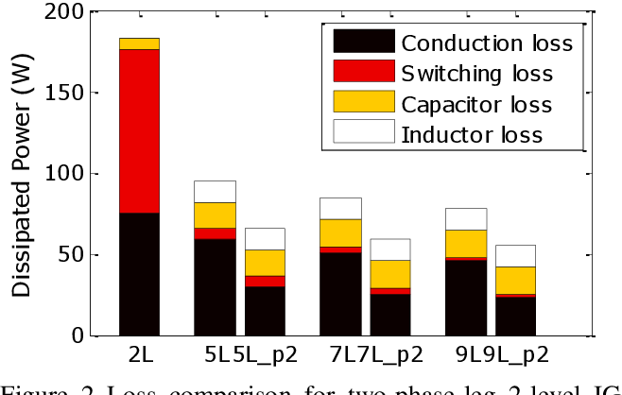
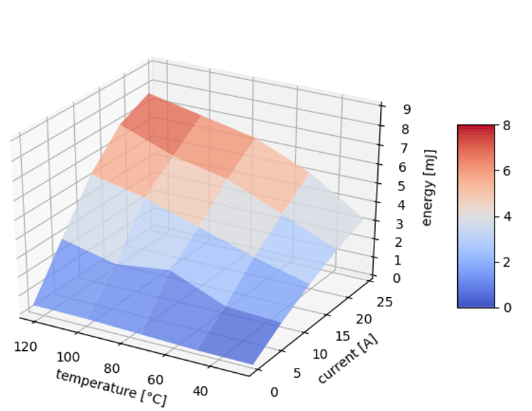
Energy consumption by An Irreversible Electronic Device
Multiple (~2) transistors fed by each input to a given logic gate
Fan‐out to a few (~3) logic gates
Parasitic wire capacitance (~2×)
Due to all these overheads, the electrical work input to each bit in real logic circuits is many times larger than the min.‐width gate energy 375‐600× (!) larger.
Generally bit energy for irreversible logic asymptotes to ~1 keV!
Best real‐world logic circuit designs can’t just magically cross this ~500× minimum power.
Thermal Management limits imply much larger practical limits!

Slide 8
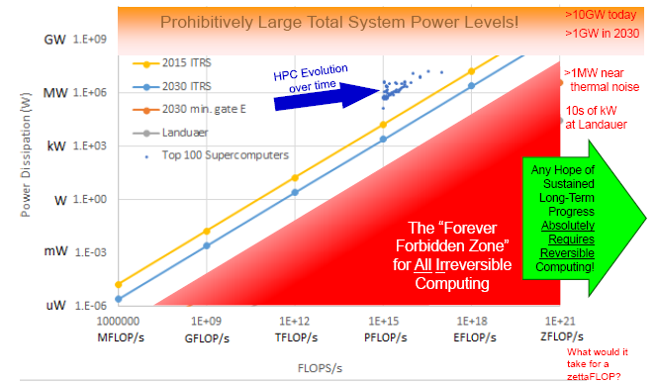
Evolution of Irreversible Computing

Slide 9
Second Law of Thermodynamics for Electronic Systems
Heat generation is an unavoidable by-product of processes in electronics.
It is impossible to construct an Electric/Electronic System which produces no effect other than the consumption of Electric power from a source and the production of an equivalent amount of Electronic Services
It is impossible to develop an electric/electronic device with zero heat generation.
It is difficult to operate electronics at ambient temperature.

Slide 10
Thermal Management: Designing for Reliability
Device reliability is a complex function of
the heat generated by the operation of an electronic device,
the tools used to dissipate or manage the heat,
the thermal stability of the materials used &
the environment in which the device is required to operate.
Diversity of applications & the increasing demand enjoin diverse thermal management tools.
Popular tools include gap fillers, active cooling systems, heat pipes and heat sinks.

Slide 11
Holistic Thermal Management Strategies
Removing the Heat – Many strategies today continually push limits for heat transfer.
Newer Arlon PCB materials offer increased thermal conductivity to reduce peak operating temperatures and
improve component life.
Beating the Heat – For over 30 years, high temperature applications have used Polyimide laminate & prepreg systems to provide device reliability in operating environments exceeding 200°C.
New enhanced polyimide system and newer lead-free compatible thermally conductive epoxy systems offer designers new approaches to maximizing reliability in tough operating environments.

Slide 12
Holistic Thermal Management Strategies
Surviving the Environment:
How materials respond to cyclic thermal exposure remains a critical contributing factor in determining device reliability.
Designing PWB’s on materials that reduce, or control thermal expansion will improve PTH.
This will improve reliability and reduce stress and fatigue on solder joints to SMT components.
Reducing the Heat – Low loss materials for microwave & High Frequency applications minimize heat generated by transmission line loss.

