Slide 1




Basics of Thermal Management
P M V Subbarao
Professor
Mechanical Engineering Department
Care for Survival & Reliable Operation of Electronics ….

Slide 2

Second Law of Thermodynamics for Electronic Systems
Heat generation is an unavoidable by-product of processes in electronics.
It is impossible to construct an Electric/Electronic System which produces no effect other than the consumption of Electric power from a source and the production of an equivalent amount of Electronic Services
It is impossible to develop an electric/electronic device with zero heat generation.
It is difficult to operate electronics at ambient temperature.

Slide 3

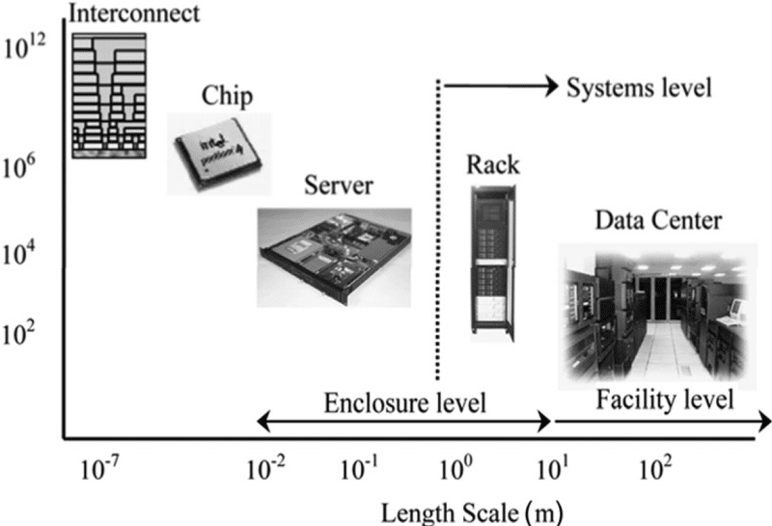
Holistic View of Thermal Management of Large Electronic Service Centers
Heat Generation Scale

Slide 4
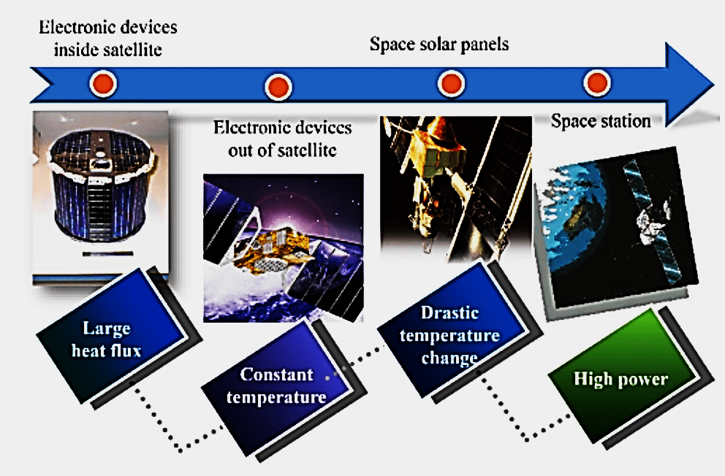
Thermal management of Space E-Devices.

Slide 5
Holistic Thermal Management Strategies
Removing the
Beating the Heat
Surviving the Environment
Reducing the Heat

Slide 6
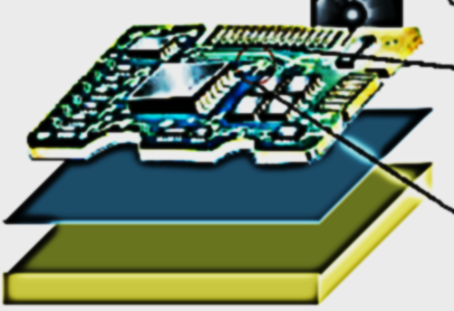
Anatomy of a General Electronic Board for Thermal Management Study
Printed Circuit Board (PCB)
Thermal Interface Material
(Optional)
Heat Sink

Slide 7
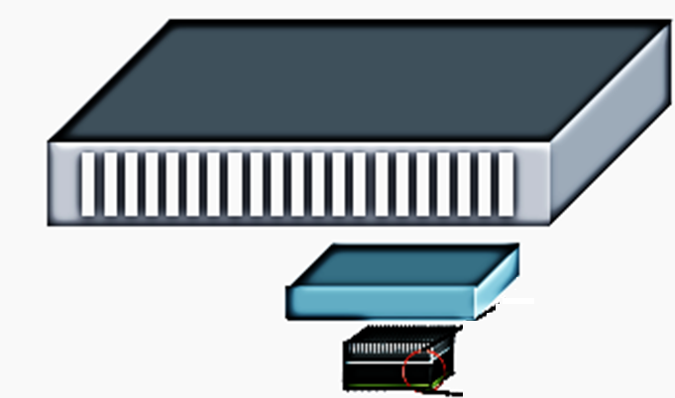
Anatomy of a General Electronic Board for Thermal Management Study
Device Enclosure
EMI Shield
Active Components

Slide 8
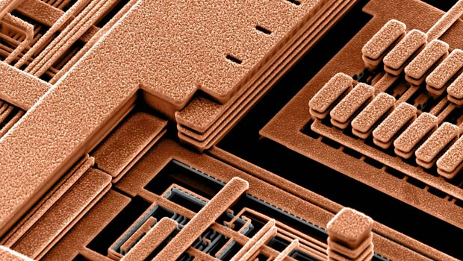
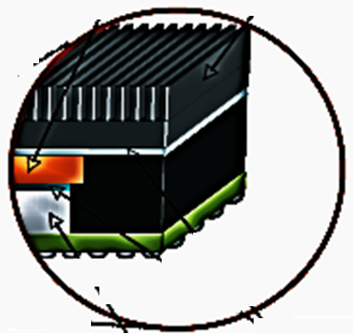
Anatomy of a General Electronic Board for Thermal Management Study
Heat Sink
Heat Spreader
Active Components
Silicon Chip
Thermal Interface Material

Slide 9
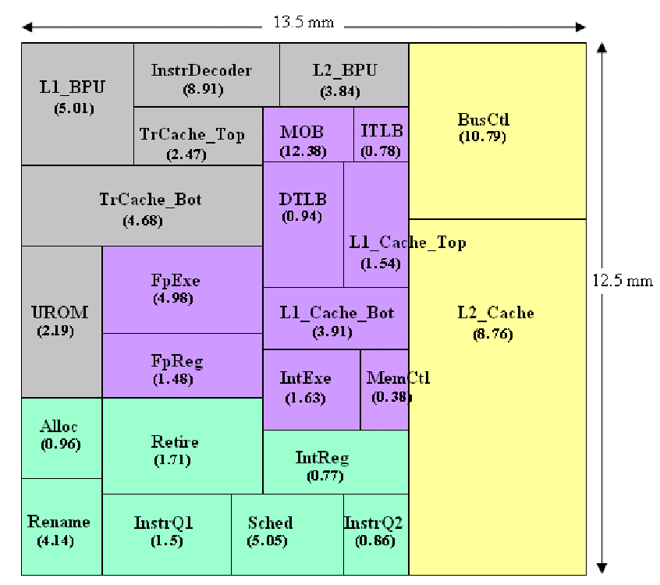
Microprocessor floor plan of Intel® Pentium® 4 Northwood-style datapath with 3 GHz clock

Slide 10
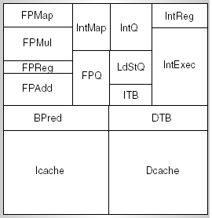
Floor Plan of A Pentium Processor

Slide 11
Thermal Management Mechanism in Pentium 4
The Pentium 4 processor implements mechanisms to measure temperature accurately using the thermal sensor.
The instantaneous power consumed is a function of the application being executed.
In a Pentium processor different functional blocks will consume vastly different amounts of power and hence heat generation.
The power consumption (local heat generation)of each block also dependent on the workload.
The heat generated on a specific block of the die is conducted to the surrounding silicon, as well as the package.
The inefficiency of heat transfer in silicon and between the die and the package results in temperature gradients across the surface of the die.

Slide 12
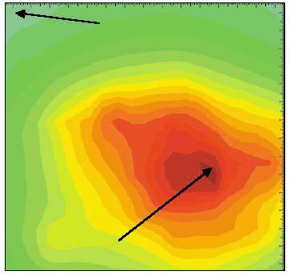
Thermal Management Mechanism in Pentium 4
While one area of the die may have a temperature well below the design point, another area of the die may exceed the maximum temperature at which the design will function reliably.
The hottest location on the die may change from application-to-application.
The concept of Power-Density Aware Thermal Floor Planning is a TM tool to reduce maximum on-chip temperature.

Slide 13
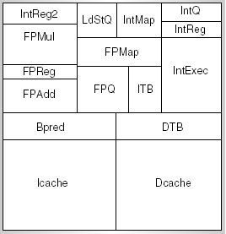
Thermal Optimization of Floor Plan
Initial Model
Low Cooling cost Model
A careful arrangement of components at the architecture level, the average reduction in peak temperature of 15°C.

Slide 14
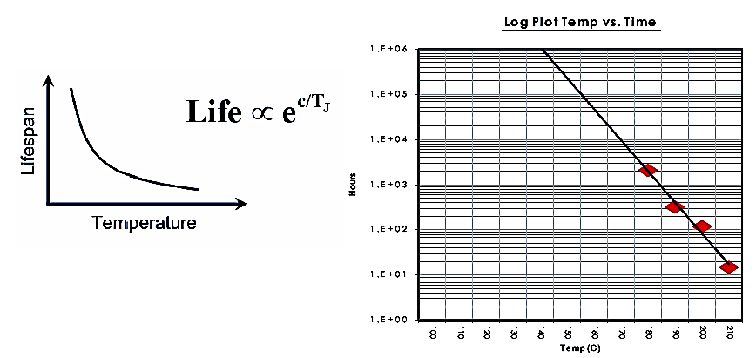
Arrhenius Equation & Reliability Chart
Junction Temperatures decide the reliability of an Electronic System
The ultimate goal of TM is to control & Monitor Junction Temperature

Slide 15
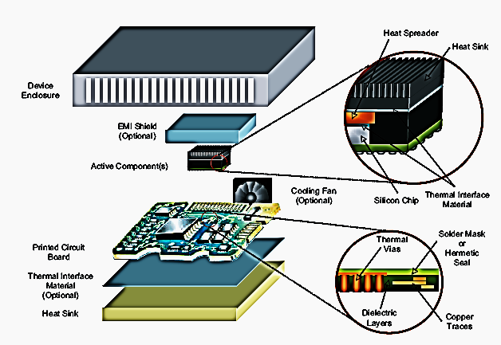
Anatomy of a General Electronic Board for Thermal Management Study

Slide 16
Newton (1701)
The key to improving reliability is to reduce device temperature by increasing the rate at which heat is removed from the device and from the working area of the PWB immediately adjacent to the device.
Understanding heat transfer then becomes the next step.
Isaac Newton published a paper, in Latin, on thermal science, Scala graduum Caloris, (Scale of the Degree of Heat), in the Philosophical Transactions (1701).

Slide 17
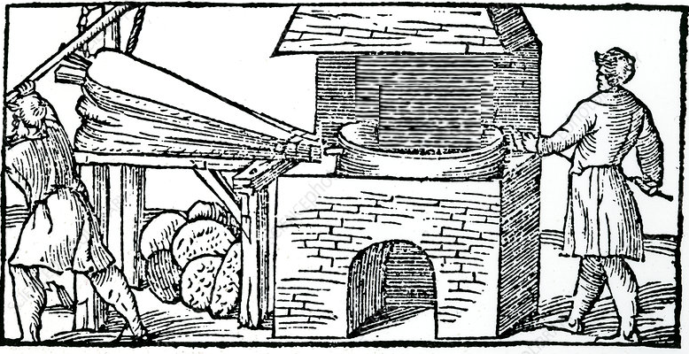
Newton’s Furnace & Law of Cooling
State 1

Slide 18
Newton’s Furnace & Law of Cooling
State 2

Slide 19
Genesis of Newton’s Law of Cooling
Statement from his 1701 paper for clarity and convenience.
The Statement:
For the heat, which the hot iron communicates in a given time, to cold bodies, which are near it, that is, the heat which the iron loses in a given time, is proportional to the whole heat of the iron.
And so, if the times of cooling are taken equal, the heats will be in a geometrical progression and consequently can easily be found with a table of logarithms.

Slide 20
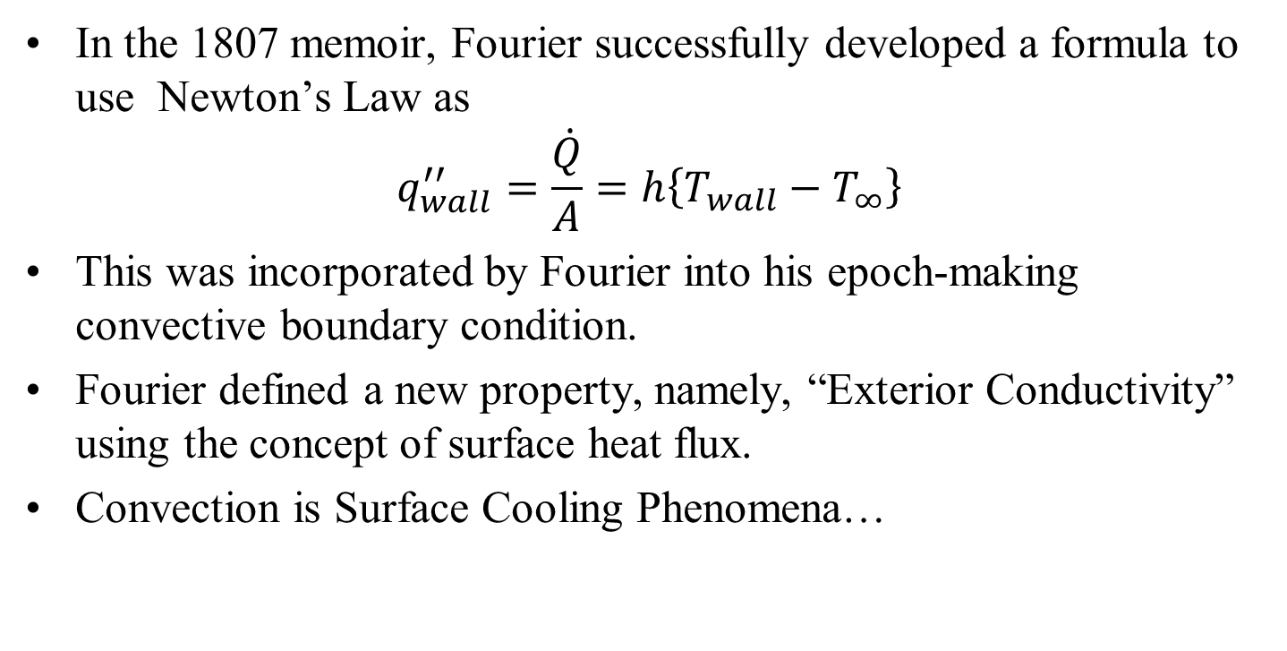
From Newton (1701) to Fourier (1822)
In the 1807 memoir, Fourier successfully developed a formula to use Newton’s Law as
$$q_{wall}^{′′}=\frac{\dot{Q}}{A}=h\left\{T_{wall}−T_{∞}\right\}$$
This was incorporated by Fourier into his epoch-making convective boundary condition.
Fourier defined a new property, namely, “Exterior Conductivity” using the concept of surface heat flux.
Convection is Surface Cooling Phenomena…

