Slide 1
Governing Equations for Thermal Management of An Electronic Processor
P M V Subbarao
Professor
Mechanical Engineering Department
Evaluation of Conditions for Survival & Reliable Operation of Electronics ….

Slide 2
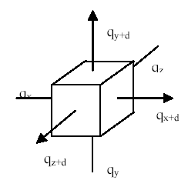
The Thermal Energy Balance Equation by Fourier
Consider an active Functional Block
$$\iiint_{V}{g(\vec{r},t)dV}$$
$$−\iint_{A_{in}}{q′′.\hat{n}dA_{in}}$$
$$\iiint_{V}{\frac{∂H}{∂t}dV}$$
$$−\iint_{A_{out}}{q′′.\hat{n}dA_{out}}$$

Slide 3
The Thermal Energy Balance Equation
$$−\iint_{A_{in}}{q′′.\hat{n}dA_{in}}+\iiint_{V}{g(\vec{r},t)dV}=−\iint_{A_{in}}{q′′.\hat{n}dA_{in}}+\iiint_{V}{\frac{∂H}{∂t}dV}$$
$$\iiint_{V}{\frac{∂H}{∂t}dV}=\iint_{A_{in}}{q′′.\hat{n}dA_{in}}−\iint_{A_{in}}{q′′.\hat{n}dA_{in}}+\iiint_{V}{g(\vec{r},t)dV}$$
$$\iiint_{V}{\frac{∂H}{∂t}dV}=−\iint_{S}{q′′.\hat{n}dS}+\iiint_{V}{g(\vec{r},t)dV}$$
Using Gauss Divergence Theorem:
$$\iiint_{V}{\frac{∂H}{∂t}dV}=−\iiint_{V}{∇.q′′dV}+\iiint_{V}{g(\vec{r},t)dV}$$

Slide 4
The Fourier Conduction Equation
$$\iiint_{V}{\frac{∂H}{∂t}dV}=−\iiint_{V}{∇.q′′dV}+\iiint_{V}{g(\vec{r},t)dV}$$
However, since the integrals are equal the arguments are also equal, and the most general form of the differential thermal energy balance equation is
$$\frac{∂H}{∂t}=−∇.q′′+g(\vec{r},t)$$
This is called the differential thermal energy balance equation.
∴ Newton’s law of cooling is an essential boundary condition for an Electronic Processor (Control Mass).

Slide 5
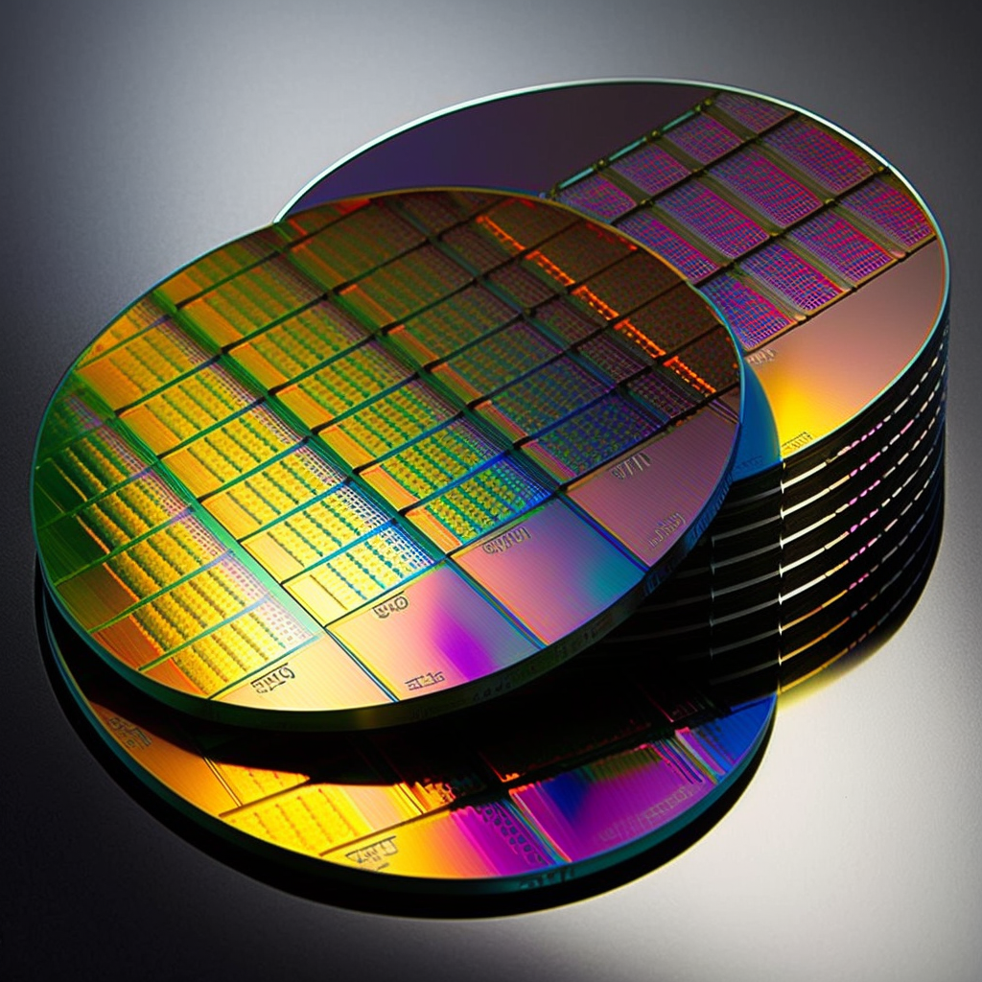
Fourier’s Constitutive Equation for the Heat Flux
$$\frac{∂H}{∂t}=−∇.q′′+g(\vec{r},t)$$
Thickness of a selected functional block is much smaller than other two dimensions:
Wafers used in VLSI fabrication are typically between 100 and 300 millimeters in diameter and between 0.5 and 1 millimeter thick.
The most common size used in the industry is 300mm, although smaller sizes, such as 200mm and 150mm are still used in some applications.
$$∆y≈∆z≫∆x$$

Slide 6
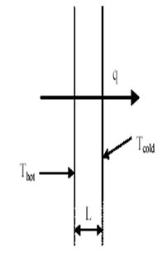
Fourier’s law of Heat Conduction : 1822
The rate of heat transfer through the wall is proportional to:
The temperatures difference between the left (hot) and right (cold) surfaces increase,
The wall surface area increases,
The wall thickness reduces,
A Constitutive Relation
$$q∝A\frac{\left(T_{hot}−T_{cold}\right)}{δx}$$
$$∝−A\left\{\frac{δT}{δx}\right\}$$
$$q=−kA\left\{\frac{δT}{δx}\right\}$$
$$δx$$
This is called as Fourier Law of Conduction

Slide 7
Local Heat Flux during Conduction
Local Heat flux in a slab:
$$q_{x}′′= −k\lim_{δx→0}\left\{\frac{\left(T_{cold}(x+δx)−T_{hot}(x)\right)}{\left(x+δx\right)−x}\right\}$$
$$q_{x}′′= −k\left\{\frac{dT}{dx}\right\}$$
$$q_{x}= −kA\left\{\frac{dT}{dx}\right\}$$
Local heat transfer rate:

Slide 8
Fourier’s Constitutive Equation for an Electronic Processor
$$\frac{∂H}{∂t}=−∇.q′′+g(r,t)$$
$$q′′=−k∇T$$
$$q′′=−\vec{\vec{k}}•∇T$$
$$\vec{\vec{k}}=\left[\begin{aligned}&k_{\text{xx}} {\text{k}}_{\text{xy}} {\text{k}}_{\text{xz}} \\ &k_{\text{yx}} {\text{k}}_{\text{yy}} {\text{k}}_{\text{yz}} \\ &k_{\text{zx}} {\text{k}}_{\text{zy}} {\text{k}}_{\text{zz}}\end{aligned}\right]$$
The Fourier Conduction Equation
$$ρC_{}\frac{∂T}{∂t}=∇.\left\{\vec{\vec{k}}.∇T\right\}+g(r,t)$$

Slide 9
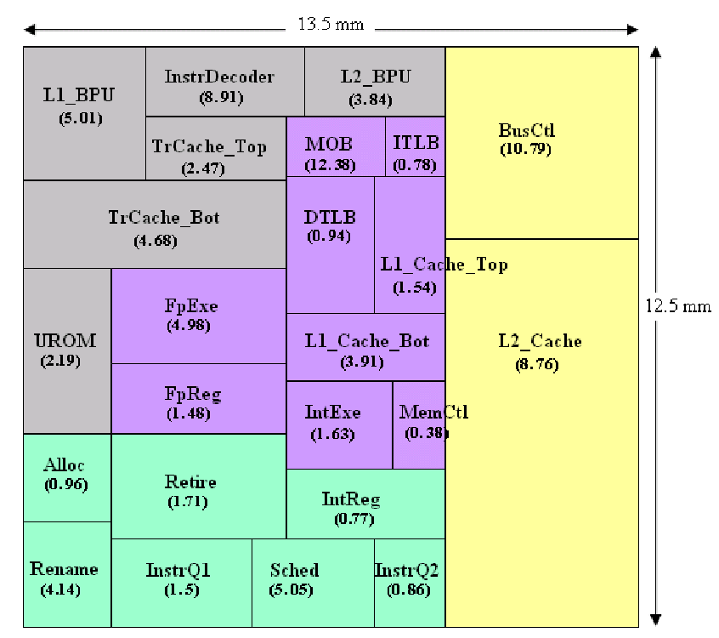
Conduction with Thermal Energy Generation
$$ρC_{}\frac{∂T}{∂t}=∇.\left\{\vec{\vec{k}}.∇T\right\}+g(r,t)$$
Conversion of electrical to thermal energy in electronic devices.
Creates a truly non-homogenous ODE for Temperature distribution in a medium.

Slide 10
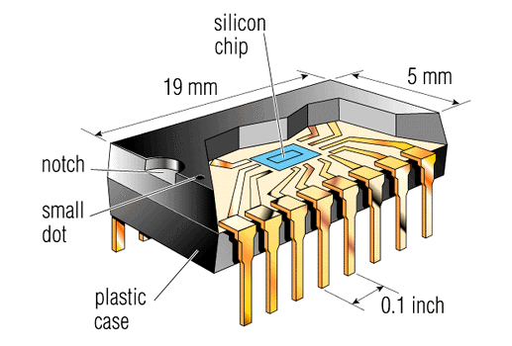
Plane Slab with Thermal Energy Generation
For one-dimensional, steady-state conduction in a medium:
$$\frac{d\left(k\frac{dT}{dx}\right)}{dx}+q^{′′′}=0$$
homogeneous medium with constant properties:
q’’’
$$k\frac{d^{2}T}{dx^{2}}+q^{′′′}=0$$

Slide 11
Local Rate of Heat Flux Transfer
$$T(x)=−\frac{q^{′′′}}{2k}x^{2}+C_{1}x+C_{2}$$
The temperature distribution is parabolic in x.
Using Fourier’s law:
Heat transfer rate:
$$q(x)=−kA\frac{dT}{dx}=−kA\left\{−\frac{q^{′′′}}{k}x+C_{1}\right\}$$
Thus, dT/dx is a function of x, and therefore both the heat transfer rate and heat flux are dependent on x for a medium with energy generation.

Slide 12
Boundary Conditions
Case 1: Simple Dirichlet Boundary Conditions:
$$T(−L)=T_{s1}$$
&
$$T(L)=T_{s2}$$
$$T_{s1}≠T_{s2}$$
q’’’
$$T(x)=−\frac{q^{′′′}}{2k}x^{2}+C_{1}x+C_{2}$$
Solution :
$$T(x)=\frac{q^{′′′}L^{2}}{2k}\left\{1−{\left[\frac{x}{L}\right]}^{2}\right\}+\frac{T_{s2}−T_{s1}}{2}\frac{x}{L}+\frac{T_{s2}+T_{s1}}{2}$$
Maximum temperature occurs inside the slab close the higher temperature surface.

