Slide 1




Steady State Electronic Processor & Analytical Description
P M V Subbarao
Professor
Mechanical Engineering Department
A Figure of Merit for Design Level Thermal Management of A Processor ….

Slide 2

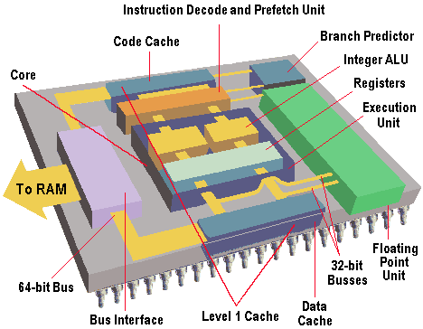
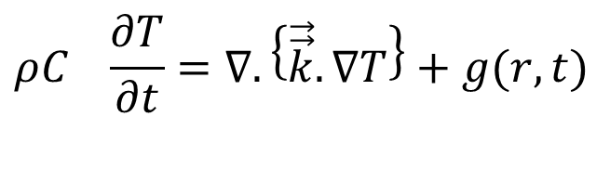
Conduction with Thermal Energy Generation
$$ρC_{}\frac{∂T}{∂t}=∇.\left\{\vec{\vec{k}}.∇T\right\}+g(r,t)$$
Conversion of electrical to thermal energy in electronic devices.
Creates a truly non-homogenous ODE for Temperature distribution in a medium.
Steady state is the culmination of Transient process.
The thermal architecture is responsible for the quality of Steady state.

Slide 3
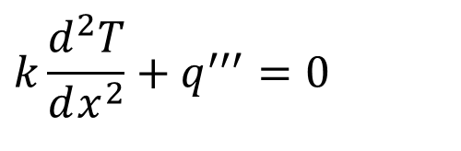
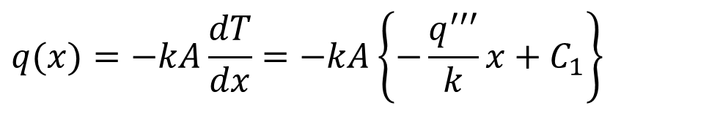
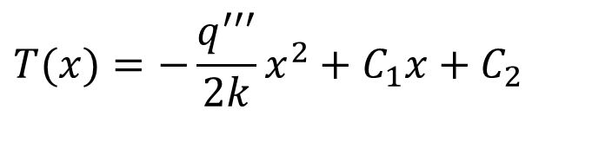
Plane Slab with Thermal Energy Generation @ SS
For one-dimensional, steady-state conduction in a homogeneous medium:
$$k\frac{d^{2}T}{dx^{2}}+q^{′′′}=0$$
An analytical equation for temperature distribution along chip (Functional Block) thickness is
$$T(x)=−\frac{q^{′′′}}{2k}x^{2}+C_{1}x+C_{2}$$
Variation of Heat transfer rate alone the chip thickness :
$$q(x)=−kA\frac{dT}{dx}=−kA\left\{−\frac{q^{′′′}}{k}x+C_{1}\right\}$$

Slide 4
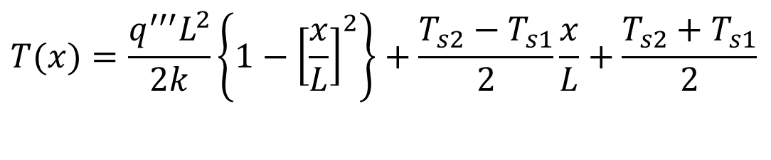
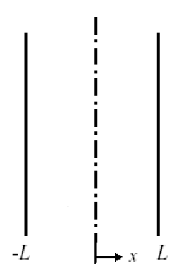



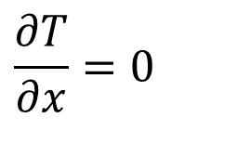

Boundary Conditions
Case 1: Simple Dirichlet Boundary Conditions:
$$T(−L)=T_{s1}$$
&
$$T(L)=T_{s2}$$
$$T(x)=\frac{q^{′′′}L^{2}}{2k}\left\{1−{\left[\frac{x}{L}\right]}^{2}\right\}+\frac{T_{s2}−T_{s1}}{2}\frac{x}{L}+\frac{T_{s2}+T_{s1}}{2}$$
$$q^{′′′}$$
$$T_{s1}≠T_{s2}$$
Location and magnitude of temperature @
$$\frac{∂T}{∂x}=0$$
Maximum temperature occurs inside the slab close the higher temperature surface.

Slide 5
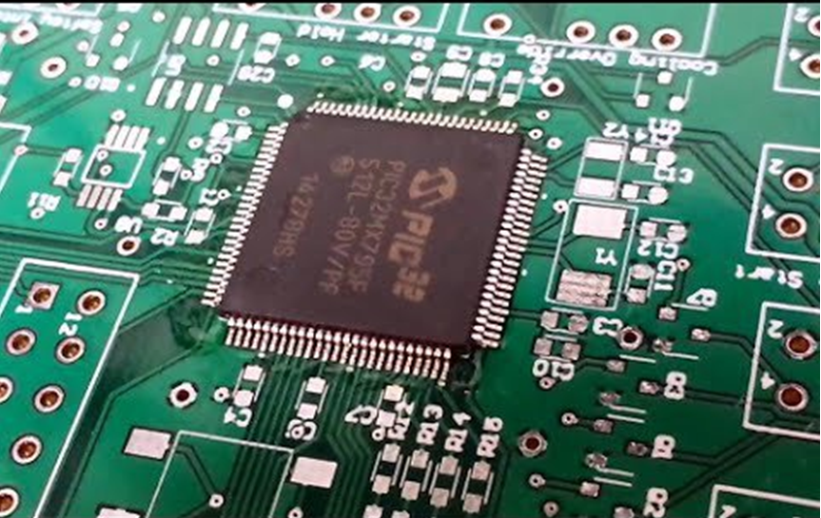
Thermal Management Aspects of Chip Erection on a Board
How to Control Surface Temperature of a Chip?
Electronic Design always leads to Asymmetric Thermal Steady State..

Slide 6
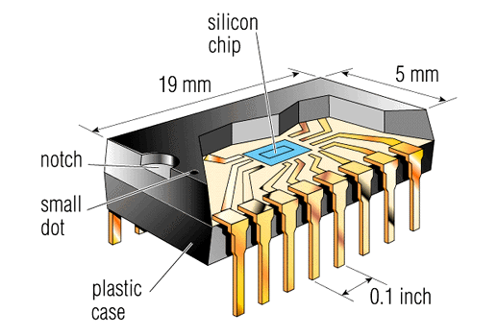
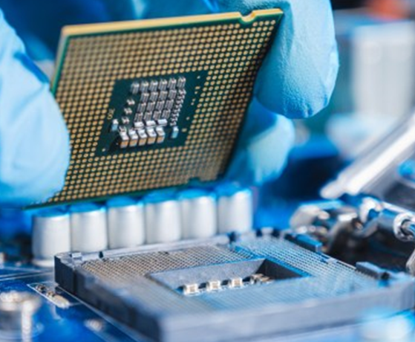
Circumstances Responsible of Transport of Heat to Chip Surface
Junctions are the sites of heat generation and thus the hottest spots in a silicon chip.
Modern chips can withstand a maximum junctions temperature of 150 ºC.
Lower Junction temperatures are desirable for extended life and lower Maintenance costs.
The basic challenge: Diffusion of Heat generation in < 1mm thick multi-core processor made of silicon wafer.

Slide 7
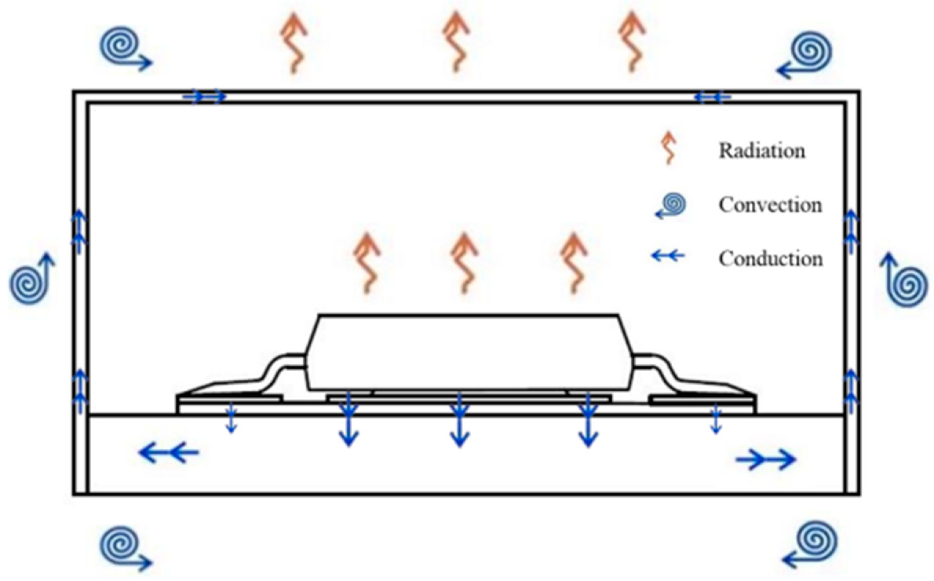
Chip Level Thermal Management
Source of Heat Generation
Convection decides the Steady State Conditions of A Processor.
Design level thermal management is responsible for the quality of SS.

Slide 8
Compact Thermal Models for Electronics
A design thermal model is a sub-group of a species of electronic part.
For a mono-chip package a compact model is a thermal resistor network containing no more than ten layers.
The concept of compact model is coined by DELPHI to achieve Boundary-Condition Independence for ease of design of electronic equipment.
Models which satisfy BCI requirement can be used in any application-specific environment.
Suppliers can develop these applications without any information about the operating environments.
Rosten, H.I., Lasance, C.J.M., Parry, J.D.: The world of thermal charaterization according to DELPHI—part I: Background to DELPHI. IEEE Trans Components Packaging Technol 20(4), 384–391, December (1997)

Slide 9
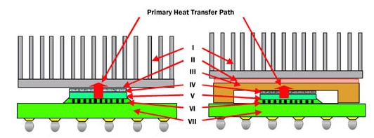
Current Practice: Lack of BCI
Laptop
Desktop and Server
I – Heat Sink
II – TIM
III – IHS
IV – TIM
V – Die
VI – Underfill
VII – Package Substrate

Slide 10
Basic Knowledge for Thermal Management
1, active die; 2, die attach 1; 3, die attach 2; 4 dummy spacer die, stacked gap; 5, heat spreader attach; and 6, heat spreader.
Use Electrical Science for Thermal Management of Electronics!

