Slide 1




Electrical Analogy Approach for Thermal Management of Electronic Processors
P M V Subbarao
Professor
Mechanical Engineering Department
An Effective Methodology for Design Level Thermal Management of A Processor ….

Slide 2

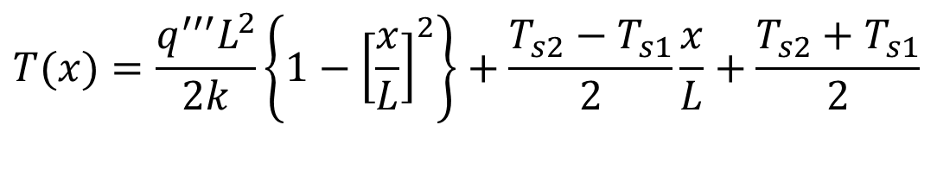
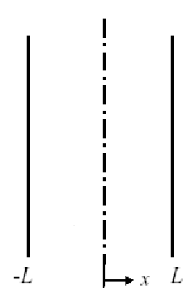




Steady State Temperature Distribution in a Processor
One-dimensional SS Analysis of a Processor with homogeneous heat generation and properties:
$$T(x)=\frac{q^{′′′}L^{2}}{2k}\left\{1−{\left[\frac{x}{L}\right]}^{2}\right\}+\frac{T_{s2}−T_{s1}}{2}\frac{x}{L}+\frac{T_{s2}+T_{s1}}{2}$$
$$q^{′′′}$$
$$T(−L)=T_{s1}$$
&
$$T(L)=T_{s2}$$
$$T_{s1}≠T_{s2}$$
Maximum temperature occurs inside the slab close the higher temperature surface.
How to Manage Temperatures on the Processor Surfaces????

Slide 3
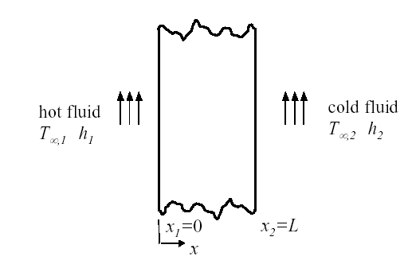
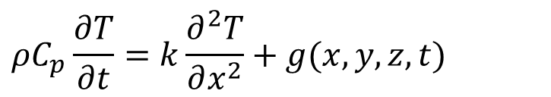
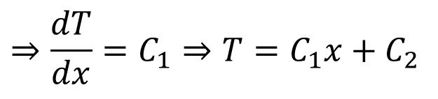
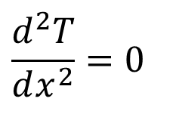
Steady-State One-Dimensional Conduction
For conduction through a large wall made of a homogeneous medium with invariant thermal conductivity ( k = constant): the heat equation reduces to:
$$ρC_{p}\frac{∂T}{∂t}=k\frac{∂^{2}T}{∂x^{2}}+g(x,y,z,t)$$
Any electronic processor consist of several inactive layers.
Heat generation is absent in these layers.
∴ Steady 1D conduction equation for these layers is:
$$\frac{d^{2}T}{dx^{2}}=0$$
$$⇒\frac{dT}{dx}=C_{1}⇒T=C_{1}x+C_{2}$$

Slide 4
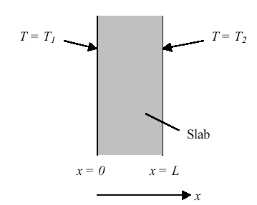

Steady Heat Transfer through a Plane Slab
$$T=C_{1}x+C_{2}$$

Slide 5

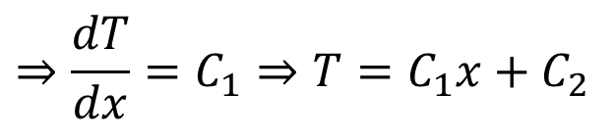
Isothermal Wall Surfaces
$$⇒\frac{dT}{dx}=C_{1}⇒T=C_{1}x+C_{2}$$
Apply boundary conditions to solve for constants: T(0)=T_{s1} ; T(L)=T_{s2}
The resulting temperature distribution is:
and varies linearly with x.

Slide 6
Reapplication of Fourier’s law:
heat transfer rate:
heat flux:
Therefore, both the heat transfer rate and heat flux are independent of x.

Slide 7
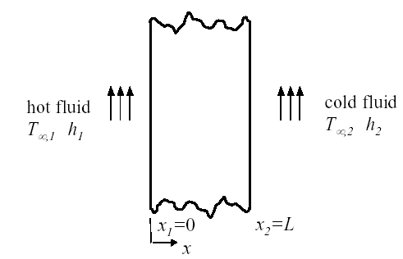
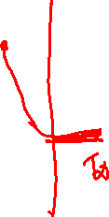
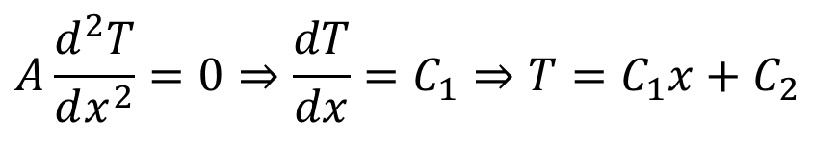
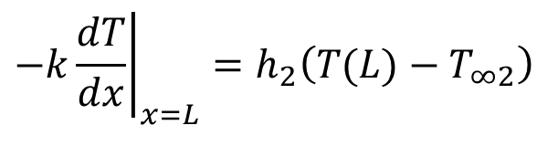
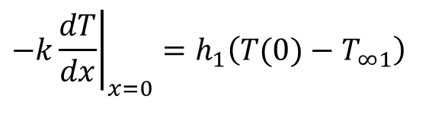
Wall Surfaces with Convection
$$A\frac{d^{2}T}{dx^{2}}=0⇒\frac{dT}{dx}=C_{1}⇒T=C_{1}x+C_{2}$$
Boundary conditions:
$$−k{\left.\frac{dT}{dx}\right|}_{x=0}=h_{1}\left(T(0)−T_{∞1}\right)$$
$$−k{\left.\frac{dT}{dx}\right|}_{x=L}=h_{2}\left(T(L)−T_{∞2}\right)$$

Slide 8
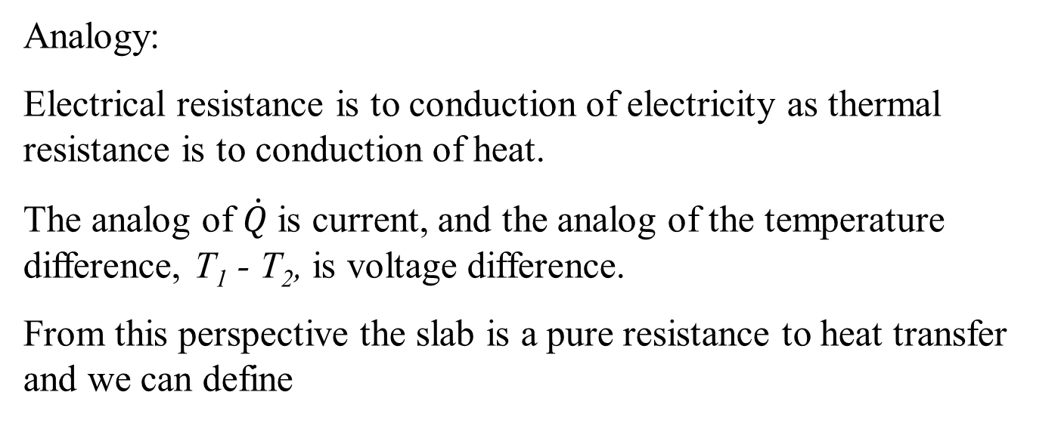

Electrical Circuit Theory of Heat Transfer
Thermal Resistance
A resistance can be defined as the ratio of a driving potential to a corresponding transfer rate.
$$R=\frac{ΔV}{i}$$
Analogy:
Electrical resistance is to conduction of electricity as thermal resistance is to conduction of heat.
The analog of $\dot{Q}$ is current, and the analog of the temperature difference, T₁ - T₂, is voltage difference.
From this perspective the slab is a pure resistance to heat transfer and we can define

Slide 9
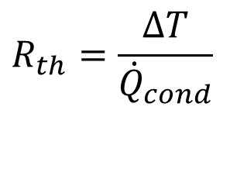
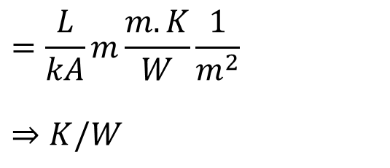
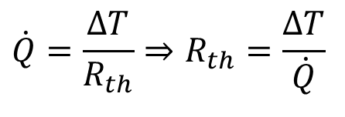
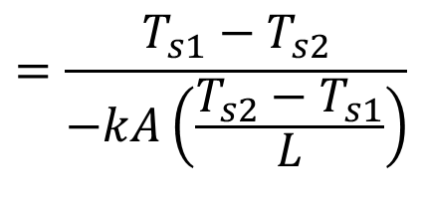
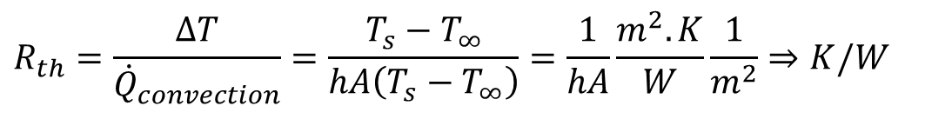
Thermal Resistance
$$\dot{Q}=\frac{ΔT}{R_{th}}⇒R_{th}=\frac{ΔT}{\dot{Q}}$$
For conduction heat transfer:
$$=\frac{T_{s1}−T_{s2}}{−kA\left(\frac{T_{s2}−T_{s1}}{L}\right)}$$
$$=\frac{L}{kA}m\frac{m.K}{W}\frac{1}{m^{2}}$$
$$⇒K/W$$
$$R_{th}=\frac{ΔT}{{\dot{Q}}_{cond}}$$
Similarly for convection:
$$R_{th}=\frac{ΔT}{{\dot{Q}}_{convection}}=\frac{T_{s}−T_{∞}}{hA\left(T_{s}−T_{∞}\right)}=\frac{1}{hA}\frac{m^{2}.K}{W}\frac{1}{m^{2}}⇒K/W$$

Slide 10
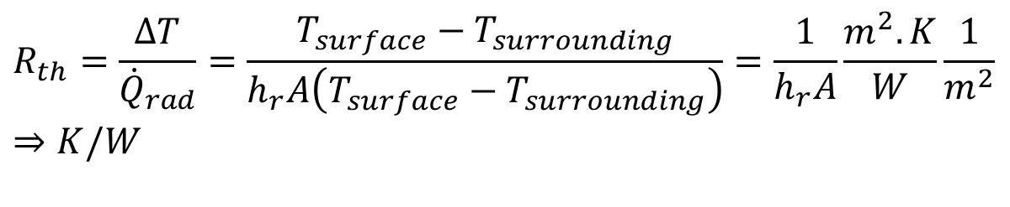
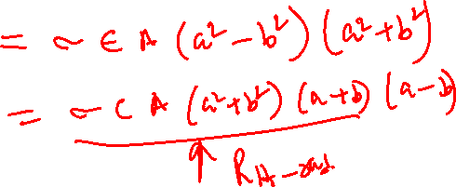
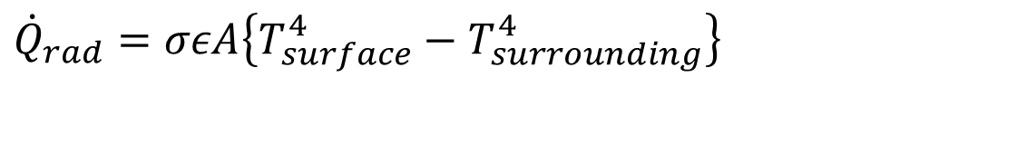
Thermal Resistance
For radiation heat transfer:
$${\dot{Q}}_{rad}=σεA\left\{T_{surface}^{4}−T_{surrounding}^{4}\right\}$$
$$R_{th}=\frac{ΔT}{{\dot{Q}}_{rad}}=\frac{T_{surface}−T_{surrounding}}{h_{r}A\left(T_{surface}−T_{surrounding}\right)}=\frac{1}{h_{r}A}\frac{m^{2}.K}{W}\frac{1}{m^{2}}⇒K/W$$

Slide 11
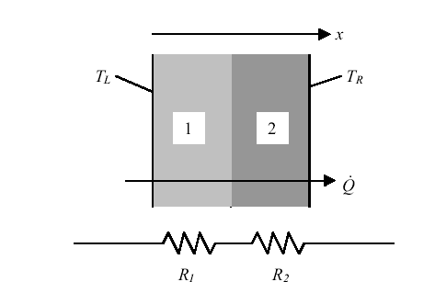
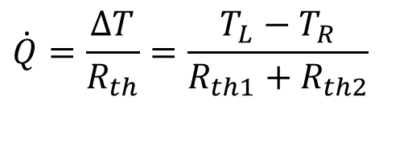
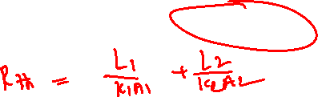
Thermal Layers in A Processors
The concept of a thermal resistance circuit allows ready analysis of problems such as a composite layers (composite planar heat transfer surface).
In the composite slab, the heat flux is constant with x.
The resistances are in series and sum to R_{th} = R_{th1} + R_{th2}.
If T_{L} is the temperature at the left, and T_{R} is the temperature at the right, the heat transfer rate is given by
$$\dot{Q}=\frac{ΔT}{R_{th}}=\frac{T_{L}−T_{R}}{R_{th1}+R_{th2}}$$

Slide 12
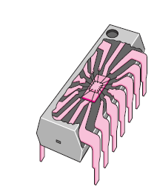
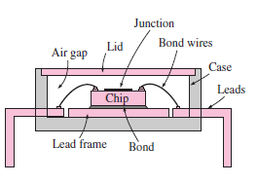
Thermal Analysis of DIP Electronic Processor

Slide 13
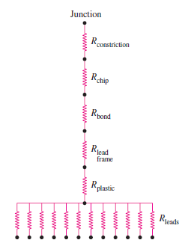
Thermal Analysis of DIP Electronic Processor

Slide 14
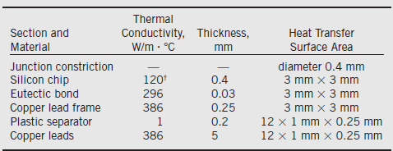
Property Model of DIP
The thermal conductivity of silicon varies greatly with temperature from 153.5 W/m · °C at 27°C to 113.7 W/m · °C at 100

Slide 15

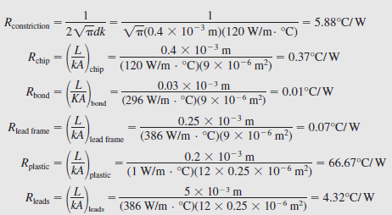
Overall Thermal Resistance
DIP is dissipating 0.6 W

Slide 16
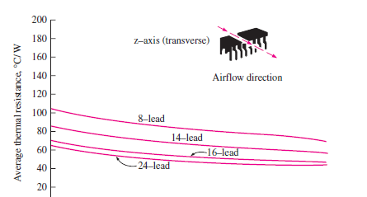
Control of Overall Thermal Resistance

Slide 17
Comparative chart of heat transfer coefficient for different cooling systems
Liquid Boiling

Slide 18
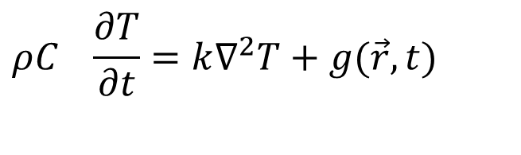
Thermal Packages for Electronic Processors
$$ρC_{}\frac{∂T}{∂t}=k∇^{2}T+g(\vec{r},t)$$
XP-BGA package

Slide 19
Thermal Packages for Electronic Processors
$$ρC_{}\frac{∂T}{∂t}=k∇^{2}T+g(\vec{r},t)$$
Package-on-package (PoP) structure

Slide 20
Superiority of Thermal Packages
$$ρC_{}\frac{∂T}{∂t}=k∇^{2}T+g(\vec{r},t)$$

Slide 21
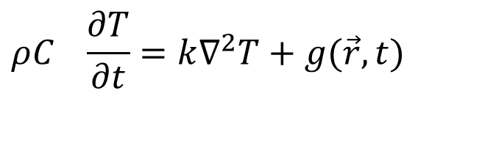
Thermal Packages for Electronic Processors
$$ρC_{}\frac{∂T}{∂t}=k∇^{2}T+g(\vec{r},t)$$
Embedded die package. 1, Embedded die; 2 BGA die; 3, passive components, 4, polyimide; 5, adhesive; 6, copper; and 7, conductive paste.

Slide 22
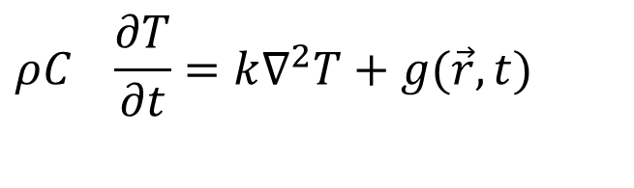
Thermal Packages for Electronic Processors
$$ρC_{}\frac{∂T}{∂t}=k∇^{2}T+g(\vec{r},t)$$
Stacked Silicon Interconnection Module

Slide 23
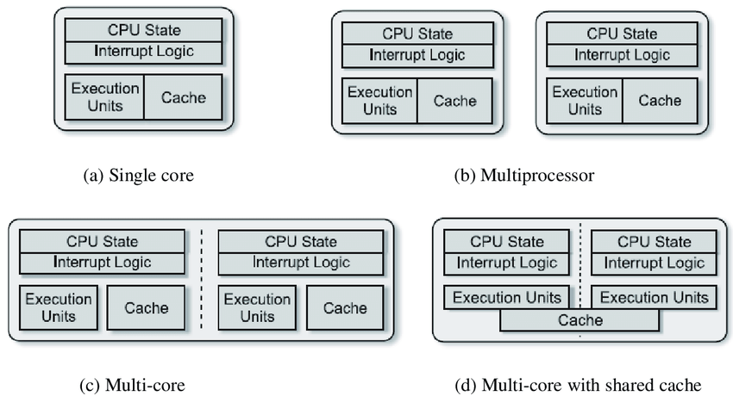
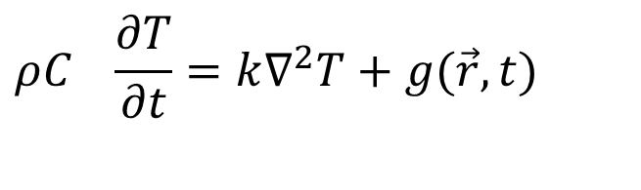
Thermal Packages for Electronic Processors
$$ρC_{}\frac{∂T}{∂t}=k∇^{2}T+g(\vec{r},t)$$
Concept of Multi-Core Processors

Slide 24
Temperature-Aware Design

