Slide 1
Selecting the Right Heat Sink for the given Processor 3
P M V Subbarao
Professor
Mechanical Engineering Department
Design Level – 2to 3

Slide 2
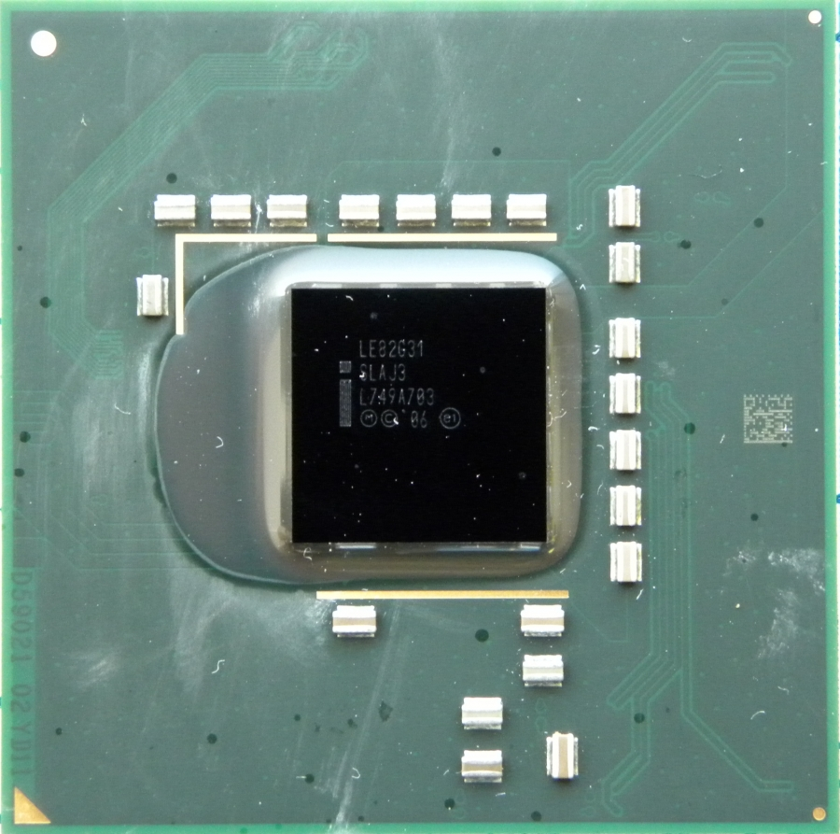
Intel GMA 3100 Graphics Card
Dimensions: 9.9 mm × 10.20 mm
Thermal power dissipation: 13W
Maximum allowable Junction temperature: 125°C
Junction to casing resistance: 2.5°C/W

Slide 3
Problem Statement
https://wakefieldthermal.com/content/data_sheets/2021_data_sheets/Wakefield-Thermal-Extrusion-Profile-Guide.pdf
Select two different suitable models of heat sinks given in above reference.
Give complete specifications of these two heat sinks.
Prove that your designs are satisfactory and reliable.
Constraint: Heat sink L and W may be in the range of 60 to 100 mm if possible.

Slide 4
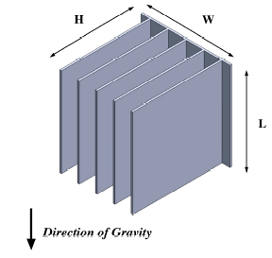
Natural Convection Cooled Fin Arrays (Heat Sinks)

Slide 5
Conditions
Date of Submission: 8 April 2024 at 12 noon.
All copied assignments will get zero marks.

