Slide 1

20th Century Phenomenological Understanding of SI I.C. Engines
P M V Subbarao
Professor
Mechanical Engineering Department
Head, CRDT
Recognize the True Nature of Working Substance, Fuel, Hardware & Processes…..

Slide 2

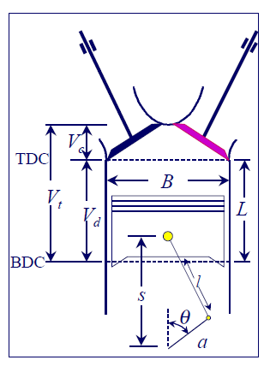

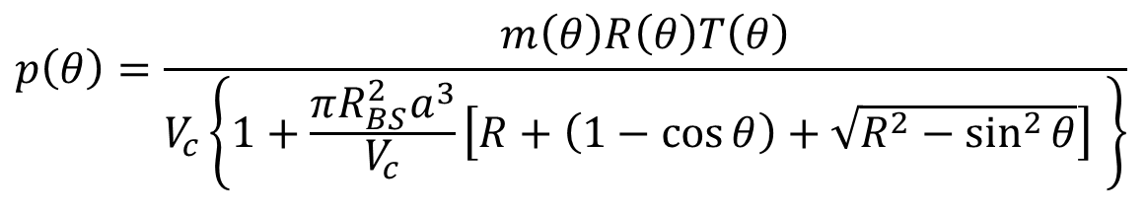
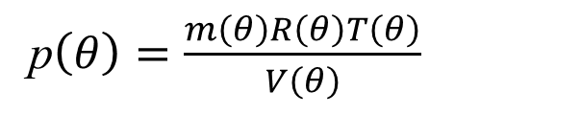
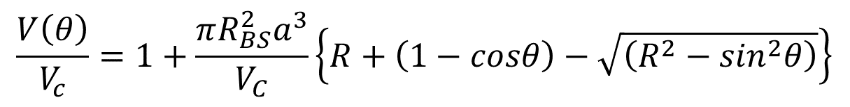
Ideal Gas as Working Fluid in An I.C. Engine (Blood of Artificial Animal)
Cylinder Bore-to-Stroke Ratio
Kinematic Rod Ratio
$$\frac{V\left(θ\right)}{V_{c}}=1+\frac{πR_{BS}^{2}a^{3}}{V_{C}}\left\{R+\left(1−cosθ\right)−\sqrt{\left(R^{2}−\sin^{2}θ\right)}\right\}$$
$$p\left(θ\right)V\left(θ\right)=m\left(θ\right)R\left(θ\right)T\left(θ\right)$$
p$\left(θ\right)=\frac{m\left(θ\right)R\left(θ\right)T\left(θ\right)}{V\left(θ\right)}$
$$p\left(θ\right)=\frac{m\left(θ\right)R\left(θ\right)T\left(θ\right)}{V_{c}\left\{1+\frac{π{R_{BS}^{2}a}^{3}}{V_{c}}\left[R+\left(1−\cos{θ}\right)+\sqrt{R^{2}−\sin^{2}{θ}}\right] \right\}}$$

Slide 3
Strategic zones of improvements for SI Engine
Low Thermal Efficiency
High thermal Stresses
Low Thermal Efficiency
Negative Work Cycle

Slide 4
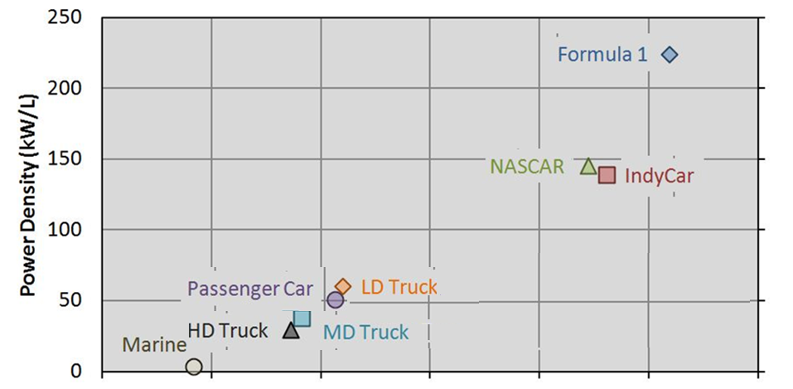
20th century Trending of Industry Practice: Bore/Stroke Ratio
Bore – to –Stroke Ratio

Slide 5
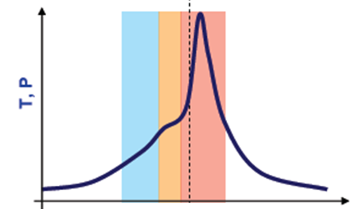
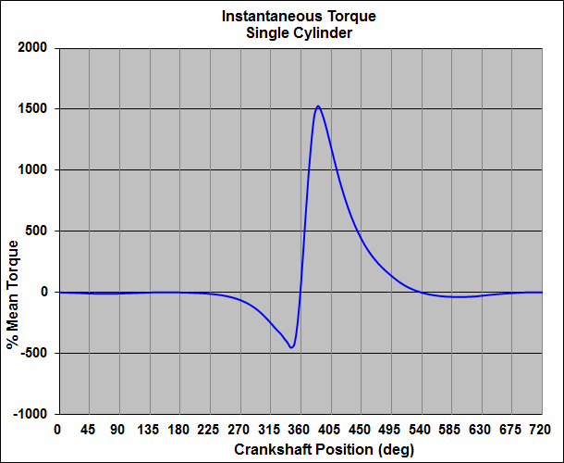
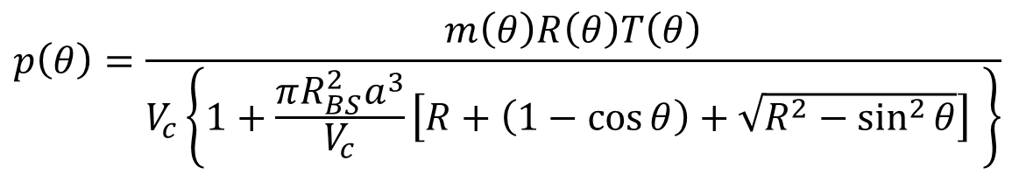
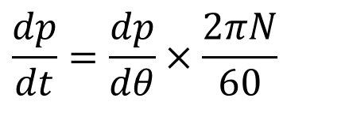

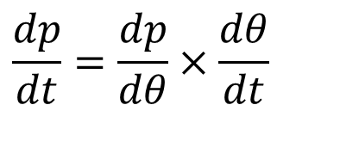
Generation of Primary Dynamic Forces
$$p\left(θ\right)=\frac{m\left(θ\right)R\left(θ\right)T\left(θ\right)}{V_{c}\left\{1+\frac{π{R_{BS}^{2}a}^{3}}{V_{c}}\left[R+\left(1−\cos{θ}\right)+\sqrt{R^{2}−\sin^{2}{θ}}\right] \right\}}$$
p
$$θ$$
$$\frac{dp}{dt}=\frac{dp}{dθ}×\frac{dθ}{dt}$$
$$\frac{dp}{dt}=\frac{dp}{dθ}×\frac{2πN}{60}$$

Slide 6
Industrial Experience : Extreme Limits of R_{BS}
The extremes to the value of R_{BS} are controlled by the inertial forces (stresses) originating from the piston motion.
To achieve high power density, the engine must operate at a high engine speed (up to 18,000 rpm for the Formula 1 engine).
High speed leads to high inertial forces that must be limited by using a large bore-to-stroke ratio.
For applications that demand high efficiency requires a slower engine speed and lower power density.
A small bore-to-stroke ratio is necessary to execute a quasi-static process.
For the marine application an engine with 2.5 m stroke, the engine speed is limited to 102 rpm for best fuel economy.

Slide 7
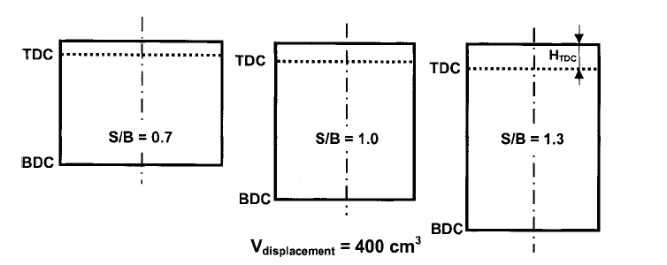
Classification of Cylinder Geometries

Slide 8
Geometry of Cylinder : A Primary Signature
An engine is described as a square engine when it has equal bore and stroke dimensions, giving a bore/stroke value of exactly 1.
By custom, engines that have a bore/stroke ratio of between 0.95 and 1.04 can be considered "square".
An engine is described as under-square or long-stroke if its cylinders have a smaller bore than its stroke - giving a ratio value of less than 0.95.
An engine is described as over-square or short-stroke if its cylinders have a greater bore diameter than its stroke length, giving a bore/stroke ratio greater than 1.04.

Slide 9
Ideal Cylinder Geometry
Identification of the optimum cylinder geometry that provides the best opportunity to develop a highly efficient internal combustion engine is the first step in an engine design.
In-cylinder simulations have shown that the heat transfer increases rapidly above a bore-to-stroke ratio of about 0.5.
Engine systems simulations have shown that the pumping work increases rapidly above a bore-to-stroke ratio of about 0.45.

Slide 10
Effect on Frictional Losses
Engine friction is affected by the bore-to-stroke ratio because of two competing effects:
Crankshaft bearing friction and power-cylinder friction.
As the bore-to-stroke ratio increases, the bearing friction increases because the larger piston area transfers larger forces to the crankshaft bearings.
However, the corresponding shorter stroke results in decreased power-cylinder friction originating at the ring/cylinder interface.

Slide 11
Geometry Vs Engine Heat Transfer
Efficiency vs Safety

Slide 12
Energy Audit of Conventional S.I. Engine Indicative Cycle at Design Conditions
Net Indicative work per cycle : 373.2 J
Fuel Energy Input (J): 943.0 J
Total cooling loss -187.3 J
Heat transfer density (W/cm²) at...
...cylinder head: -45.168
... piston upper face: -42.378
...cylinder wall: -14.228
Effective torque (Nm): 110.0

Slide 13
Effect on Heat Transfer
Simple geometric relationships show that an engine cylinder with low bore -to- stroke ratio will have a smaller surface area exposed to the combustion chamber gasses compared to a cylinder with longer bore-to- stroke ratio.
The smaller area leads directly to reduced in-cylinder heat transfer, increased energy transfer to the crankshaft and, therefore, higher efficiency.

Slide 14
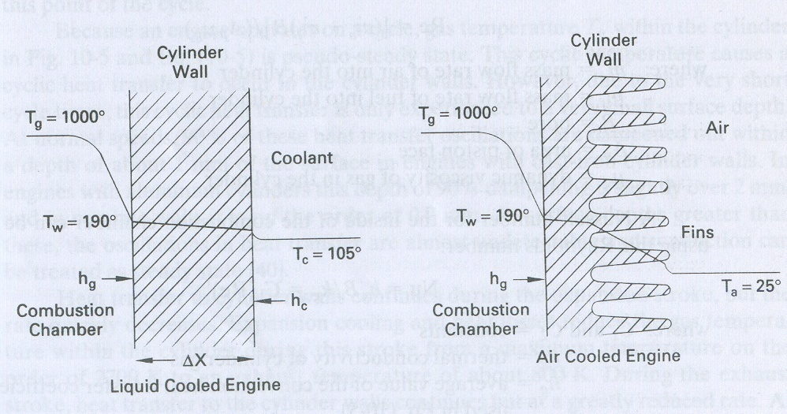
Instantaneous Heat Transfer (loss) form Cylinder

Slide 15
Gas to Surface Heat Transfer
Heat transfer to walls is cyclic.
Gas temperature T_{g} in the combustion chamber varies greatly over and engine cycle.
Coolant temperature is fairly constant.
Heat transfer from gas to walls occurs due to convection & radiation.
Convection Heat transfer:
Radiation heat transfer between cylinder gas and combustion chamber walls is

