Slide 1
Phenomenological Simulation of SI Engine Cycle - 1
P M V Subbarao
Professor
Mechanical Engineering Department
Head, CRDT
Model must be Close to The True Process Occurring in a Real SI Engine…..

Slide 2
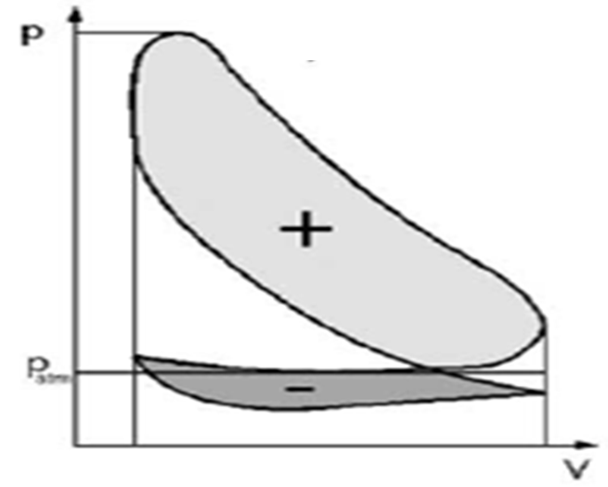
Indicative Gas Cycle of a Four Stroke SI Engine
Ignition
Fuel/Air
Mixture
Compression
Stroke
Power
Stroke
A
I
R
FUEL
Combustion
Products
Exhaust
Stroke
Intake
Stroke

Slide 3
21st Century Phenomenological Models for Engine Cycles
Fuel-air analysis is more accurate analysis when compared to Air-standard cycle analysis.
An accurate representation of constituents of working fluid is considered.
More accurate models are used for properties of each constituents.
Process | Otto’s Engine | Diesel’sEngine
Intake | Air + Fuel +Residual gas | Air + Residual gas
Compression | Air+Fuel vapour +Residual gas | Air + Residual gas
Expansion | Combustion products | Combustion Products
Exhaust | Combustion products | Combustion Products

Slide 4
Modelling of Intake Process : SI Engine
$${\left(\frac{dm}{dt}\right)}_{Cyl}={\dot{m}}_{air}(t)+{\dot{m}}_{fuel}(t)={\dot{m}}_{mixture}(t)$$
FUEL
A
I
R
$$p_{cyl}×V_{cyl}=m_{mix}R_{mix}T_{mix}$$
$$V\left(θ\right)=V_{c}\left\{1+\frac{r−1}{2}\left[R+\left(1−\cos{θ}\right)−\sqrt{R^{2}−\sin^{2}{θ}}\right]\right\}$$
$${\left(\frac{d(mc_{v}T)}{dt}\right)}_{mix}={\left(\dot{m}c_{p}T\right)}_{mix}+{\overset{•}{Q}}_{cyl}(t)−{\overset{•}{W}}_{mix}(t)$$
SI Engine
$${\dot{Q}}_{cyl}\left(t\right)={\dot{Q}}_{conv}\left(t\right)+{\dot{Q}}_{rad}\left(t\right)$$
$${\dot{W}}_{mix}\left(t\right)=\frac{δW}{dt}=p\frac{dV}{dt}$$

Slide 5
Total Mass of mixture inhaled during Intake Process
$$m_{mix@IVC}=m_{res@IVO}+\int_{t_{ivo}}^{t_{ivc}}{{\left(\frac{dm}{dt}\right)}_{Cyl}}$$
FUEL
A
I
R
$$m_{res@IVO}=m_{exh−gas@EVC}$$
$$p_{cyl@IVO}=p_{cyl@EVC}$$
$$T_{res@IVO}=T_{exh−gas@EVC}$$

Slide 6

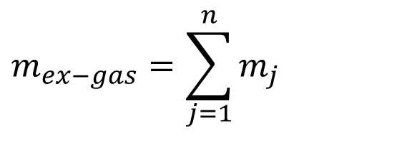
Modeling of Exhaust Process : SI Engine
$$m_{ex−gas}=m_{CO_{2}}+m_{H_{2}O}+m_{O_{2}}+m_{N_{2}}+m_{HC}+m_{CO}$$
$$m_{ex−gas}=\sum_{j=1}^{n}{m_{j}}$$
Combustion
Products
$${\left(\frac{d\sum_{j=1}^{n}{m_{j}}}{dt}\right)}_{exh−gas}=−\sum_{j=1}^{n}{{\dot{m}}_{j}}$$
$${\left(\frac{dm_{ex−gas}}{dt}\right)}_{}=−{\dot{m}}_{ex−port}$$
Exhaust
Stroke

Slide 7
$${\left(\frac{d\sum_{j=1}^{n}{m_{j}e_{j}}}{dt}\right)}_{CV}+\sum_{j=1}^{n}{\overset{•}{m_{j}}}(t)h_{j}={\overset{•}{Q}}_{CV}(t)−{\overset{•}{W}}_{CV}(t)$$
$${\left(\frac{d\sum_{j=1}^{n}{m_{j}c_{p,j}T}}{dt}\right)}_{Cyl}+\sum_{j=1}^{n}{\overset{•}{m_{j}}}(t)c_{p,j}T={\overset{•}{Q}}_{Cyl}(t)−{\overset{•}{W}}_{Cyl}(t)$$
$$m_{cyl@EVO}=m_{cyl@IVC}$$
$$p_{cyl@EVO}=p_{cyl@EEP}$$
$$m_{cyl@EVC}=m_{cyl@EVO}−\int_{t_{EVO}}^{t_{EVC}}{{\left(\frac{dm_{gas}}{dt}\right)}_{Cyl}}$$
$$T_{cyl@EVO}=T_{cyl@EEP}$$

Slide 8
Fuel-Air Model for Closed Otto Cycle
Air+Fuel vapour +Residual gas
Products of Combustin
TC
Products of Combustin
BC
Compression
Process
Const volume
combustion
Process
Expansion
Process
Const volume
Blow down
Process
Otto
Cycle

Slide 9
Indicative Gas Cycle of a Four Stroke SI Engine

Slide 10
21st Century Model for Ideal Otto Cycle
This is known as Fuel-air Cycle.
1—2 Isentropic compression of a mixture of air, fuel vapour and residual gas without change in chemical composition.
2—3 Complete combustion at constant volume, without heat loss, with burned gases in chemical equilibrium.
3—4 Isentropic expansion of the burned gases which remain in chemical equilibrium.
4—5 Ideal adiabatic blow down.

Slide 11
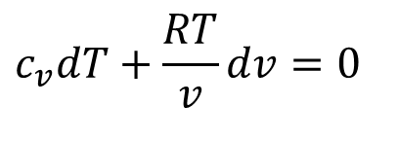
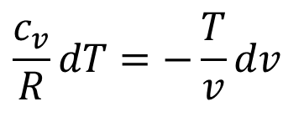
Isentropic Compression Process: 1 - 2
For a infinitesimal compression process:
$$TdS=dU+pdV$$
$$0=dU+pdV$$
$$mc_{v}dT+pdV=0$$
Assume ideal gas nature with variable properties:
$$mc_{v}dT+m\frac{RT}{v}dv=0$$
$$c_{v}dT+\frac{RT}{v}dv=0$$
$$\frac{c_{v}}{R}dT=−\frac{T}{v}dv$$
$$⇒\left(\frac{c_{v}}{R}\right)\left(\frac{dT}{T}\right)=\frac{−dv}{v}$$
Mass averaged properties for an ideal gas mixture:
$$c_{p}=\sum_{i=1}^{n}{x_{i}c_{p,i}}\text{ \& }c_{v}=\sum_{i=1}^{n}{x_{i}c_{v,i}}\text{ \& }R=\sum_{i=1}^{n}{x_{i}R_{i}}$$

Slide 12
Variation of Specific Heat of Ideal Gases
$$c_{p}=C_{0}+C_{1}\frac{T}{1000}+C_{2}{\left(\frac{T}{1000}\right)}^{2}+C_{3}{\left(\frac{T}{1000}\right)}^{3}kJ/kgK$$
Gas | C₀ | C₁ | C₂ | C₃
Air | 1.05 | -0.365 | 0.85 | -0.39
Methane | 1.2 | 3.25 | 0.75 | -0.71
CO₂ | 0.45 | 1.67 | -1.27 | 0.39
Steam | 1.79 | 0.107 | 0.586 | -0.20
O₂ | 0.88 | -0.0001 | 0.54 | -0.33
N₂ | 1.11 | -0.48 | 0.96 | -0.42

Slide 13
γ
c_{p}
c_{v}

Slide 14
Properties of Fuels
$$C_{p,f}=C_{0}+C_{1}\frac{T}{1000}+C_{2}{\left(\frac{T}{1000}\right)}^{2}+C_{3}{\left(\frac{T}{1000}\right)}^{3}+\left(\frac{C_{4}}{T^{2}}\right) kJ/kgK$$
Fuel | C₀ | C₁ | C₂ | C₃ | C₄
Methane | -0.29149 | 26.327 | -10.610 | 1.5656 | 0.16573
Propane | -1.4867 | 74.339 | -39.065 | 8.0543 | 0.01219
Isooctane | -0.55313 | 181.62 | -97.787 | 20.402 | -0.03095
Gasoline | -24.078 | 256.63 | -201.68 | 64.750 | 0.5808
Diesel | -9.1063 | 246.97 | -143.74 | 32.329 | 0.0518

Slide 15
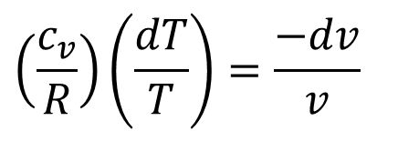
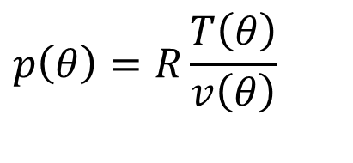
Isentropic Compression model with variable properties : 1 - 2
$$\frac{V\left(θ\right)}{V_{c}}=1+\frac{r−1}{2}\left[R+\left(1−\cos{θ}\right)−\sqrt{R^{2}−\sin^{2}{θ}}\right]$$
$$v\left(θ\right)=\frac{V_{c}}{m}\left\{1+\frac{r−1}{2}\left[R+\left(1−\cos{θ}\right)−\sqrt{R^{2}−\sin^{2}{θ}}\right]\right\}$$
$$\left(\frac{c_{v}}{R}\right)\left(\frac{dT}{T}\right)=\frac{−dv}{v}$$
$$p\left(θ\right)=R\frac{T\left(θ\right)}{v\left(θ\right)}$$

