Slide 1
Analysis of First Generation (Class S) Models for Artificial Horse
P M V Subbarao
Professor
Mechanical Engineering Department
Head, CRDT
Development and Evaluation of Exact Measures for Fuel Capacility ….

Slide 2
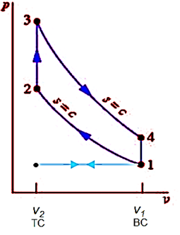
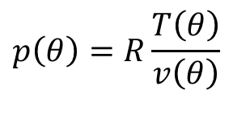
Analysis of Compression Process in Otto’s Model
For crank displacement from 180° to 360°:
$$v\left(θ\right)=\frac{V_{c}}{m}\left\{1+\frac{r−1}{2}\left[R+\left(1−\cos{θ}\right)−\sqrt{R^{2}−\sin^{2}{θ}}\right]\right\}$$
Mixture
$$p\left(θ\right)=R\frac{T\left(θ\right)}{v\left(θ\right)}$$
Compression
Process
For an infinitesimal Isentropic compression process:
$$⇒\left(\frac{c_{v}}{R}\right)\left(\frac{dT}{T}\right)=\frac{−dv}{v}$$
$$C_{p}=C_{0}+C_{1}\frac{T}{1000}+C_{2}{\left(\frac{T}{1000}\right)}^{2}+C_{3}{\left(\frac{T}{1000}\right)}^{3}+\left(\frac{C_{4}}{T^{2}}\right) kJ/kgK$$

Slide 3
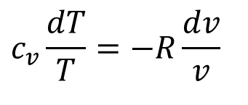
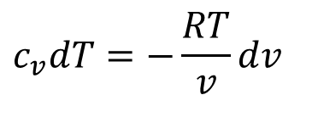
True Phenomenological Model for Isentropic Compression
$$c_{v}dT=−\frac{RT}{v}dv$$
$$c_{v}\frac{dT}{T}=−R\frac{dv}{v}$$
Let the mixture is modeled as:
$$c_{v}=c_{v,0}+c_{v,1}T+c_{v,2}T^{2}+c_{v,3}T^{3}+\frac{c_{v,4}}{T^{2}}kJ/kgK$$
$$\int_{1}^{2}{\left\{c_{v,0}+c_{v,1}T+c_{v,2}T^{2}+c_{v,3}T^{3}+\frac{c_{v,4}}{T^{2}}\right\}\frac{dT}{T}}=−R\int_{1}^{2}{\frac{dv}{v}}$$
$$\left\{c_{v,0}\ln\left(\frac{T_{2}}{T_{1}}\right)+c_{v,1}\left(T_{2}−T_{1}\right)+\frac{c_{v,2}}{2}\left(T_{2}^{2}−T_{1}^{2}\right)+\frac{c_{v,3}}{3}\left(T_{2}^{3}−T_{1}^{3}\right)−\frac{c_{v,4}}{2}\left(T_{2}^{−2}−T_{1}^{−2}\right)\right\}=−R\ln\left(\frac{v_{2}}{v_{1}}\right)$$
$$\left\{c_{v,0}\ln\left(\frac{T_{2}}{T_{1}}\right)+c_{v,1}\left(T_{2}−T_{1}\right)+\frac{c_{v,2}}{2}\left(T_{2}^{2}−T_{1}^{2}\right)+\frac{c_{v,3}}{3}\left(T_{2}^{3}−T_{1}^{3}\right)\right\}=−R\ln\left(\frac{1}{r}\right)$$

Slide 4
Realistic Estimate of Work for Isentropic Compression
$$m_{mix}c_{v}dT=−pdV$$
Let the mixture is modeled as:
$$c_{v}=c_{v,0}+c_{v,1}T+c_{v,2}T^{2}+c_{v,3}T^{3}kJ/kgK$$
$${{}_{1}^{}W}_{2}=−m_{mix}\int_{1}^{2}{\left\{c_{v,0}+c_{v,1}T+c_{v,2}T^{2}+c_{v,3}T^{3}\right\}dT}$$
$${{}_{1}^{}W}_{2}=−m_{mix}\left\{c_{v,0}\left(T_{2}−T_{1}\right)+\frac{c_{v,1}}{2}\left(T_{2}^{2}−T_{1}^{2}\right)+\frac{c_{v,2}}{3}\left(T_{2}^{3}−T_{1}^{3}\right)+\frac{c_{v,3}}{4}\left(T_{2}^{4}−T_{1}^{4}\right)\right\}$$

Slide 5
Generalized First Order Models for Variable Specific Heats
$$c_{p}=a_{p}+k_{1}×T$$
$$c_{v}=b_{v}+k_{1}×T$$
For design analysis of Engine Models:
a_{p} = 28.182 – 32.182 kJ/kmol.K
b_{v} = 19.868 – 23.868 kJ/kmol.K
k₁ = 0.003844–0.009844 kJ/kmol.K²

Slide 6
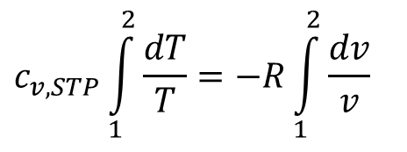
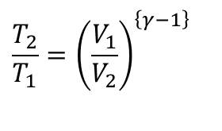
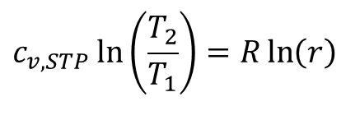
Carnot’s Concept of Air-Standard Model
Let the mixture is modeled as air with constant properties measured at STP:
$$c_{v,STP}\int_{1}^{2}{\frac{dT}{T}}=−R\int_{1}^{2}{\frac{dv}{v}}$$
$$c_{v,STP}\ln\left(\frac{T_{2}}{T_{1}}\right)=−R\ln\left(\frac{v_{2}}{v_{1}}\right)$$
$$c_{v,STP}\ln\left(\frac{T_{2}}{T_{1}}\right)=R\ln\left(r\right)$$
$$c_{v,STP}\ln\left(\frac{T_{2}}{T_{1}}\right)=−R\ln\left(\frac{1}{r}\right)$$
$$\frac{T_{2}}{T_{1}}={\left(\frac{V_{1}}{V_{2}}\right)}^{\left\{γ−1\right\}}$$
$$c_{v−STP}\int_{1}^{2}{dT}=−\int_{1}^{2}{pdv}={{}_{1}^{}W}_{2}=−c_{v−STP}\left(T_{2}−T_{1}\right)=−T_{1}c_{v−STP}\left(r^{γ−1}−1\right)$$

Slide 7
The Role of Isentropic Compression
Higher order Property Model:
$$\left\{c_{v,0}\ln\left(\frac{T_{2}}{T_{1}}\right)+c_{v,1}\left(T_{2}−T_{1}\right)+\frac{c_{v,2}}{2}\left(T_{2}^{2}−T_{1}^{2}\right)+\frac{c_{v,3}}{3}\left(T_{2}^{3}−T_{1}^{3}\right)\right\}=R\ln\left(r\right)$$
$$k_{1}×\left(T_{2}−T_{1}\right)+b_{v}\ln\left\{\frac{T_{2}}{T_{1}}\right\}=R\ln\left[r\right]$$
First order Property Model:
Makes the fuel-air mixture ready for combustion:
In a combustion reaction, bonds are being destroyed and formed between different atoms in molecules.
The parts of the molecules that undergo bond breakage and formation need to line up with each other.
There needs to be the appropriate overlap in the orbitals that are "donating" and "accepting" electrons.
The probability of occurrence of appropriate overlap is proportional to temperature of reacting molecules.

Slide 8
Collision Theory
Collision theory says that ”in order for a chemical reaction to happen, three separate things need to happen” :
1. The molecules have to hit each other
2. The molecules have to hit each other in the right way (both have to be facing the right way)
3. The molecules have to hit each other with enough speed (energy of motion, or "kinetic energy") to activate the reaction.
Number of successful collisions ∝ Frequency of collisions × Time available for collision.

Slide 9
Phenomenological Modeling of Combustion
Engineering Objective of Combustion:
To Create Maximum Possible Temperature through conversion of free energy into microscopic kinetic energy.
Thermodynamic Strategies for conversion:
Constant temperature combustion
Constant volume combustion
Constant pressure combustion

Slide 10
Engineering Strategy to Utilize A Resource
Engineering constraint: Both combustion and expansion must be finished in a single stroke.
Rapid combustion : Constant Volume combustion
Less time allowed for combustion process.
More time to adiabatic expansion
Slow combustion : Constant pressure combustion
More time for combustion process.
Less time for adiabatic expansion

Slide 11
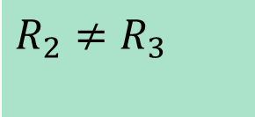
2—3 Complete combustion at constant volume, without heat loss.
Otto’s Strategy : Premixed, Homogeneous Combustion
2—3 : Loss of Purity of Substance
$$R_{2}≠R_{3}$$

Slide 12
Second law limit on possible extent of reaction
Reactants Products
At any time, a reactor contains a combination of reactants and products.
A reaction is said to be complete when the entropy of an adiabatic reactor reaches its maximum value.
The value of maximum entropy will vary with the pressure and temperature of the reaction.
A reaction system and parameters of reaction should be designed such that the maximum entropy is obtained when the reaction is almost complete (>98%).

Slide 13
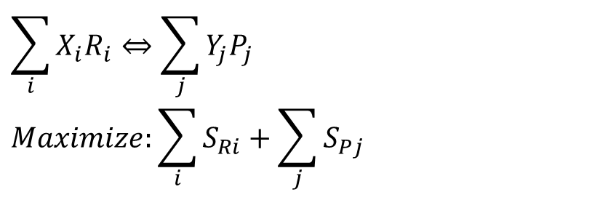
Mathematical Model for Culmination of Reaction
$$\sum_{i}{X_{i}R_{i}⇔\sum_{j}{Y_{j}P_{j}}}$$
$$Maximize:\sum_{i}{S_{Ri}+\sum_{j}{S_{Pj}}}$$
For every fuel, a designer should know all possible reactants !!!
Some products will influence the efficiency of reaction.
Few other may not influence the efficiency of reaction but severely affect the environment.
The optimal parameters for efficient reaction may not be optimal for safe reaction !!
There may be a need to use secondary reactor with catalysts.
Catalytic Converter

Slide 14
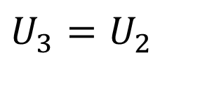
2—3 Complete & Adiabatic combustion at constant volume
First law for a Closed system under going process 2 - 3
0
0
$$(U_{3}−U_{2})={{}_{2}^{}Q}_{3}−{{}_{2}^{}W}_{3}$$
$$U_{3}=U_{2}$$

Slide 15
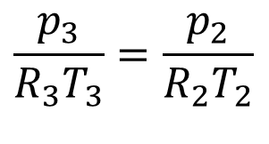
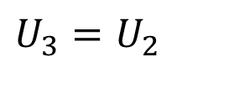
Engineering Model for Prediction of Highest Temperature
$$U_{3}=U_{2}$$
$$\int_{T_{0}}^{T_{3}}{m_{mix}C_{v,mix}dT}=\int_{T_{0}}^{T_{2}}{m_{air}C_{v,air}dT}+\sum_{j=1}^{m}{\int_{T_{0}}^{T_{2}}{m_{fuel,j}C_{v,fuel,j}dT}}+\int_{T_{0}}^{T_{2}}{m_{res,mix}C_{v,res,mix}dT}$$
$$\int_{T_{0}}^{T_{3}}{m_{mix}C_{v,mix}dT}≈\int_{T_{0}}^{T_{2}}{m_{air}C_{v,air}dT}+\int_{T_{0}}^{T_{2}}{m_{res,i,mix}C_{v,res,mix}dT}+m_{fuel}×H.V.$$
$$\left\{c_{v,0}\left(T_{3}\right)+\frac{c_{v,1}}{2}\left(T_{3}^{2}\right)+\frac{c_{v,2}}{3}\left(T_{3}^{3}\right)\right\}=K_{s}$$
Second order Property Model:
First order Property Model:
$$k_{1}×T_{3}^{2}+b_{v}T_{3}=K_{f}$$
$$\frac{p_{3}}{R_{3}T_{3}}=\frac{p_{2}}{R_{2}T_{2}}$$

Slide 16
2—3 constant volume Heat addition to air with constant properties : Air Standard Model
First law for a Closed system undergoing process 2 - 3
Q_{in}
0
TC
$$(U_{3}−U_{2})={{}_{2}^{}Q}_{3}−{{}_{2}^{}W}_{3}$$
Const volume
heat addition
Process
$${{}_{2}^{}Q}_{3}=U_{3}−U_{2}=mc_{v,STP}\left(T_{3}−T_{2}\right)$$
$${{}_{2}^{}Q}_{3}=m_{mix}c_{v,STP}\left(T_{3}−T_{2}\right)≈m_{fuel}HCV$$

Slide 17
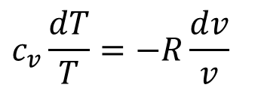
3—4 Isentropic expansion of the burned gases
For an infinitesimal expansion process:
$$Tds=du+pdv$$
Using second order models for properties:
$$c_{v}\frac{dT}{T}=−R\frac{dv}{v}$$
$$\left\{c_{v,0}\ln\left(\frac{T_{4}}{T_{3}}\right)+c_{v,1}\left(T_{4}−T_{3}\right)+\frac{c_{v,2}}{2}\left(T_{4}^{2}−T_{3}^{2}\right)+\frac{c_{v,3}}{3}\left(T_{4}^{3}−T_{3}^{3}\right)\right\}=−R\ln\left(\frac{v_{4}}{v_{3}}\right)$$
$${{}_{3}^{}W}_{4}=m\left\{c_{vg,0}\left(T_{3}−T_{4}\right)+\frac{c_{vg,1}}{2}\left(T_{3}^{2}−T_{4}^{2}\right)+\frac{c_{vg,2}}{3}\left(T_{3}^{3}−T_{4}^{3}\right)+\frac{c_{vg,3}}{4}\left(T_{3}^{4}−T_{4}^{4}\right)\right\}$$

Slide 18
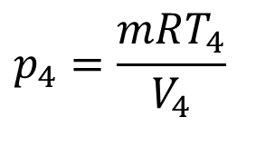
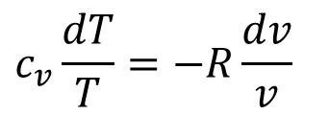
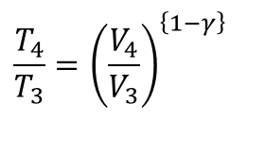
3—4 Isentropic expansion of Standard Air
For an infinitesimal expansion process:
$$Tds=du+pdv$$
$$c_{v}\frac{dT}{T}=−R\frac{dv}{v}$$
$$c_{v,STP}\ln\left(\frac{T_{4}}{T_{3}}\right)=−R\ln\left(\frac{v_{4}}{v_{3}}\right)$$
$$\frac{T_{4}}{T_{3}}={\left(\frac{V_{4}}{V_{3}}\right)}^{\left\{1−γ\right\}}$$
Expansion
Process
$$p_{4}=\frac{mRT_{4}}{V_{4}}$$
$$c_{v−STP}\int_{3}^{4}{dT}=−\int_{3}^{4}{pdv}={{}_{3}^{}W}_{4}=−c_{v−STP}\left(T_{4}−T_{3}\right)=T_{3}c_{v−STP}\left(r^{γ−1}−1\right)$$

Slide 19
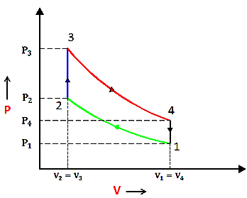
The Quick Closure Model : Constant Volume Process Heat Rejection: 4 – 1

Slide 20
Evaluation of Process Effects: Realistic Model
$${{}_{1}^{}W}_{2}=−m_{mix}\left\{c_{v,0}\left(T_{2}−T_{1}\right)+\frac{c_{v,1}}{2}\left(T_{2}^{2}−T_{1}^{2}\right)+\frac{c_{v,2}}{3}\left(T_{2}^{3}−T_{1}^{3}\right)+\frac{c_{v,3}}{4}\left(T_{2}^{4}−T_{1}^{4}\right)\right\}$$
$${{}_{2}^{}Q}_{3}≈m_{fuel}HCV$$
$${{}_{3}^{}W}_{4}=m_{mix}\left\{c_{vg,0}\left(T_{3}−T_{4}\right)+\frac{c_{vg,1}}{2}\left(T_{3}^{2}−T_{4}^{2}\right)+\frac{c_{vg,2}}{3}\left(T_{3}^{3}−T_{4}^{3}\right)+\frac{c_{vg,3}}{4}\left(T_{3}^{4}−T_{4}^{4}\right)\right\}$$
$$W_{net}={{}_{3}^{}W}_{4}+{{}_{1}^{}W}_{\begin{aligned}2 \\ \end{aligned}}=m_{mix}\left[\begin{aligned}&\left\{c_{vg,0}×\left(T_{3}−T_{4}\right)+\frac{c_{vg,1}}{2}\left(T_{3}^{2}−T_{4}^{2}\right)+\frac{c_{vg,2}}{3}\left(T_{3}^{3}−T_{4}^{3}\right)+\frac{c_{vg,3}}{4}\left(T_{3}^{4}−T_{4}^{4}\right)\right\} \\ &−\left\{c_{v,0}\left(T_{2}−T_{1}\right)+\frac{c_{v,1}}{2}\left(T_{2}^{2}−T_{1}^{2}\right)+\frac{c_{v,2}}{3}\left(T_{2}^{3}−T_{1}^{3}\right)+\frac{c_{v,3}}{4}\left(T_{2}^{4}−T_{1}^{4}\right)\right\}\end{aligned}\right]$$

Slide 21
Evaluation Process Effects: Air Standard Model
$${{}_{1}^{}W}_{2}=−m\left\{c_{v,STP}\left(T_{2}−T_{1}\right)\right\}$$
$${{}_{2}^{}Q}_{3}=mc_{v,STP}\left(T_{3}−T_{2}\right)$$
$${{}_{3}^{}W}_{4}=m\left\{c_{v,STP}\left(T_{3}−T_{4}\right)\right\}$$
$$W_{net}={{}_{3}^{}W}_{4}+{{}_{1}^{}W}_{2}=mc_{v,STP}\left\{\left(T_{3}−T_{4}\right)−\left(T_{2}−T_{1}\right)\right\}$$

Slide 22
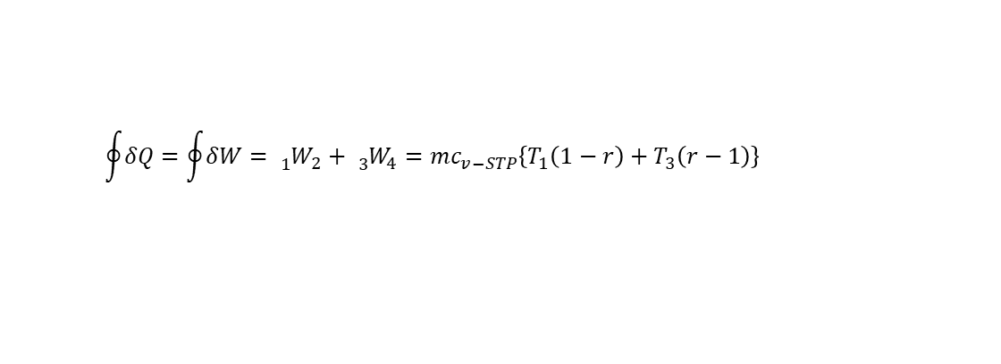
Cyclic Integral of Standard Air Cycle
$$\text{Compression} \text{Ratio} \left(r\right)=\frac{V_{1}}{V_{2}}=\frac{V_{c}+V_{d}}{V_{c}}$$
$$\oint{δQ}=\oint{δW}={{}_{1}^{}W}_{2}+{{}_{3}^{}W}_{4}=mc_{v−STP}\left\{T_{1}\left(1−r\right)+T_{3}\left(r−1\right)\right\}$$
$$η_{th−AS}=\frac{\oint{δW}}{\int_{2}^{3}{δQ}}=\frac{mc_{v−STP}\left\{T_{1}\left(1−r\right)+T_{3}\left(r−1\right)\right\}}{mc_{v−STP}\left\{T_{3}−T_{2}\right\}}$$
$$η_{th−AS}=\frac{\left\{T_{3}−T_{4}−\left(T_{2}−T_{1}\right)\right\}}{\left\{T_{3}−T_{2}\right\}}=1−\frac{\left\{T_{4}−T_{1}\right\}}{\left\{T_{3}−T_{2}\right\}}$$

