Slide 1

Strategic zones of improvements for SI Engine
Low Thermal Efficiency
High thermal Stresses
Low Thermal Efficiency
Negative Work Cycle

Slide 2
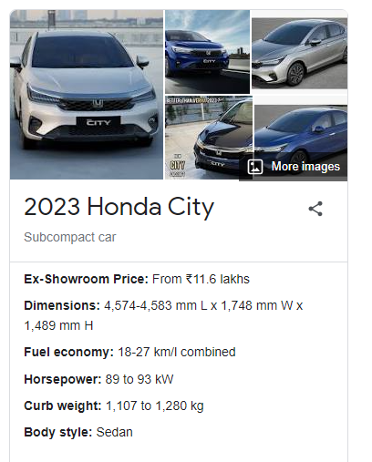
2023 : 5th Generation SI Vehicle
High Accuracy valve control technology DOHC0i-VTEC+VTC is used to
Improve Combustion Efficiency,
Reduced friction &
Lower emissions

Slide 3
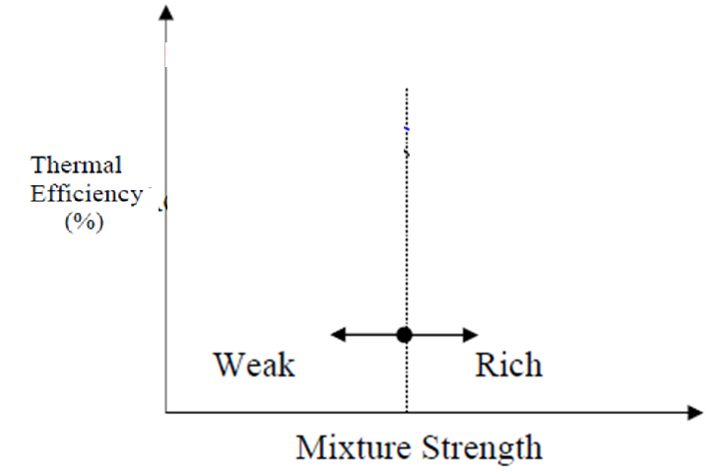
Fuel Air Cycle Modelling :
Selection of Mixture Strength
Air Standard Model
Fuel-air Model
Actual Performance curve

Slide 4
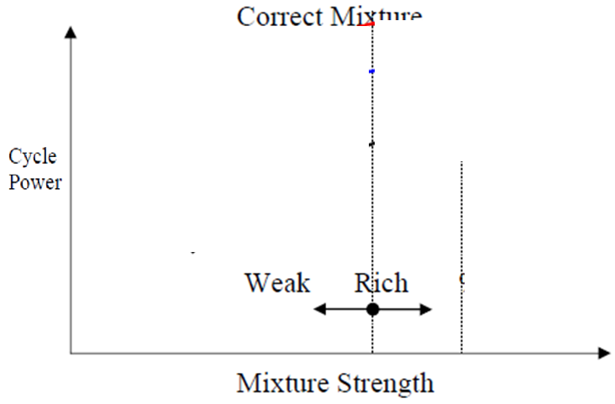
Fuel Air cycle Modelling :
Selection of Mixture Strength
Air Standard Model
Fuel-air Model
Actual Performance curve

Slide 5
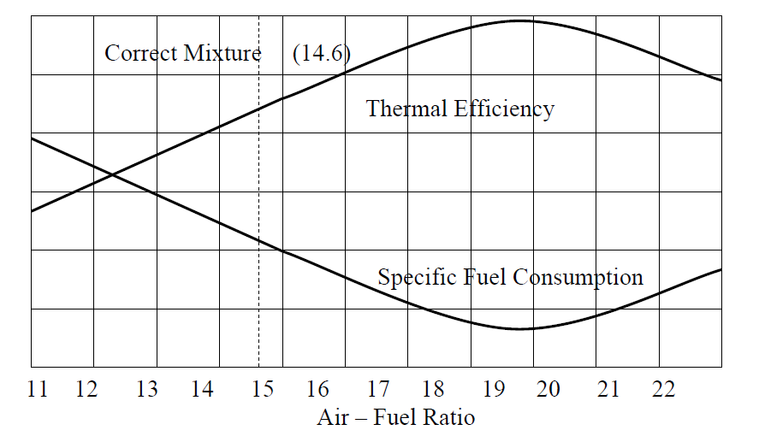
Selection of Sufficient Air : Minimization of Running Cost

Slide 6
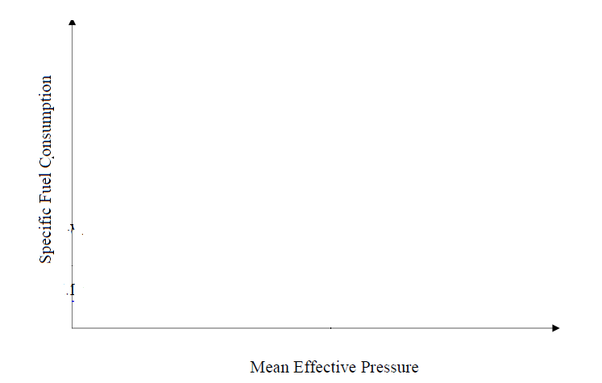
Selection of Sufficient Air : Running Cost Vs Capital Cost

Slide 7

Advanced Valve Systems for Ecofriendly Engines
P M V Subbarao
Professor
Mechanical Engineering Department
Efficient Breathing is a Sign of Healthy Engine ….
Green Engines Demand Experts to Study the Breath Controls…..

Slide 8
Conventional Breathing System in 20th Century….

Slide 9
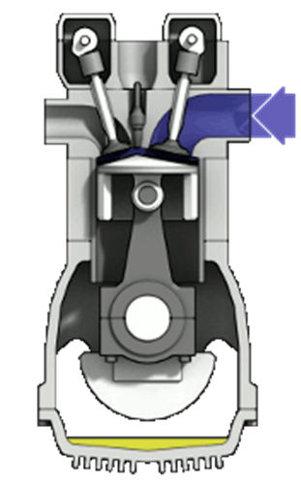
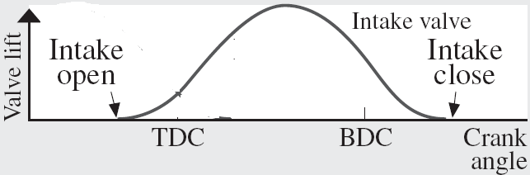
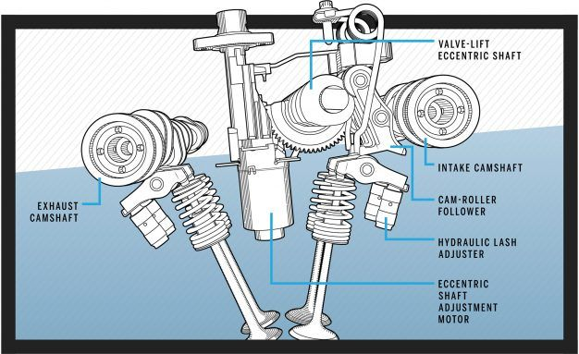
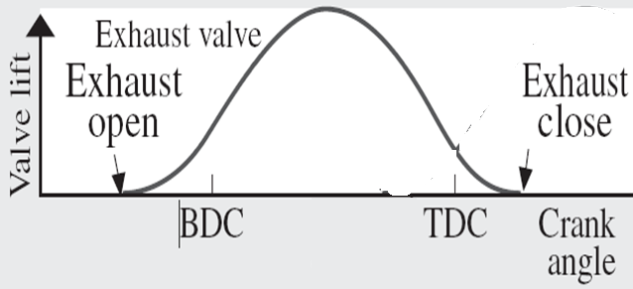
Engine Breathing & Valve Actions

Slide 10
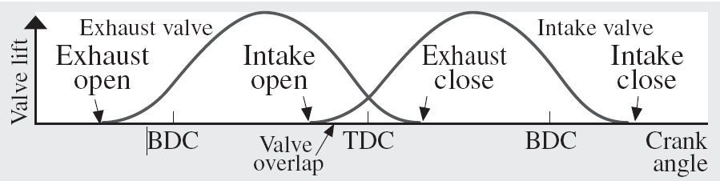
Engine Breathing & Valve Actions

Slide 11

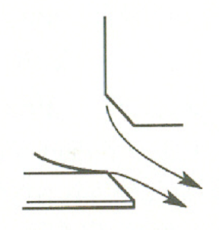
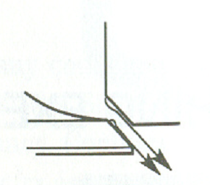

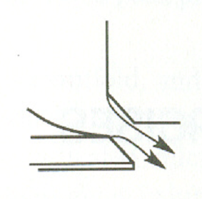

Stream Tube formed by Flow Through Valves
Equivalent Converging-Diverging Nozzle Configurations:
Mild Separation.
Severe Separation

Slide 12
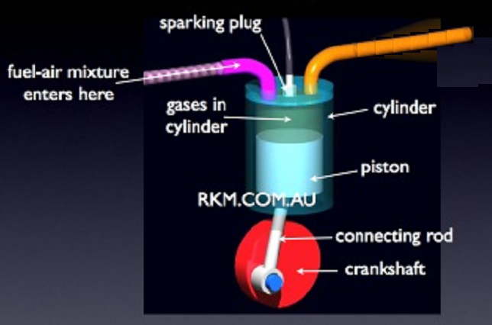
Choking of Valve Passage
Valve Lift

Slide 13
Frictional Compressible Flow Through Inlet Valve
The real gas flow effects are included by means of an experimentally determined discharge coefficient C_{D}.
When the flow is chocked:

Slide 14
Frictional Flow & Discharge Coefficient
The value of C_{D} and the available minimum flow area A_{min} are linked together.
The product C_{D} . A_{min} is the effective flow area of the valve assembly, A_{E}.

Slide 15
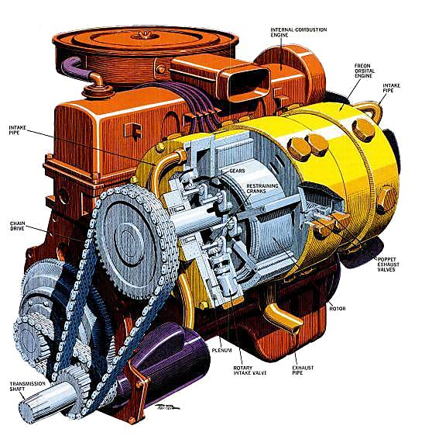
A Global Measure of Breathing Effectiveness
Volumetric efficiency a measure of overall effectiveness of engine and its intake and exhaust system as a natural breathing system.
Volumetric efficiency is defined as:

Slide 16
“ When you can measure what you are speaking about, and express it in numbers, you know something about it;
but when you cannot measure it in numbers, your knowledge is of a meagre and unsatisfactory kind . . . ”.
-- Lord Kelvin

Slide 17
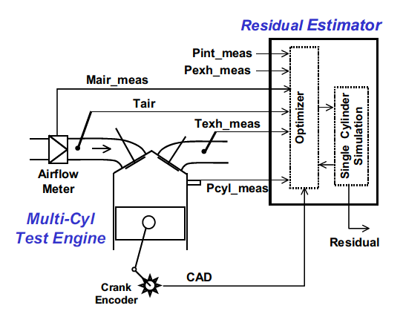
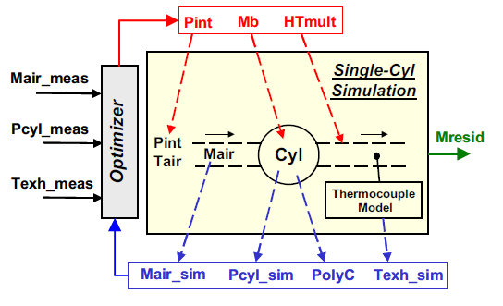
A Number based learning Through Comprehensive Experimental Research

Slide 18
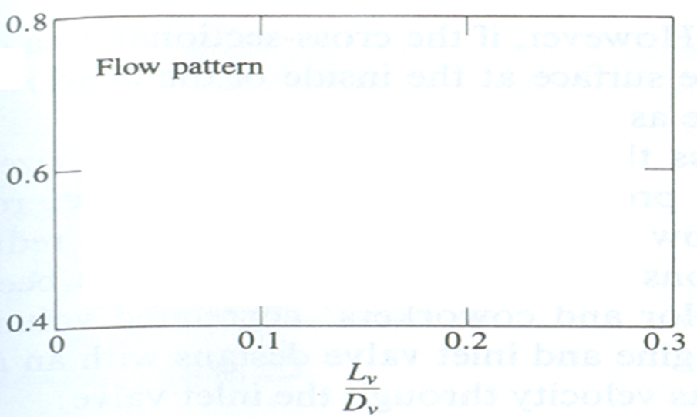
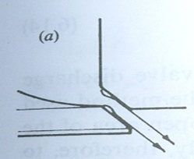
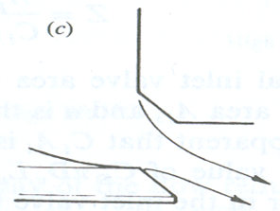
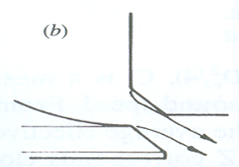
Non-dimensional available flow area for real Flow through INLET VALVES
a
b
c

Slide 19
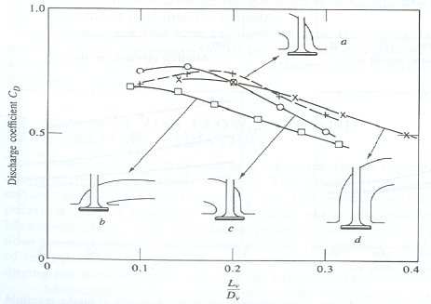
Design of EXHAUST VALVES

Slide 20
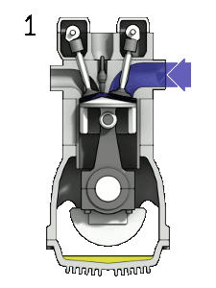
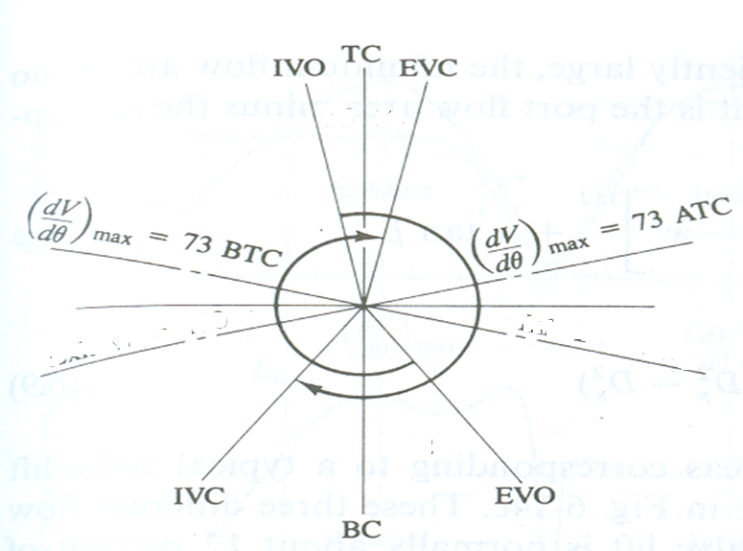
Selection of Valve Timing for Better Flow

Slide 21
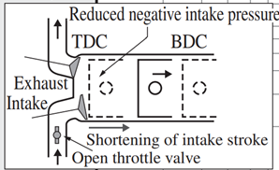
Intake Mass of Air/Air-fuel Mixture
The total mass of air intake during an intake stroke is an integral of instantaneous mass flow rate.

Slide 22
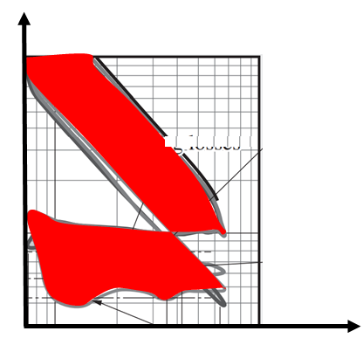
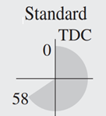
Tuning of p-V Diagram (Shape of actual Cycle)

Slide 23
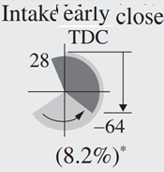
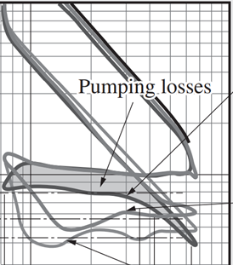
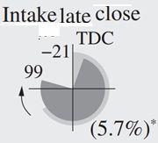
Tuning of p-V Diagram (Shape of actual Cycle)

Slide 24
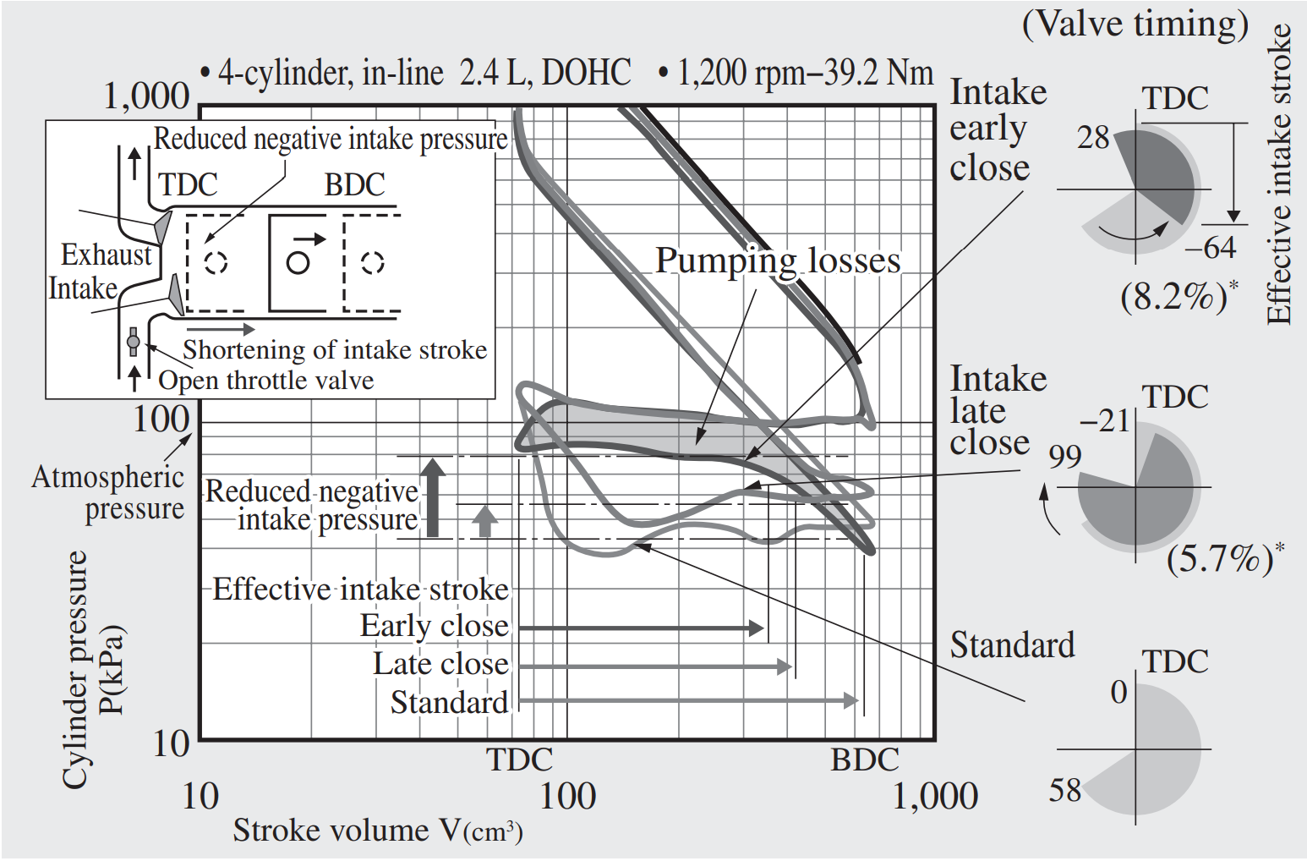
Tuning of p-V Diagram (Shape of actual Cycle)

Slide 25
Signature of Valve Design: Residual Gas Fraction
The residual gas fraction in the cylinder during compression is determined by the exhaust and inlet processes.
Its magnitude affects volumetric efficiency and engine performance directly.
The residual gas fraction is a function of inlet and exhaust pressures, speed, compression ratio, valve timing, and exhaust system dynamics.
The residual gas fraction is defined as:

Slide 26
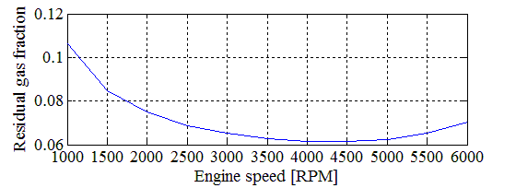
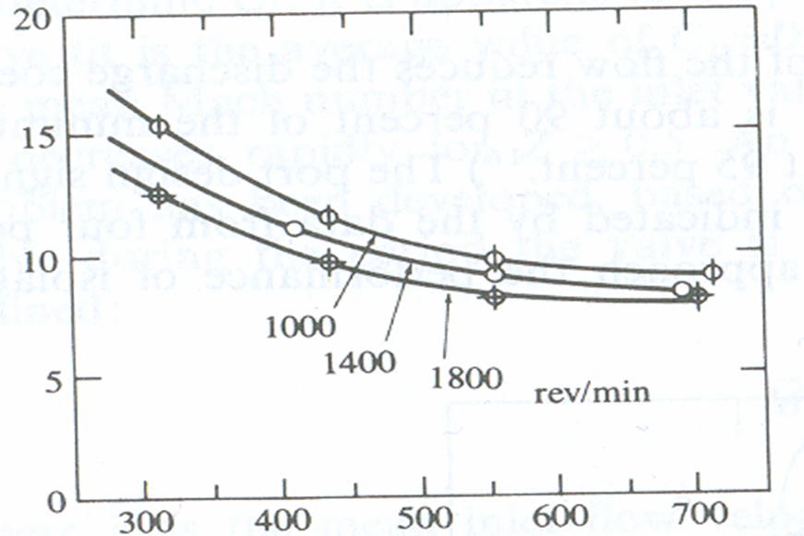
Residual Gas Fraction: Effect of Speed
x_{r}, %
Intake Manifold Pressure, mm of Hg

Slide 27
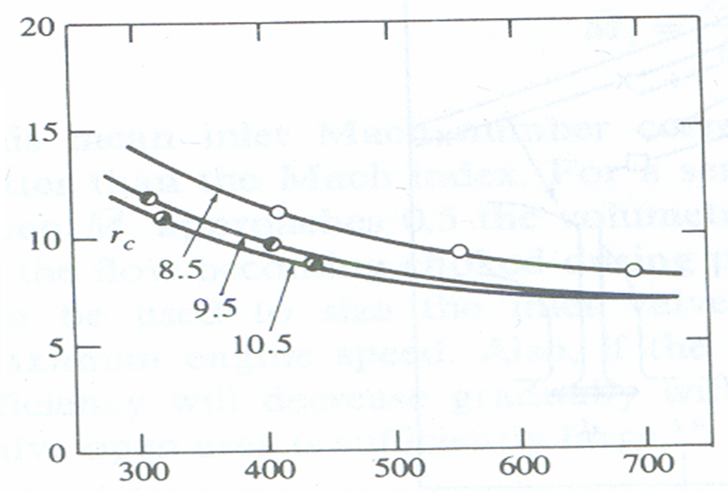
Residual Gas Fraction : Effect of Compression Ratio
x_{r}, %
Intake Manifold Pressure, mm of Hg

Slide 28
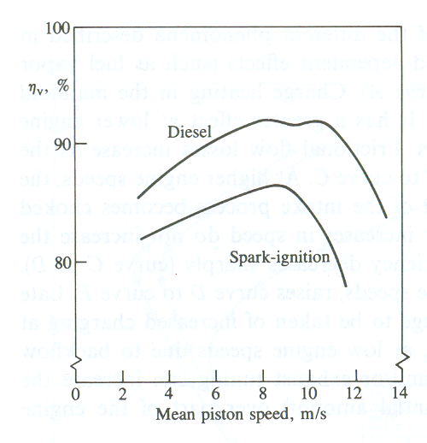
Fixed Valves: Speed Vs Volumetric Efficiency
Compression Ignition

Slide 29
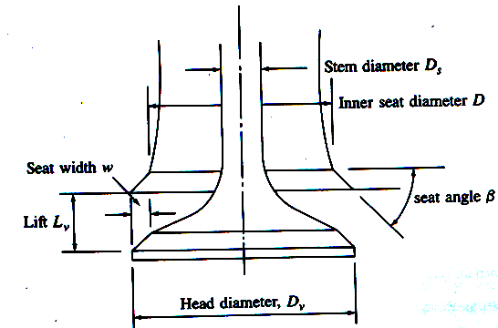
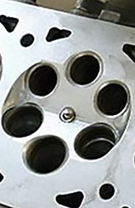
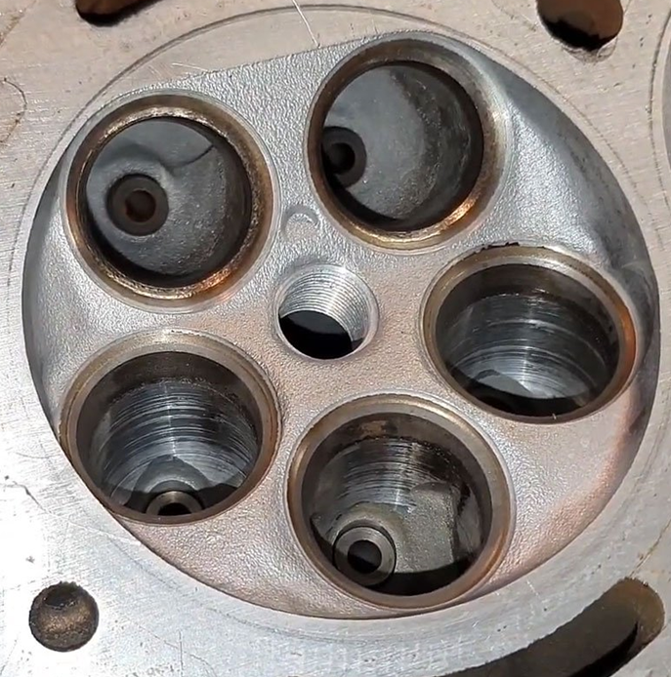
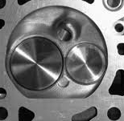
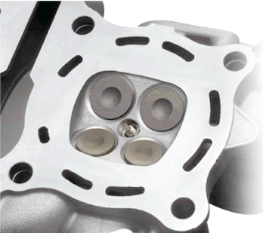
Enhanced Flow Area due to multiple valves
More valves improve an engine’s breathing by letting more air and fuel into the combustion chamber and expelling exhaust gases more efficiently.
Each valve is smaller and lighter in a multi-valve engine, so higher engine speeds are easier to achieve than with the larger, heavier valves found in 2-valve designs.

Slide 30
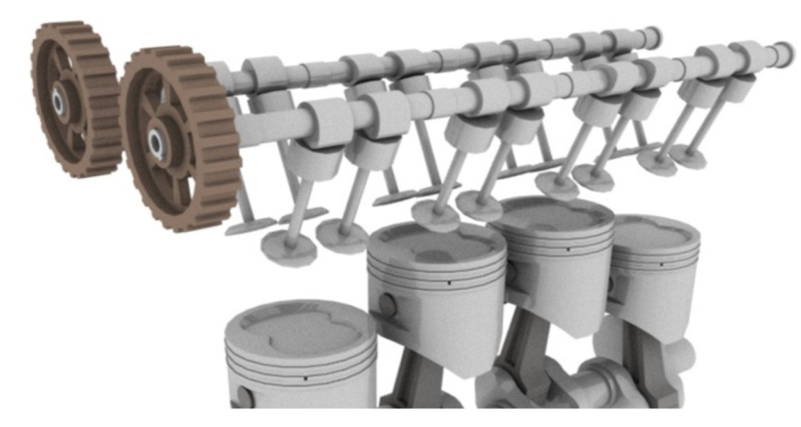
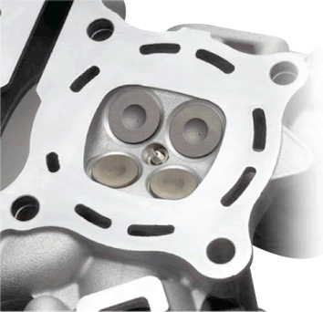
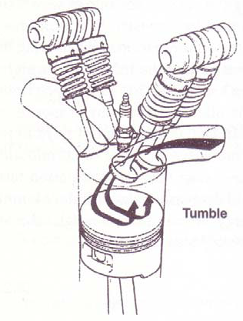
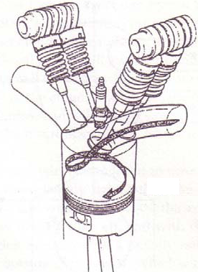
Enhancement of Intake Flow Area using Twin Valves

Slide 31
Performance Objective Vs Valve Actions

Slide 32
21st Century Breath Smart Engines
Variable valve actuation (VVA) technologies are used to add flexibility to the engine’s valve train.
Flexible variables: Variable valve event timing, duration and/or lift.
The main types of VVA technologies include valve timing control (VTC), Variable valve lift (VVL) and camless valve trains

Slide 33
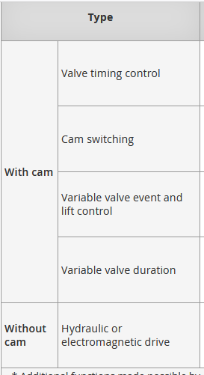



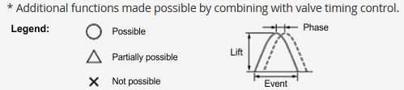



General classification of VVA technology

Slide 34
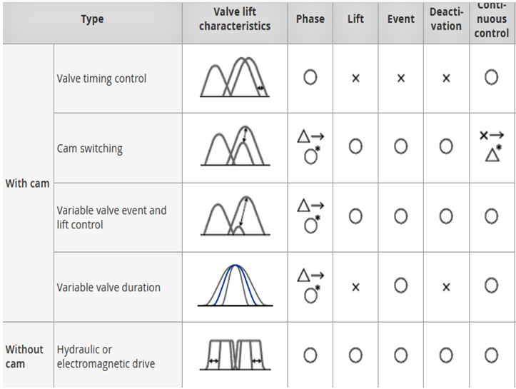
General classification of VVA technology

Slide 35
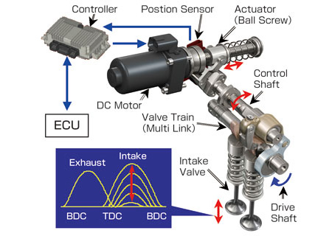
Variable Valve Actuation System

Slide 36
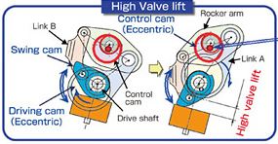
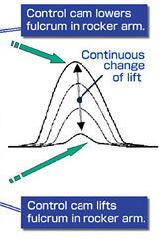

Principle of Operation of VVA

Slide 37

Progress in Development of VVA Systems

Slide 38



Performance Parameter:
Control of Power or Torque
Influencing Engine Characteristic
Process factors to be improved
Control Parameters
Reference: Variable Valve Actuation Systems for Environmentally Friendly Engines
Seinosuke Hara
Seiji Suga
Satoru Watanabe
Makoto Nakamura

Slide 39



Performance Parameter:
Control Fuel Economy
Influencing Engine Characteristic
Process factors to be improved
Control Parameters
Reference: Variable Valve Actuation Systems for Environmentally Friendly Engines
Seinosuke Hara
Seiji Suga
Satoru Watanabe
Makoto Nakamura

Slide 40

Digital Valves
https://www.eeworldonline.com/electronic-engines-valves-an-idea-whose-time-has-come-and-gone-part-3-the-electronic-camless-approach-faq/

