Slide 1

Variable Valve Systems for Environment Friendly Engines
P M V Subbarao
Professor
Mechanical Engineering Department
Green Engines Demand Special Experts to Study the Flexible Breath Controls…..

Slide 2

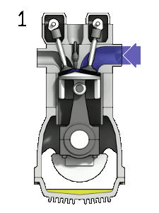
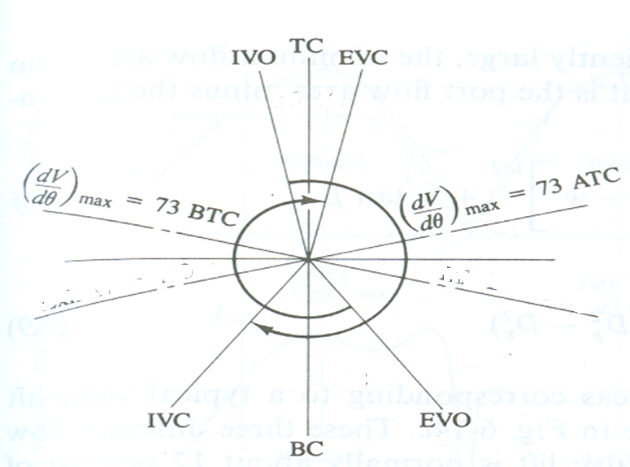
Selection of Valve Timing for Better Flow

Slide 3
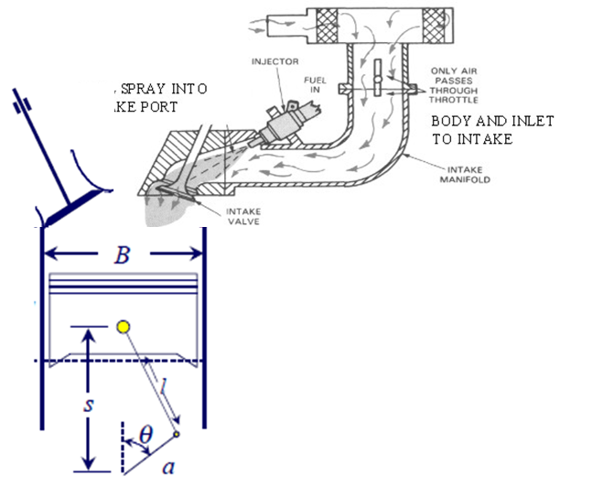
Intake Mass of Air/Air-fuel Mixture
The total mass of air intake during an intake stroke is an integral of instantaneous mass flow rate.

Slide 4
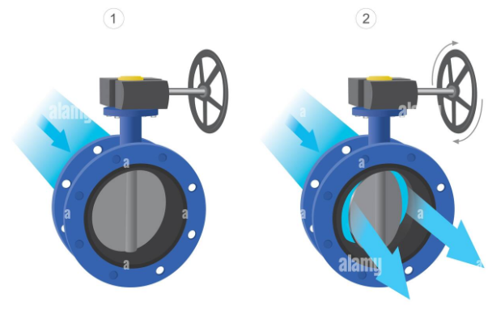
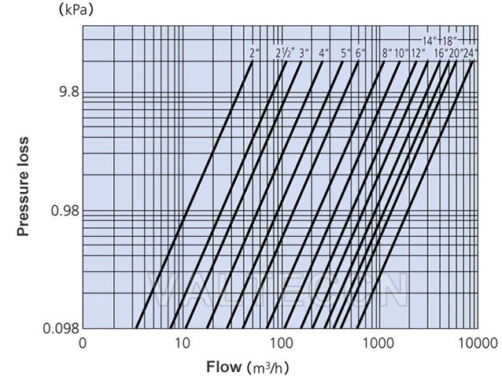
Fluid Dynamics of Valves

Slide 5
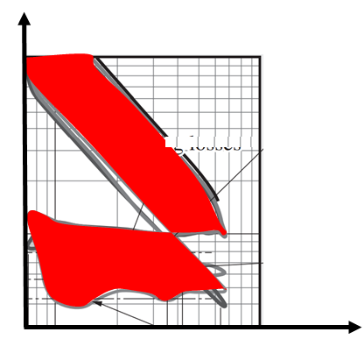
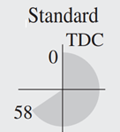
Tuning of Valve Operation to Modify the
Shape of the Pumping Cycle

Slide 6
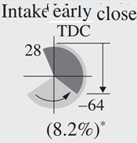
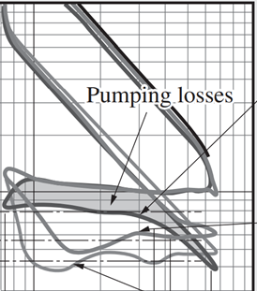
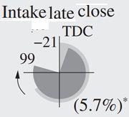
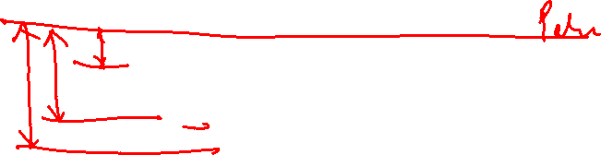
Tuning of p-V Diagram (Shape of actual Cycle)

Slide 7
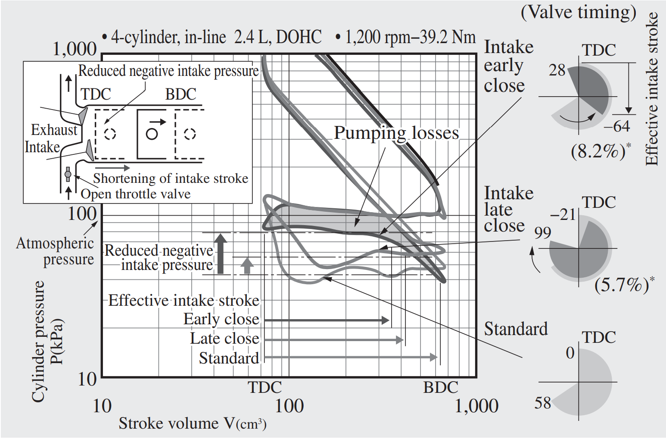
Tuning of p-V Diagram (Shape of actual Cycle)

Slide 8
Signature of Exhaust Valve Timing: Residual Gas Fraction
The residual gas fraction in the cylinder during compression is determined by the exhaust and inlet processes.
Its magnitude affects volumetric efficiency and engine performance directly.
The residual gas fraction is a function of inlet and exhaust pressures, speed, compression ratio, valve timing, and exhaust system dynamics.
The residual gas fraction is defined as:

Slide 9
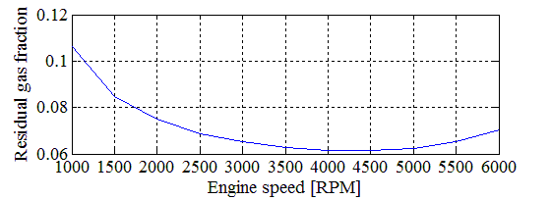
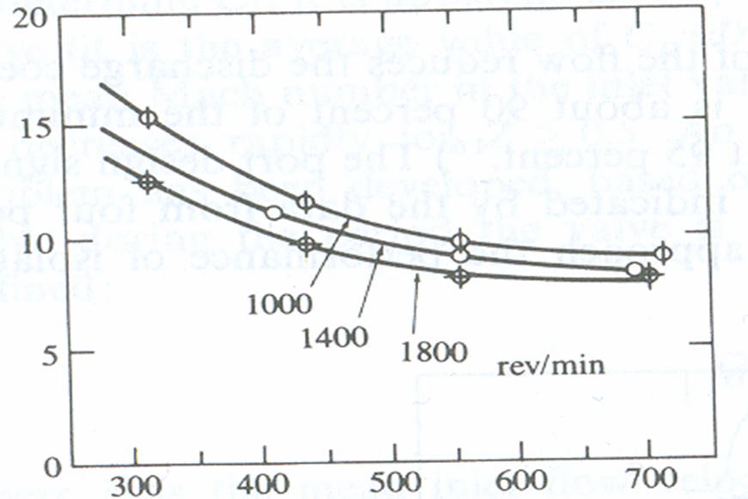
Residual Gas Fraction: Effect of Speed
x_{r}, %
Intake Manifold Pressure, mm of Hg

Slide 10
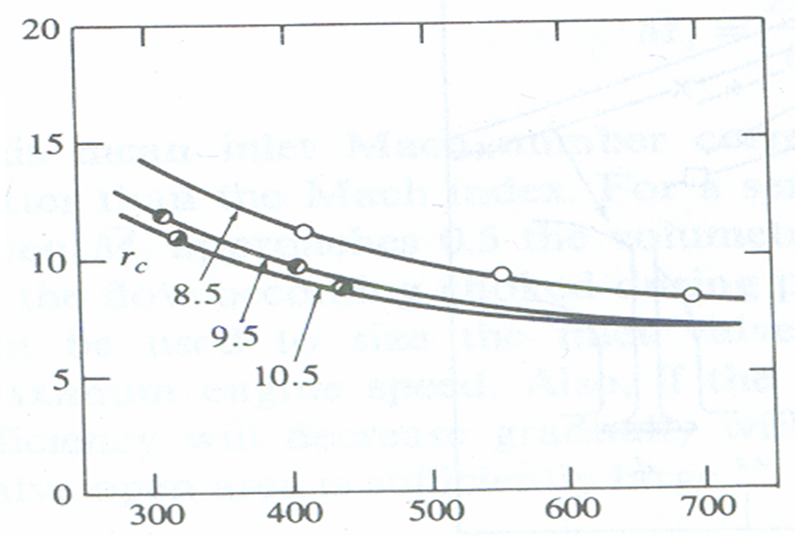
Residual Gas Fraction : Effect of Compression Ratio
x_{r}, %
Intake Manifold Pressure, mm of Hg

Slide 11
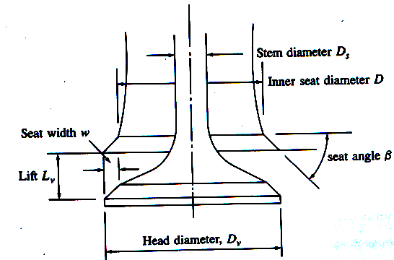
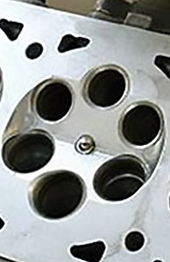
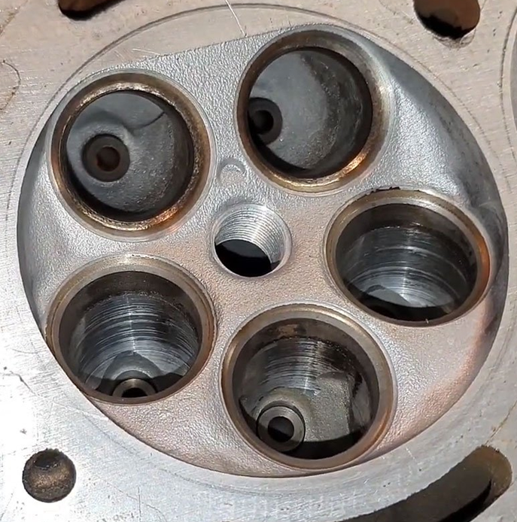
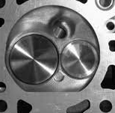
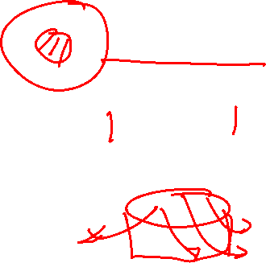
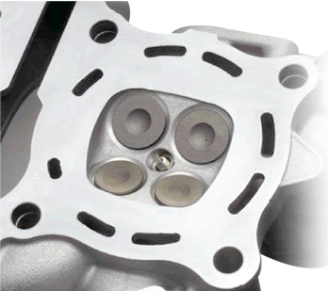
Enhanced Flow Area due to multiple valves
More valves improve an engine’s breathing by letting more air and fuel into the combustion chamber and expelling exhaust gases more efficiently.
Each valve is smaller and lighter in a multi-valve engine, so higher engine speeds are easier to achieve than with the larger, heavier valves found in 2-valve designs.

Slide 12
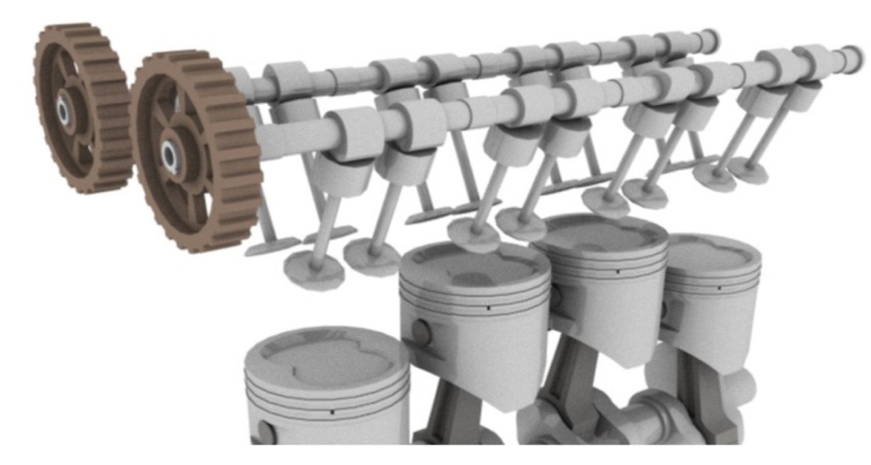
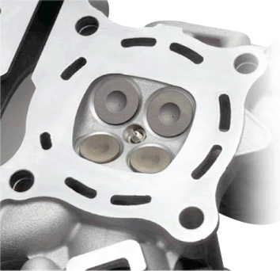
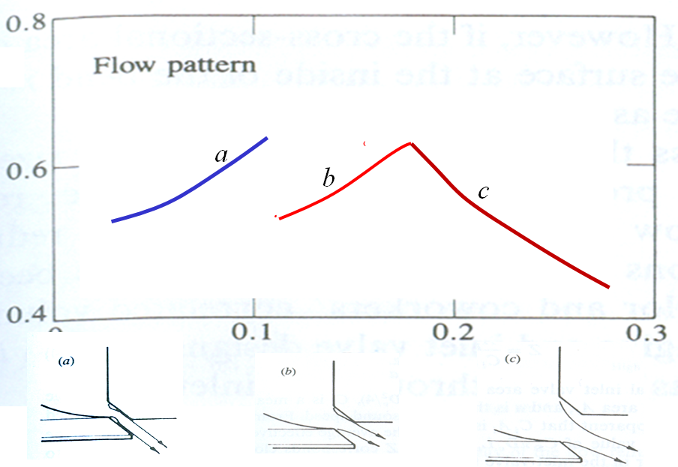
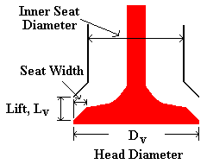
Enhancement of Intake Flow Area using Twin Valves

Slide 13
Performance Objective Vs Valve Actions

Slide 14
21st Century Breath Smart Engines
Variable valve actuation (VVA) technologies are used to add flexibility to the engine’s valve train.
Flexible variables: Variable valve event timing, duration and/or lift.
The main types of VVA technologies include valve timing control (VTC), Variable valve lift (VVL) and camless valve trains

Slide 15
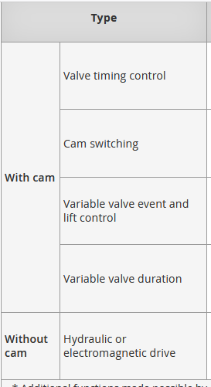



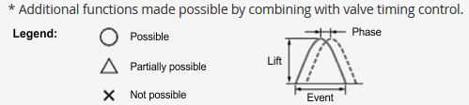



General classification of VVA technology

Slide 16
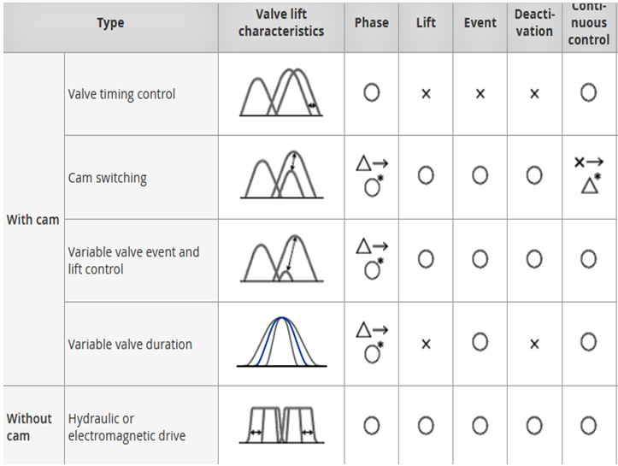
General classification of VVA technology

Slide 17
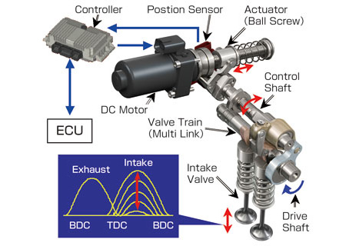
Variable Valve Actuation System

Slide 18
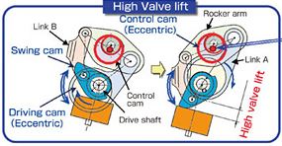
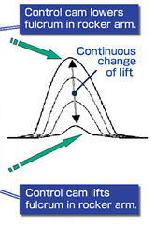
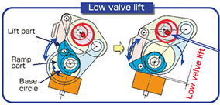
Principle of Operation of VVA

Slide 19
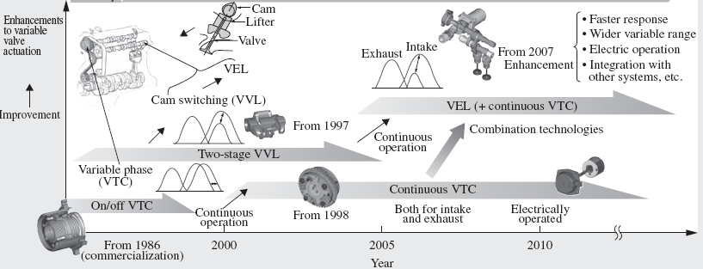
Progress in Development of VVA Systems

Slide 20
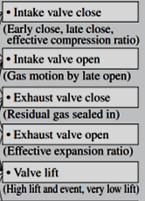

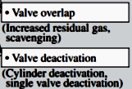
Performance Parameter:
Control of Torque
Influencing Engine Characteristic
Process factors to be improved
Control Parameters

Slide 21
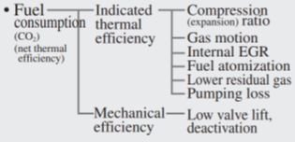
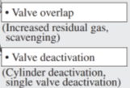
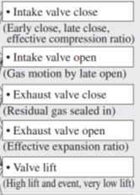
Performance Parameter:
Control Fuel Economy
Influencing Engine Characteristic
Process factors to be improved
Control Parameters
Reference: Variable Valve Actuation Systems for Environmentally Friendly Engines
Seinosuke Hara
Seiji Suga
Satoru Watanabe
Makoto Nakamura

Slide 22
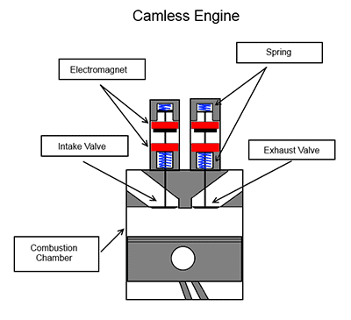
Digital Valves
https://www.eeworldonline.com/electronic-engines-valves-an-idea-whose-time-has-come-and-gone-part-3-the-electronic-camless-approach-faq/

