Slide 1
Fuel Drop and Wall Interactions in Ports of MPFI System
P M V Subbarao
Professor
Mechanical Engineering Department
Post Spray Process are more Crucial for Development of Green Vehicles…

Slide 2
Drop-Wall impact Phenomena

Slide 3
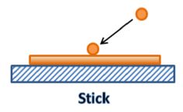
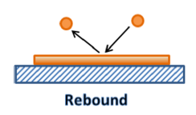
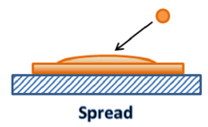
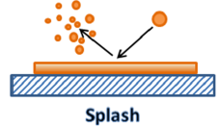
Physics of Liquid Droplet Impingement on A Wall
The wall impingement process is classified as four regimes:
The regime transition criteria are determined based on the Reynolds number and Weber number of the incident droplet and the surface condition:
$$We_{drop}=\frac{ρ_{l}V_{drop}^{2}D_{drop}}{σ_{l}}$$
$${Re}_{drop}{=}\frac{ρ_{l}V_{drop}D_{drop}}{μ_{l}}$$
$$We_{drop}>10 \\ \&We_{drop}×\sqrt{{Re}_{drop}{}}<H_{cr}$$
$$We_{drop}×\sqrt{{Re}_{drop}{}}≥H_{cr}$$
$$We_{drop}≤5$$
$$5≤We_{drop}≤10$$
splash is the most important and also the most complex.
Injectors must be designed to realize Spread and Splash are in SI engine ports.

Slide 4
Characterization of Liquid Droplet Impingement
Two basic issues to be understoo in liquid droplet impingement processes.
Formation of fuel film.
Occurrence of type of Impacting regime.
the rebound velocity magnitude and its direction for the rebound regime,
the fraction of the mass deposited on the wall and
the size and velocity distributions of the secondary droplets for the splash/breakup regime.

Slide 5
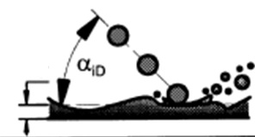
Spreading Dynamics of Films
There are two different forces exerted on a fuel wall film.
On the gas side, the gas flow tends to drive the film moving along the same direction.
On the wall side, the viscous friction tends to resist the film movement.
The force balance on the film gives the equation for the film motion:
$$ρ_{film}δ\frac{d{\vec{V}}_{film}}{dt}=τ_{drag}−τ_{friction}−τ_{impact}$$
$$δ$$
$$τ_{drag}=\frac{1}{2}C_{f}ρ_{air}\left|{\vec{V}}_{air−port}−{\vec{V}}_{fs}\right|\left({\vec{V}}_{air−port}−{\vec{V}}_{fs}\right)$$
$$τ_{friction}=2μ_{fuel}\frac{\left|{\vec{V}}_{film}\right|}{δ}$$
$$τ_{impact}=\frac{m_{d−f}U_{SMF−t}}{A_{film}Δt}$$

Slide 6
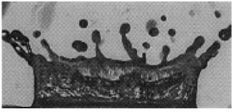
The Splash
Splash results in the rebounding of many smaller secondary droplets from the impinging location.
The size and velocities of the secondary droplets are statistically distributed.
β : non-dimensional surface roughness = (roughness height/incident droplet diameter),
δ : non-dimensional film thickness =(film thickness/incident droplet diameter)
The splash threshold film thickness H_{cr}
$$H_{cr}=\left(1500+\frac{650}{β^{0.42}}\right)\left[1+0.1{Re}_{drop}^{0.5}{×}\min\left(δ,0.5\right)\right]$$

Slide 7
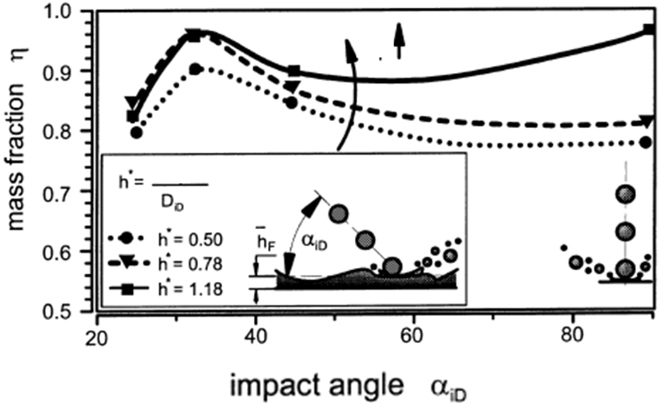
Deposited Film Mass Fraction
$$h^{∗}$$
$$δ$$
The ratio of the reflected to the impinging mass is
given by
Ohnesorge numbers
$$\frac{{\dot{m}}_{ref}}{{\dot{m}}_{impinge}}=3.98×10^{−21}{Re}_{SMD}^{11.51}{O}h^{9.21}$$
$$Oh=\frac{μ}{\sqrt{ρσD_{SMD}}}$$

Slide 8
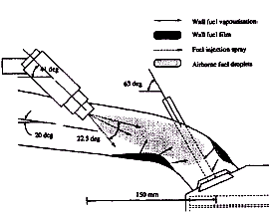
Instantaneous Rate of Fuel Entering the Cylinder
Instantaneous rate of fuel entering the cylinder will be equal to algebraic sum of fuel injected and film depletion/accumulation.
$${\dot{m}}_{fuel−net−cyl}={\dot{m}}_{inj}±{\dot{m}}_{film}$$
Selection and erection of injector must ensure steady and known value of net fuel flow rate into the cylinder for better fuel economy.

Slide 9
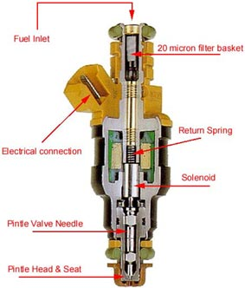
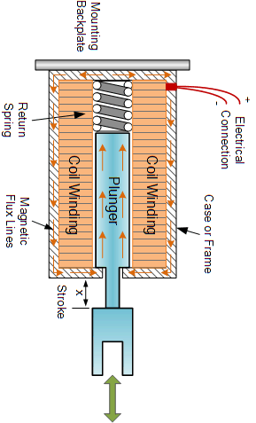
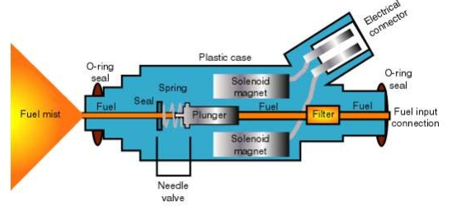
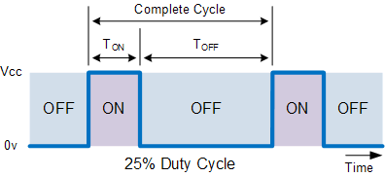
Anatomy of A Mechanical Solenoid Injector
Solenoid Magnet
Force Function

Slide 10
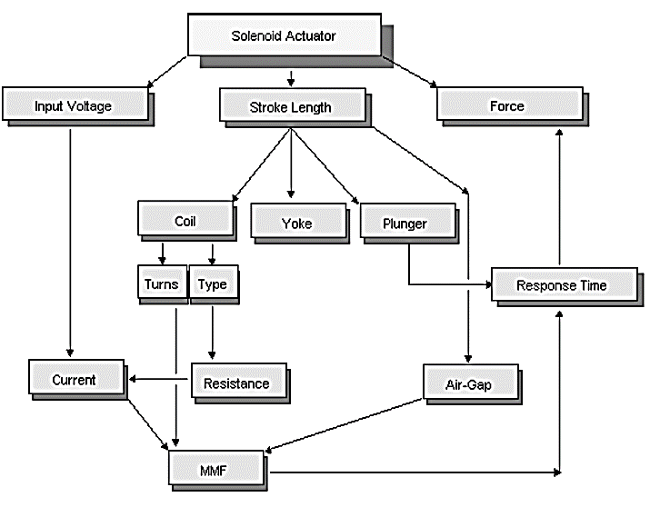
MEM Features of Injector

Slide 11
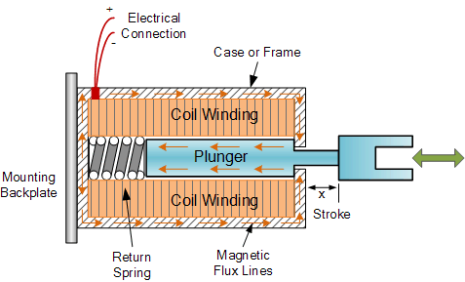
Working Principle of Solenoid
The coil is solely responsible for lifting the plunger to deliver fuel.
When the solenoid is powered up, it acts as an electromagnet and attracts the permanent magnet attached towards the top of the plunger.
Stoppers ensure a fixed value of maximum lift.
ECU supplies DC current at 6 – 12 Volts, to activate the solenoid.

Slide 12
Force applied by the Solenoid on the Rod
Initial Magnetic Energy of the field
Final Magnetic Energy of the field
$$U_{i}=πR^{2}L\frac{B^{2}}{2μ_{0}}$$
$$U_{f}=πR^{2}L\frac{B^{2}}{2μ_{0}}×\frac{μ_{m}}{μ_{0}}$$
$$ΔU=πR^{2}L\frac{B^{2}}{2μ_{0}}×\left\{\frac{μ_{m}}{μ_{0}}−1\right\}$$
Change in energy
$$F_{MM}=\frac{−δW}{dx}=\frac{ΔU}{L}$$
$$F_{MM}=πR^{2}\frac{B^{2}}{2μ_{0}}×\left\{\frac{μ_{m}}{μ_{0}}−1\right\}$$

Slide 13
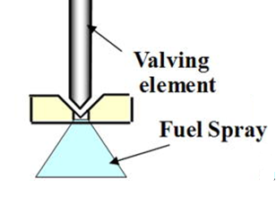
Design of Solenoid
$$F_{MM}=πR^{2}\frac{B^{2}}{2μ_{0}}×\left\{\frac{μ_{m}}{μ_{0}}−1\right\}$$
$$B=μ_{0}nI$$
A solenoid has the following design variables:
Number of turns per meter
Current passing through solenoid
Resistance of solenoid wire
$$a_{plunger}=\frac{F_{plunger−net}}{m_{plunger}}$$

Slide 14
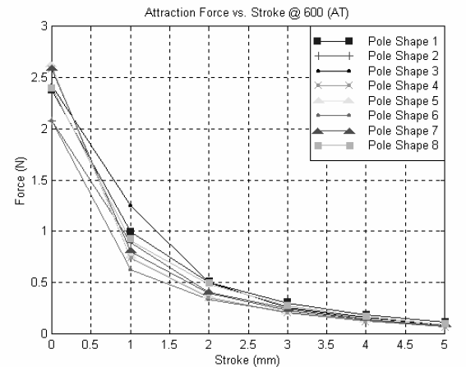
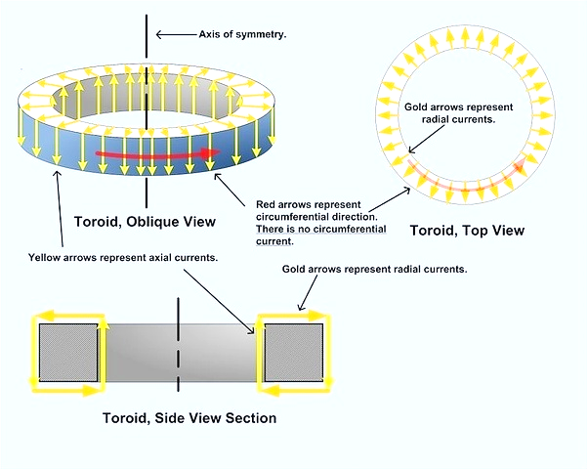
Solenoid characteristics - 1
Shape of Pole

Slide 15
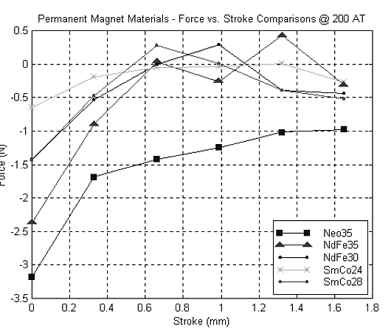
Solenoid characteristics - 2

Slide 16
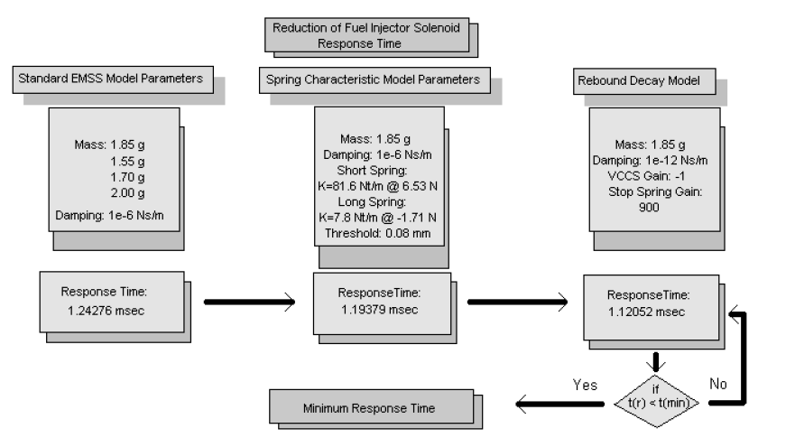
Process of reducing the response time of the fuel injector solenoid

Slide 17
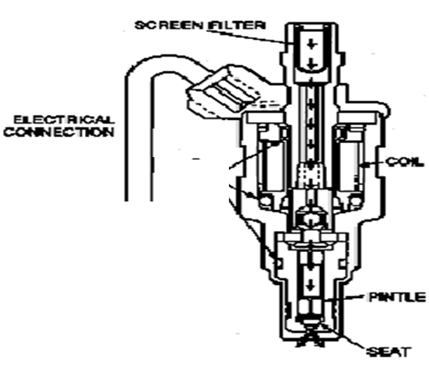
Electrical Input to Control Injector Operation
An injector is essentially a gate valve for fuel delivery.
Increasing fuel pressure can allow to cram more fuel into the intake port for a given injector pulse width.
Injection Pulse
Full Open Accelerator
Once in two Revolutions
Idling
Cold Starting

Slide 18
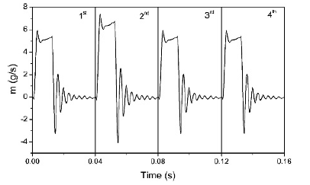
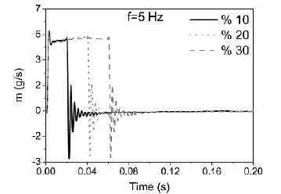
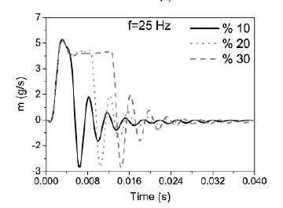
Transient Response of Injector

Slide 19
Additional Merits of Fuel Injection in Manifolds of SI Engine
Precise in Metering Fuel in Ports
Precise Fuel Distribution Between Cylinders (MPFI).
More precise control of the equivalence ratio.
Helps in achieving better volumetric efficiency
Manifold Branch Pipes Not concerned with Mixture Preparation (MPFI).
Use of Greater Valve Overlap
Hot Spots for Preheating cold air eliminated/Denser air enters
Further improvement in Acceleration Response (MPI)
Use of Sensors to Monitor Operating Parameters/Gives Accurate Matching of Air/fuel Requirements: Improves Power, Reduces fuel consumption and Emissions

Slide 20
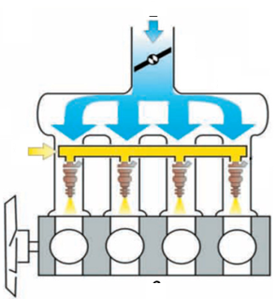
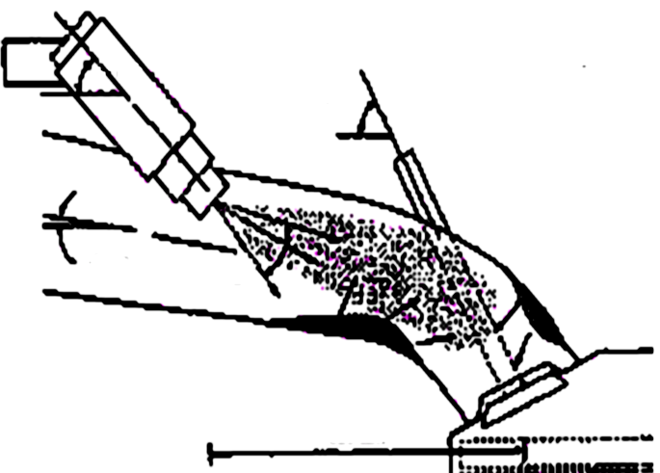
Multi-Point (Port) Fuel Injection System for SI Engine
Orientation Angle of intake port
Orientation Angle of Valve
Spray Angle
A MPFI is a system of injecting fuel into internal combustion engine through multi ports situated on intake valve of each cylinder.
It delivers an exact quantity of fuel in each cylinder at the right time.

Slide 21
Working Principle of MPFI
MPFI uses multiple individual injectors to supply fuel in each cylinder through intake port situated upstream of cylinder’s intake value.
The fuel pressure regulator, connected to the fuel rail by means of an inlet and outlet, directs the flow of the fuel.
While the control diaphragm and pressure spring controls the outlet valve opening and the amount of fuel that can return.
Orientation Angle of intake port
Orientation Angle of Valve
Spray Angle

Slide 22
Demerits of MPFI in Ports of SI Engine
There could be a case of misfiring sometimes.
Regular inspection of fuel injectors is required.
It is costly as compared to conventional systems.

Slide 23
Variants of MPFI Systems
There are basically three types of MPFI systems.
Sequential multi point fuel injection system : Fuel injection is timed to overlap with intake stroke of each cylinder.
Simultaneous multi point fuel injection system : Fuel is inserted to all cylinders at the same time.
Batched multi point fuel injection system : Fuel is injected to the cylinders without bringing their intake stroke together.

Slide 24
Erection of Injector in Manifold
After injection, the movement of droplets takes place in the intake port
Orientation Angle of Injector
Orientation Angle of Valve
Orientation Angle of intake port
Spray Angle

