Slide 1

Atmospheric Boundary Layer & Micro Wind Turbines
P M V Subbarao
Professor
Mechanical Engineering Department
Head,CRDT
Advanced Sciences to Highlight the Superiority of Rural Sites for Wind Turbines

Slide 2

Fundamental Force Fields responsible for Wind
Pressure gradient force
Viscous force
Gravitational force
Apparent forces: Centrifugal and Coriolis
Can you think of other classical forces ?
Would they be important in the generation and control of wind?
Electromagnetic force
Total Force field is the vector sum of all of these fields.

Slide 3
The Momentum Equation of Real Wind
+ other forces
Material
derivative of the velocity vector
Pressure
gradient
force
Viscous
force
Gravity force =
gravitational force +
centrifugal force
with g = 9.81 m s⁻²

Slide 4
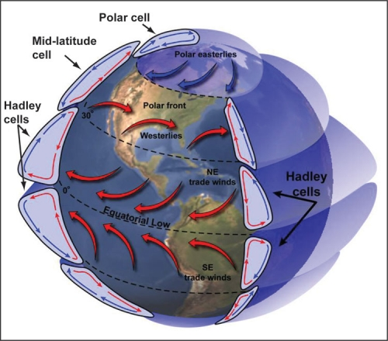
Convection Cells in Earth’s Atmosphere

Slide 5
Wind at Lower Altitudes
At heights in excess of 500m or so above the earth ‘s surface , horizontal air motions proceed in a largely geostrophic maner.
These motions are essentially unretarded by friction known as planetary boundary layer.
Between an altitude of around 50m and the surface , the speed of the wind reduces more and more rapidly towards zero .
This sub-region is often termed the ‘Surface Boundary Layer ‘.
The region between 500m and 50m is in effect a zone of transition between the smooth geostrophic flow in the free atmosphere and flow of an essentially turbulent nature near the ground.

Slide 6
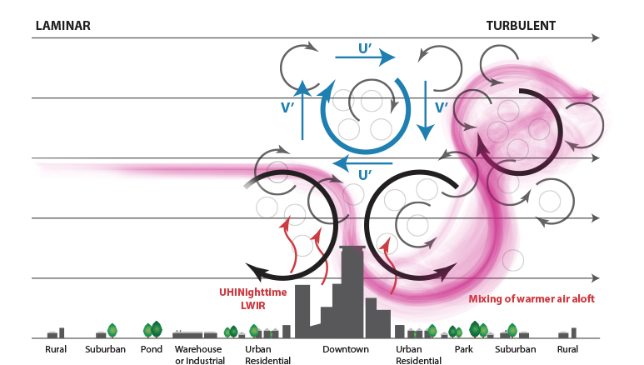
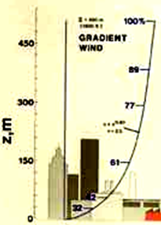
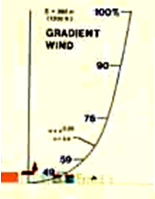
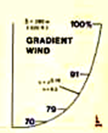
Variation of Wind Profiles and Superiority of Rural Sites
At lower altitudes the thickness of boundary layer is a strong function of surface roughness.
Urban locale
Sub-urban locale
Rural locale

Slide 7
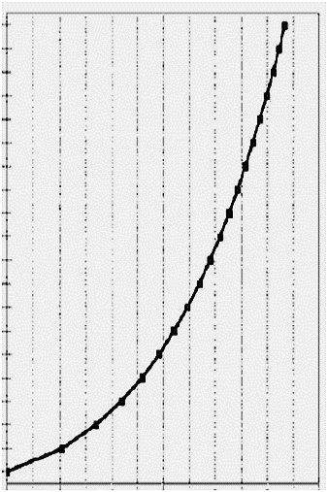


Instantaneous & Mean Wind Speed Profile
Day 2
Day 1
Day 3

Slide 8
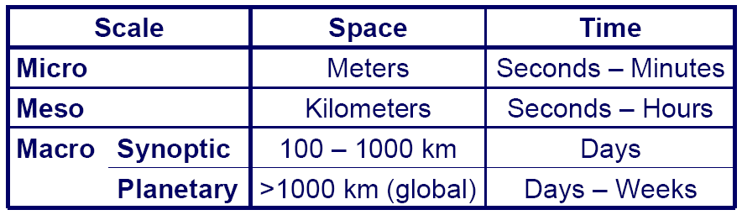
Random Nature of Wind
The wind in the atmospheric boundary layer is known to be distinctively turbulent and unsteady.
As a consequence the wind speed varies rather randomly on many different time scales.
These time scales range from long-term variations (years) to very short ones (minutes down to less than a second).
The latter are commonly considered to correspond to small-scale (microscale) turbulence.
These small-scale fluctuations are superimposed to the mean velocity varying on diurnal or even larger scales.

Slide 9
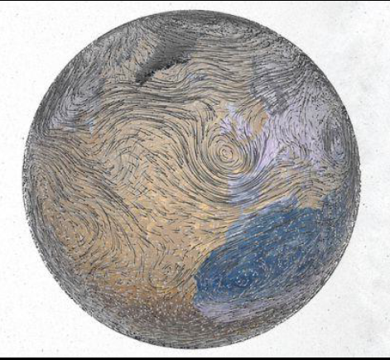
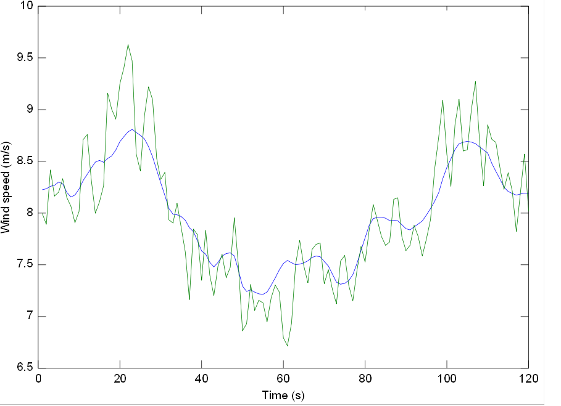
Large Scale Wind Variations
Local Instantaneous Wind

Slide 10
Characterization of Local Turbulent Wind
Mean velocity component
Turbulence Level

Slide 11
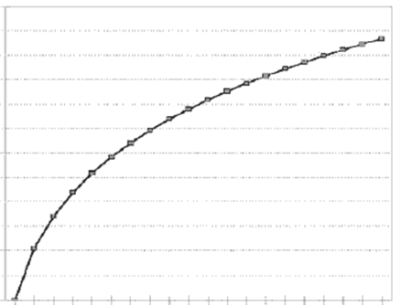

A Model for Mean Wind Speed Profile
U* = friction velocity (m/s)
κ = von Karman constant, approximately equal to 0.4
z = elevation above ground level (m)
z₀ = empirical surface roughness length (m)

Slide 12
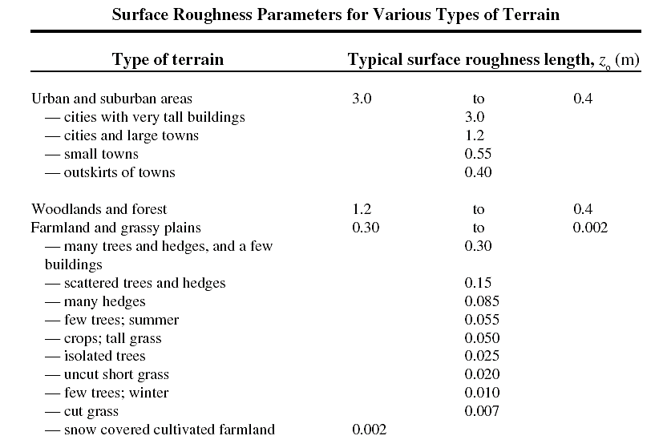

Slide 13
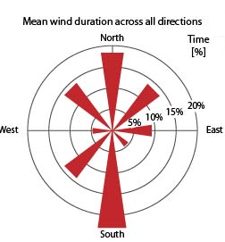
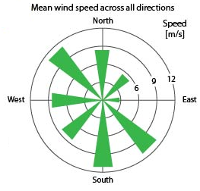

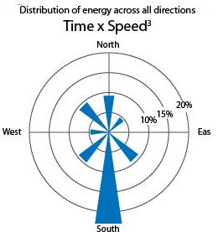
Statistical Distribution of Turbulent Wind

Slide 14
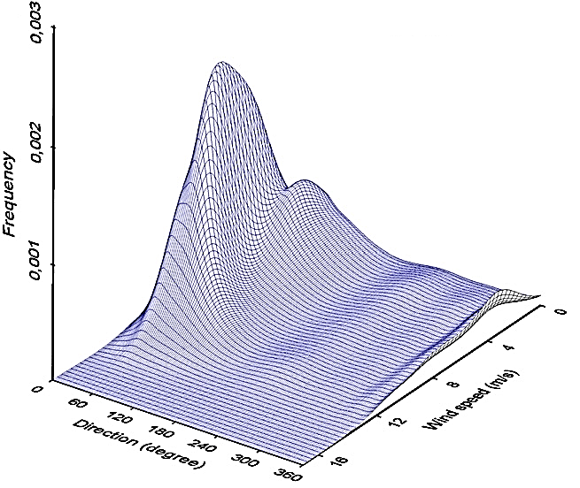
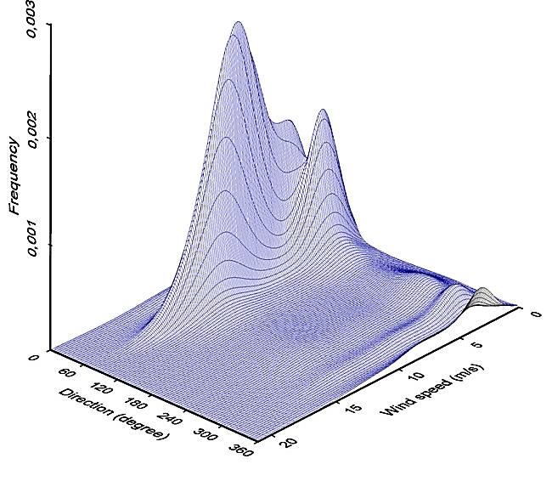
Two Variable (speed-direction) PDF for Wind

Slide 15
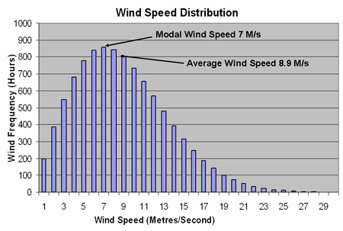
PDF for Wind Speed
A single variable PDF can be generated using wind speed as a primary variable.
This function shows probability of occurrence of wind of a given speed in all possible directions.

