Slide 1
Geometrical Details of Wind Turbine Rotors
P M V Subbarao
Professor
Mechanical Engineering Department
Head,CRDT
Anatomy of A Wind Harvestor…

Slide 2
Scale of Wind Turbines

Slide 3
Wind generation for developing countries
Unlike the trend toward large-scale grid connected wind turbines seen in the West.
The more immediate demand for rural energy supply in developing countries is for smaller machines in the 5 - 100 kW range.
These can be connected to small, localized micro-grid systems and used in conjunction with diesel generating sets and/or solar photovoltaic systems.
The main area of growth being for very small battery charging wind turbines (50 - 150 Watts).
In Inner Mongolia there are over 30,000 such machines used by herders for providing power for lighting, televisions, radios, etc.
Other applications for small wind machines include water pumping, telecommunications power supply and irrigation.

Slide 4
Anatomy of Rotors: CLASS 1 TYPE OF WIND TURBINES
Level 1 Innovations:

Slide 5
Anatomy of Rotors : Class 2 Type of Wind Turbines
Level 1 Innovation:

Slide 6
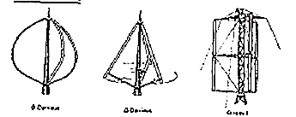
Anatomy of Rotors :CLASS 2 TYPE OF WIND TURBINES
Level 2 Innovations:

Slide 7
Anatomy of Rotors: Type of Wind Turbines
Level 3 Innovation: Unnecessary

Slide 8
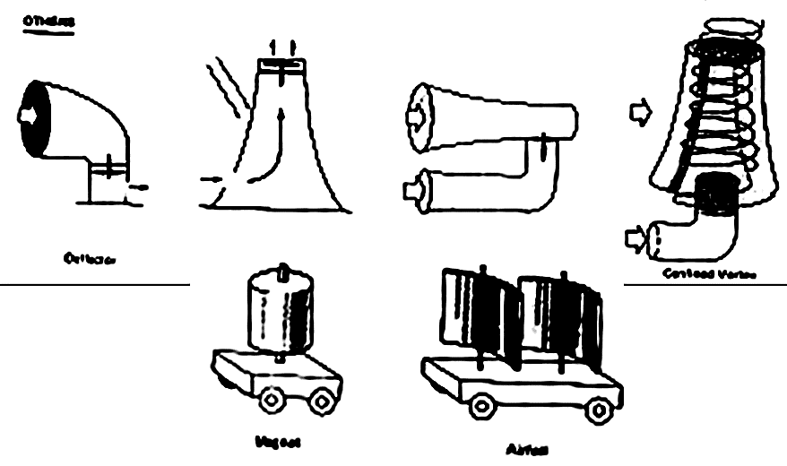
Anatomy of Rotors :TYPE OF WIND TURBINES
Level 3 Innovations: Unnecessary

Slide 9
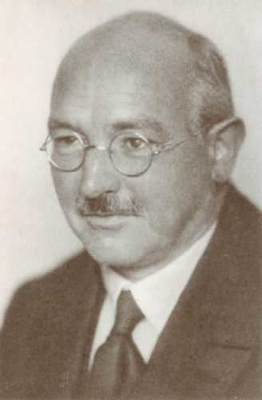
Maximum Power Theory for Wind Mills
Development of wind turbines, in a plan to establish German rural population in the east, replacing the Slavic population.
In 1936 he succeeded Ludwig Prandtl as director of the Aerodynamische Versuchsanstalt (AVA, aerodynamics laboratory).
He received the Ludwig-Prandtl-Ring from the German Society for Aeronautics and Astronautics for "outstanding contribution in the field of aerospace engineering" in 1958.
Prof. Albert Betz.
1920 paper "Theoretical Limit for Best Utilization of Wind by Wind Motors".

Slide 10
Definition of Thermodynamic Control Volume

Slide 11
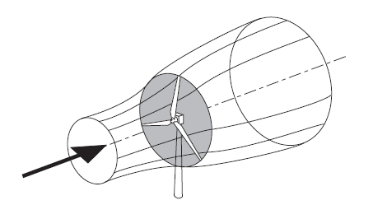
The Donor Stream Tube to A Wind Turbine

Slide 12
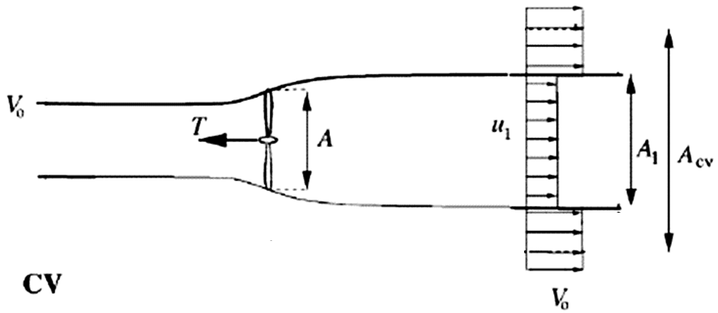
Cooperation from Surroundings of A Donor Stream Tube

Slide 13
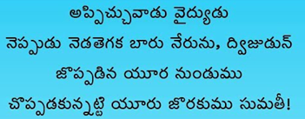

Slide 14
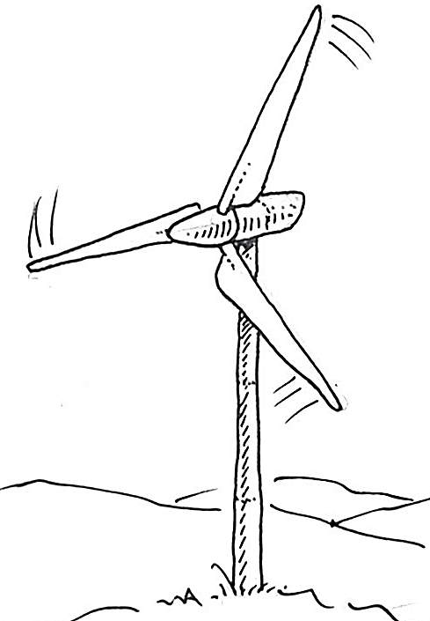
Who are Contiguous to A Wind Turbine?

Slide 15
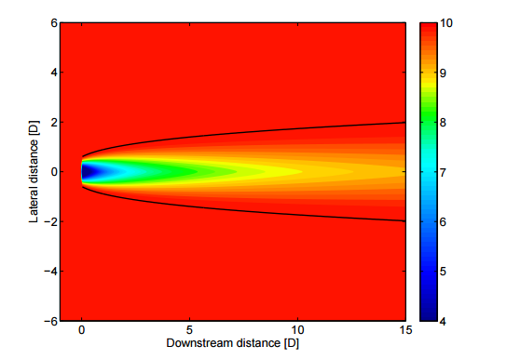
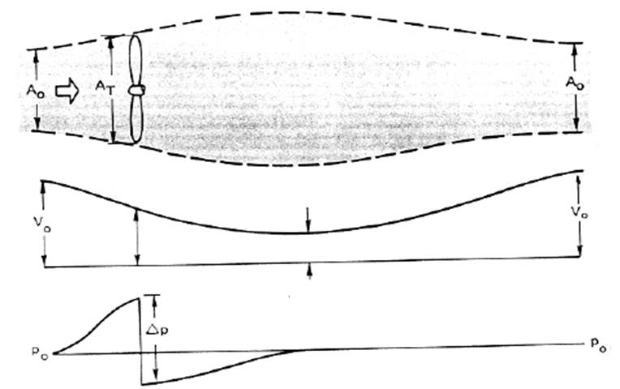
Support from Surroundings of A Donating Stream Tube
A_{rotor}

Slide 16
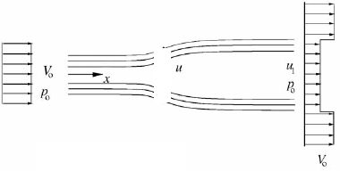
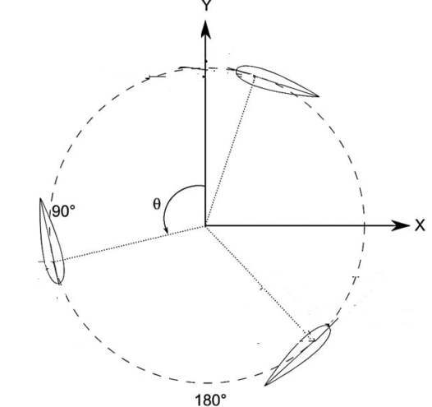
Thermodynamic Description of Flow Past A Working Wind Turbine
Front view of Stream Tube for HAWT
The rotor disc acts as an energy extractor slowing the wind speed from V₀ far upstream of the rotor to u at the rotor plane and to u₁ in the wake.
Top view of Stream Tube for VAWT

Slide 17
Basic Assumptions to Identify the Important Design Parameter
This analysis uses the following assumptions:
Homogenous, incompressible, steady state fluid flow;
No frictional drag;
An infinite number of blades;
Uniform thrust over the disc or rotor area;
A non–rotating wake;
The static pressure far upstream and far downstream of the rotor is equal to the undisturbed ambient static pressure

Slide 18
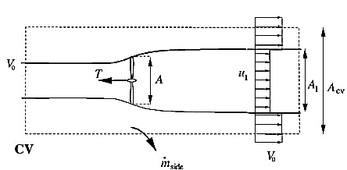
Characteristic Design Parameter of A Wind Turbine Rotor
Define a design parameter as axial induction factor:
Ideal Power Extracted by Wind turbine Rotor:

Slide 19
Performance of an Ideal Wind Turbine
The absorbed power is often compared with respect to P_{avail} as a power coefficient C_{P}:
the power and thrust coefficients for the ideal 1-D wind turbine may be written as:

Slide 20
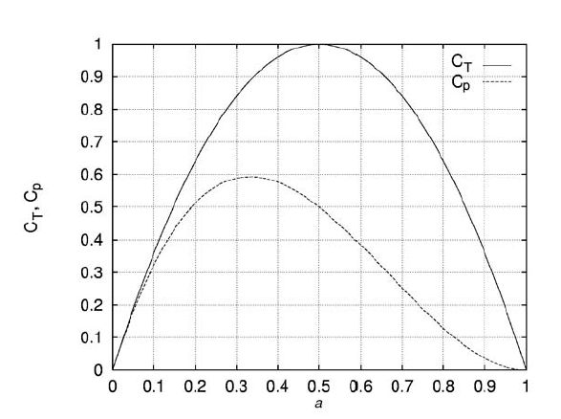
The Compact Ideal Wind Turbine
a

Slide 21
Maximum Feasible Axial Induction
Differentiating C_{P} with respect to a yields:
It is easily seen that C_{P}, max = 16/27 for a = 1/3.
This theoretical maximum for an ideal wind
turbine is known as the Betz limit.

Slide 22
