Slide 1
Solar Energy as a Direct Source of Energy
P M V Subbarao
Professor
Mechanical Engineering Department
Head, CRDT
Recognition of Electro-magnetic Nature of Solar Energy…....

Slide 2
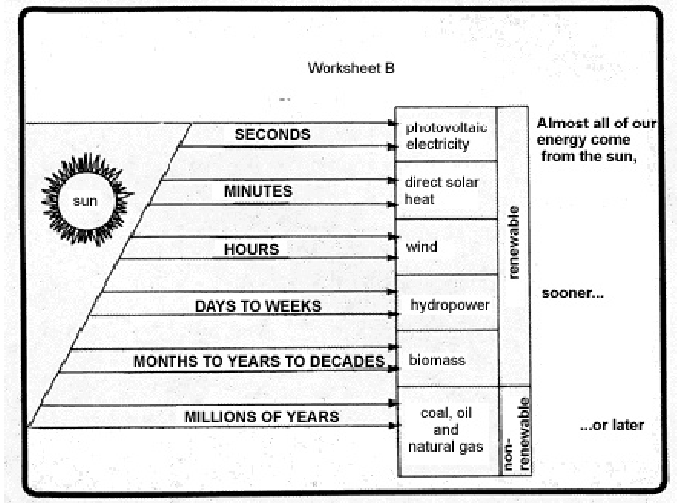

Slide 3
Breakdown of Incoming Solar Energy

Slide 4
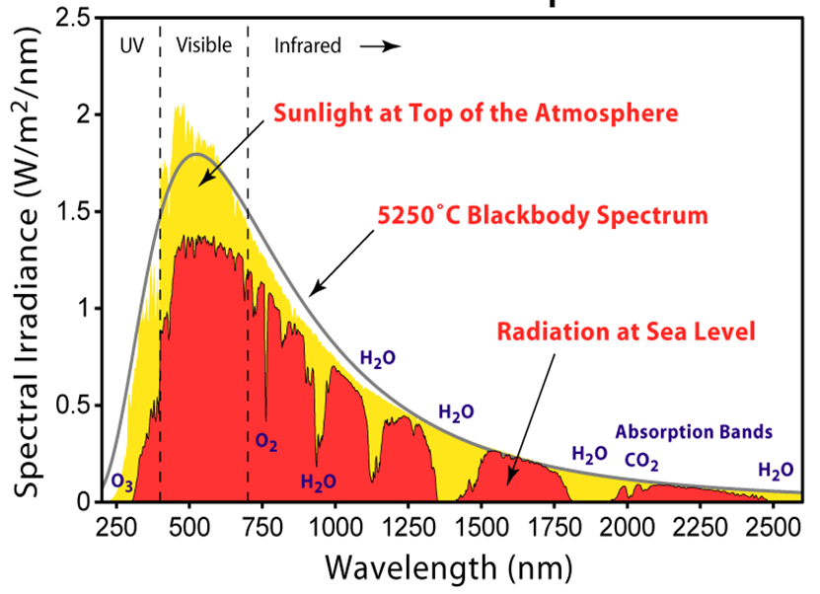
Spectral Description of Solar Radiation

Slide 5
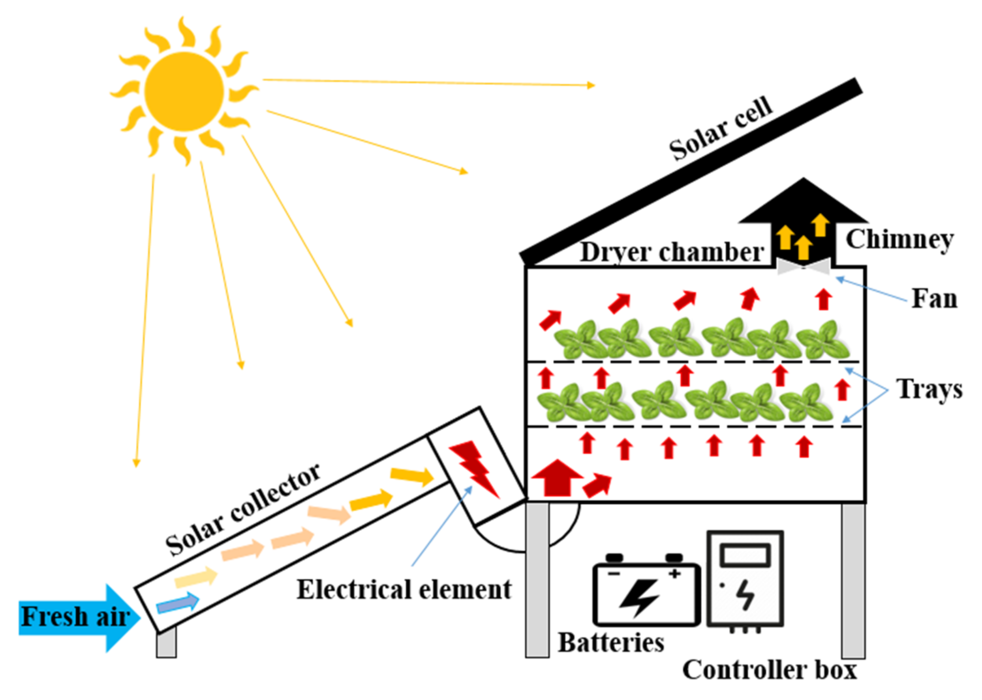
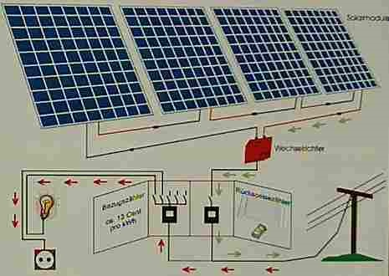
Mimicking of Autotrophs : An Artificial Route
Solar Drying System
Solar Photo-voltaic Energy Systems

Slide 6
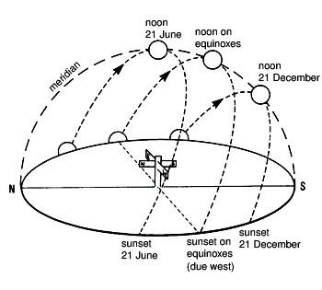
Position of the Sun (view from Earth)
Apparent placement of the Sun in the northern hemisphere

Slide 7
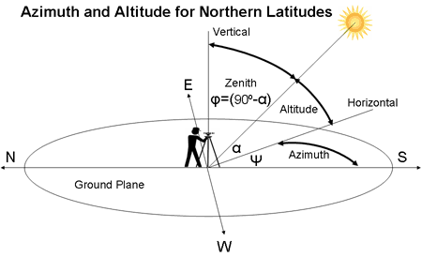
Measures for the Position of the Sun
Azimuth angle of the sun: Often defined as the angle from due north in a clockwise direction.
Zenith angle of the sun: Defined as the angle measured from vertical downward.

Slide 8
The Global Standard Spectrum
Both absorption and scattering depend rather strongly on the path length of sunlight through the atmosphere.
When the sun comes closer to the horizon, its light passes through more air.
Hence, the terrestrial spectrum varies and considering any reference spectrum has some arbitrariness.
To make the standard spectrum representative to as many solar applications as possible, a reference spectrum is defined.
If the sun shines from 90° above the horizon, the light goes by definition through the optical air mass 1.
The spectrum is then called 'AM1'.

Slide 9
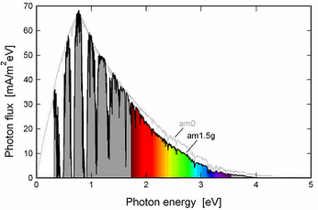
Air Mass 1.5 Specturm
The spectrum received by ground when the sun is about 41° above the horizon is defined as the Air Mass 1.5 spectrum.
The receiver is tilted by 37° from the horizon (so the sun shines at an angle of 11.2° from the cell's normal vector);
A spectrum that includes the blue sky and the surrounding ground is called a global spectrum, so the spectrum is called AM1.5g.

Slide 10
Solar Photo Voltaic Power Plants
No Moving Parts, a Direct E.C.S…..

Slide 11
Recognition of Chemical Reactions Caused by Light
French scientist Edmond Becquerel, 19 years old, discovered the photovoltaic effect in 1840.
He was especially interested in phosphorescence and luminescence, chemical reactions caused by exposing certain substances to light.
In the1840s he found that these reactions could produce an electric current in both liquids and metals.
He devised an instrument, called an actinometer, that could measure the intensity of a light source by observing the amount of electrical current it elicited in these substances.
The connection between light energy and chemical energy was seized upon by many scientists in the following years.

Slide 12
PV Cell as a Electricity Generator
1905: In 1905 Albert Einstein published the first theoretical work describing the photovoltaic effect titled
“Concerning an Heuristic Point of View Toward the Emission and Transformation of Light.”
By the 1920s, scientists referred to the phenomenon as the “photovoltaic effect.”
1953: Bell Laboratories (now AT&T labs) developed the first silicon solar cell capable of generating a measurable electric current.
The New York Times reported the discovery as
“the beginning of a new era, leading eventually to the realization of harnessing the almost limitless energy of the sun for the uses of civilization.”

Slide 13
An Exotic Use to Common Use
1970’s: The use of costly (uneconomical) solar cells in space flourished during the 1960s and early 1970s.
Solar-cell technology proved too expensive for terrestrial use until the early 1970s.
1978: On Nov. 4, 1978 Jimmy Carter signs Solar Photovoltaic Energy Research, Development, and Demonstration Act.
Due to dedicated research worldwide, the efficiency of photovoltaics has continued to increase while production costs have dropped substantially from $100 per Watt in 1970 to $1 per Watt now.

Slide 14
Capability of Solar Radiation with Silicon as Working Substance
When solar radiation strikes a silicon crystal, it may be reflected, be absorbed, or may go right through.
What if it is absorbed?
When light of relatively low energy is absorbed by a silicon, it enhances the internal energy without altering the electrical properties of the material.
That is, low-energy light striking a silicon crystal causes atoms of silicon to vibrate and twist in their bound positions, but do not break loose.
Similarly, electrons in bonds also gain more energy and are said to attain a higher energy level.
Since these energy levels are not stable, the electrons soon return to their original lower energy levels, giving off as internal energy.

Slide 15
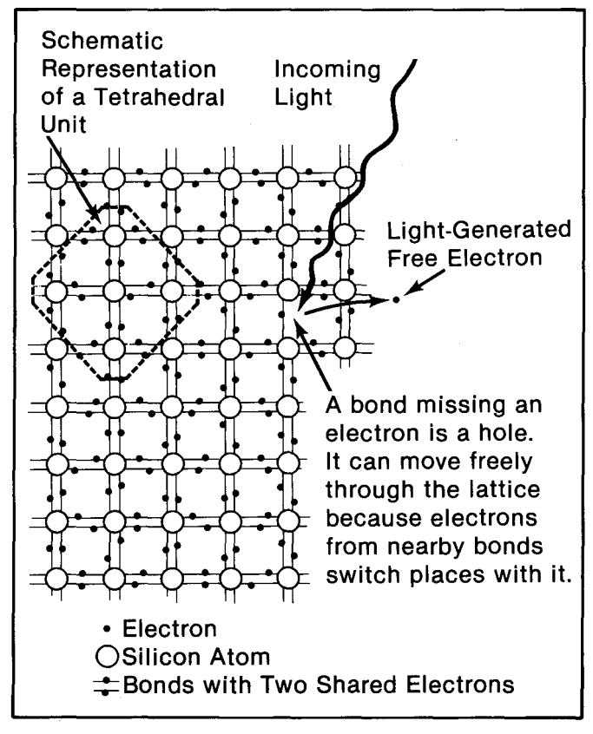
Work Transfer Capability of Solar Radiation in Silicon
Solar radiation of greater energy can alter the electrical properties of the crystal.
If such light strikes a bound electron, the electron is torn from its place in the crystal.
This leaves behind a silicon bond missing an electron and frees an electron to move about in the crystal.
A bond missing an electron, rather picturesquely, is called a hole.
An electron free to move throughout the crystal is said to be in the crystal's conduction band.
Both the conduction-band electrons and the holes play important parts in the electrical behavior of PV cells.
Electrons and holes freed from their positions in the crystal in this manner are said to be light-generated electron-hole pairs (EHP).
To harvest the electrons and holes to produce an electric force and a current, another mechanism is needed-
A built-in "potential" barrier.

Slide 16
Mechanism of Generation
The solar cell is composed of a P and N-type semiconductors.
Solar light hitting the cell produces, negatively and positively charged ions in the semiconductors.
Negatively charged (-) electrons gather around the N-type semiconductor while positively charged (+) ions gather around the P-type semiconductor.
When you connect loads such as a light bulb, electric current flows between the two electrodes.
Electrode
Reflect-Proof Film
Solar Energy
N-Type Semiconductor
P-Type Semiconductor
Load
+
-
Electric Current
+
-
-
Electrode
+
-
+
Photo Voltaic cell
Notes:
I will introduce the principle to begin with.
Solar cell, invented in the USA in 1954, is a kind of semiconductor to convert energy of light directly into electricity. Most semiconductor used for solar cell are silicon semiconductors and it is composed of P-type semiconductor and N-type semiconductor.
Sunlight hitting the cell produces two types of electrons, negatively charged and positively charged electrons in the semiconductors. Negatively charged electrons gather around N-type semiconductor while positively charged electrons gather around P-type semiconductor.
When youconnect loads such as a light bulb or motor, electric current occurs between two electrodes.

Slide 17
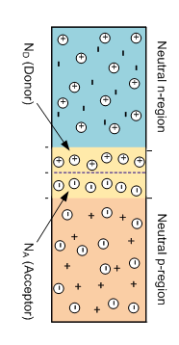
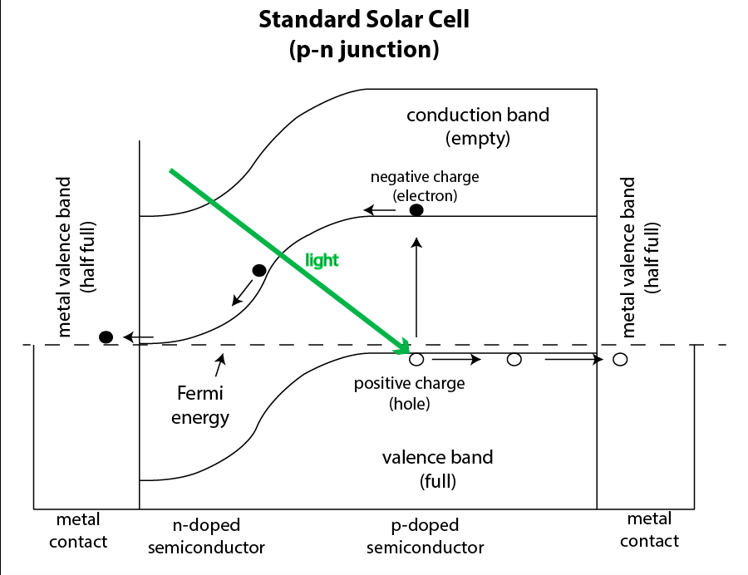
A silicon p-n junction solar cell: A Force Generation Device
All photons with energy greater than or equal will create a built-in-barrier (Force) using E_{g} of the photons.
Energy greater than E_{g} of the photons is used to increase internal energy and hence temperature.

Slide 18
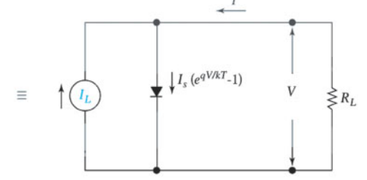
Idealized Equivalent circuit of a Solar Cell
Each photon with energy greater than E_{g} = hν_{g} produces one electronic charge q at a voltage of V_{g} =hν_{g} /q.
The ideal I-V characteristics of a solar cell are given by
The source I_{L} results from the excitation of excess carriers by solar radiation, I_{s} is the diode saturation current, and R_{L} is the load resistance.

