Slide 1
Computer vision: models, learning and inference
Chapter 6
Learning and Inference in Vision

Slide 2
2
Structure
Computer vision models
Two types of model
Worked example 1: Regression
Worked example 2: Classification
Which type should we choose?
Applications
Computer vision: models, learning and inference. ©2011 Simon J.D. Prince
2

Slide 3
Computer vision models
Observe measured data, x
Draw inferences from it about state of world, w
Examples:
Observe adjacent frames in video sequence
Infer camera motion
Observe image of face
Infer identity
Observe images from two displaced cameras
Infer 3d structure of scene
Computer vision: models, learning and inference. ©2011 Simon J.D. Prince
3

Slide 4
Regression vs. Classification
Observe measured data, x
Draw inferences from it about world, w
When the world state w is continuous we’ll call this regression
When the world state w is discrete we call this classification
Computer vision: models, learning and inference. ©2011 Simon J.D. Prince
4

Slide 5
Ambiguity of visual world
Unfortunately visual measurements may be compatible with more than one world state w
Measurement process is noisy
Inherent ambiguity in visual data
Conclusion: the best we can do is compute a probability distribution Pr(w|x) over possible states of world
Computer vision: models, learning and inference. ©2011 Simon J.D. Prince
5

Slide 6
Refined goal of computer vision
Take observations x
Return probability distribution Pr(w|x) over possible worlds compatible with data
(not always tractable – might have to settle for an approximation to this distribution, samples from it, or the best (MAP) solution for w)
Computer vision: models, learning and inference. ©2011 Simon J.D. Prince
6

Slide 7
Components of solution
We need
A model that mathematically relates the visual data x to the world state w. Model specifies family of relationships, particular relationship depends on parameters θ
A learning algorithm: fits parameters θ from paired training examples xi,wi
An inference algorithm: uses model to return Pr(w|x) given new observed data x.
Computer vision: models, learning and inference. ©2011 Simon J.D. Prince
7

Slide 8
Types of Model
The model mathematically relates the visual data x to the world state w. Two main categories of model
Model contingency of the world on the data Pr(w|x)
Model contingency of data on world Pr(x|w)
Computer vision: models, learning and inference. ©2011 Simon J.D. Prince
8

Slide 9
Generative vs. Discriminative
Model contingency of the world on the data Pr(w|x)
(DISCRIMINATIVE MODEL)
2. Model contingency of data on world Pr(x|w)
(GENERATIVE MODELS)
Generative as probability model over data and so when we draw samples from model, we GENERATE new data
Computer vision: models, learning and inference. ©2011 Simon J.D. Prince
9

Slide 10
Type 1: Model Pr(w|x) - Discriminative
How to model Pr(w|x)?
Choose an appropriate form for Pr(w)
Make parameters a function of x
Function takes parameters θ that define its shape
Learning algorithm: learn parameters θ from training data x,w
Inference algorithm: just evaluate Pr(w|x)
Computer vision: models, learning and inference. ©2011 Simon J.D. Prince
10

Slide 11
Type 2: Pr(x|w) - Generative
How to model Pr(x|w)?
Choose an appropriate form for Pr(x)
Make parameters a function of w
Function takes parameters θ that define its shape
Learning algorithm: learn parameters θ from training data x,w
Inference algorithm: Define prior Pr(w) and then compute Pr(w|x) using Bayes’ rule
Computer vision: models, learning and inference. ©2011 Simon J.D. Prince
11

Slide 12
Summary
Two ifferent types of model depend on the quantity of interest:
Pr(w|x) Discriminative
Pr(w|x) Generative
Inference in discriminative models easy as we directly model posterior Pr(w|x). Generative models require more complex inference process using Bayes’ rule
Computer vision: models, learning and inference. ©2011 Simon J.D. Prince
12

Slide 13
13
Structure
Computer vision models
Two types of model
Worked example 1: Regression
Worked example 2: Classification
Which type should we choose?
Applications
Computer vision: models, learning and inference. ©2011 Simon J.D. Prince
13

Slide 14
Worked example 1: Regression
Consider simple case where
we make a univariate continuous measurement x
use this to predict a univariate continuous state w
(regression as world state is continuous)
Computer vision: models, learning and inference. ©2011 Simon J.D. Prince
14

Slide 15
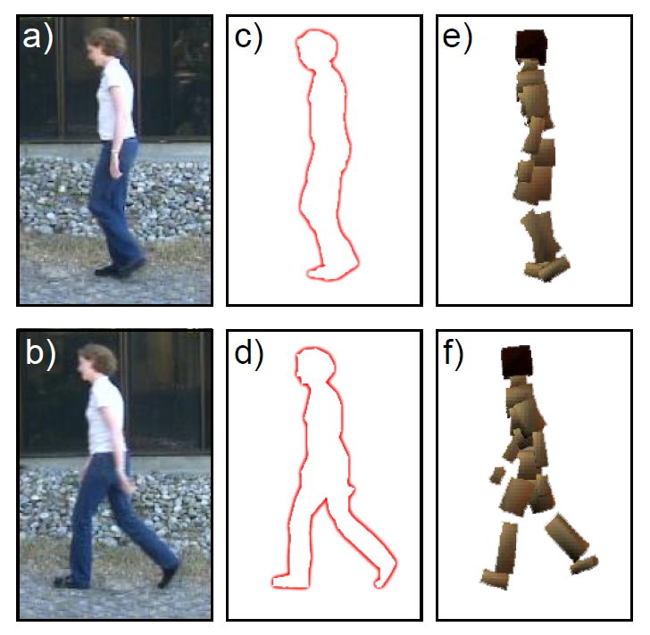
Regression application 1: Pose from Silhouette
Computer vision: models, learning and inference. ©2011 Simon J.D. Prince
15

Slide 16
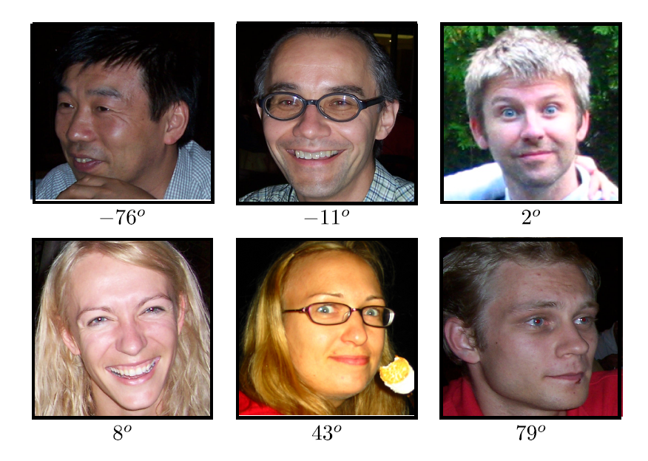
Regression application 2: Head pose estimation
Computer vision: models, learning and inference. ©2011 Simon J.D. Prince
16

Slide 17
Worked example 1: Regression
Consider simple case where
we make a univariate continuous measurement x
use this to predict a univariate continuous state w
(regression as world state is continuous)
Computer vision: models, learning and inference. ©2011 Simon J.D. Prince
17

Slide 18
Type 1: Model Pr(w|x) - Discriminative
How to model Pr(w|x)?
Choose an appropriate form for Pr(w)
Make parameters a function of x
Function takes parameters θ that define its shape
Learning algorithm: learn parameters θ from training data x,w
Inference algorithm: just evaluate Pr(w|x)
Computer vision: models, learning and inference. ©2011 Simon J.D. Prince
18

Slide 19
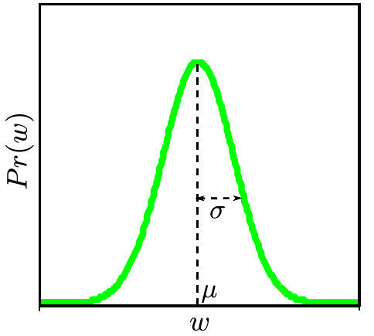
Type 1: Model Pr(w|x) - Discriminative
How to model Pr(w|x)?
Choose an appropriate form for Pr(w)
Make parameters a function of x
Function takes parameters θ that define its shape
Choose normal distribution over w
Make mean μ linear function of x (variance constant)
Parameters are φ0, φ1, σ2.
This model is called linear regression.
Computer vision: models, learning and inference. ©2011 Simon J.D. Prince
19

Slide 20
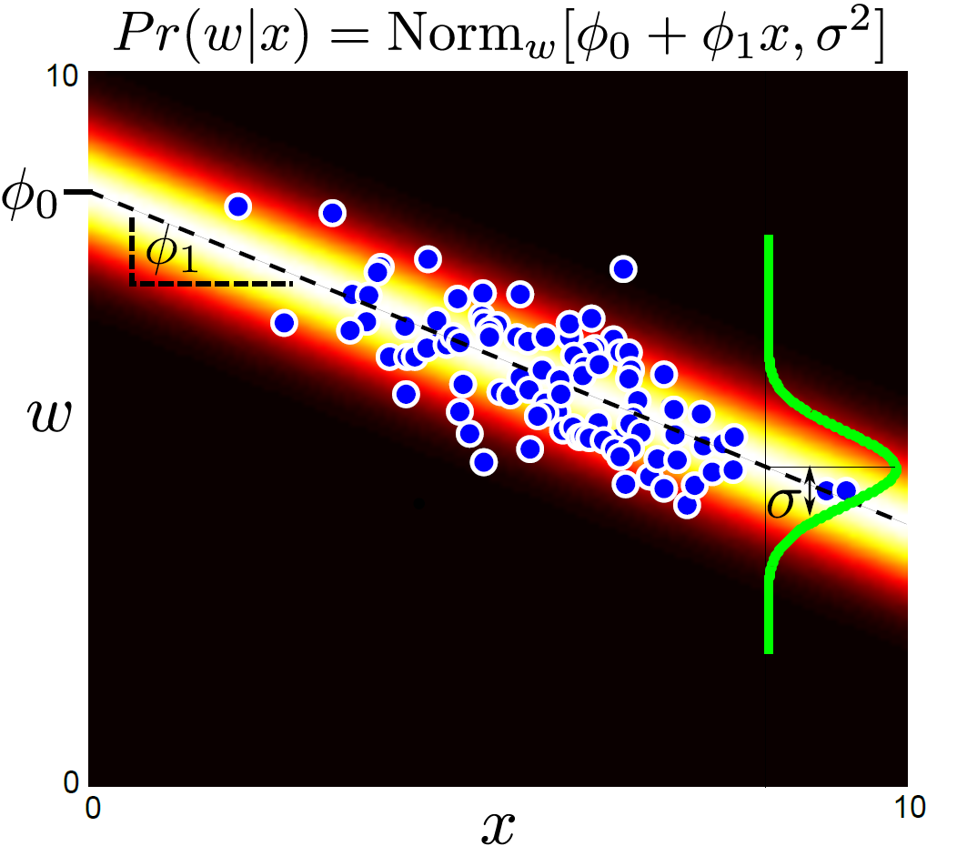
Parameters are y-offset, slope and variance
Computer vision: models, learning and inference. ©2011 Simon J.D. Prince
20

Slide 21
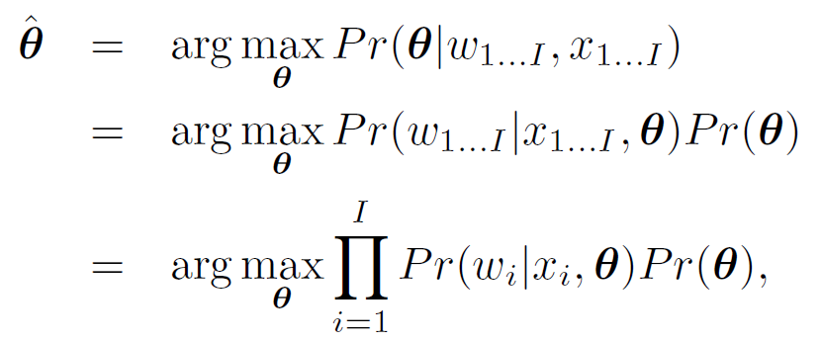
Learning algorithm: learn θ from training data x,y. E.g. MAP
Computer vision: models, learning and inference. ©2011 Simon J.D. Prince
21

Slide 22
Inference algorithm: just evaluate Pr(w|x) for new data x
Computer vision: models, learning and inference. ©2011 Simon J.D. Prince
22

Slide 23
Type 2: Pr(x|w) - Generative
How to model Pr(x|w)?
Choose an appropriate form for Pr(x)
Make parameters a function of w
Function takes parameters θ that define its shape
Learning algorithm: learn parameters θ from training data x,w
Inference algorithm: Define prior Pr(w) and then compute Pr(w|x) using Bayes’ rule
Computer vision: models, learning and inference. ©2011 Simon J.D. Prince
23

Slide 24
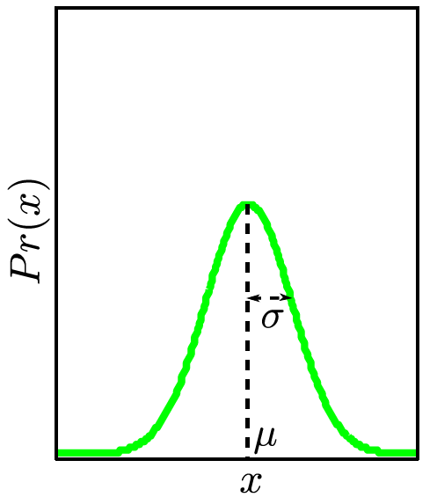
Type 2: Pr(x|w) - Generative
How to model Pr(x|w)?
Choose an appropriate form for Pr(x)
Make parameters a function of w
Function takes parameters θ that define its shape
Choose normal distribution over x
Make mean μ linear function of w (variance constant)
Parameter are φ0, φ1, σ2.
Computer vision: models, learning and inference. ©2011 Simon J.D. Prince
24

Slide 25
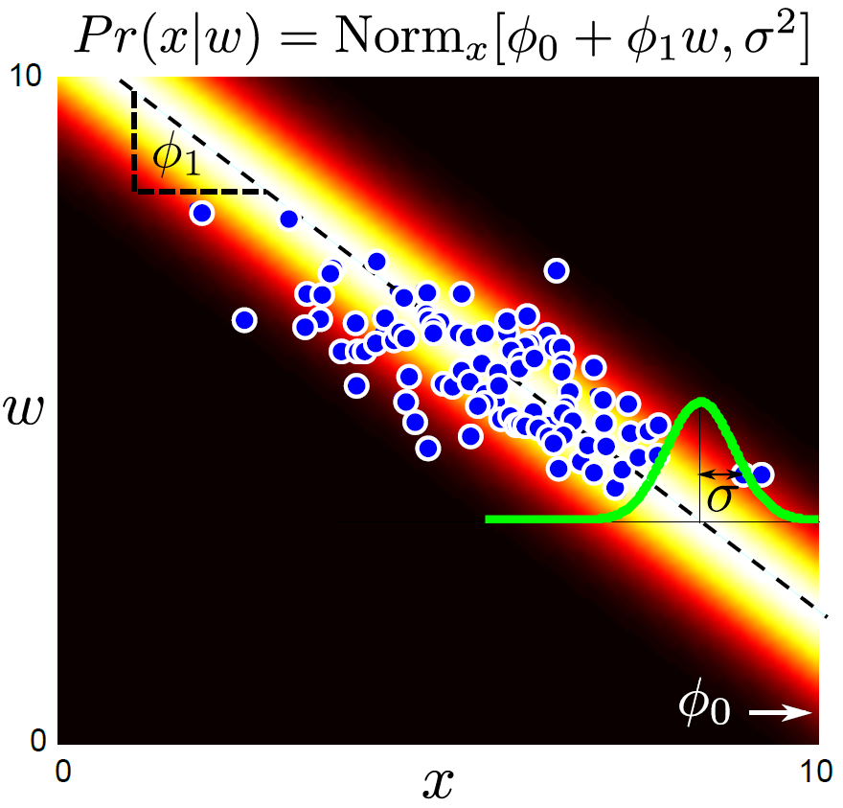
Learning algorithm: learn θ from training data x,w. e.g. MAP
Computer vision: models, learning and inference. ©2011 Simon J.D. Prince
25

Slide 26
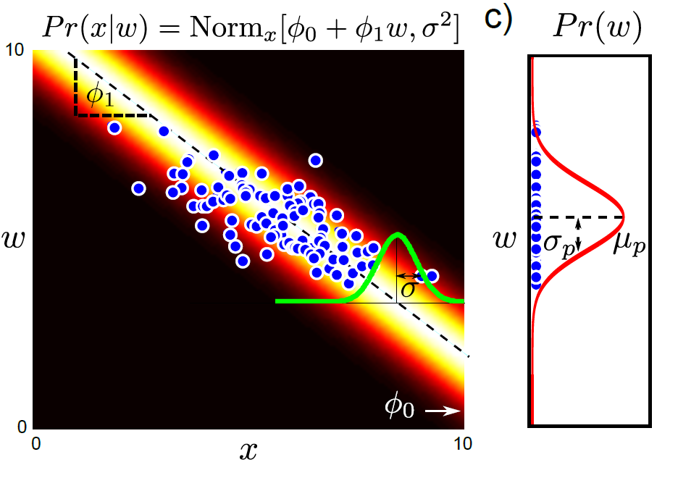
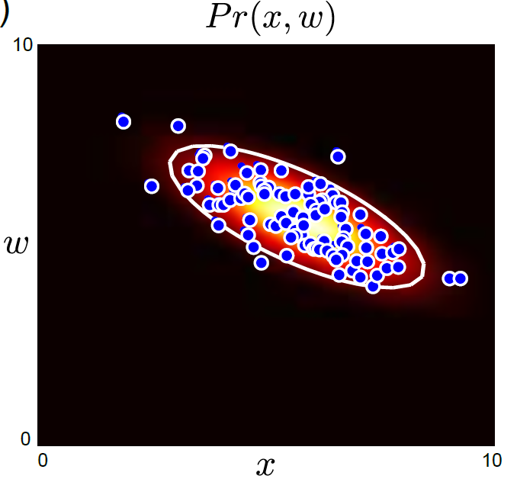
Pr(x|w) x Pr(w) = Pr(x,w)
Can get back to joint probability Pr(x,y)
Computer vision: models, learning and inference. ©2011 Simon J.D. Prince
26

Slide 27
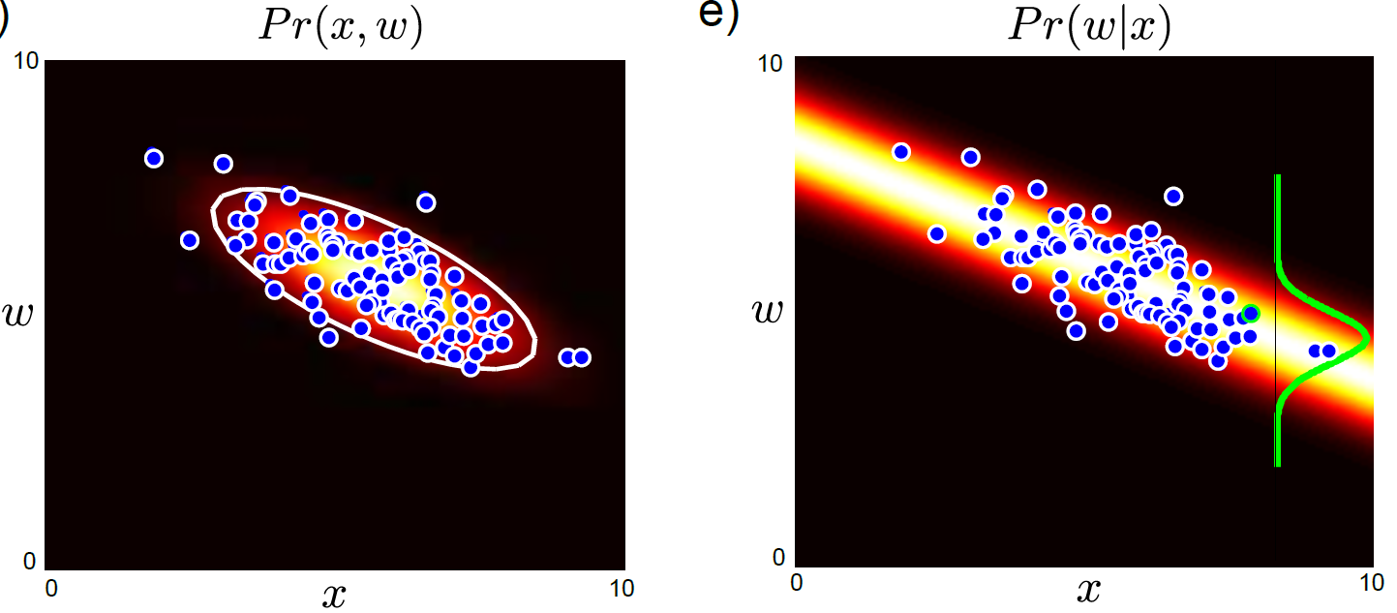
Inference algorithm: compute Pr(w|x) using Bayes rule
Computer vision: models, learning and inference. ©2011 Simon J.D. Prince
27

Slide 28
28
Structure
Computer vision models
Three types of model
Worked example 1: Regression
Worked example 2: Classification
Which type should we choose?
Applications
Computer vision: models, learning and inference. ©2011 Simon J.D. Prince
28

Slide 29
Worked example 2: Classification
Consider simple case where
we make a univariate continuous measurement x
use this to predict a discrete binary world
w
(classification as world state is discrete)
Computer vision: models, learning and inference. ©2011 Simon J.D. Prince
29

Slide 30
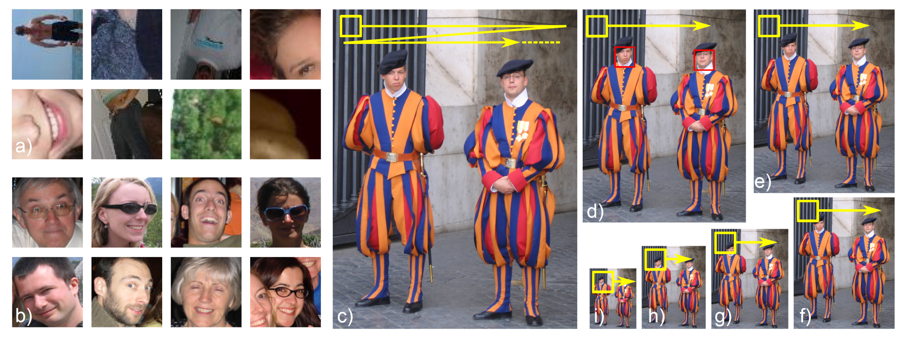
Classification Example 1: Face Detection
Computer vision: models, learning and inference. ©2011 Simon J.D. Prince
30

Slide 31
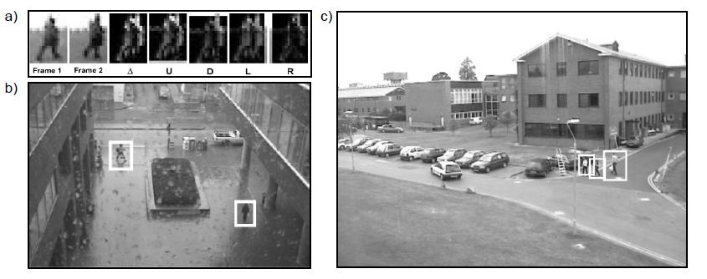
Classification Example 2: Pedestrian Detection
Computer vision: models, learning and inference. ©2011 Simon J.D. Prince
31

Slide 32
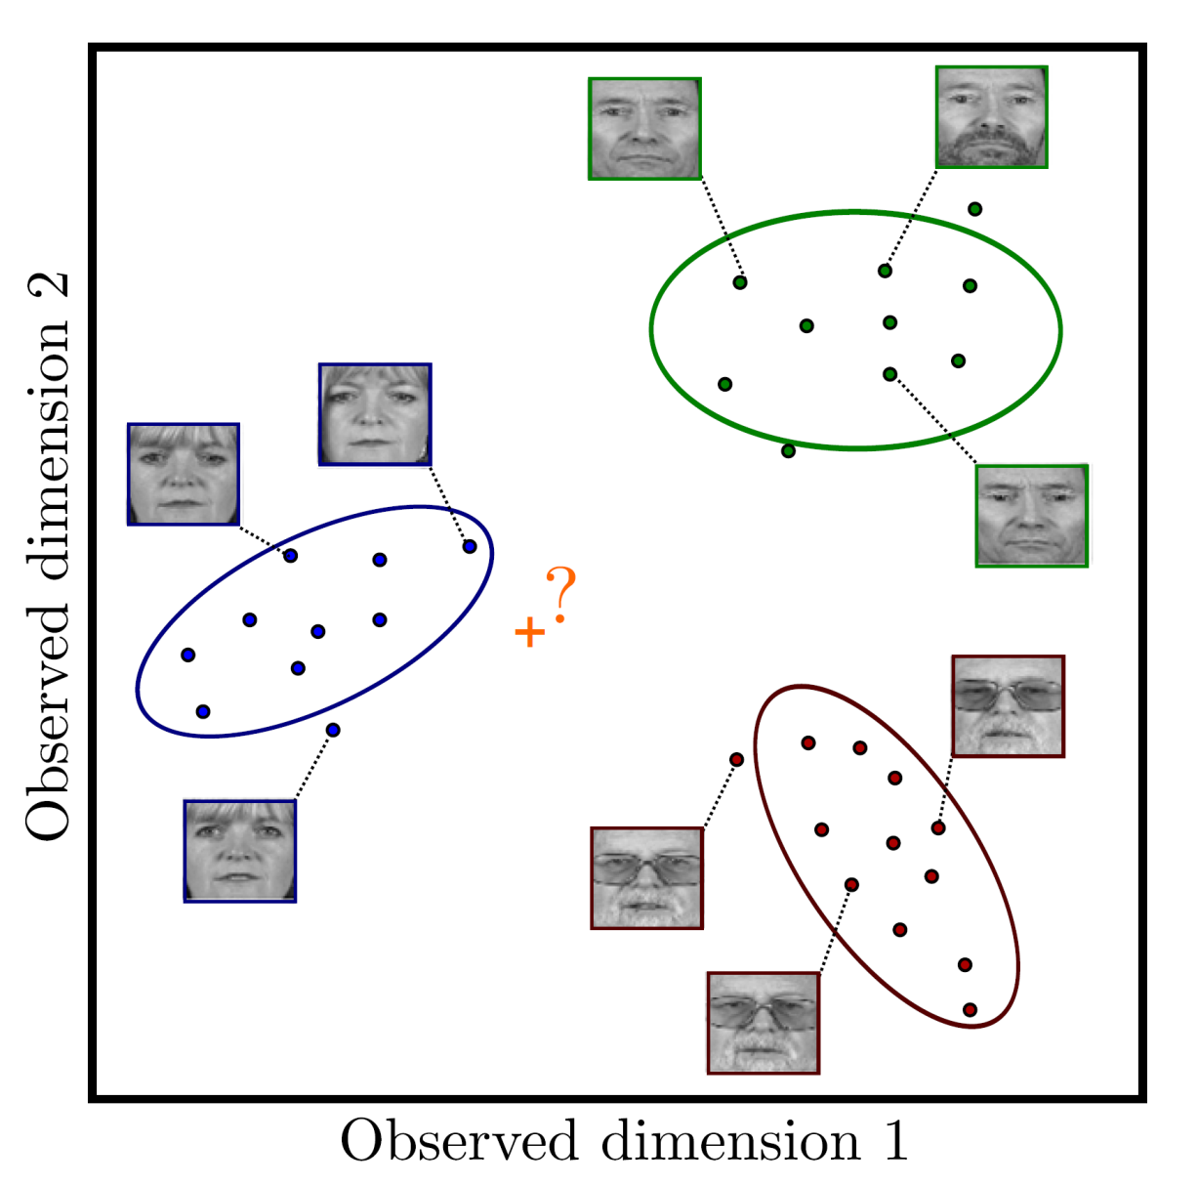
Classification Example 3: Face Recognition
Computer vision: models, learning and inference. ©2011 Simon J.D. Prince
32

Slide 33
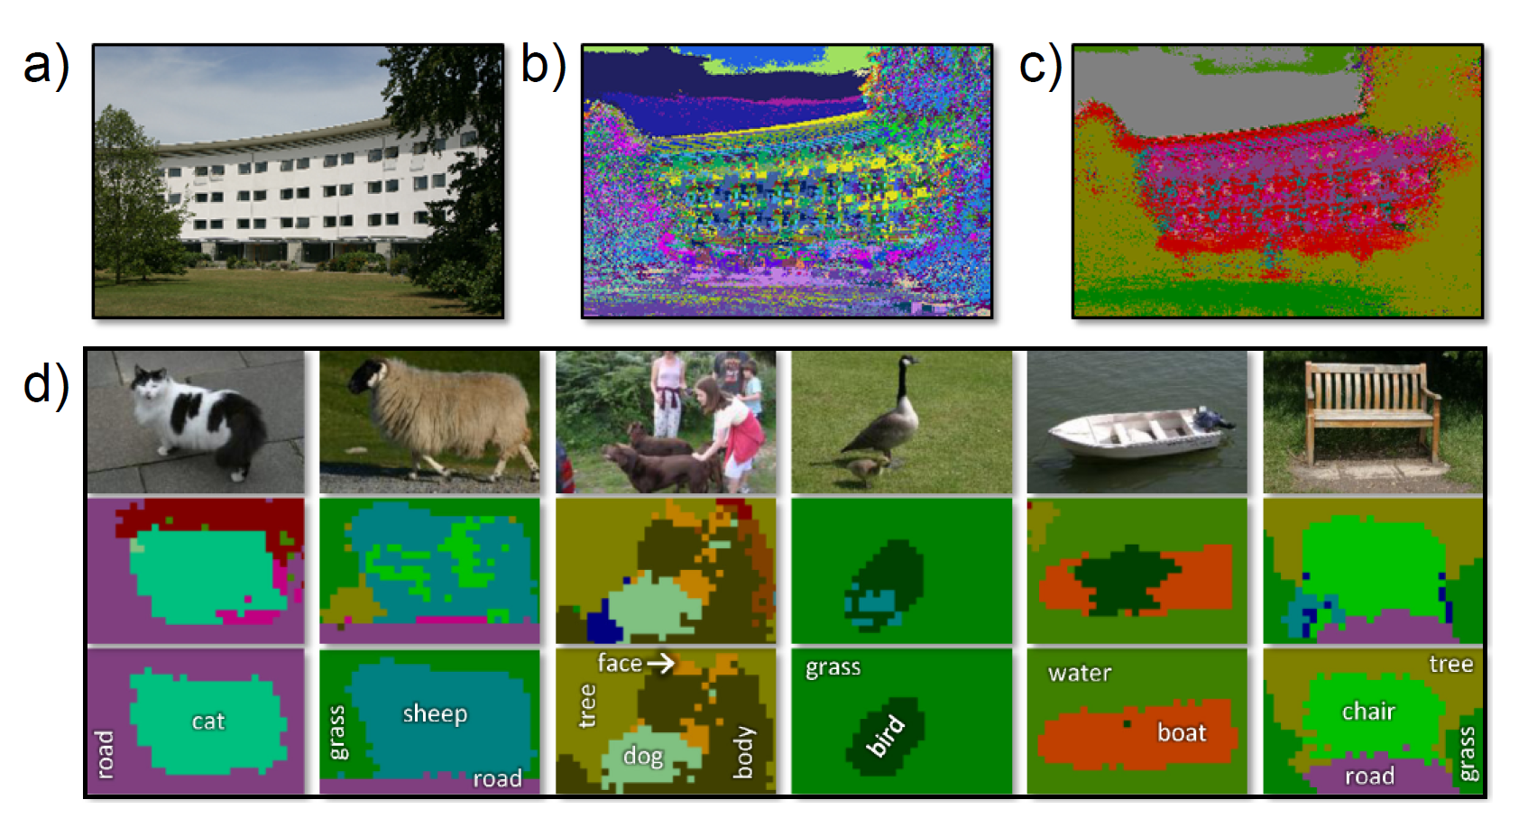
Classification Example 4: Semantic Segmentation
Computer vision: models, learning and inference. ©2011 Simon J.D. Prince
33

Slide 34
Worked example 2: Classification
Consider simple case where
we make a univariate continuous measurement x
use this to predict a discrete binary world
w
(classification as world state is discrete)
Computer vision: models, learning and inference. ©2011 Simon J.D. Prince
34

Slide 35
Type 1: Model Pr(w|x) - Discriminative
How to model Pr(w|x)?
Choose an appropriate form for Pr(w)
Make parameters a function of x
Function takes parameters θ that define its shape
Learning algorithm: learn parameters θ from training data x,w
Inference algorithm: just evaluate Pr(w|x)
Computer vision: models, learning and inference. ©2011 Simon J.D. Prince
35

Slide 36
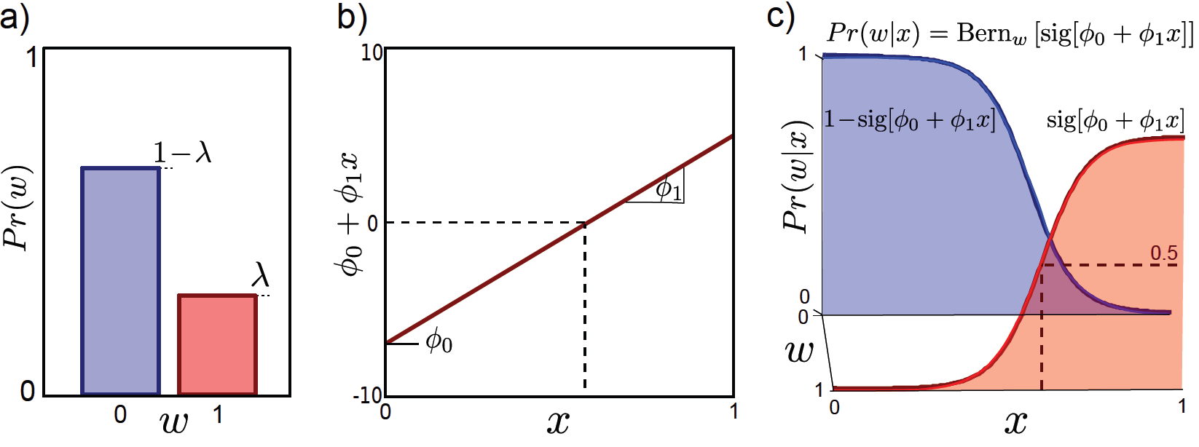
Type 1: Model Pr(w|x) - Discriminative
How to model Pr(w|x)?
Choose an appropriate form for Pr(w)
Make parameters a function of x
Function takes parameters θ that define its shape
Choose Bernoulli dist. for Pr(w)
Make parameters a function of x
Function takes parameters φ0 and φ1
This model is called logistic regression.
Computer vision: models, learning and inference. ©2011 Simon J.D. Prince
36

Slide 37
Two parameters
Learning by standard methods (ML,MAP, Bayesian)
Inference: Just evaluate Pr(w|x)
Computer vision: models, learning and inference. ©2011 Simon J.D. Prince
37

Slide 38
Type 2: Pr(x|w) - Generative
How to model Pr(x|w)?
Choose an appropriate form for Pr(x)
Make parameters a function of w
Function takes parameters θ that define its shape
Learning algorithm: learn parameters θ from training data x,w
Inference algorithm: Define prior Pr(w) and then compute Pr(w|x) using Bayes’ rule
Computer vision: models, learning and inference. ©2011 Simon J.D. Prince
38

Slide 39
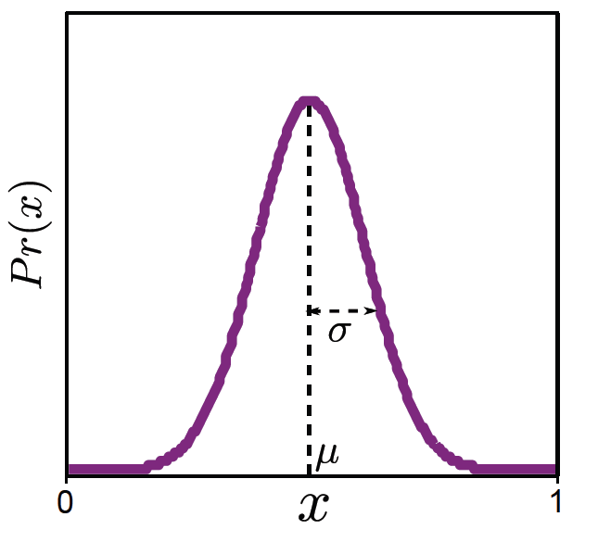
Type 2: Pr(x|w) - Generative
How to model Pr(x|w)?
Choose an appropriate form for Pr(x)
Make parameters a function of w
Function takes parameters θ that define its shape
Choose a Gaussian distribution for Pr(x)
Make parameters a function of discrete binary w
3. Function takes parameters μ0, μ1, σ20, σ21 that define its shape
Computer vision: models, learning and inference. ©2011 Simon J.D. Prince
39

Slide 40
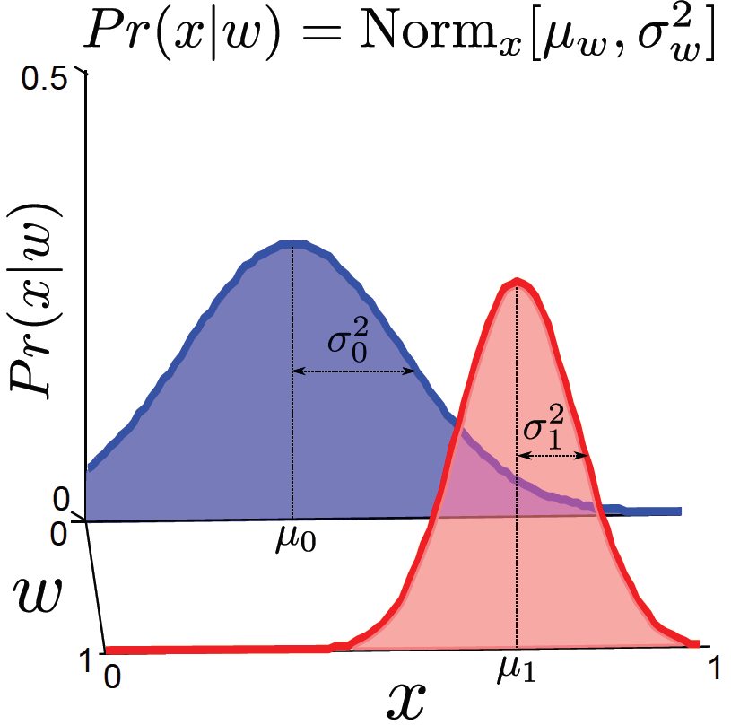
Learn parameters μ0, μ1, σ20, σ21 that define its shape
Computer vision: models, learning and inference. ©2011 Simon J.D. Prince
40

Slide 41
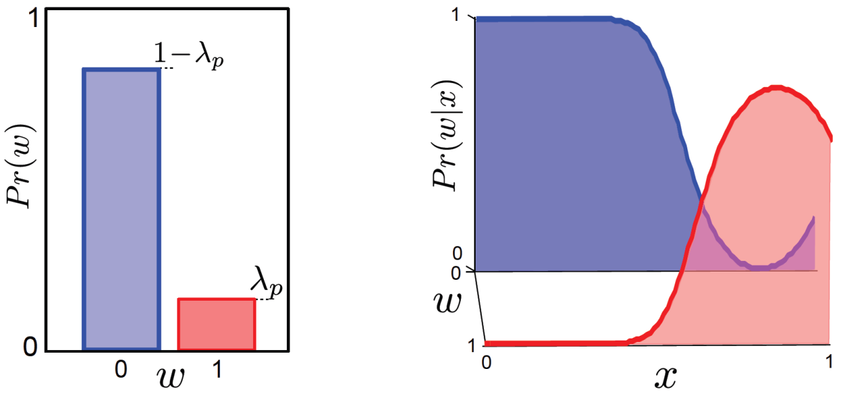
Inference algorithm: Define prior Pr(w) and then compute Pr(w|x) using Bayes’ rule
Computer vision: models, learning and inference. ©2011 Simon J.D. Prince
41

Slide 42
42
Structure
Computer vision models
Three types of model
Worked example 1: Regression
Worked example 2: Classification
Which type should we choose?
Applications
Computer vision: models, learning and inference. ©2011 Simon J.D. Prince
42

Slide 43
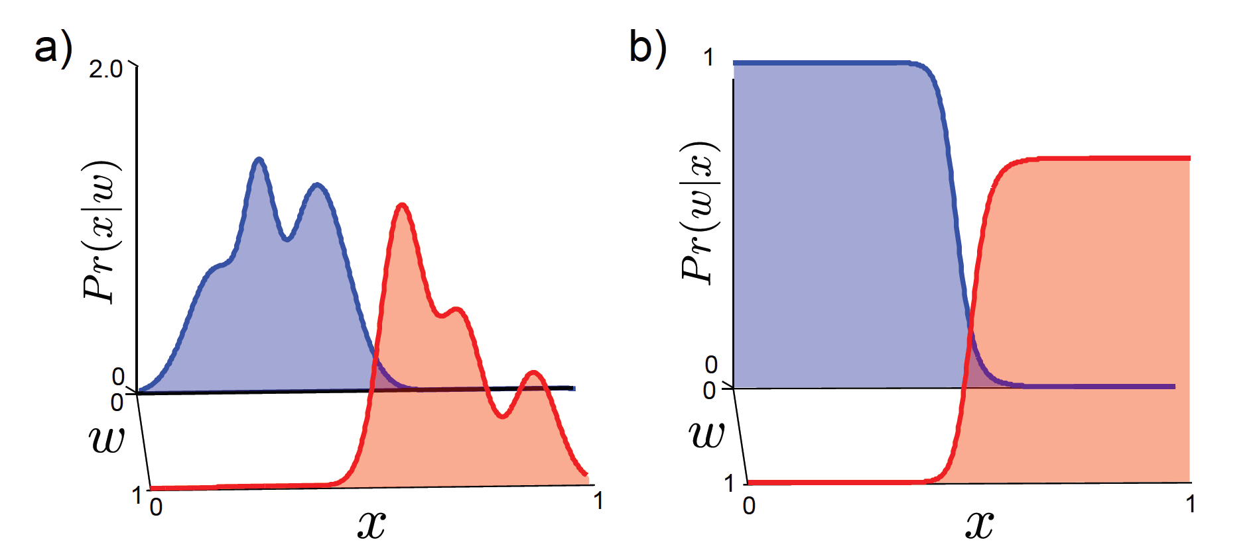
Which type of model to use?
Generative methods model data – costly and many aspects of data may have no influence on world state
Computer vision: models, learning and inference. ©2011 Simon J.D. Prince
43

Slide 44
Which type of model to use?
Inference simple in discriminative models
Data really is generated from world – generative matches this
If missing data, then generative preferred
Generative allows imposition of prior knowledge specified by user
Computer vision: models, learning and inference. ©2011 Simon J.D. Prince
44

Slide 45
45
Structure
Computer vision models
Three types of model
Worked example 1: Regression
Worked example 2: Classification
Which type should we choose?
Applications
Computer vision: models, learning and inference. ©2011 Simon J.D. Prince
45

Slide 46
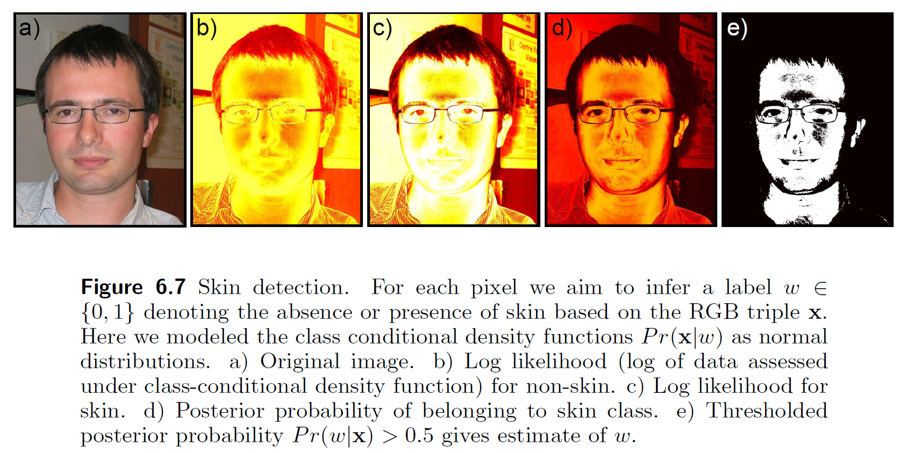
46
Application: Skin Detection
Computer vision: models, learning and inference. ©2011 Simon J.D. Prince
46

Slide 47
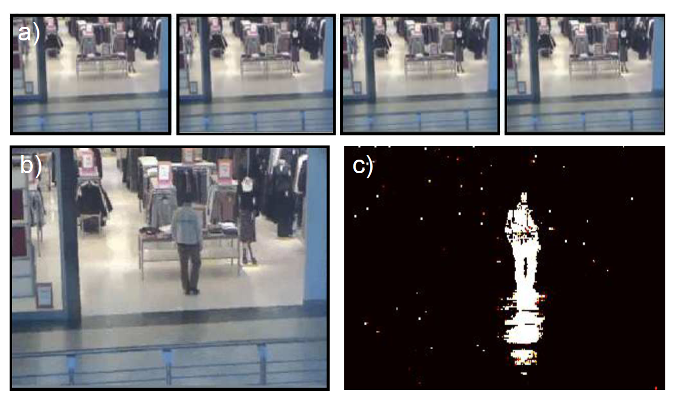
47
Application: Background subtraction
Computer vision: models, learning and inference. ©2011 Simon J.D. Prince
47

Slide 48
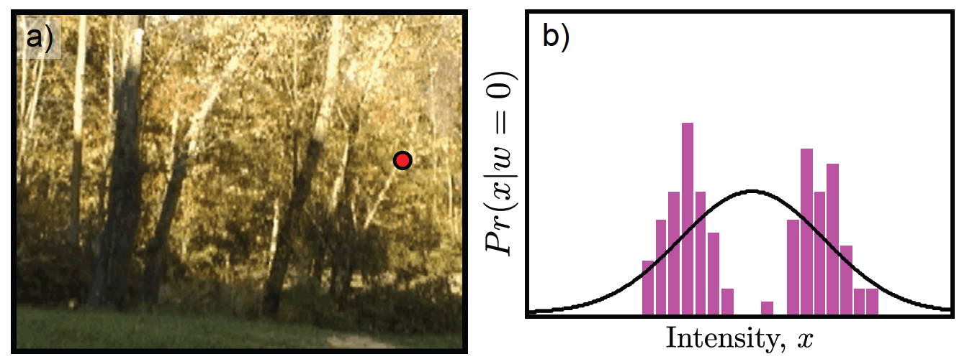
48
Application: Background subtraction
But consider this scene in which the foliage is blowing in the wind. A normal distribution is not good enough! Need a way to make more complex distributions
Computer vision: models, learning and inference. ©2011 Simon J.D. Prince
48

Slide 49
49
Future Plan
Seen two types of model
Probability density function
Linear regression
Logistic regression
Next three chapters concern these models
Computer vision: models, learning and inference. ©2011 Simon J.D. Prince
49

Slide 50
Conclusion
To do computer vision we build a model relating the image data x to the world state that we wish to estimate w
Three types of model
Model Pr(w|x) -- discriminative
Model Pr(w|x) – generative
Computer vision: models, learning and inference. ©2011 Simon J.D. Prince
50

